Slide 1
Problem Statement No.13 - Fitness Buddy
CAPSTONE PROJECT
Presented By:
1. Priti Kumari – Amity University Jharkhand- B.Tech CSE

Slide 2
OUTLINE
Problem Statement (Should not include solution)
Proposed System/Solution
System Development Approach (Technology Used)
Algorithm & Deployment
Result (Output Image)
Conclusion
Future Scope
References

Slide 3
Problem Statement
Example: Modern routines leave little room for maintaining consistent health and fitness habits due to lack of personalized guidance, limited time, and inconsistent motivation. Traditional fitness options often demand costly subscriptions, in-person consultations, or rigid schedules that fail to align with individual routines and preferences. As a result, many people struggle to stay committed to their health goals. There is a growing demand for a solution that is flexible, affordable, and easily accessible.
Fitness Buddy addresses this need by offering a conversational, AI-powered virtual health coach available anytime, anywhere. It delivers personalized support by recommending home workout routines based on user input, sharing motivational tips and daily fitness inspiration, suggesting simple and nutritious meal ideas, and encouraging long-term habit-building. With its friendly and adaptive approach, Fitness Buddy makes health and wellness achievable for everyone, regardless of their schedule or fitness level, promoting consistency and empowering users to lead healthier lives. is this fine.

Slide 4
Proposed Solution
To help individuals adopt and maintain a healthy lifestyle, we propose Fitness Buddy, a conversational AI-powered virtual coach deployed on IBM’s watsonx.ai platform, utilizing the LLaMA 3-70B Instruct model for intelligent, context-aware interactions. The solution delivers personalized wellness guidance and motivation in real-time, tailored to individual routines and preferences.
User Profiling & Data Handling
Gather user inputs such as goals, fitness level, available time, and dietary preferences.
Continuously adapt based on interaction history and feedback.
Natural Language Understanding & Dialogue Management
Utilize LLaMA 3-70B Instruct’s capabilities to:
Comprehend user queries.
Maintain supportive, conversational flow.
Deliver actionable, personalized recommendations.
Personalized Content Delivery
Suggest home workout routines, meal plans, and habit-building tips.
Incorporate context like time of day, user goals, and motivation level.
Deployment
The solution is deployed on IBM watsonx deployment space, ensuring secure, scalable, and production-ready access.
Evaluation & Feedback Loop
Track key metrics such as engagement, satisfaction, and habit consistency.
Refine responses and personalization through iterative feedback and monitoring.

Slide 5
System Approach
To build a scalable, intelligent, and user-centric virtual fitness assistant, Fitness Buddy is developed using a modern AI architecture and deployment stack. The system components are carefully selected to ensure seamless performance, contextual adaptability, and robust conversational capabilities.
Platform: IBM watsonx.ai
Model: Meta's LLaMA 3-70B Instruct
Framework: LangGraph
Architecture: ReAct
Storage: Cloud-based user state tracking (if needed)

Slide 6
Algorithm & Deployment
Core Logic:
Collect user inputs (goals, schedule, preferences).
Generate contextual prompts using LLaMA 3-70B to:
Recommend workouts.
Suggest meals/snacks.
Provide motivational content.
Store/update user context for future interactions.
Deployment:
Deployed on watsonx deployment space, leveraging IBM Cloud's scalable infrastructure.

Slide 7
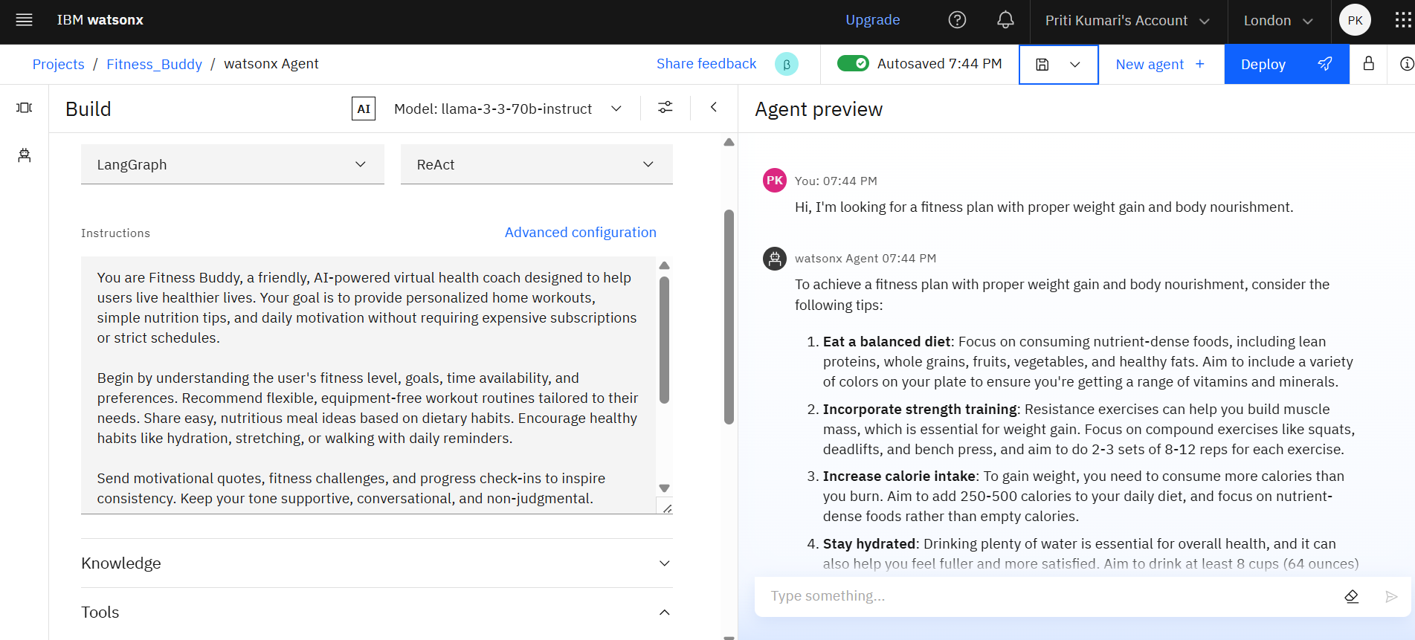
Result

Slide 8
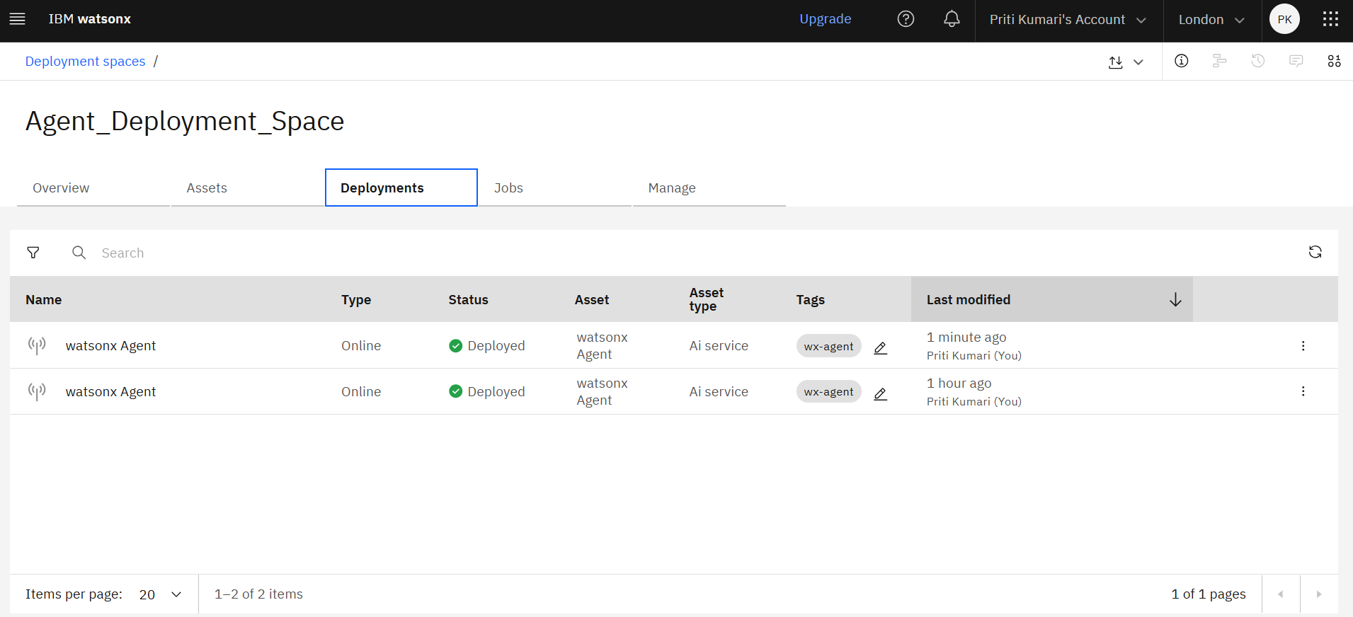
Result

Slide 9
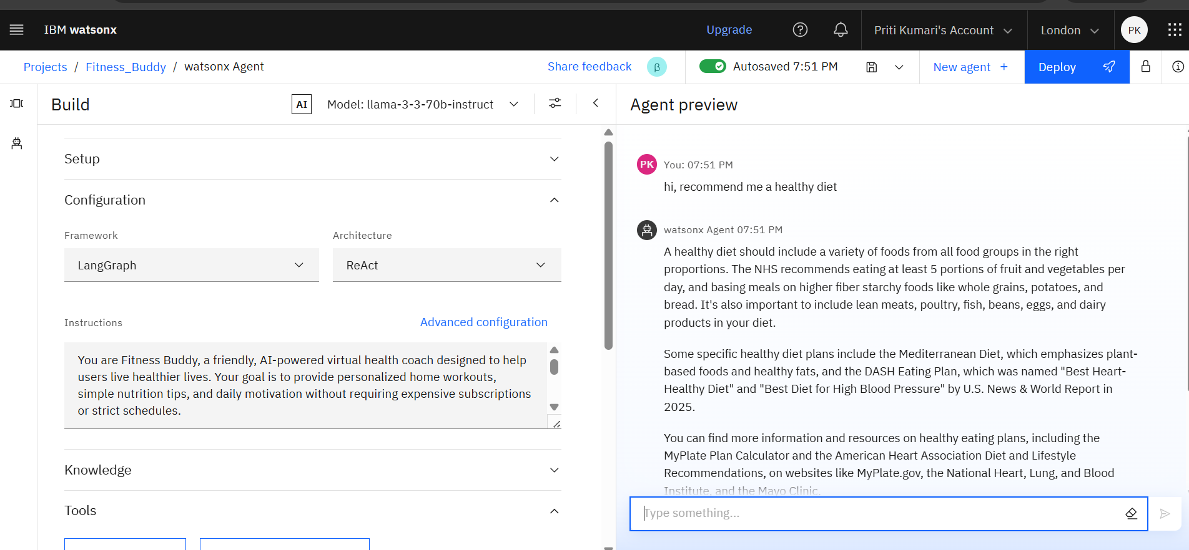
Result

Slide 10
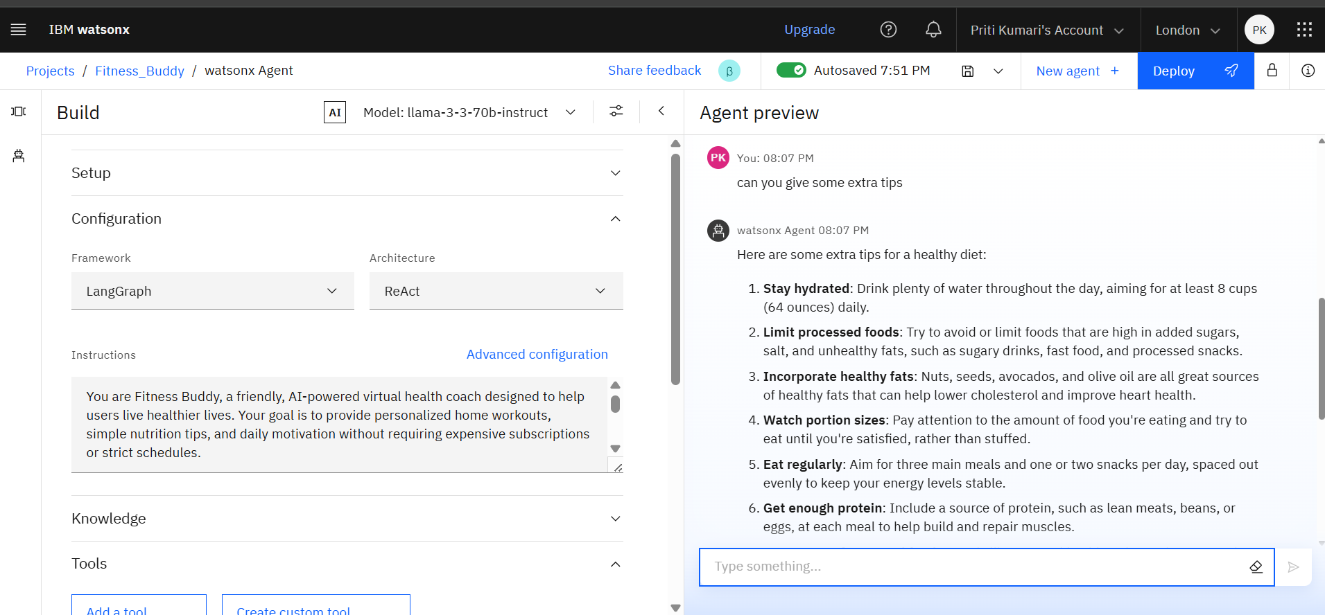
Result

Slide 11
Conclusion
Fitness Buddy effectively bridges the gap between busy lifestyles and the need for consistent health habits. By combining conversational AI with personalized wellness content, it makes fitness guidance accessible, flexible, and motivating. Its deployment on watsonx.ai ensures robust performance, seamless integration, and scalability.

Slide 12
Future scope
Integration with wearable devices (e.g., Fitbit, Apple Watch) for real-time tracking.
Voice-enabled interface for smart assistant compatibility.
Multilingual support to expand accessibility.
Incorporating mental wellness modules (e.g., breathing exercises, mindfulness).
Feedback-driven content refinement using reinforcement learning.

Slide 13
References
IBM Watsonx.ai Documentation – https://www.ibm.com/products/watsonx-ai
Meta AI – LLaMA 3 Model Release – https://ai.meta.com/llama
WHO: Physical Activity Facts – https://www.who.int/news-room/fact-sheets/detail/physical-activity.

Slide 14
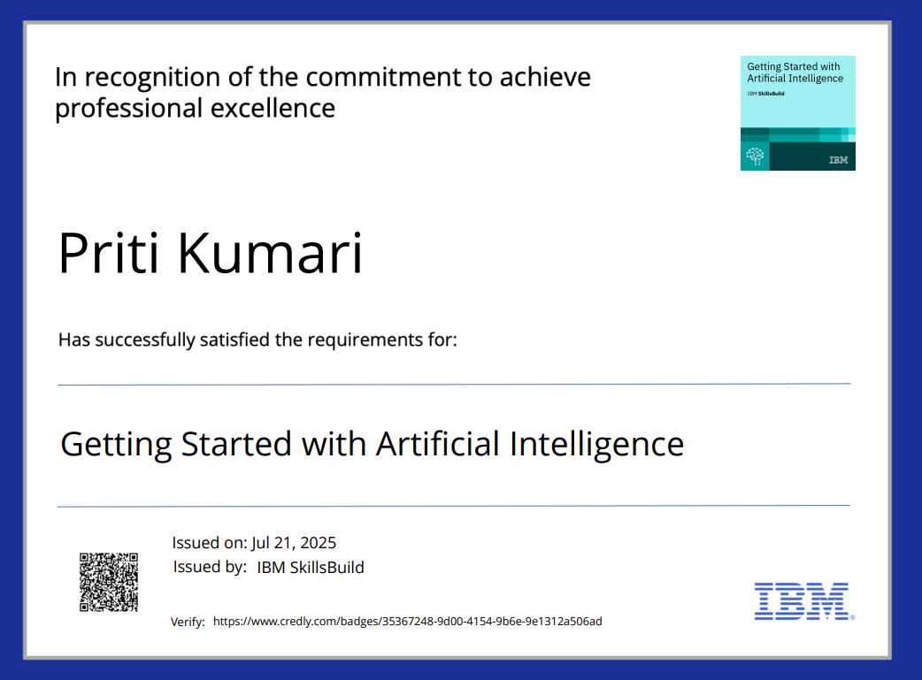
IBM Certifications

Slide 15

IBM Certifications

Slide 16
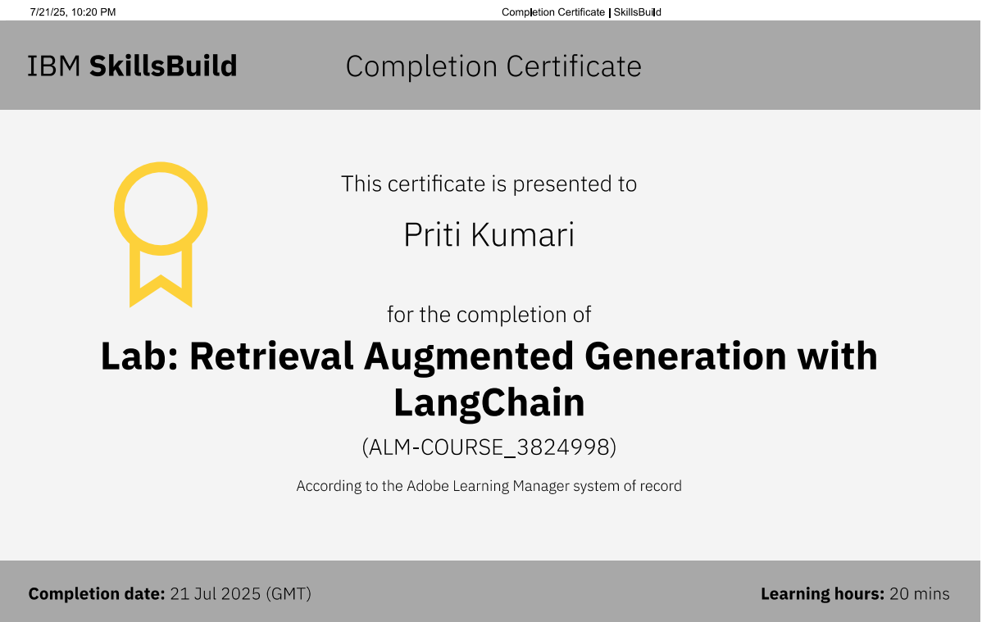
IBM Certifications

Slide 17
THANK YOU

