Slide 1
RideSafe
Women-first ride sharing — Interactive Prototype Deck
9 editable screens • onboarding walkthrough • live demo link
Tip: every text box on the following slides is fully editable in PowerPoint. Replace screenshots by right-click → Change Picture.

Slide 2
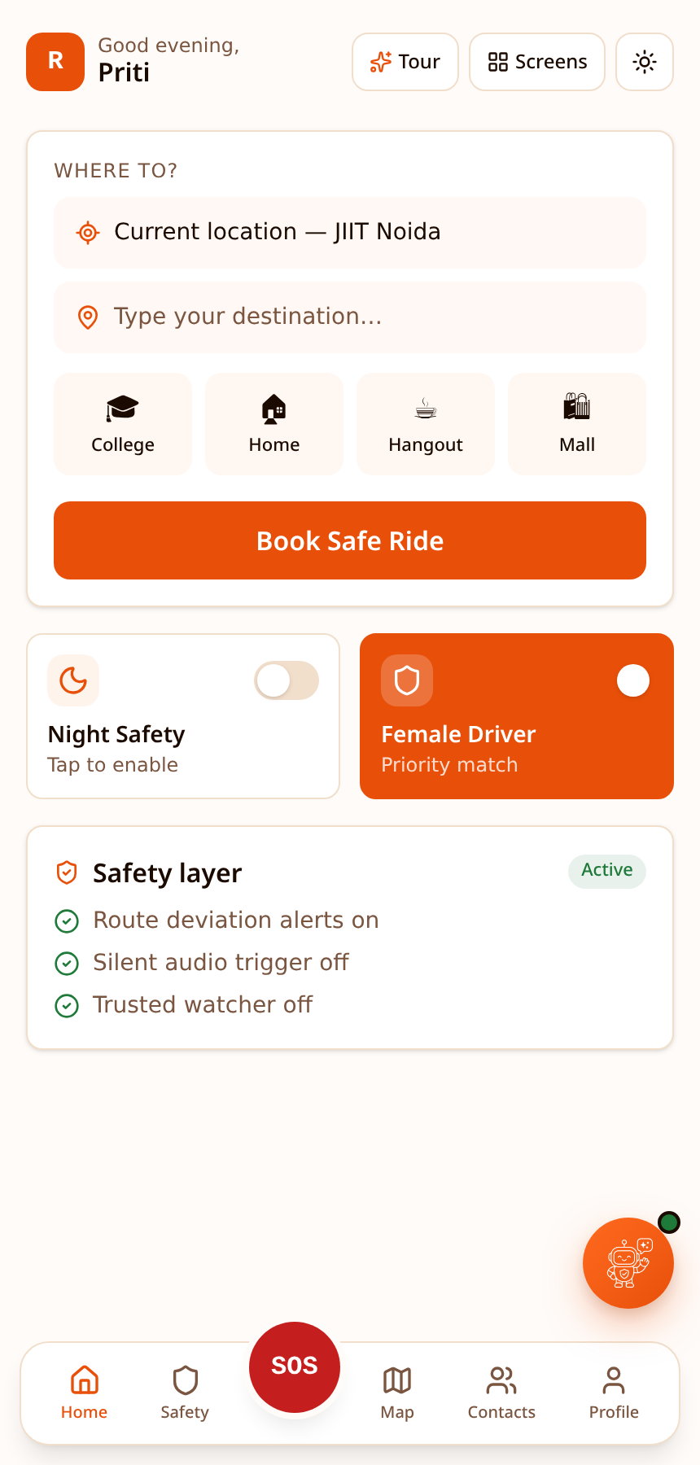
RIDE BOOKING
Home Screen
The launch pad. Users see personalised greeting, quick book with pickup & destination, saved places, and ride-mode toggles.
Key features
Pickup + destination inputs
Saved places (Home / College / Mall)
Female-driver-only toggle
One-tap night safety mode
SOS button always visible in bottom nav
RideSafe • editable prototype • customize freely

Slide 3
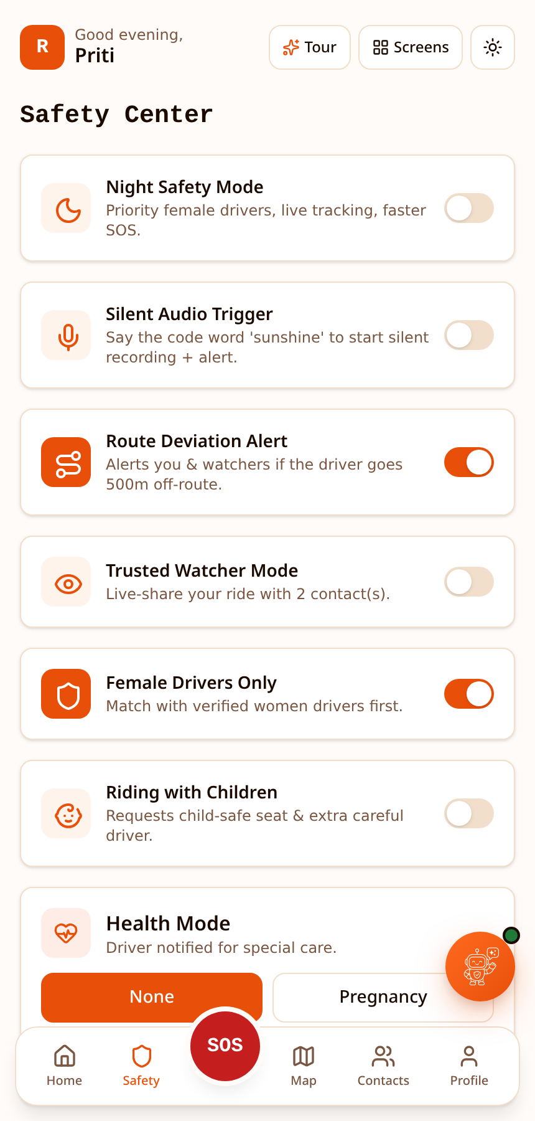
CORE SAFETY
Safety Modes
Central control panel for every safety feature. Every toggle updates the ride experience in real time.
Key features
Night Safety Mode (dark UI + auto share)
Silent SOS Audio (records + streams)
Route Deviation Alerts
Trusted Watcher live share
Child-safe & Health modes (pregnancy / period / medical)
RideSafe • editable prototype • customize freely

Slide 4
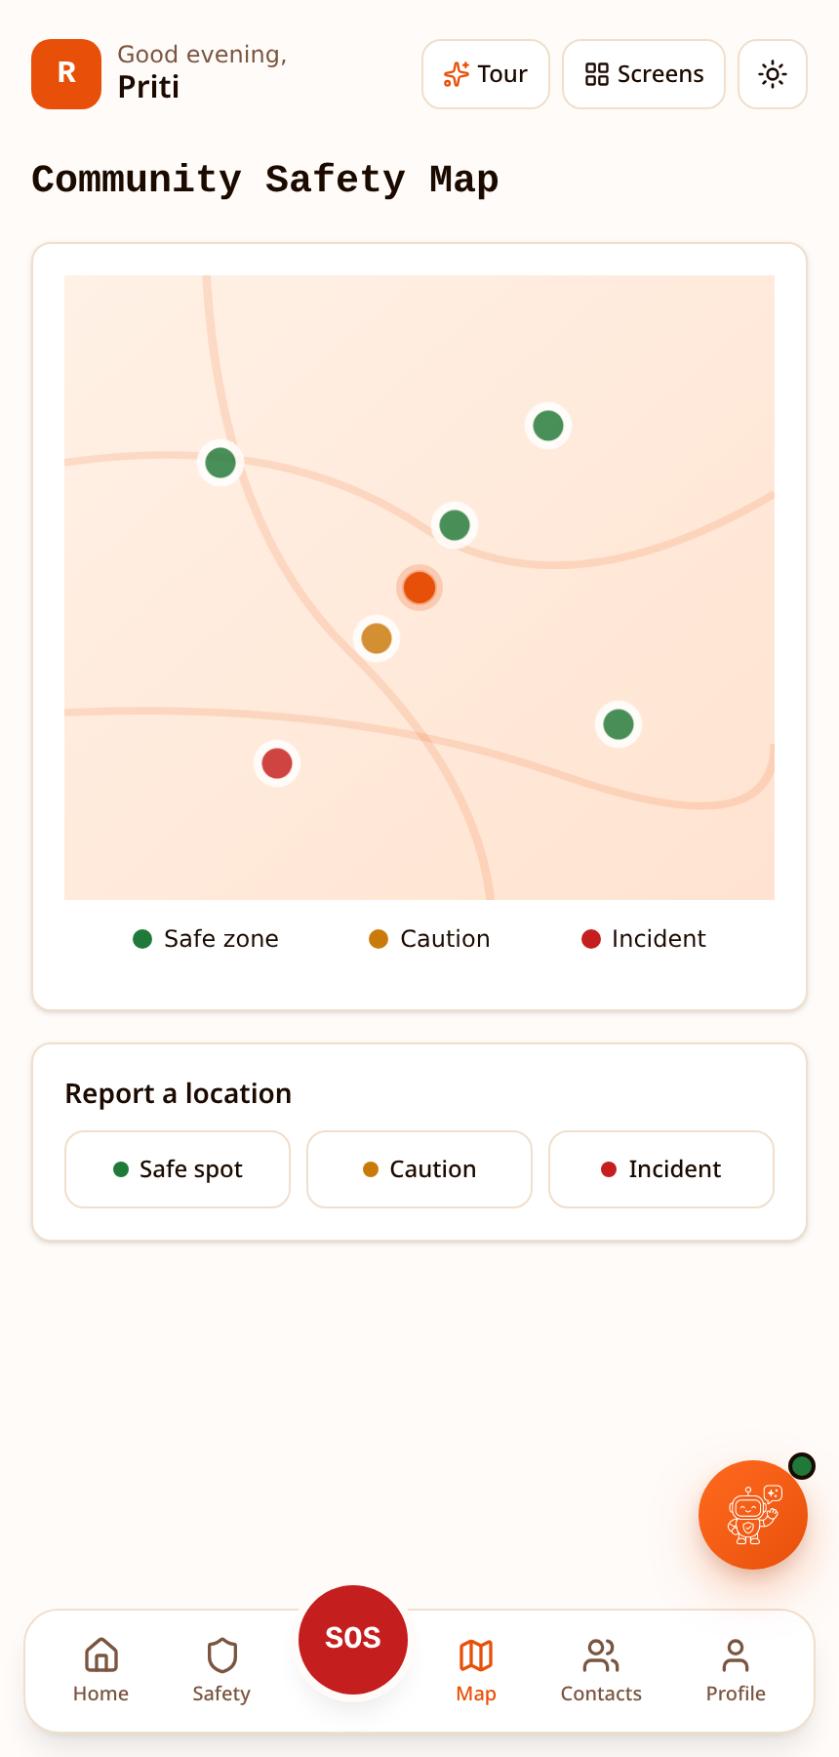
MAP
Community Safety Map
Crowd-sourced safe / caution / alert pins so riders know their route before they start.
Key features
Green pins — verified safe zones
Amber pins — caution after dark
Red pins — recent incidents
Landmarks: police, pharmacies, RideSafe hubs
RideSafe • editable prototype • customize freely

Slide 5
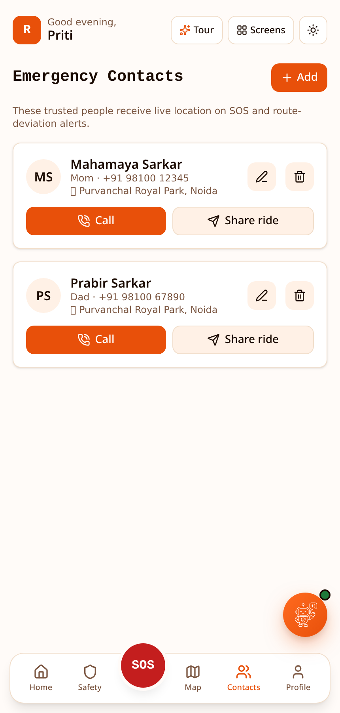
CONTACTS
Trusted Contacts
The people who get notified when SOS fires, night mode starts, or route deviates.
Key features
Add / edit / delete contacts
Relationship + address stored
Auto-notify on SOS or deviation
Priority contact for live share
RideSafe • editable prototype • customize freely

Slide 6
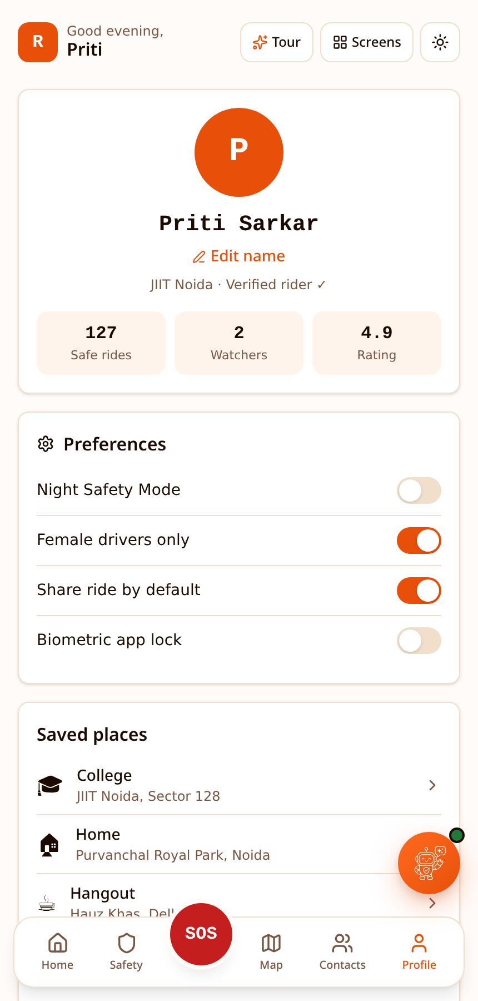
SETTINGS
Profile & Settings
Account, preferences, and quick access to global toggles.
Key features
Editable display name
Female-driver-only default
Night mode default
Emergency contacts summary
RideSafe • editable prototype • customize freely

Slide 7
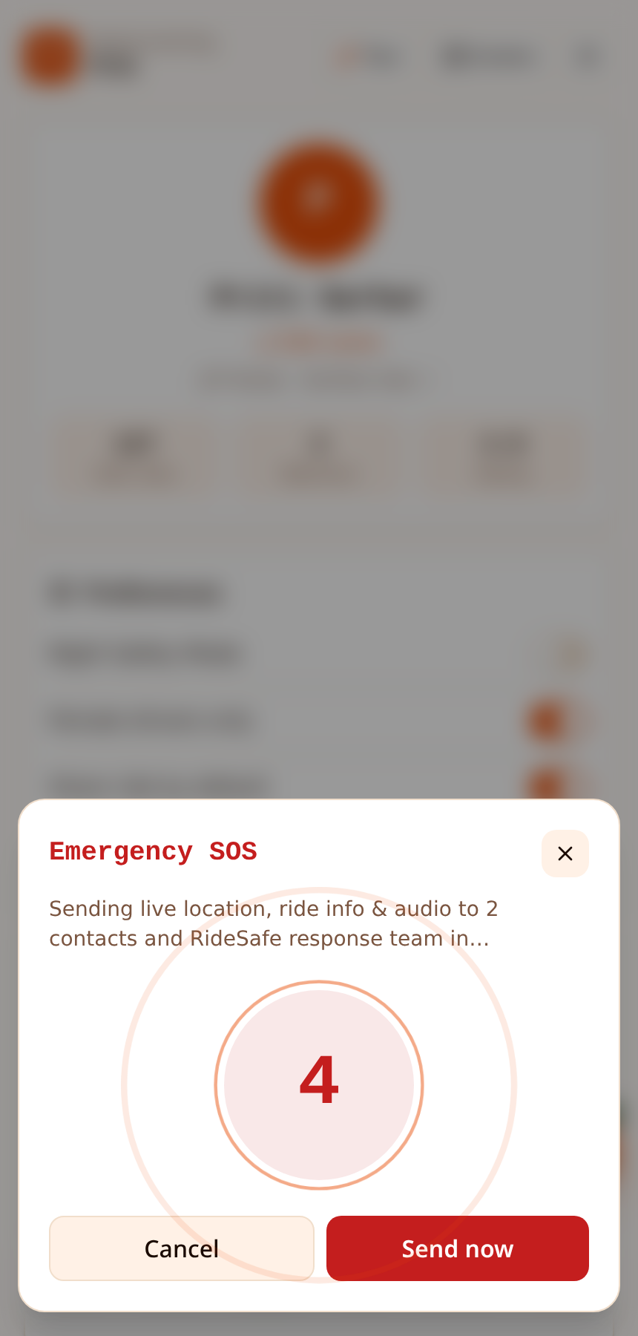
EMERGENCY
SOS Modal
Triggered by the red SOS button. Sends live location + audio to trusted contacts and 112.
Key features
5-second countdown to cancel
Auto-dial emergency services
Broadcast location to contacts
Silent audio recording begins
RideSafe • editable prototype • customize freely

Slide 8
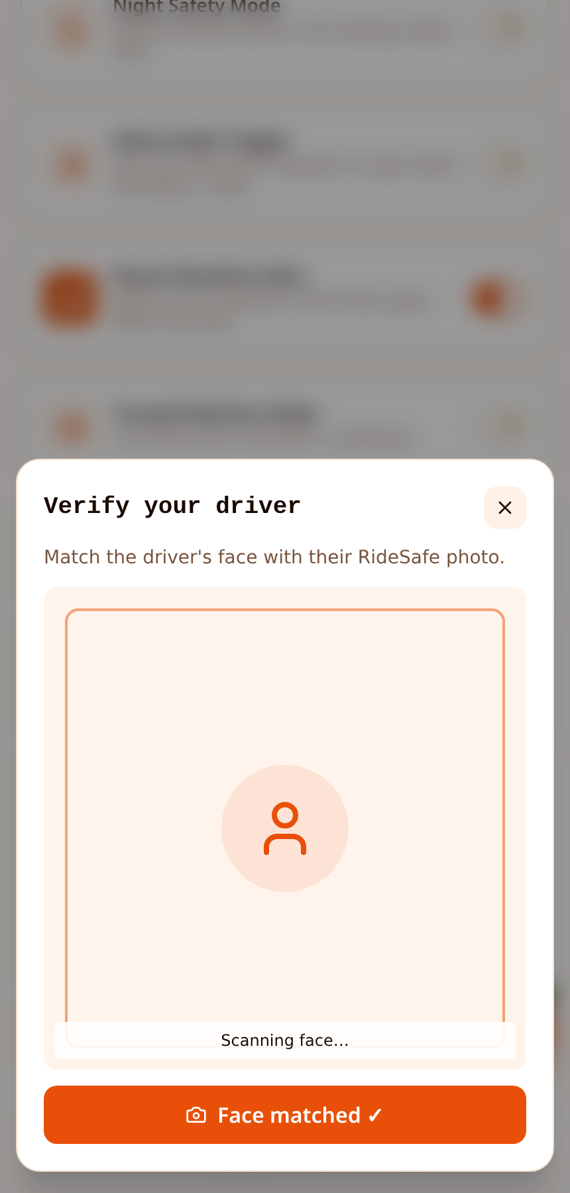
TRUST
Driver Verification
Face-match the driver against their RideSafe photo before the ride starts.
Key features
Live camera scan
Face match confirmation
Vehicle plate + rating check
Reports back to dispatch if mismatch
RideSafe • editable prototype • customize freely

Slide 9
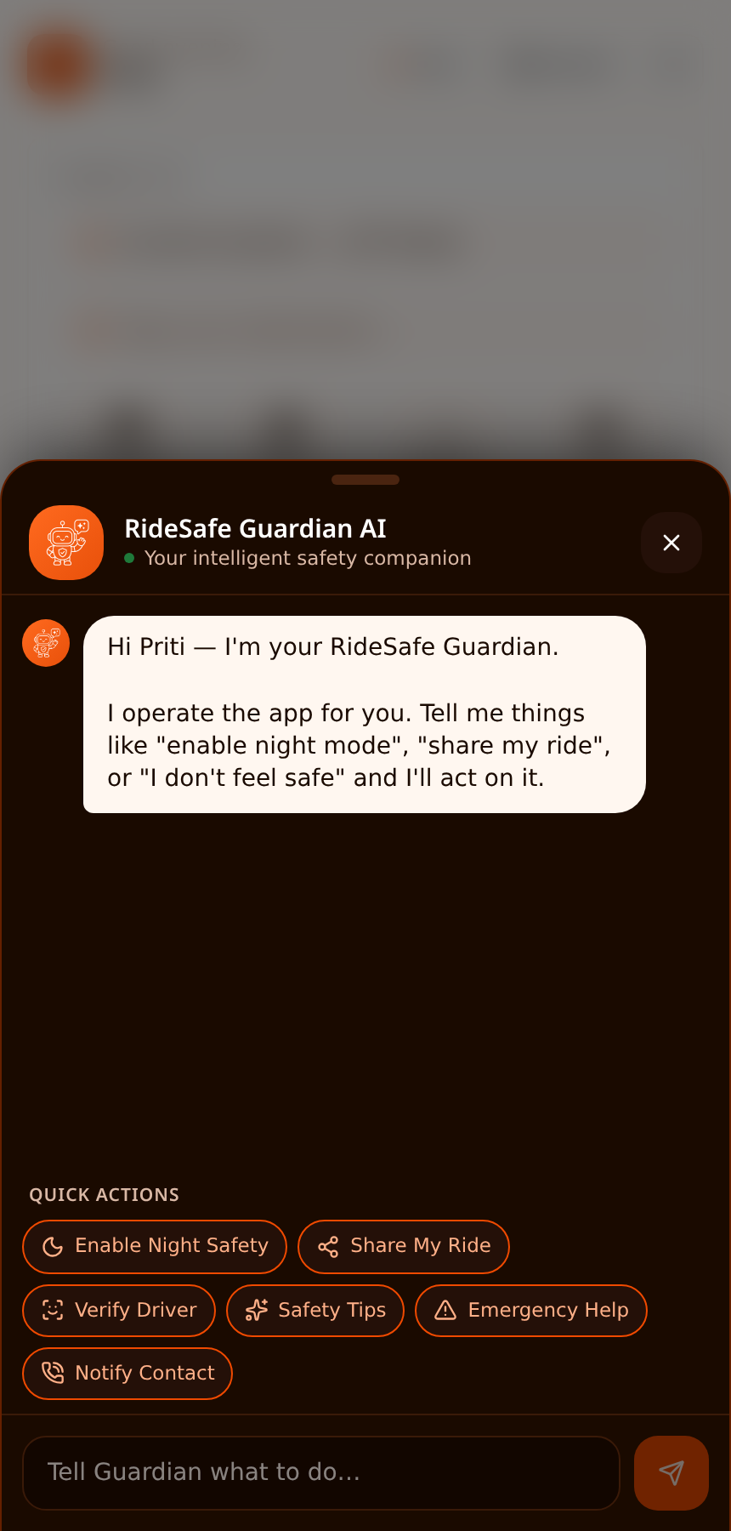
AI COMPANION
Guardian AI Chatbot
Natural-language safety companion. Understands intents and performs real app actions.
Key features
"Enable night mode" → toggles instantly
"I don't feel safe" → arms SOS + share
Proactive suggestions after 10pm
Quick-action chips for common tasks
RideSafe • editable prototype • customize freely

Slide 10
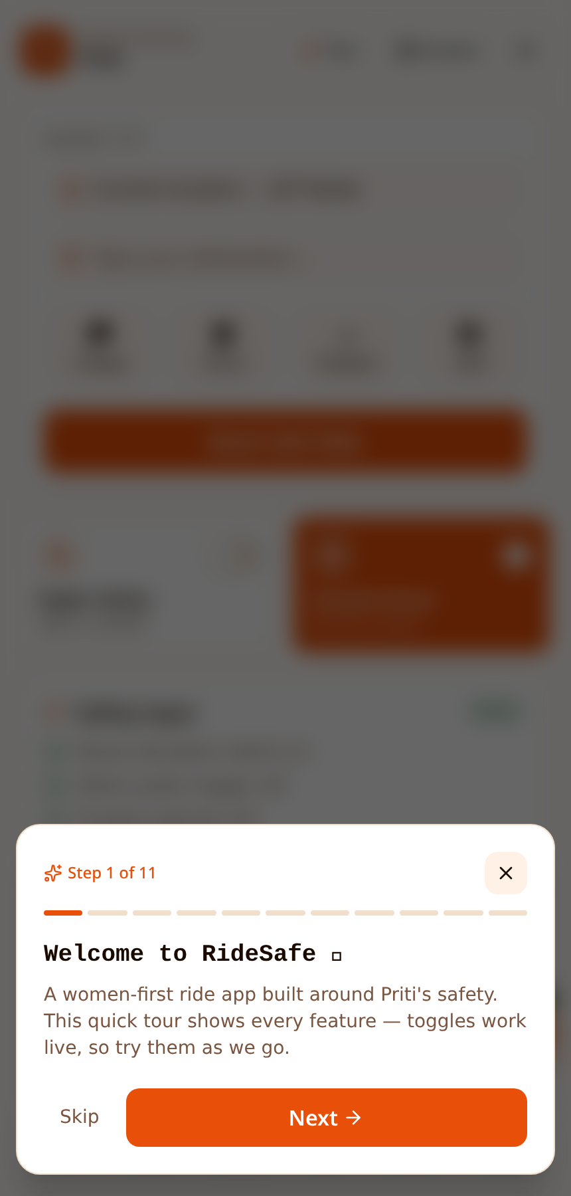
WALKTHROUGH
Interactive Onboarding
First-run tour that highlights each safety feature and toggles them live so users see exactly what changes.
Key features
Step-by-step highlights
Real toggles fire during the tour
Skip / next / back controls
Re-openable from the top bar anytime
RideSafe • editable prototype • customize freely

Slide 11
Live interactive demo
Every screen above is running in a real, editable web prototype. Product managers can click through it in real time — no install needed.
Open live prototype ➜ https://id-preview--529d472e-3ee8-4b80-8d41-c5ce437f2274.lovable.app
Tip for PMs: click SOS, toggle Night Mode, or open Guardian AI to see real-time state changes.

