Slide 1
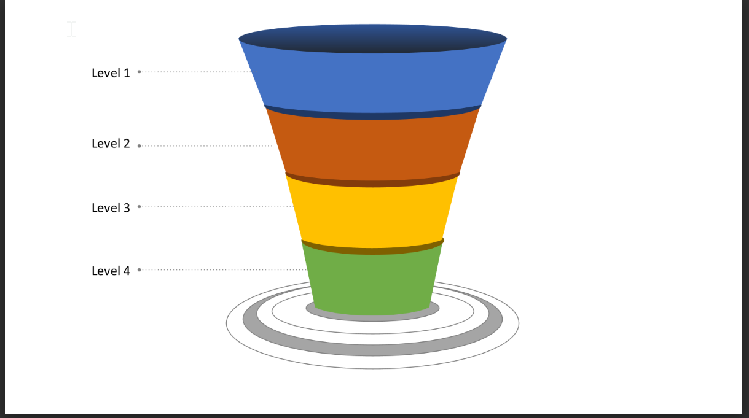
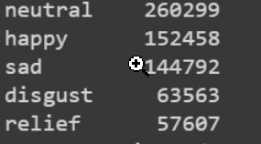
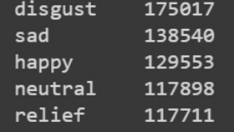
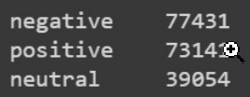

Web Scrapped tweets
Chronologically sorted tweets
Hashtags and Keywords
Data Pre-processing
The collected data has been cleansed by removing non-English and duplicate tweets and removing stop words, punctuations, URLs, user mentions, and hashtags.
TextBlob
16,88,376
Duplicate tweets removal
8,49,596
Non-English tweets removal
6,79,071
VADER
Emotion Detection
Sentimental Analysis
TextBlob
VADER

Slide 4
