Slide 1
Executive Summary Outline for Stratethon 4
OptiHelp
Connecting you to care

Slide 2
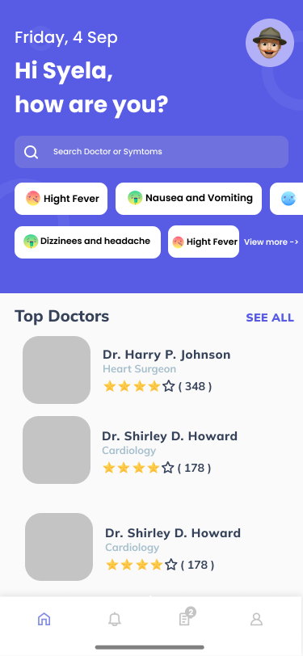
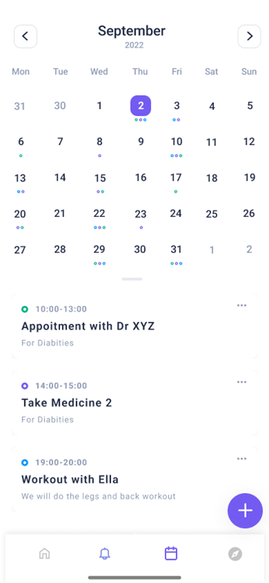
Business Problem & Solution
Reducing hospitalization and re-hospitalization
Focus: Consumer Health Journey
OptiHelp is an application devised for early intervention, guidance, and management of health resources.
OptiHelp offers:
Disease detection using symptoms analysis.
Comprehensive medical directory with verified information about doctors and hospitals.
E-consultation and Online appointment booking portal.
Health Planner with push notifications and reminders for appointments, medication, and routine exercise.
P-Connect connects patients to the patients using chat groups to boost recovery and nurture mental health.
OptiHelp's mission is to promote 3R- Recover, Reduce and Raise.
Recover - Recovering with support.
Reduce- Reducing rates of hospitalization and re-hospitalization.
Raise- Raising medical literacy.

Slide 3
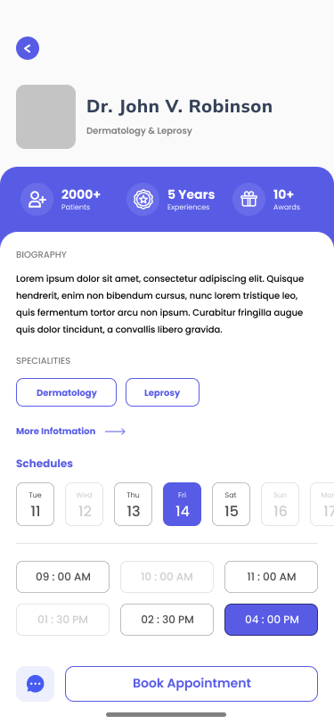
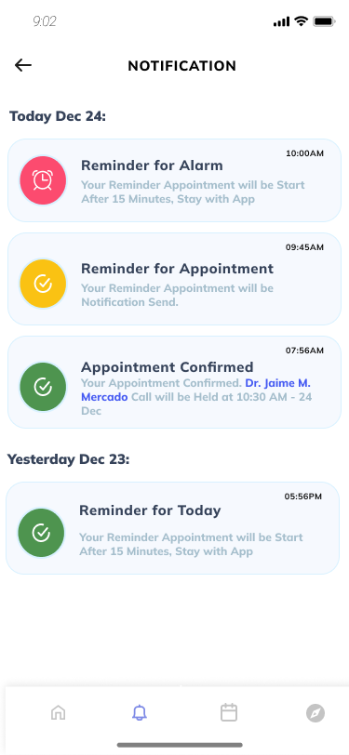
Value Proposition and Differentiators
Through this application, we aim to impact the healthcare sector by developing and promoting digital healthcare services to boost the health ecosystem by connecting the three main pillars - Patient, Physician, and Pharmacy.
OptiHelp provides exceptional features such as disease detection using symptoms analysis which provides the user with accurate information about the possible ailment and helps develop an understanding of the disease with the recent trends.
This application also provides a Health Planner to track all health-related activities to not miss, such as appointments and medications, with a push notification and reminder feature, which makes it stand out from the current competitors in the market, such as Practo, TATA Health, and many more.

