Slide 1
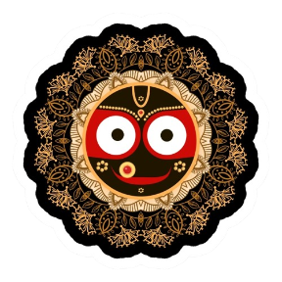
Jay Jagannath
Welcome to django

Slide 2

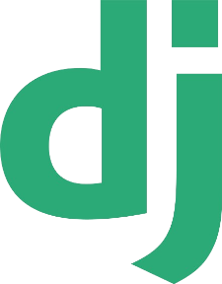
django
Instructor : Surendra Kumar Panda

Slide 3
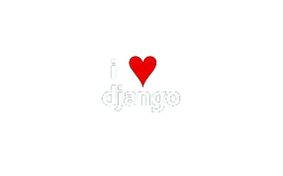
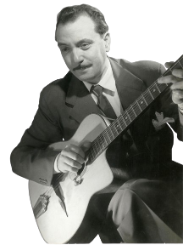
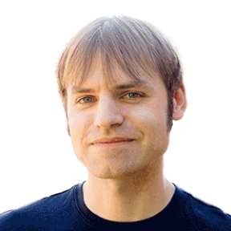
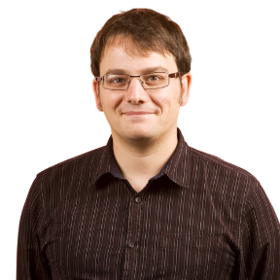
Django
Introduction
Django is a framework for developing web applications.
Django is built using the Python programming language.
Django is an open-source framework that is freely available without the need for a licence.
Django follows the MVT (Model-View-Template) design pattern.
The official web site of django is www.djangoproject.com
Django provides RAD (rapid application development) facilities.
Django serves as a framework for constructing fast, scalable, and secure web applications.
The DSF (Django Software Foundation) maintains Django.
History
Lawrence World created Django in 2003.
Adrian Holovaty and Simon Willison are the creators of Django.
Django was released to the public on July 21, 2005.
The term "Django" came from the renowned musician Django Reinhardt.
Django latest official version is 5.0.2
The correct pronunciation of Django is "JANG-goh".

Slide 4
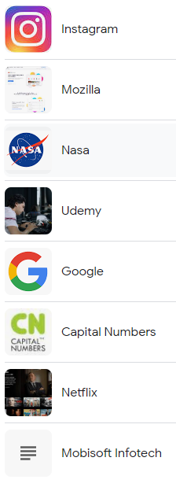
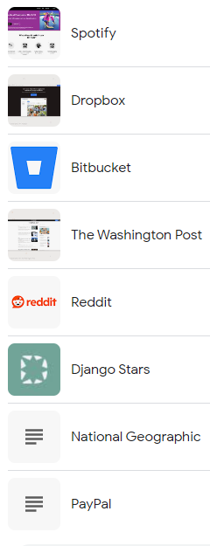
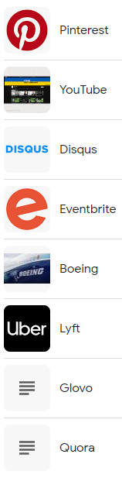
Leading organizations using Django
Instagram
Pinterest
Spotify
NASA
Disqus
Dropbox
Bitbucket
Reddit
Udemy
edX
YouTube
Mozilla
The Washington Times
National Geographic
and so on.

Slide 5
Web Framework
A web framework is a software platform designed for building and managing web applications.
A web framework provides a structure and tools for creating web applications, which include web services, web resources, and web APIs.
Web frameworks simplify the web development process and enhance the entire experience for developers.
A web framework contains tools for building, developing, and running web applications.
There are several web frameworks available for different programming languages to develop web applications.
Python
Django
Flask
FastAPI
Java
Spring
Struts
Grails
JavaScript
Angular
Next.js
Express.js

Slide 6
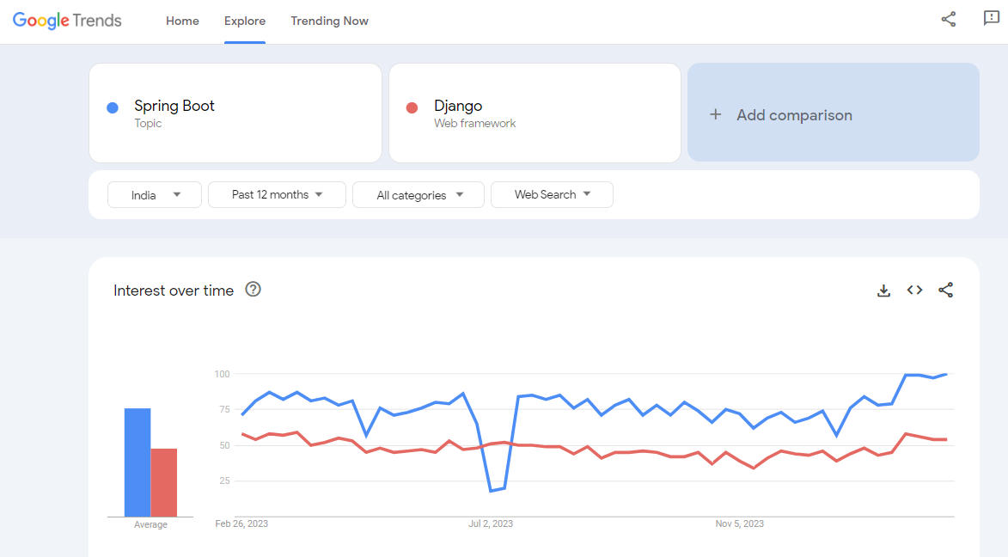

Slide 7
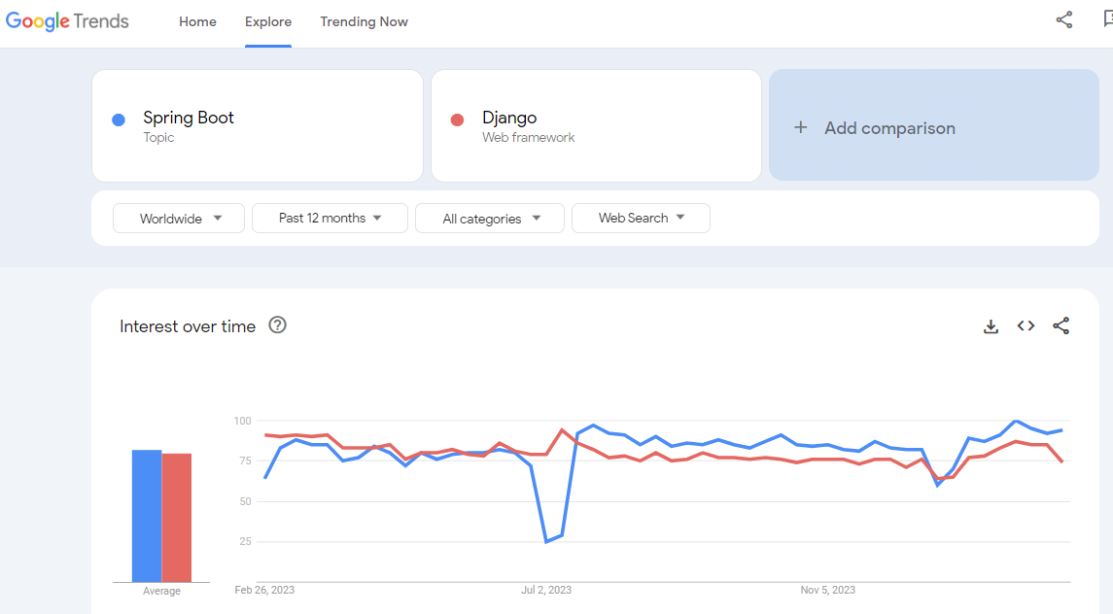

Slide 8
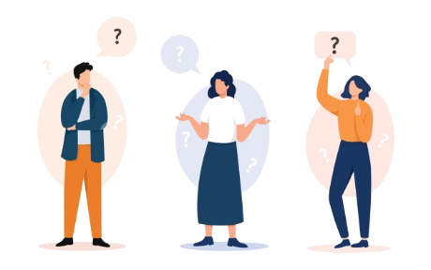
Why django
“The web platform for deadline-driven perfectionists”
Ridiculously fast
Fully loaded
Reassuringly secure
Highly scalable
Incredibly versatile
Rapid Development
Batteries-Included Philosophy
Built-in Admin Interface
Template Engine
ORM (Object-Relational Mapping)
REST Framework
Community Support
Documentation
Open Source

Slide 9
Django Setup

Slide 10
Steps to download and install Django
First download and install Python.
Open terminal/ CMD type : pip install django to install django.
If you want to download specific version, then type pip install django=5.0.2.
Check django version : django-admin - -version.

Slide 11
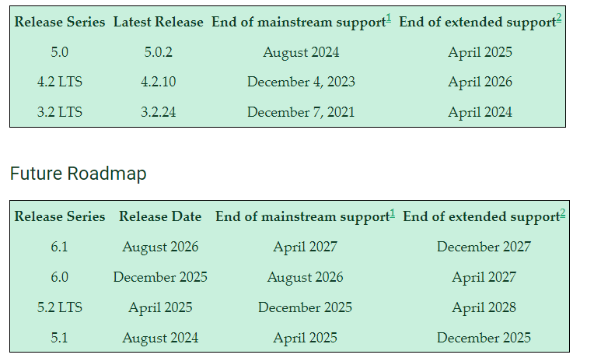
Django Versions

Slide 12
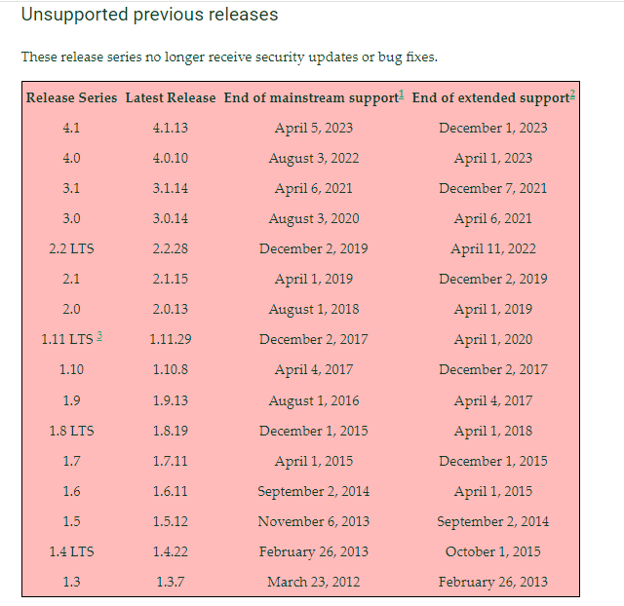
Django Versions (continue)

Slide 13
Getting started with Django project development

Slide 14
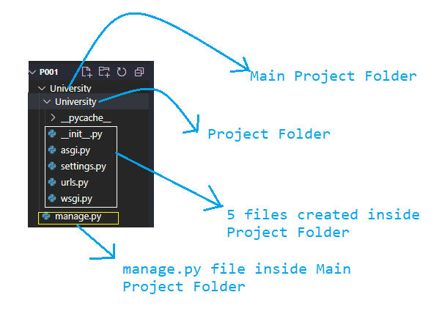
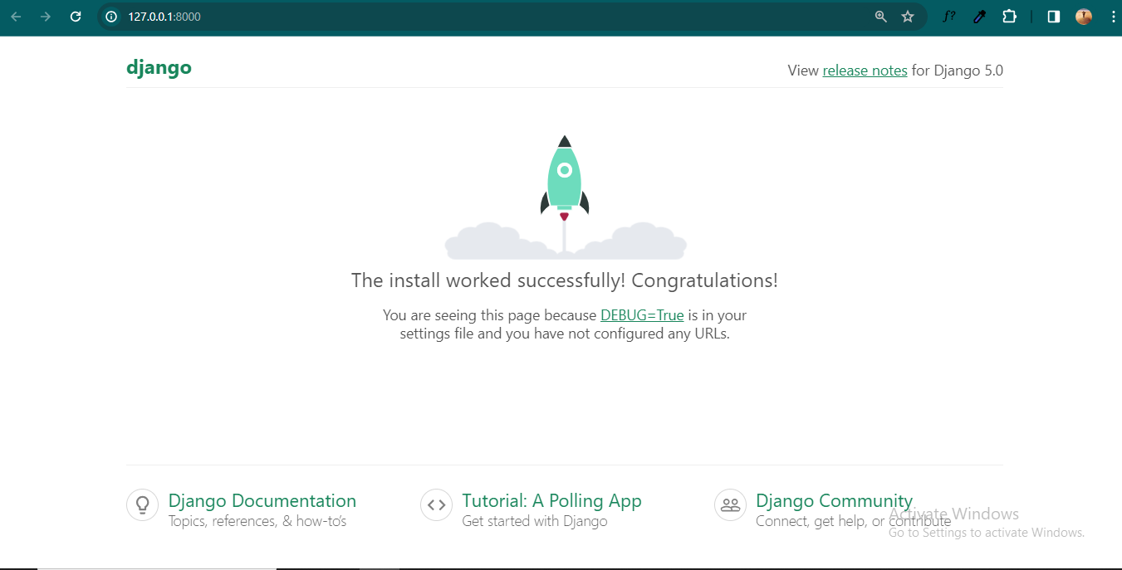
Project : P001
Problem Statement : Create first Django project
Step 1: Create a folder named Django Projects; inside this folder, create a subfolder named P001; then open the VS code or other IDE inside this P001 folder.
Step 2: Create django project : django-admin startproject project_name .
Step 3: Once project is created successfully then django automatically create a main folder with your project name inside POO1, then inside that main folder it created a file manage.py and a subfolder named as same project name which contain 5 different files.
Step 4: Enter inside project folder : cd project_name
Step 5: Run server : py manage.py runserver.
Step 6: Send request http://127.0.0.1:8000/

Slide 15
ian Holovaty and Simon Willison created Django while working at the Lawrence Journal-World newspaper in Kansas, USA in 2003. They developed the framework to help journalists create complex news websites and web applications quickly and easily. The name "Django" comes from the Belgian jazz guitarist Django Reinhardt, and the first version of Django was released to the public in 2005 under the BSD license, making it an open-source framework. The motivation behind creating Django was to simplify the process of web development and make it more accessible to developers, especially those who were new to web development or who wanted to build web applications quickly without sacrificing quality.
f

