Slide 1
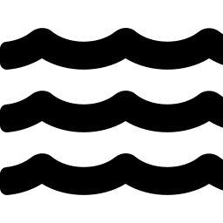
COGNITIVE ROBOTICS PROJECT
Belief-Based Task Planning for
Multi-Robot Ship Hull Cleaning
A belief-driven, closed-loop cognitive layer for defect prioritization and cleaning verification — evaluated in simulation
Team
Pritish Bhatasana
Reg. No: 23BRS1035
Siddharth Seth
Reg. No: 23BRS1038

Slide 2




The Problem: Hull Fouling & Structural Defects
Ship hulls accumulate biofouling (algae, barnacles), corrosion, and cracks over time. Left unmanaged, these raise fuel consumption, accelerate structural damage, and drive up maintenance cost — yet manual underwater inspection and cleaning is slow, expensive, and hazardous for divers.
Our Reference System
Mapping Robot
Magnetic wheels + depth camera; scans hull, builds point cloud / mesh
Increased fuel drag
from biofouling accumulation
Cleaning Robot
Corrosion & cracks
Motors + cleaning/repair kit; navigates to marked defects and acts
risk structural integrity
Manual inspection
Inspired by prior internship work on ship hull cleaning robotics
slow, costly, diver-hazardous
2

Slide 3
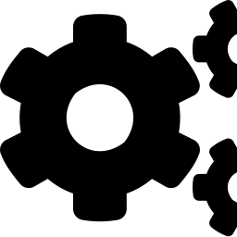

Project Scope: Why Simulation
No original hardware / source
Different ROS2 environment
Simulation-first approach
The mapping + cleaning robot hardware, ZED2i camera, and original RTAB-Map codebase from the internship are not available for this project.
Development machine runs Ubuntu 26.04 LTS with ROS2 Lyrical, not the Humble / Ubuntu 22.04 stack the original system used.
The system is built and evaluated entirely in a Gazebo simulation — sidestepping hardware and unproven-distro risk while keeping the same problem structure.
Consequence for this project: novelty is deliberately placed in the cognition / task-planning layer — the one part of the pipeline that does not depend on unavailable hardware or an unproven ROS distro.
3

Slide 4
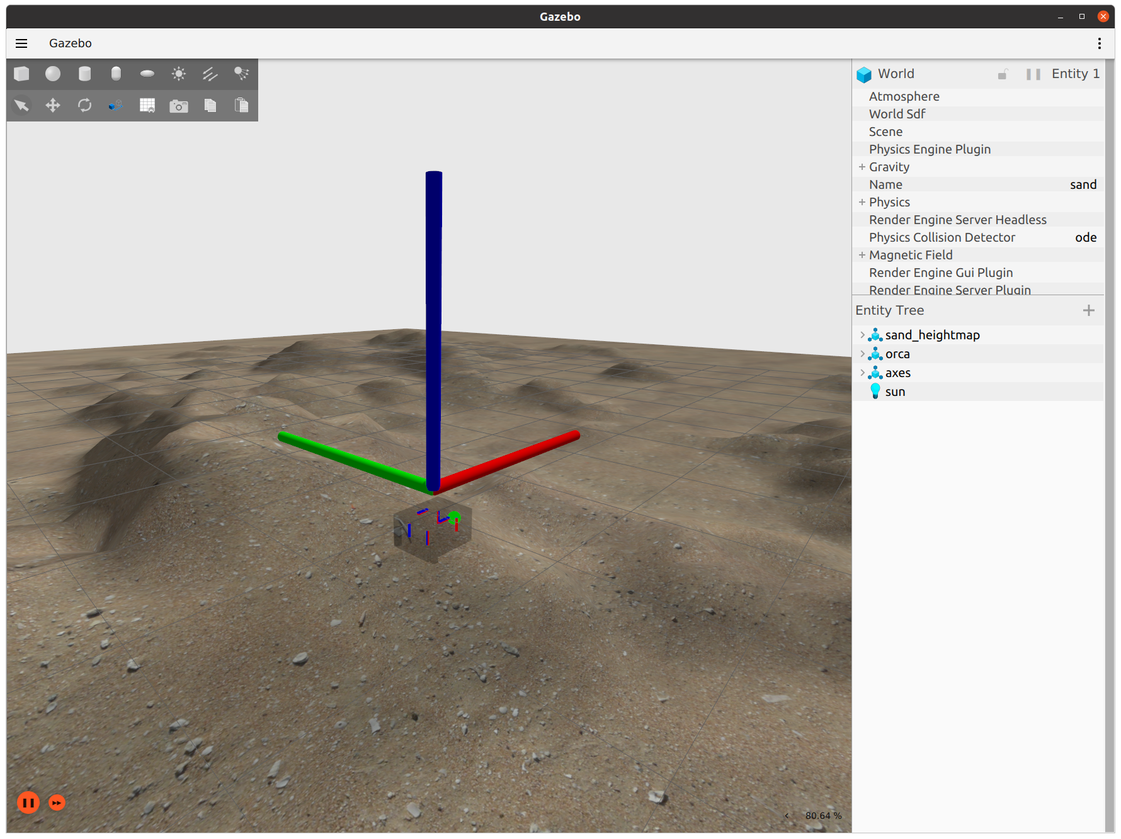
Simulation Environment: Gazebo + ROS2
OS / ROS
Ubuntu 26.04 LTS — ROS2 Lyrical
Simulator
Gazebo (Gz Sim), synthetic hull mesh
Sensors
Simulated RGB-D camera feed (ZED2i substitute)
Defects
Synthetic texture patches: crack / rust / biofouling
Two robots (mapper + cleaner) are spawned in the same simulated world, exchanging state only through explicit ROS2 topics/services — mirroring the real two-robot handoff.
Gazebo simulation of an underwater vehicle (reference render)
4

Slide 5
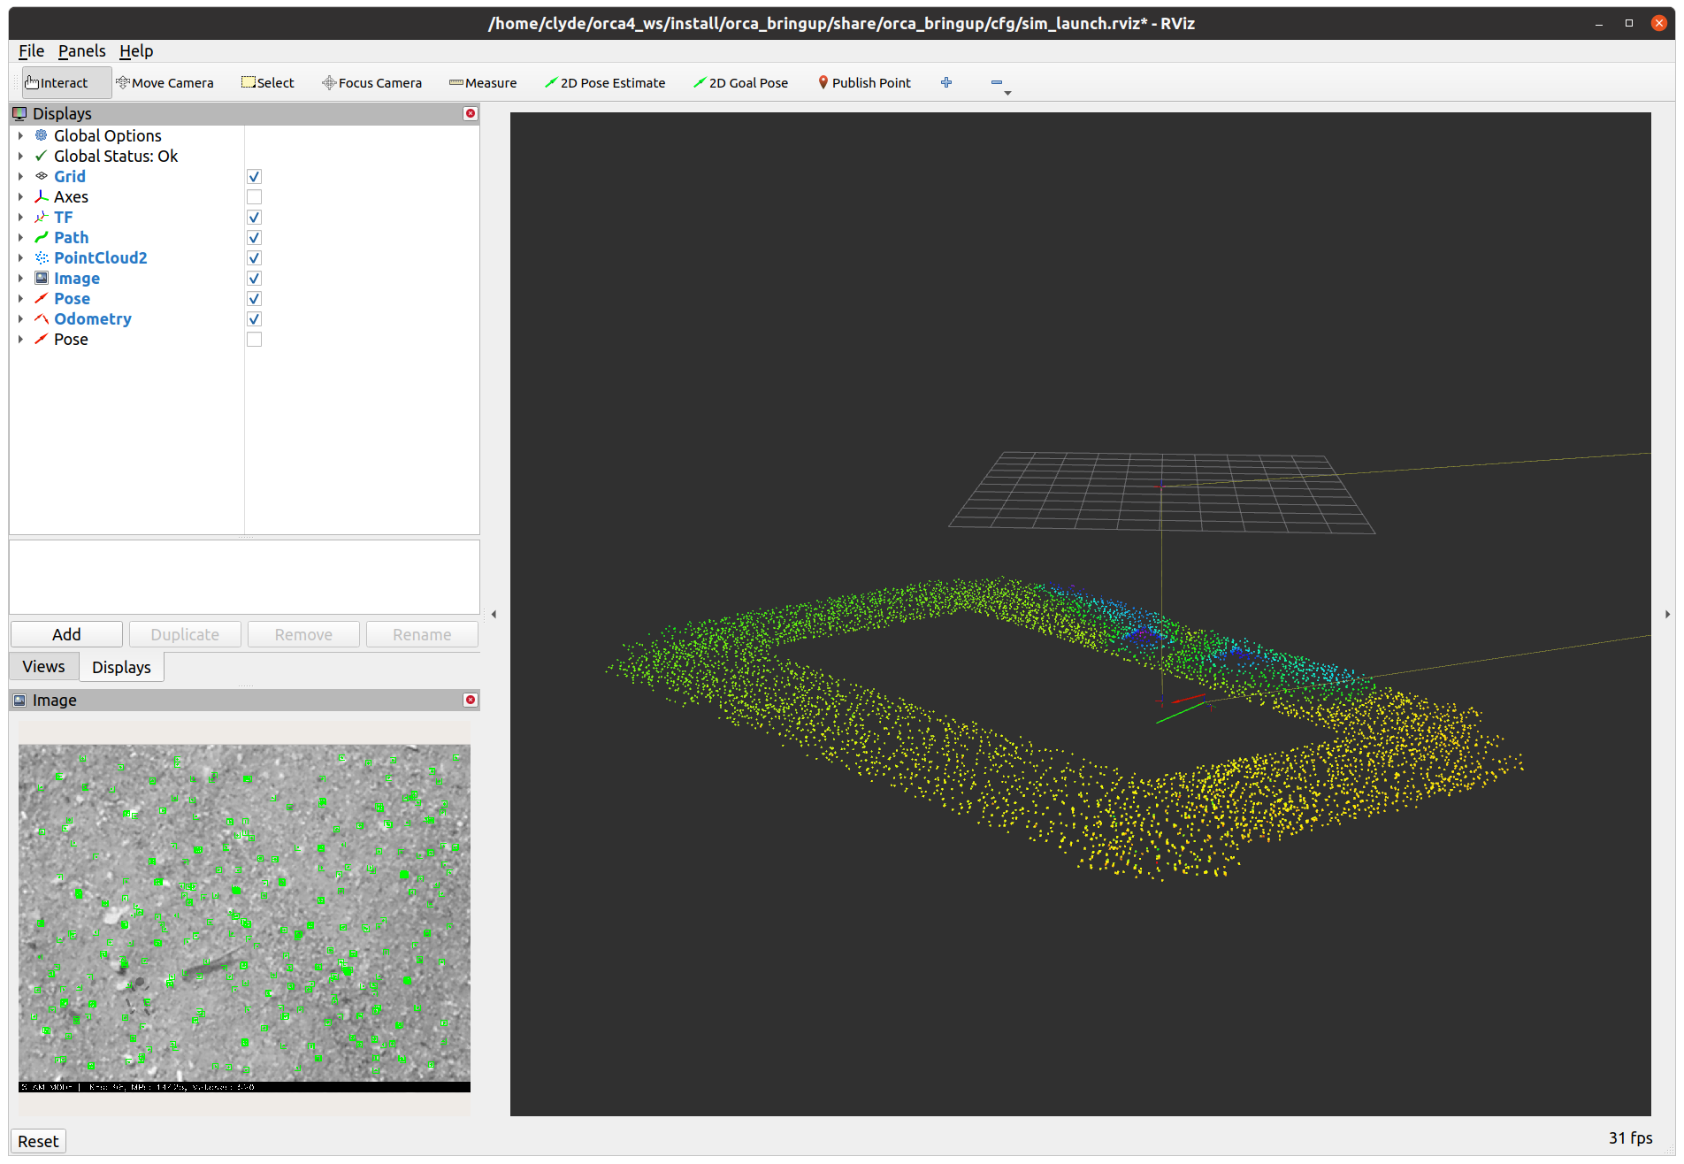
Mapping & Localization Layer
Treated as a solved sub-problem
Point-to-point navigation and hull mapping are not this project's novelty target. Localization is provided either by:
1
Gazebo ground-truth pose (fastest path to a working demo)
2
A ROS2-native SLAM stack (e.g. slam_toolbox) for a more realistic pose estimate
Either way, the mapping robot's output to the cognition layer is the same: a point cloud / mesh plus a set of candidate defect locations — the interface our belief map consumes.
RViz2 visualization of robot pose, path, and sensor point cloud
5

Slide 6


Domain Selection: Perception vs. Path Planning vs. Cognition
OUR FOCUS
Perception
Path Planning
Deep-learning defect detectors (cracks, rust, biofouling) are already well-studied — e.g. YOLOv8 hull-crack detection, LIACI segmentation benchmark.
Collision-aware hull navigation (enhanced A*) and SLAM-based task discovery (Map-TIDAL) are already published for this exact domain.
Cognition
No existing work carries defect severity + confidence into task priority, or closes the loop with post-cleaning verification. This is the open gap.
6

Slide 7


Core Novelty: Belief-Driven, Self-Verifying Task Layer
A closed cognitive loop absent from prior hull-cleaning and inspection-robotics literature
→
→
→
→
→
Detect
Belief Update
Utility Scoring
Task Queue
Clean / Repair
Verify
Defect + confidence
Severity, confidence map
Severity × risk − cost
Prioritized work order
Cleaning robot acts
Re-scan → update belief
If defect still detected after cleaning → belief updated, task re-queued (loop back to Task Queue)
Why this is novel: Map-TIDAL and similar systems discover and allocate tasks by distance/keypoint density, and mark them done once visited. No reviewed paper carries severity + confidence into prioritization, or re-verifies completion — this project targets exactly that gap, in simulation.
7

Slide 8
System Architecture (Simulation)
Cognition Layer
Mapping Robot Node
Belief Map
Cleaning Robot Node
Point cloud + defect flags
Type, severity, confidence per defect
Executes task, reports status
/defect_detections
/task_queue
Utility Scorer
Ranks tasks by severity × risk − cost
Task Queue Manager
Publishes ordered task list
Verification Monitor
Re-scan result → update / re-queue
/task_complete (verification re-scan trigger)
Two ROS2 nodes (mapper, cleaner) communicate only through the cognition layer's topics/services — a fixed specialized two-robot hand-off, not a homogeneous swarm.
8

Slide 9
Novelty Positioning vs. Published Work
Paper
Domain
Key Gap vs. Our Project
Map-TIDAL (Ruediger & Banerjee, 2026)
Task discovery + allocation
No severity/confidence model; no post-action verification
Biofouling recognition + tracking (Su et al., 2024)
Perception + control
Detection fused into steering; no task-priority layer
Enhanced A* hull navigation (review, 2025)
Path planning
Collision-free routing only; no task ordering
LLM hierarchical orchestration (2026)
Cognition / orchestration
No belief model, no verification; different domain
YOLOv8 hull crack detection (2026)
Perception
Detection only, no downstream planning
Full 8-paper literature review with citations available in the accompanying document.
9

Slide 10

References
Su, H., Liu, S., Zhang, L., Chen, Y., Yang, C. — “Biofouling recognition and boundary tracking control for underwater cleaning robots.” Ocean Engineering, Vol. 295 (2024), Art. 116707.
“Automated detection and classification of cracks in ship hull structures using deep learning.” Ocean Engineering (2026).
“Detection of Cracks and Corrosion for Automated Vessels Visual Inspection” (LIACI dataset), EU FP7 MINOAS project.
“Design, perception, planning and control for underwater cleaning robotics: Progress, challenges and trends.” Ocean Engineering review (2025).
“Algorithm for Determining the Position of a Ship Hull-Cleaning Robot.” Applied Sciences 15(10), 5705 (2025).
Ruediger, M., Banerjee, A.G. — “Mapping-Guided Task Discovery and Allocation for Cooperative Robotic Inspection of Underwater Structures” (Map-TIDAL). arXiv:2602.02389 (2026).
“A Centralized Multi-Robot Task Allocation for Industrial Plant Inspection by Using A* and Genetic Algorithms.”
“A Hierarchical LLM-Based Framework for Heterogeneous Multi-Robot Orchestration in High-Risk Energy Facility Maintenance” (2026).
All sources retrieved via web search; full comparison and links provided in the literature review document.
10

Slide 11


Expected Outcomes & Impact
Novel contribution
A working belief-driven, severity-aware task prioritization layer with closed-loop cleaning verification — demonstrated absent from reviewed literature.
Fully reproducible in simulation
Entire two-robot pipeline runs in Gazebo without dependence on unavailable hardware or an unproven ROS distro.
Clear comparison baseline
Directly benchmarked in concept against Map-TIDAL-style task discovery to demonstrate the added verification/prioritization value.
Extensible design
Belief map + utility scoring is detector-agnostic — real perception models (YOLOv8, segmentation) can be substituted later without redesigning the cognition layer.
11

Slide 12
Thank You
Questions & Discussion
Pritish Bhatasana
23BRS1035
Siddharth Seth
23BRS1038

