Slide 1
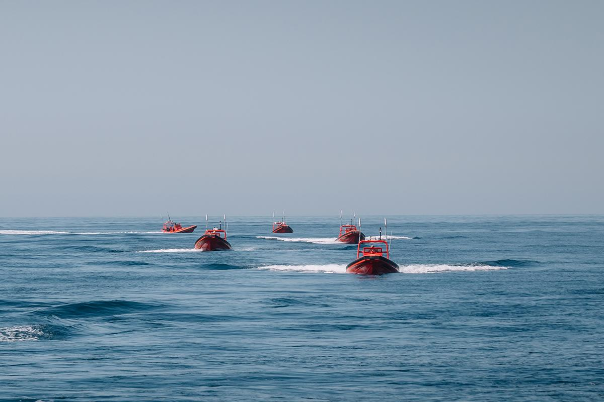
CAPSTONE PROJECT PROPOSAL • AI & AUTONOMOUS ROBOTICS
Agentic Self-Healing
Marine Drone Swarm
Fault-aware cooperative detection, tracking and
non-destructive interception for USV swarms
Guide: Dr. Linda Joseph
Suchet Kumbar
Siddharth Seth
Pritish Bhatasana
23BRS1073
23BRS1038
23BRS1035
Simulation-first research proposal | 17 July 2026
Image: Johns Hopkins APL, Swarming USVs

Slide 2








PRESENTATION FLOW
What we'll cover
01
02
03
04
Problem & Fault Taxonomy
Existing Work & Research Gap
Literature Review
Objectives & Scope
Why swarm autonomy breaks — and what breaks it
State of the art, and the gap it leaves open
15 papers, systematically reviewed and tabulated
What we will build, and the boundaries around it
05
06
07
08
Proposed Solution & Novelty
Applications
Experimental Design
Feasibility, Risk & Timeline
An agentic, fault-aware recovery loop
Where a self-healing marine swarm matters
A two-stage, simulation-first validation plan
A realistic 16-week, risk-aware roadmap
02

Slide 3
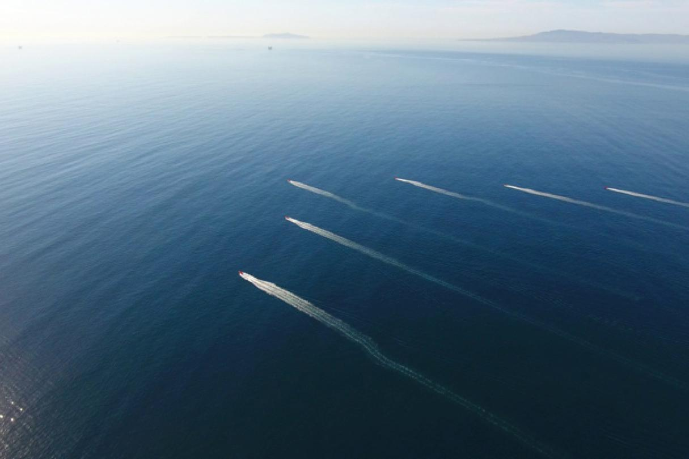
01 · INTRODUCTION
A swarm is useful only if it survives its own failures
Unmanned surface vehicle (USV) swarms are increasingly proposed for coastal surveillance, port security, search-and-rescue and non-destructive interception of moving vessels. Conventional swarm control, however, assumes sensing, communication and propulsion keep working throughout the mission.
At sea, that assumption fails routinely — salt-water corrosion, GPS multipath, sun-glare on cameras, thruster fouling and intermittent RF links are the norm, not the exception.
6-10
30%
USVs per patrol swarm
nodes may fail mid-mission
The real question: Can a marine swarm keep its mission, not just its formation, alive when a robot, sensor or link fails?
Coordinated USV patrol formation, live sea trial
03

Slide 4



01 · INTRODUCTION
Three failure classes break a swarm mission
Context: Johns Hopkins APL, Swarming Uncrewed Surface Vehicles
Sensor Fault
Robot Fault
Network Fault
GPS bias, camera dropout or perception noise corrupts the shared target estimate before it ever reaches the swarm's planner.
Thruster degradation, battery collapse or a dead node leaves an assigned role — scout, tracker, relay — unfilled mid-mission.
Link loss splits the coordination graph, breaking shared target belief and containment consensus across the swarm.
Conventional swarm control has no unified answer to any of these — this project targets a closed loop that handles all three.
04

Slide 5
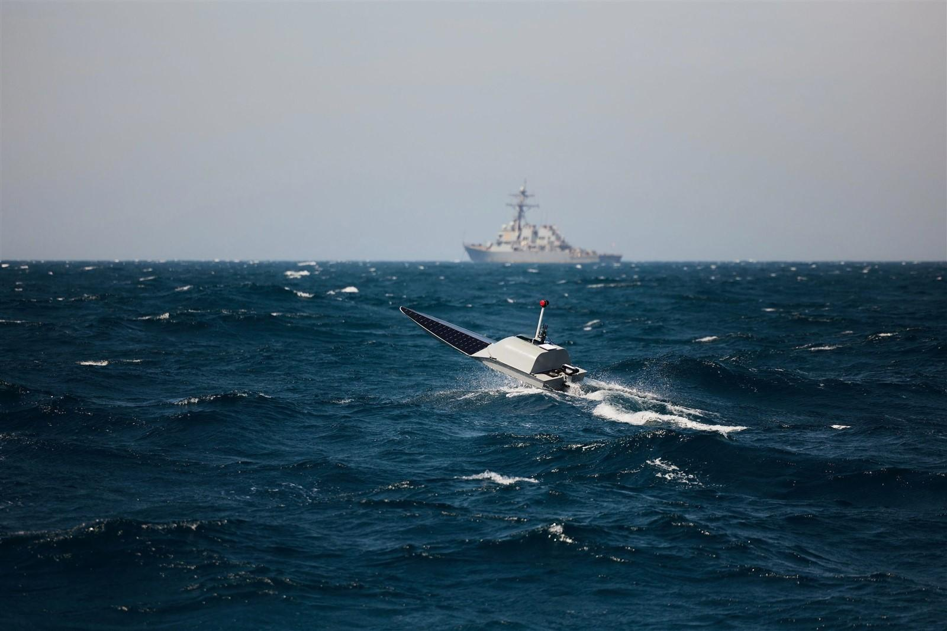
02 · INTRODUCING THE PROBLEM
Problem Statement
To develop and validate a simulation-first, agentic control architecture that unifies real-time fault diagnosis ($h_i(t)$), dynamic role reallocation, fault-aware policy execution (FA-MAPPO), and closed-loop mission verification—preserving cooperative tracking and encirclement integrity under up to 30% node and link degradation without human intervention.
Coordinated USV patrol formation, live sea trial
05

Slide 6
“
02 · THE RESEARCH GAP
The gap is not another MARL policy — it is a unified, testable fault-recovery architecture.
Existing research has demonstrated USV perception, cooperative MARL, MAPPO-based tracking/interception, fault-tolerant learning, and agentic planning largely as separate capabilities. However, there is limited work demonstrating their closed-loop integration for autonomous marine swarms operating under realistic node and communication-link failures.
The missing capability is a diagnose → reconfigure → act → verify → recover loop
GAP: A simulation-validated, agentic control architecture that integrates real-time fault diagnosis, dynamic role reallocation, fault-aware MAPPO, and closed-loop mission verification into a single autonomous recovery framework for multi-USV systems.
06

Slide 7
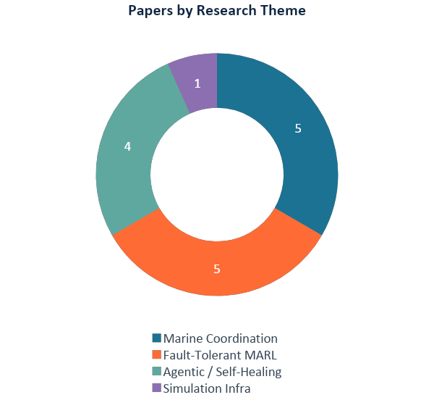



03 · LITERATURE REVIEW
15 papers reviewed
Sourced from peer-reviewed journals, ScienceDirect, MDPI, Nature, Frontiers and arXiv preprints (2021–2026), spanning four converging research threads.
Marine Swarm Coordination & Tracking
5
Fault-Tolerant Multi-Agent RL
5
Agentic AI & Self-Healing Architectures
4
Simulation & Test Infrastructure
1
Gap identified: strong single-domain results in each thread, but no marine-specific paper closes the diagnose → plan → act → verify loop end to end.
07

Slide 8
03 · LITERATURE REVIEW
Marine & swarm coordination — cooperative sensing, tracking, interception
S. No. | Title | Brief of the Paper | Shortcomings
1 | ACL-LSTM-MAPPO Multi-USV Interception (Xiang et al., 2026) | Combines attention, curriculum learning and LSTM-MAPPO for multi-USV interception. Curriculum learning improves convergence and interception performance under dynamic disturbances. | Focuses on interception performance but does not address explicit fault diagnosis, role reallocation, or autonomous recovery after agent or link failures.
2 | Swarm USV Encirclement with MAPPO / MAPPO-LSTM (Transportation Research Procedia, 2026) | Compares MAPPO and MAPPO-LSTM for cooperative USV encirclement of an evasive target. LSTM improves temporal coordination and motion smoothness under partial observability. | Evaluates healthy-agent encirclement and does not explicitly model node failures, communication degradation, or closed-loop recovery.
3 | Explainable MARL for Secure UAV Swarm FANET Communication (Scientific Reports, 2026) | Combines decentralized MARL, trust-based routing and explainable AI for adaptive UAV swarm communication under adversarial conditions. | Focuses on secure communication and routing rather than mission-level recovery, USV control, or coordinated task reconfiguration.
4 | Self-Healing UAV Communication Networks (Hegde et al., 2026) | Proposes a self-healing UAV network that dynamically adapts communication strategies after node loss and under interference. | Addresses network resilience but does not integrate vehicle-level control, MARL policy adaptation, role reassignment, or mission verification.
5 | AI-Enabled Diagnose–Heal–Verify Loop (Luo et al., 2026) | Demonstrates an AI-enabled system that detects damage, initiates autonomous healing, and verifies successful repair through a closed loop. | Demonstrated for self-healing materials rather than autonomous multi-agent robotic systems; no MARL or swarm-level validation.
08

Slide 9
03 · LITERATURE REVIEW
Fault-tolerant multi-agent reinforcement learning
S. No. | Title | Brief of the Paper | Shortcomings
6 | Agentic AI Architecture for UAV Swarms (Emami et al., 2026) | Presents an agentic architecture integrating perception, memory, reasoning, planning and action for adaptive UAV swarm autonomy. | Provides an architectural framework but lacks domain-specific validation for marine systems and quantitative evaluation of fault recovery.
7 | Implicit Human-Preference Fine-Tuning for USV Swarm MARL (Kim et al., 2025) | Fine-tunes USV swarm MARL policies using implicit human preference signals, improving mission behavior without relying entirely on hand-designed rewards. | Improves policy alignment but does not explicitly address fault diagnosis, agent degradation, dynamic role reassignment, or self-healing.
8 | Agentic LLM-Based Robotic Systems: A Review (Raptis et al., 2025) | Reviews agentic LLM-based robotic systems and evaluates their autonomy, goal-directed behavior, adaptability and decision-making capabilities. | Provides a broad review rather than a concrete fault-tolerant control architecture or experimental validation for USV swarms.
9 | A Survey on UAV Control with Multi-Agent Reinforcement Learning (Ekechi et al., 2025) | Surveys MARL methods for UAV coordination, including scalability, cooperation, control and robustness across multi-agent missions. | Identifies fault tolerance as an emerging area but does not provide an integrated mechanism for diagnosis, recovery and mission verification.
10 | Collaborative USV Target Detection & Localization (Mao et al., 2024/2025) | Uses multi-sensor fusion with LiDAR, marine radar and optical cameras for collaborative USV target detection and localization, improving accuracy over single-USV sensing. | Focuses primarily on perception and localization; does not address cooperative control, fault recovery, or degraded-agent operation.
09

Slide 10
03 · LITERATURE REVIEW
Agentic AI, self-healing architectures & simulation infrastructure
S. No. | Title | Brief of the Paper | Shortcomings
11 | Fault-Tolerant MARL for UAV–UGV Coverage Planning — SERT-DQN (Ramezani et al., 2024) | Proposes SERT-DQN for fault-tolerant UAV–UGV coverage planning, using redundancy and shared experience to maintain performance after failures. | Demonstrated for UAV–UGV coverage rather than marine swarms; does not provide integrated communication, role-reallocation and mission-verification mechanisms.
12 | Towards Fault Tolerance in Multi-Agent RL (Shi et al., 2024) | Introduces attention-based architectures and fault-aware training strategies to improve MARL robustness against agent faults and fault-induced training imbalance. | Primarily addresses fault-aware learning and agent-level robustness rather than a complete runtime diagnose–reconfigure–act–verify loop.
13 | USV Swarm Control & Tracking via MA-DDPG (Shrudhi et al., 2023) | Applies multi-agent DDPG to coordinate USVs tracking a moving surface target. Learned policies improve tracking and coverage compared with rule-based approaches. | Assumes healthy agents and reliable communication; does not include fault diagnosis, dynamic role reassignment, or recovery under node/link degradation.
14 | Attention-Based Fault-Tolerant MARL — FT-Attn (Gu, Geng & Lan, 2021) | Uses multi-head attention to identify and reduce the influence of faulty or noisy agents during multi-agent reinforcement learning. | Focuses on learning-level fault tolerance and does not provide system-level recovery, role reallocation, or mission verification.
15 | VRX Simulation Environment for USV Autonomy (OSRF, 2019) | Provides a Gazebo-based simulation environment for USV autonomy with WAM-V dynamics, sensors and realistic maritime disturbances. | Provides the simulation infrastructure but does not itself implement agentic fault diagnosis, recovery planning, fault-aware MARL, or mission verification.
10

Slide 11

04 · OBJECTIVES & SCOPE
Clear objectives, a bounded scope and measurable outcomes
Objectives, boundaries and success criteria are fixed before implementation begins — not discovered along the way.
01
02
Primary Objectives
In-Scope
Build a fault-aware agentic recovery loop (diagnose – plan – act – verify) for a marine USV swarm and evaluate it against a fault-blind MAPPO baseline.
2D Python/PettingZoo simulation, up to 10 USVs, one moving target, sensor/robot/network faults, FA-MAPPO policy and a small VRX validation subset.
03
04
Out-of-Scope
Expected Outcomes
Physical hardware trials, real-world deployment, offensive or destructive payloads and multi-target interception — reserved for future work.
A reproducible simulator, a trained diagnosis + FA-MAPPO policy, and a research paper showing measurable gains over fault-blind MAPPO.
11

Slide 12

05 · PROPOSED SOLUTION
Agentic AI wraps diagnosis, planning and verification around MARL
MONITOR
DIAGNOSE
PLAN
ACT
VERIFY
Telemetry + target belief
Fault class + confidence
Role & recovery action
FA-MAPPO waypoint
Mission health check
MISSION MEMORY
Fault history • attempted recovery • outcome • confidence update — feeds every future MONITOR pass
Safety by design: the LLM/agentic layer is optional and never commands thrusters directly. A deterministic safety layer constrains every physical action it proposes.
Framing informed by Emami et al., arXiv:2607.09756 — extended here to marine multi-fault recovery
12

Slide 13
05 · PROPOSED SOLUTION
Two learning components create a fault-aware control policy
1. Learned Fault Diagnosis
2. Fault-Aware MAPPO
Model: XGBoost or GRU classifier
Policy: FA-MAPPO (multi-agent PPO)
INPUTS
OBSERVATION
• GPS – odometry residual
Position, velocity, neighbors, target belief, battery and health belief
• IMU residual
• Commanded vs. actual speed
ACTION
• Detection confidence
Select role, waypoint, speed and assistance / relay request
• Packet loss & battery trend
OUTPUT
REWARD
Fault class + confidence + health belief hᵢ(t)
Search + tracking + containment + recovery − collision − energy − communication
13

Slide 14
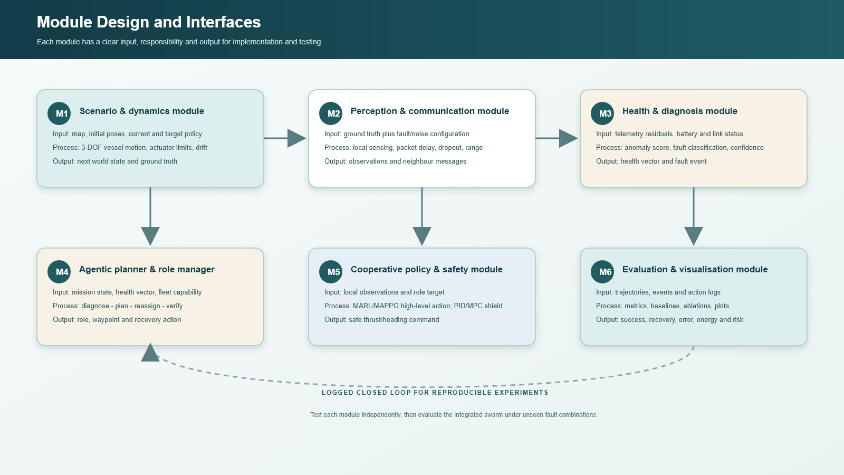
14

Slide 15
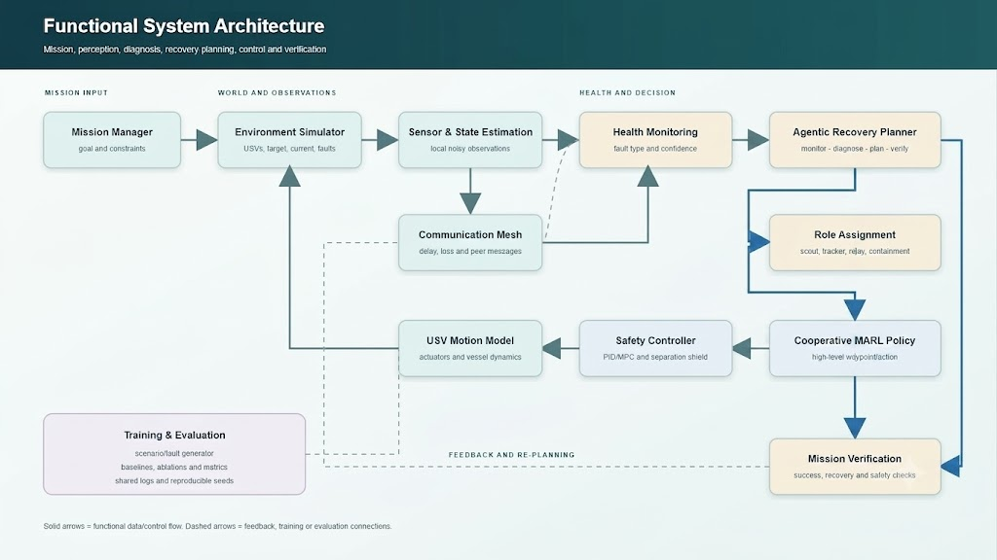
15

Slide 16
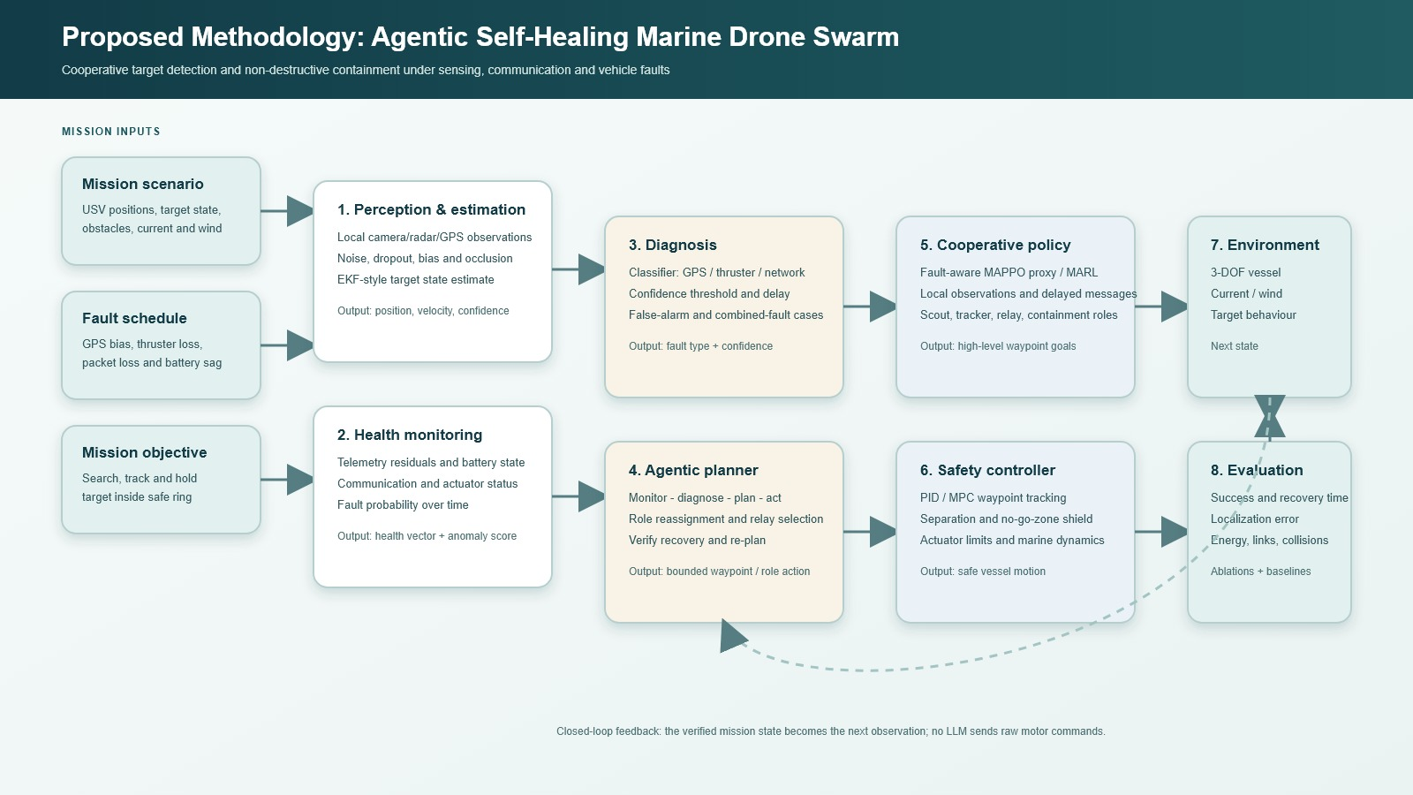
16

Slide 17
06 · NOVELTY
Novelty comes from the recovery loop — not detection alone
Proposed contribution: a marine swarm that reasons about its own health while completing a cooperative mission.
01
02
Health-Aware Observations
Fault-Specific Recovery
The policy consumes diagnosis confidence rather than a binary failure flag — richer signal, better decisions.
GPS, perception, propulsion and link failures each trigger a different, tailored recovery option.
03
04
Dynamic Role Reassignment
Post-Action Verification
Scout, tracker, interceptor and relay roles change automatically as the swarm degrades.
The system measures whether recovery worked and replans when the first action fails.
17

Slide 18




07 · APPLICATIONS
Where a self-healing marine swarm matters
Coast Guard & Port Security
Search & Rescue
Environmental Monitoring
Persistent perimeter patrol around harbours and coastal installations, resilient to jamming and node loss.
Wide-area search that keeps covering water even as individual units lose sensors or battery.
Long-duration ocean and pollution monitoring swarms that self-repair instead of aborting missions.
Offshore Infrastructure Inspection
Border & Maritime Security
Disaster Response Relay
Continuous inspection rings around rigs, wind farms and pipelines despite harsh sea conditions.
Non-destructive interception and shadowing of non-cooperative vessels near sensitive waters.
Ad-hoc communication relay swarms that reform their mesh after storm-damaged infrastructure.
18

Slide 19
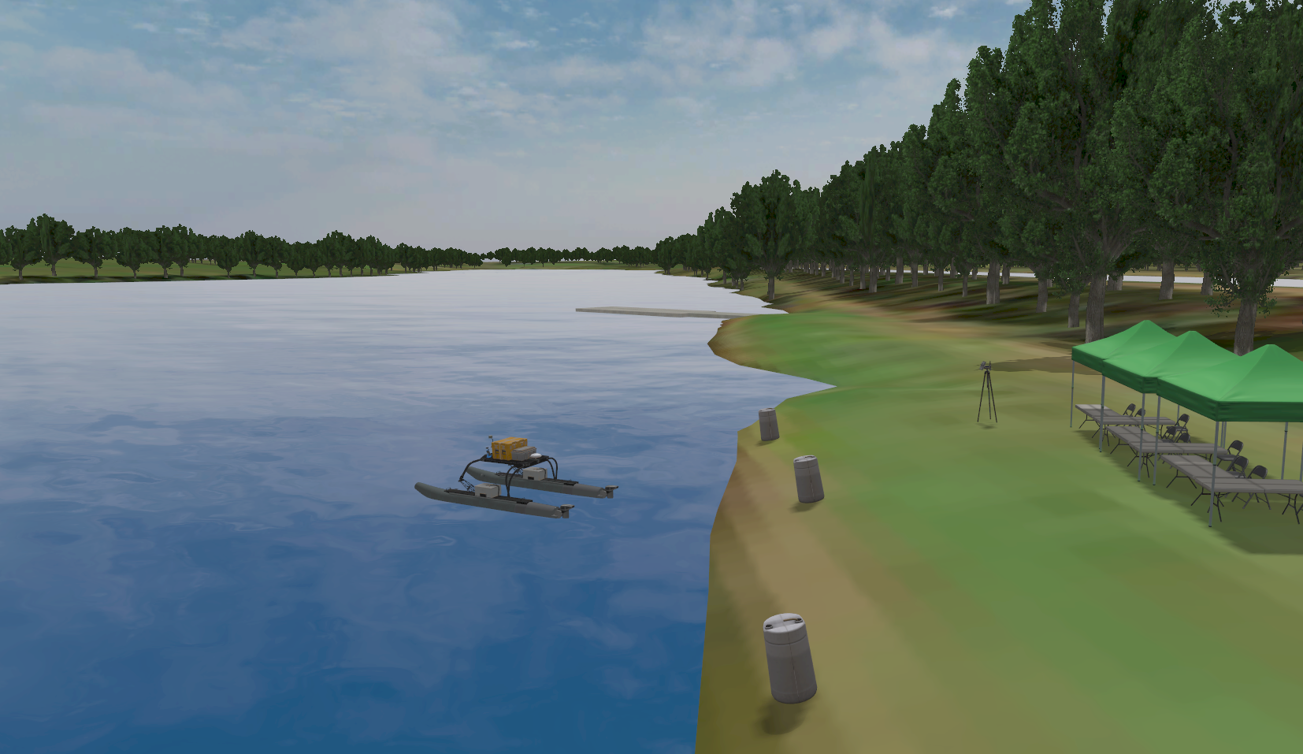
08 · PROPOSED DESIGN
A two-stage simulator keeps the project feasible and credible
MINIMUM VIABLE STUDY
Python + PettingZoo
2D vessel dynamics, moving target, noisy sensing, link graph and injected robot / sensor faults.
STRETCH VALIDATION
ROS 2 + Gazebo VRX
Repeat a small subset with WAM-V dynamics, simulated marine sensors and environmental disturbances.
SWARM
FAILURES
LINK LOSS
TARGET
4 / 6 / 8 / 10
0–30% nodes
0 / 20 / 40%
slow / fast / evasive
OSRF VRX simulation environment — WAM-V USV model
19

Slide 20
09 · FEASIBILITY & RISK
Design Feasibility and Associated Risks
Resourcing, risk mitigation, ethical safeguards and role allocation, fixed ahead of Review 2.
01
02
Feasibility
Key Risks
Simulation-only scope, open-source tools (PettingZoo, VRX, Ollama-class compute) and a 3-person team make the plan achievable in 16 weeks.
Sim-to-real gap, MARL training instability, delayed convergence and scope creep — each carries a named mitigation and a schedule buffer.
03
04
Ethics & Safety
Work Planning
Non-destructive interception only, no physical weapons, a deterministic safety layer overrides every agentic action, and all data stays simulation-only.
Roles split three ways — simulation & environment, diagnosis + policy training, and evaluation/paper — with weekly syncs and shared checkpoints.
Risk status and role allocation are reviewed weekly against the 16-week timeline.
20

Slide 21
10 · TIMELINE
Phase-wise distribution for a simulation-first plan
W1
W3
W5
W7
W9
W11
W13
W15
Environment & Fault Injection
W1–4
2D vessel dynamics, moving target, noisy sensing and injected sensor/robot/network faults.
Diagnosis Model
W5–7
Generate labeled telemetry and train the fault classifier (XGBoost / GRU).
FA-MAPPO Training
W8–11
Train the health-aware policy; tune reward shaping and role reassignment.
Integration & Ablations
W12–14
Close the diagnose-plan-act-verify loop; run ablations and baseline comparisons.
Evidence, Buffer & Paper
W15–16
Statistics, VRX demo subset, schedule buffer and final report.
SCOPE GUARDRAILS — pretrained/simulated perception · one moving target · high-level waypoints · no physical weapons · VRX only after the Python study is validated
HOW SUCCESS IS MEASURED
01
Mission success
02
Recovery time
03
Fault Macro-F1
04
Lost-target time
05
Collision rate
06
Energy + messages
21

Slide 22
11 · CONCLUSION
Approve a simulation-first capstone on agentic
self-healing marine swarms.
Reproducible Simulator
Tested AI Method
Research Paper
Fault injection, swarm mission and visual demo across Python and VRX.
Diagnosis model + FA-MAPPO + agentic verification, validated end to end.
Baselines, ablations, statistics and limitations, grounded in 15 reviewed papers.
Success means the full system outperforms fault-blind MAPPO under unseen failures — safely and measurably.
22

Slide 23
REFERENCES
Key sources
[1] B. Wang, C. Mao, K. Wei, X. Wu, and Y. Li, “A collaborative surface target detection and localization method for an unmanned surface vehicle swarm,” Engineering Applications of Artificial Intelligence, vol. 139, Art. no. 109679, 2025, doi: 10.1016/j.engappai.2024.109679. (EurekaMag)
[2] S. R. S. Shrudhi, S. Mohanty, and S. Elias, “Control and coordination of a SWARM of unmanned surface vehicles using deep reinforcement learning in ROS,” arXiv preprint arXiv:2304.08189, 2023. (ResearchGate)
[3] N. Hamid, W. Dharmawan, M. S. AbouOmar, H. Kurniawan, H. Saleh, and S. El Ferik, “Swarm unmanned surface vehicle encirclement task with multi-agent reinforcement learning,” Transportation Research Procedia, vol. 96, pp. 468–475, 2026, doi: 10.1016/j.trpro.2026.04.017. (KFUPM)
[4] B. Xiang, Z. Chen, X. Zhao, J. Tang, S. Rong, et al., “Multi-USV interception decision-making method based on deep reinforcement learning,” Journal of King Saud University Computer and Information Sciences, 2026, doi: 10.1007/s44443-026-00954-6. (DOI)
[5] S. Hegde, V. S. R. Kantheti, L. C. Chu, E. Blasch, et al., “Autonomous self-healing UAV swarms for robust 6G non-terrestrial networks,” arXiv preprint arXiv:2601.13418, 2026. (ResearchGate)
[6] W.-L. Luo, Y.-Y. Xu, X. Cheng, F.-Z. Wang, et al., “From self-healing to smart-healing: A self-diagnosing and self-healing system based on artificial intelligence,” Advanced Materials, vol. 38, no. 4, Art. no. e13641, 2026, doi: 10.1002/adma.202513641. (Wiley Online Library)
[7] Y. Emami, R. Taheri, M. Homaei, M. A. Ur Rehman, and M. Shojafar, “LLM-centric agentic AI for UAV swarms: Architecture, enabling technologies, and open problems,” arXiv preprint arXiv:2607.09756, 2026. (SciRate)
[8] Open Source Robotics Foundation, “Virtual RobotX (VRX) simulation environment,” GitHub repository and documentation, 2026. [Online]. Available: . (Docker Hub)
[9] S. Gu, M. Geng, and L. Lan, “Attention-based fault-tolerant approach for multi-agent reinforcement learning systems,” Entropy, vol. 23, no. 9, Art. no. 1133, 2021, doi: 10.3390/e23091133. (PubMed)
[10] M. Ramezani, M. A. Amiri Atashgah, and A. Rezaee, “A fault-tolerant multi-agent reinforcement learning framework for unmanned aerial vehicles–unmanned ground vehicle coverage path planning,” Drones, vol. 8, no. 10, Art. no. 537, 2024, doi: 10.3390/drones8100537. (MDPI)
[11] C. C. Ekechi, T. Elfouly, A. Alouani, and T. Khattab, “A survey on UAV control with multi-agent reinforcement learning,” Drones, vol. 9, no. 7, Art. no. 484, 2025, doi: 10.3390/drones9070484. (MDPI)
[12] Y. Shi, H. Pei, L. Feng, Y. Zhang, and D. Yao, “Towards fault tolerance in multi-agent reinforcement learning,” arXiv preprint arXiv:2412.00534, 2024. (arXiv)
[13] H. Kim, K. Lee, J. Park, J. Li, and J. Park, “Human implicit preference-based policy fine-tuning for multi-agent reinforcement learning in USV swarm,” in Proc. IEEE/RSJ Int. Conf. Intell. Robots Syst. (IROS), 2025, pp. 18653–18659, doi: 10.1109/IROS60139.2025.11246039. (KAIST)
[14] E. K. Raptis, A. C. Kapoutsis, and E. B. Kosmatopoulos, “Agentic LLM-based robotic systems for real-world applications: A review on their agenticness and ethics,” Frontiers in Robotics and AI, vol. 12, Art. no. 1605405, 2025, doi: 10.3389/frobt.2025.1605405. (Frontiers)
[15] H. K. Alkahtani, G. Ybytayeva, A. Bekarystankyzy, et al., “Explainable multi agent reinforcement learning framework for secure and adaptive communication in UAV swarm based FANETs,” Scientific Reports, vol. 16, Art. no. 11830, 2026, doi: 10.1038/s41598-026-39366-x. (Nature)
23

Slide 24
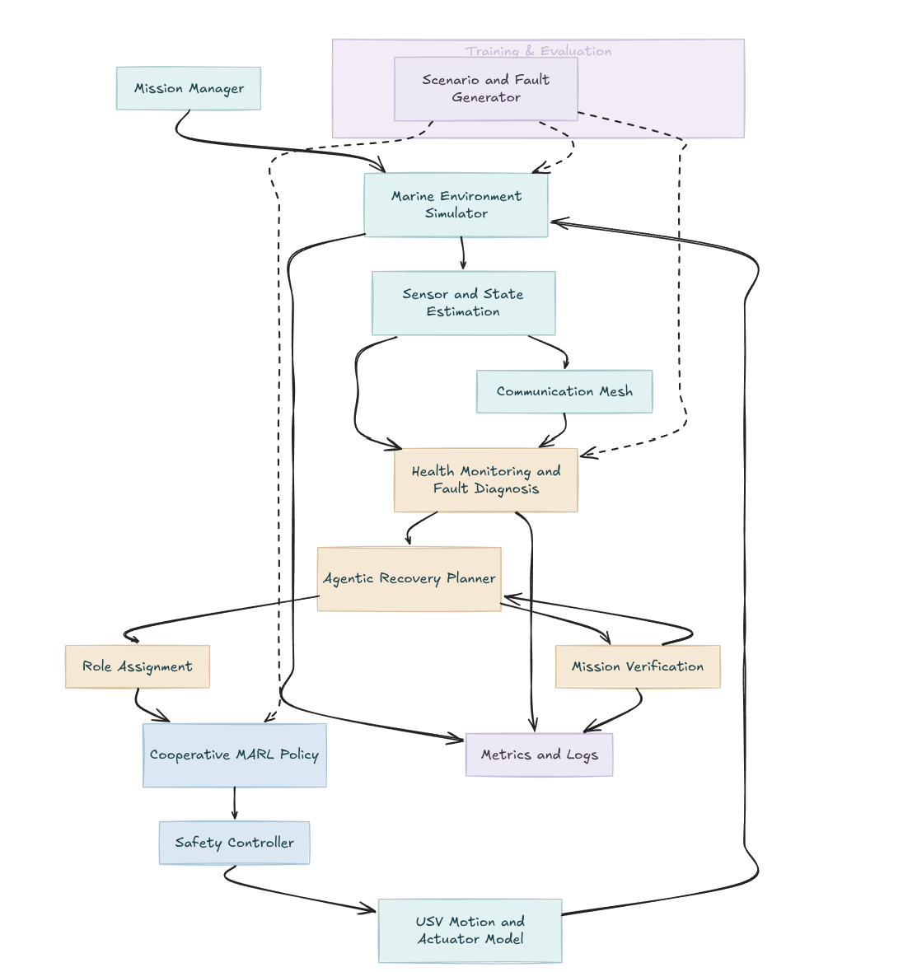
Appendix
Flow Diagram
24

Slide 25
Appendix
Data Sources
5. Agentic / Self-Healing AI
Agentic AI for UAV swarms: https://arxiv.org/abs/2607.09756
Agentic LLM-based robotic systems: https://doi.org/10.3389/frobt.2025.1605405
AI diagnose–heal–verify: https://doi.org/10.1002/adma.202513641
6. Marine Perception Datasets
USVTrack: https://github.com/usvtrack/usvtrack
USVTrack MOT: https://github.com/SnowPye/USVTrack
WaterScenes: https://github.com/WaterScenes/WaterScenes
MODD: https://vision.fe.uni-lj.si/RESEARCH/modd/
SeaDronesSee: https://github.com/Ben93kie/SeaDronesSee
7. Marine Environment / Trajectory Data
NOAA AIS: https://marinecadastre.gov/ais/
NOAA Buoy Data: https://www.ndbc.noaa.gov/
Copernicus Marine: https://data.marine.copernicus.eu/
GEBCO: https://www.gebco.net/
EMODnet Bathymetry: https://emodnet.ec.europa.eu/en/bathymetry
8. Simulation
VRX: https://github.com/osrf/vrx
VRX Wiki: https://github.com/osrf/vrx/wiki
Gazebo: https://gazebosim.org/
1. MADDPG
Lowe et al. — Multi-Agent Actor-Critic for Mixed Cooperative-Competitive Environments
https://arxiv.org/abs/1706.02275
OpenAI MADDPG: https://github.com/openai/maddpg
2. MAPPO
Yu et al. — The Surprising Effectiveness of PPO in Cooperative Multi-Agent Games
https://arxiv.org/abs/2103.01955
MAPPO: https://github.com/marlbenchmark/on-policy
3. USV / Marine MARL
USV swarm control using DRL: https://arxiv.org/abs/2304.08189
USV swarm encirclement with MARL: https://doi.org/10.1016/j.trpro.2026.04.017
Multi-USV interception with DRL: https://doi.org/10.1007/s44443-026-00954-6
Human preference-based MARL for USV swarm: https://arxiv.org/abs/2503.03796
4. Fault-Tolerant MARL
Towards Fault Tolerance in MARL: https://arxiv.org/abs/2412.00534
Attention-based fault-tolerant MARL: https://doi.org/10.3390/e23091133
Fault-tolerant UAV–UGV MARL: https://doi.org/10.3390/drones8100537
Self-healing UAV networks: https://arxiv.org/abs/2601.13418
Explainable MARL for UAV swarm: https://doi.org/10.1038/s41598-026-39366-x
25

Slide 26
Appendix
Abbreviations
AI: Artificial Intelligence
AIS: Automatic Identification System
AR: Agentic Recovery
CTDE: Centralized Training with Decentralized Execution
DRL: Deep Reinforcement Learning
FANET: Flying Ad Hoc Network
FA-MAPPO: Fault-Aware Multi-Agent Proximal Policy Optimization
GPS: Global Positioning System
IMU: Inertial Measurement Unit
LLM: Large Language Model
MADDPG: Multi-Agent Deep Deterministic Policy Gradient
MAPPO: Multi-Agent Proximal Policy Optimization
MARL: Multi-Agent Reinforcement Learning
MPC: Model Predictive Control
RL: Reinforcement Learning
ROS: Robot Operating System
SFG: Scenario and Fault Generator
USV: Unmanned Surface Vehicle
VRX: Virtual RobotX
UAV: Unmanned Aerial Vehicle
UGV: Unmanned Ground Vehicle
26

Slide 27
Appendix
Glossary
Fault Diagnosis: Identification and classification of active hardware, sensor, or network anomalies in individual agents.
Fault Injection: Deliberate introduction of synthetic sensor, actuator, and link faults into simulation to benchmark robustness.
Node Degradation: Partial or complete loss of sensing, processing, or propulsion capability in an individual USV.
Link Degradation: Reduced communication throughput, high packet loss, or link partitioning across the swarm mesh.
Fault Tolerance: The ability of the swarm to maintain nominal operations despite sub-system or component failures.
Self-Healing: Autonomous closed loop that detects degradation, executes corrective policies, and restores swarm functionality.
Agentic Recovery: High-level reasoning process to diagnose faults, replan swarm topology, and restore mission performance.
Role Reallocation: Dynamic reassignment of operational roles (Scout, Tracker, Interceptor, Relay) when an agent degrades.
Mission Verification: Closed-loop evaluation measuring whether mission objectives and geometric bounds have been recovered.
Mission Robustness: The capacity of the entire fleet to sustain target tracking and containment under continuous operational disturbances.
Cooperative Tracking: Multi-USV pursuit utilizing a fused, shared spatial belief map of a target vessel.
Encirclement: Coordinated angular positioning of USVs to form a non-destructive containment ring around a target.
Decentralized Execution: Operational mode where each USV selects actions independently based on local observations and 1-hop neighbor data.
State Estimation: Kinematic filtering (e.g., via EKF) to infer accurate vehicle and target states from noisy sensor streams.
Recovery Planner: Module that arbitrates fallback formations and topology restructuring following an isolated fault.
Safety Controller: Deterministic layer (e.g., Control Barrier Functions) that enforces minimum vessel separation and collision avoidance.
27

Slide 28
Thank You
Questions & discussion welcome
Suchet Kumbar
Siddharth Seth
Pritish Bhatasana
23BRS1073
23BRS1038
23BRS1035
28

