Slide 1
Git & GitHub

Slide 2
What is Version control System ?
Version control systems are a category of software tools that helps record changes to files by keeping a track of modifications done to the code
A repository: It can be thought as a database of changes. It contains all the edits and historical versions (snapshots) of the project
Copy of Work (sometimes called as checkout): It is the personal copy of all the files in a project. You can edit to this copy without affecting the work of others and you can finally commit your changes to a repository when you are done making your changes

Slide 3
Types of Version Control System
Centralized Version Control System (CVCS)
Distributed Version Control System (DVCS)

Slide 4
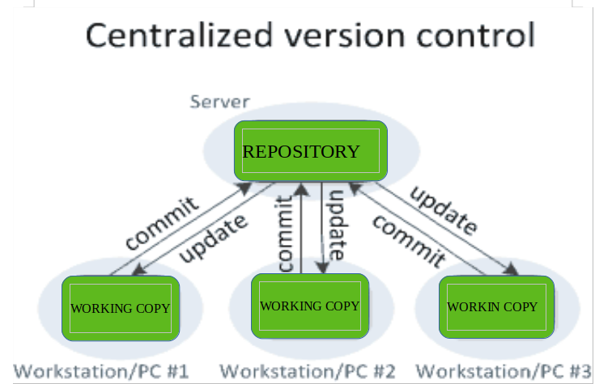
Centralized Version Control System (CVCS)
Centralized version control system contain just one repository

Slide 5
Disadvantages of CVCS (Centralized Version Control System)
Single point of failure
Remote commits are slow
CVCS

Slide 6
Distributed Version Control System (DVCS)
Distributed version control system contain multiple repositories
Each user have their own repository and working copy
Example: GIT

Slide 7
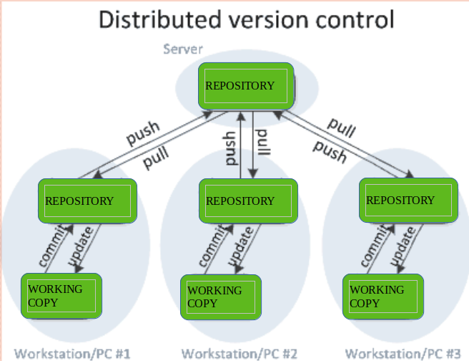
Distributed Version Control System (DVCS)

Slide 8
Advantages of DVCS over CVCS
Because of local commits, full history is always available
No need to access a remote server (work without Internet)
Ability to push your changes continuously (faster)

Slide 9

What is Git ?
Git is a free and open source distributed version control system
Started in 2005
Created by Linus Torvald to support Linux Kernel development

Slide 10
Important GIT Terminologies
Snapshot
Commit
Repository
Branch
Head
Merge

Slide 11
Snapshot
The way Git keeps track of your code changes and history
Essentially records how all your files look like at a given point of time
Have the ability to go back to visit any snapshot

Slide 12
Commit
The act of creating a snapshot on Git DB
Commit have 3 pieces of information:
Information about what changes were made with respect to previous version
A reference to the commit that come before it
A SHA 1 Hash code ID of commit

Slide 13
Repositories (Repo)
A collection of all the files and the history of those files
We can keep on a local machines (PC or local server) or on a remote server (like GitHub)
The act of copying a repository from a remote server is called cloning
The process of downloading commit that doesn’t exist on your machine from a remote repository is called ( pull ) pulling changes
The process of adding your local changes to the remote repository is called pushing

Slide 14
Branches
All commit in Git live on some branch
But there can be many branches
The main branch in project called the master branch

Slide 15
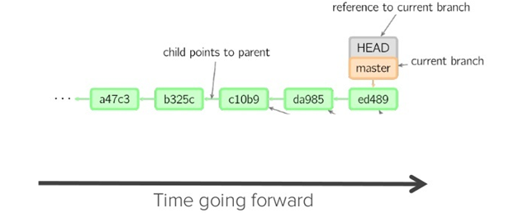
Head
A reference to most recent commit

Slide 16
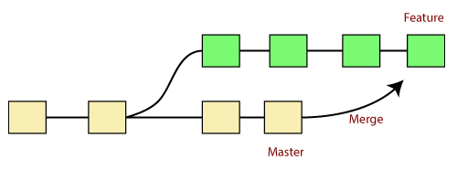
Merging
Once you done with your feature you merge it back into master

Slide 17
Setup a repository
There are 3 main methods to create git repository
Method 1: Create a repository from absolutely blank state
Method 2: Convert an existing unversioned project to repository
Method 3: Copy an existing Git Repository from GitHub to local system

Slide 18
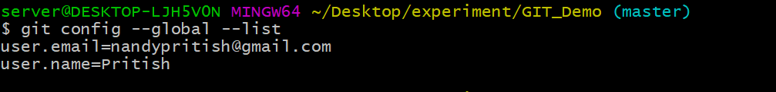
Before creating repository, its highly recommended to configure the author name and email
Its not essential, but its important enough
Command to check global config :
$ git config --global –list

Slide 19
Command to configure global config list
$ git config --global user.name <user_name>
$ git config --global user.email <user_email>

Slide 20
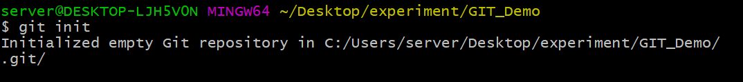
How to create Repository ?
Use command: $ git init
It will create an empty git repository or reinitialize an existing one

Slide 21
Three Stages of Artifacts
After creating git repository, artifact goes through following stages in git repository:
Modified : Here we make modification or create artifacts in repository
Staged : Here we add the changes to staging area
Committed : Here we can commit the changes to Git database

Slide 22
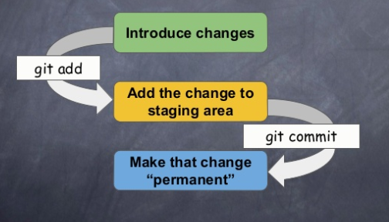
Stages of Artifacts

Slide 23
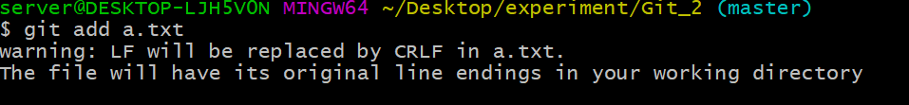
Command to add the artifact to staging of repo
$ git add <file name>

Slide 24
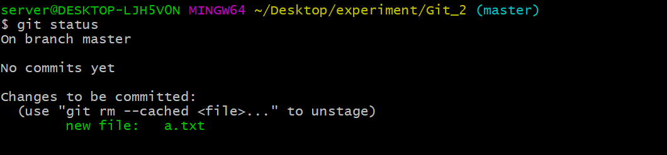
$ git status
The git status command can be used to obtain a summary of which files have changed that were staged for the next commit

Slide 25
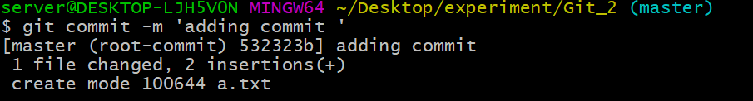
To add the artifacts to git db we need to commit to artifacts
$ git commit -m <commit massage >
It also create SHA Hash code which represent snapshot of current point of repository.

Slide 26
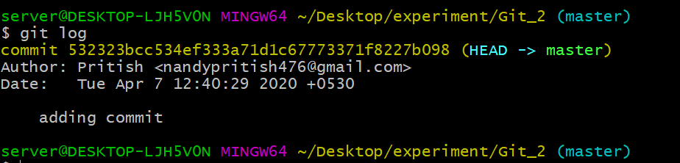
Git log command provides list of hash IDs. With the help of hash ID, one can find out details like when was the file last modified, by whom & what changes were made
Command: $ git log

Slide 27

Branch
To create branch of repository that inherited all snapshots from master branch
$ git branch <new branch name>

Slide 28
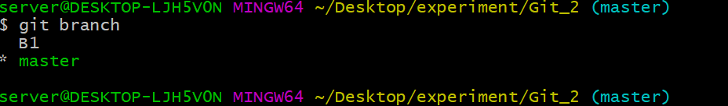
Branch
To list out branch list : $ git branch

Slide 29
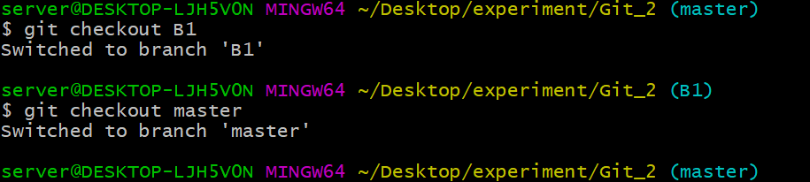
Branch
To switch to another branch:
$ git checkout <new_branch1 >

Slide 30
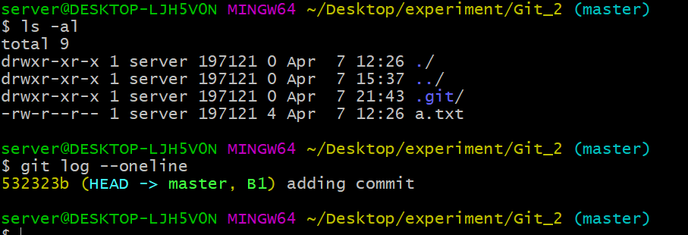
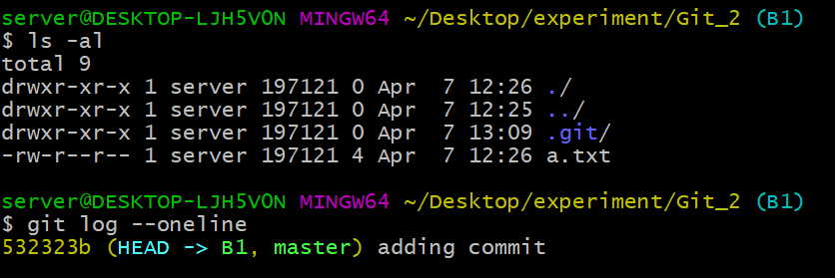
Branch
After creating child branch, its inherited master class attributes are as:

Slide 31
How to rollback the change of last snapshot of repo and particular file ?
Command to revert back to a particular file
$ git checkout <Hash ID> <file name >
Command to revert back to particular
repo temporarily
$ git checkout <Hash ID>
Note: You have to create a new
branch to retain commits you created.

Slide 32

What is GitHub ?

Slide 33
GitHub
Largest web-based git repository hosting service. Also known as remote repository
Allows for online code collaboration
Adds extra functionality on top of git like UI, Doc, bug tracking, feature request and more
Founded in 2008
Also has an enterprise edition for business

Slide 34
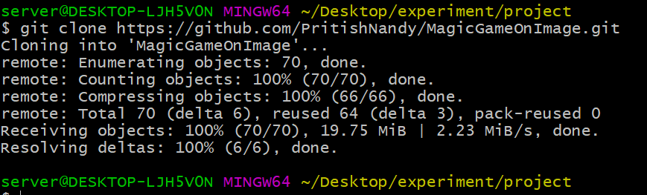
How to Clone GitHub repo
$ git clone <github repo link>

Slide 35
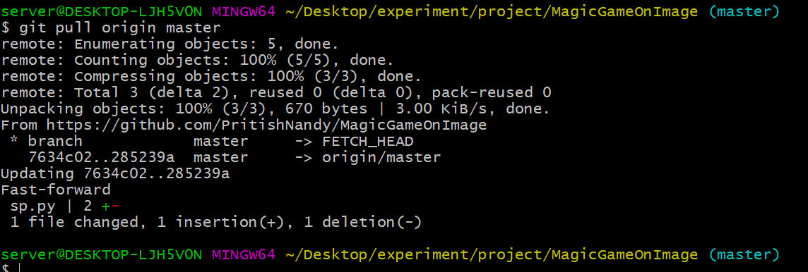
How to pull update from remote repo
$ git pull origin master

Slide 36
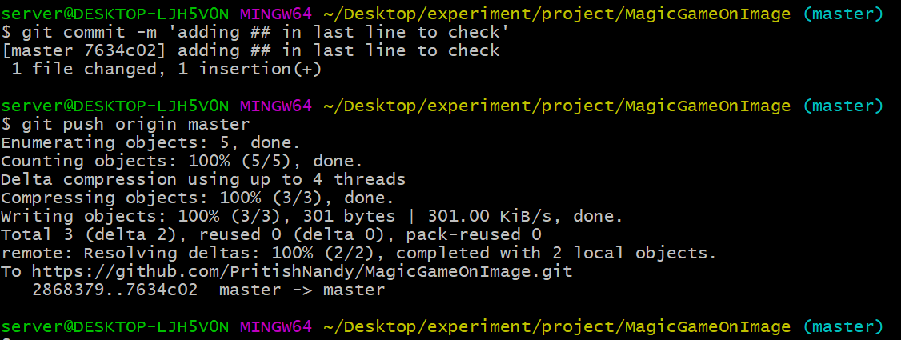
How to push update to remote repo
$ git push origin master

Slide 37
Thank You

