Slide 1
HATEater
Name: Pritish Chugh
College: Indian institute of technology, mandi

Slide 2
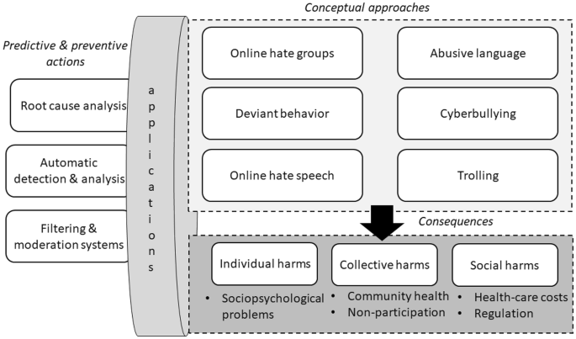
How the process will go:
Using diagrams:

Slide 3
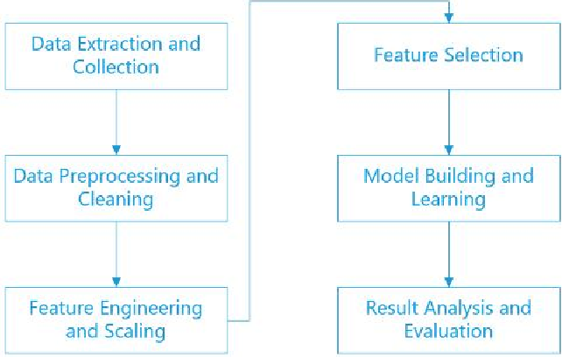
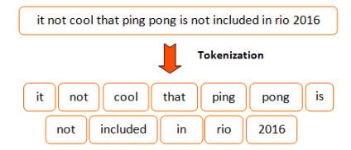

Slide 4
Need of the Project
Now a days people spread so much hatred on social media and fake news. These need to be monitored and taken care of. Using my model, it will become very easy to detect news/posts that spread hatred. This can be done because while spreading these news we generally use some specific words that can be made to learn by the machine and finally can find it.

Slide 5
About the Project
My idea is to implement
1. NLP using tokenizer
2. pre-processing
3. Train different models
4. Optimize solution using Back-tracking approach.

