Slide 1

Design Practicum (IC201P)
PlasBot
Tackling the Plastic Problems in Oceania
Group 19
Tanmay.M (B19252)
Sourav Sehgal (B19059)
Nikhil(B19217)
Ayuj Panchal (B19099)
Pritish Chugh (B19187)
Piyush (B19179)
Under the supervision of
Dr. Hitesh Shrimali
Dr. Prateek Saxena

Slide 2

Contents
Introduction
Market Research.
Conceptual Design
Embodiment and Detail Design.
Fabrication and Assembly.
.

Slide 3

Introduction
Motivation:
Water is one of the most essential resources that almost every species on earth needs and every drop of it is valuable.
On the other hand, Water Pollution is increasing day by day everywhere.
It has become very difficult for marine life to survive. Also, fresh water available for consumption is decreasing rapidly due to pollution.
Studies suggest that approximately 165 million tons of plastic wastes were estimated to be present in the oceans of the world.
Wastes found in the oceans are made up of approximately 80% plastics. Hence it is needed to separate/filter water from the garbage/plastics present in it.

Slide 4
Introduction
Scope:
Water pollution is increasing day by day. Along with it plastic entering the water bodies is deprecating the situation.
Plastic not only pollutes the water but also kills the marine life present in it.
‘PlasBot’ is a way to separate the plastic garbage from the water bodies which can collect plastic garbage from both under and over water.
We also designed it in a way so that it is efficient, minimum wastage and minimum use of manpower.
The beneficiaries will be both governmental as well as non-governmental organizations who are working towards cleaning of oceans, rivers, etc.

Slide 5
Introduction
Problem Statement:
To cleanse the water bodies of plastic waste both of floating and underwater nature thus leading to various benefits such as cleaner environment for the aquatic flora and fauna.

Slide 6
Objectives
To tackle the plastic garbage in the water bodies.
Provide the healthy/clean environment to marine life.
Affordable.

Slide 7
Market Research
Existing products, their technologies, problems in the current products.
Ro-boat
AI driven waste detection and collection.
Light weight and easily transportable.
Endurance of 2 hours in one charge
Can operate close to shore in shallow waters.
Capable of extracting 5 kgs of waste per hour.

Slide 8
Market Research
Existing products, their technologies, problems in the current products.
Hong Kong startup’s Clearbot
This robot uses a computer vision system to spot the trash.
It collects pieces of litter floating on water bodies.
The trash goes through the open bow of the robot and is collected in a mesh bin with the help of a conveyor belt system.
The robot could be operated for 48 hours once it is fully charged capable to carry a 10 kg of waste.

Slide 9
Market Research
Existing products, their technologies, problems in the current products.
Kerala’s sewage-cleaning robot- Bandicoot
The Bandicoot has four limbs and a bucket system attached to a spider-web extension.
Has Wi-Fi and Bluetooth modules.
The robot is powered by pneumatics
The robot monitors the manholes through pictorial representations, inspects conditions, including gaseous information and blocks and then does the clean-up.
Other similar products are Seaswarm and ORCA

Slide 10
Market Research
How our product is different from other products?
Semi-automatic bot
Simpler Mechanism
Small size
Affordable
Effective Collection of Plastic.
Good Battery Life.
Market Price: ~ Rs. 18000/-

Slide 11
Market Research
How our product is different from other products?
Existing Products | PlasBot
Mainly remote controlled or are preprogrammed to follow a particular path. | Semi-automatic, works autonomously for over water while for under water operations, manual instructions are required.
Quite expensive. Not affordable by everyone | Affordable by anyone.
Big Size | Relatively smaller Size
Difficult to collect garbage at the banks. | Effective in eliminating plastic wastes from banks.
Cannot be used at small scale | Can be used at both small and large scale.

Slide 12
Conceptual & Detailed Design/ Methodology
Steps we took to reach the proposed solution:
Proposed to design a project during Design Practicum course that will make significant impact in reducing the pollution and damage being caused to the environment
Each member proposed 100 problems each which were narrowed down to a single problem after many interactive sessions on the bases of social impact, feasibility, accessibility, economic feasibility, time required to build it, reach to users, and SWOT analysis .
We had many iterative sessions in order to resolve the difficulties and problems that could arise on real life implementation of PlasBot.
Decided on functional requirements of PlasBot and issues related to designing of PlasBot keeping in mind the efficiency, accuracy and precision.

Slide 13
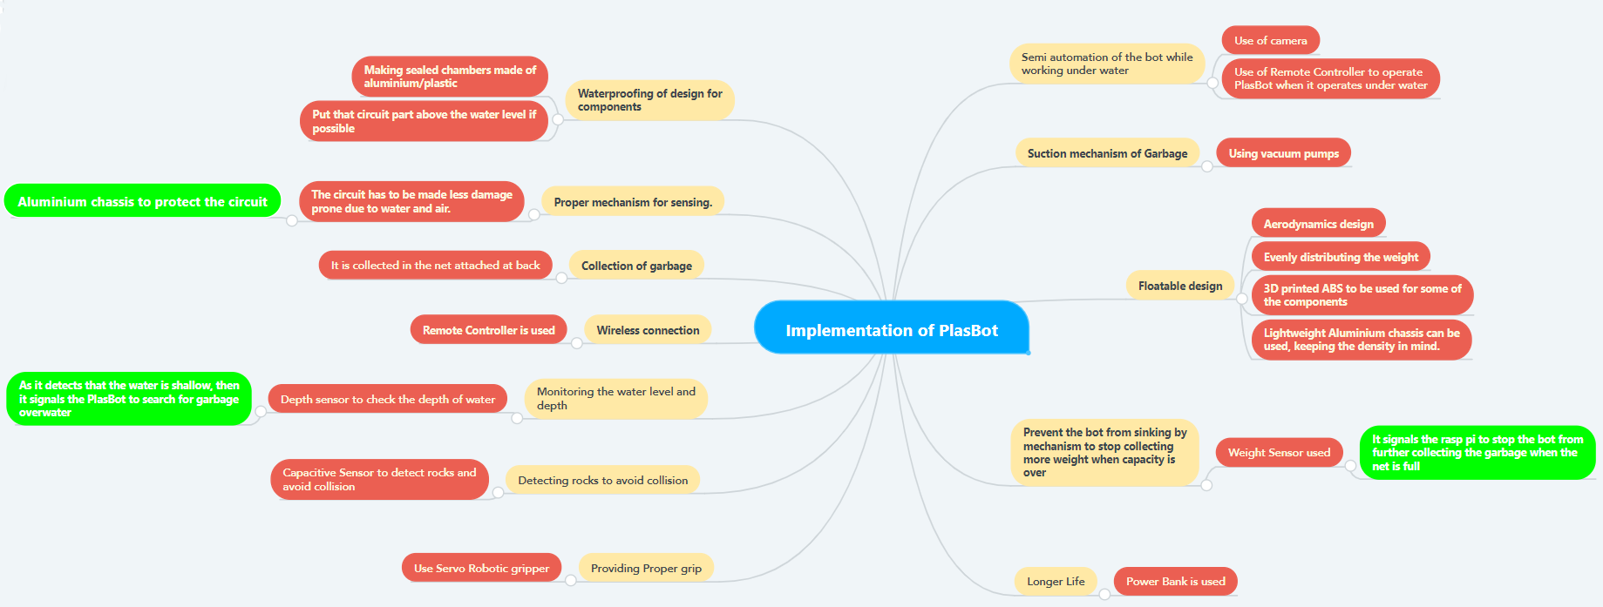
Conceptual & Detailed Design/ Methodology
Mind Map for implementation of PlasBot

Slide 14
Conceptual & Detailed Design/ Methodology
Product architecture
Semi-autonomous feature of the PlasBot is selected in order to increase its working efficiency given the power, vision constraints.
The floating garbage on the water body is collected autonomously.
Manual control for underwater operations.

Slide 15
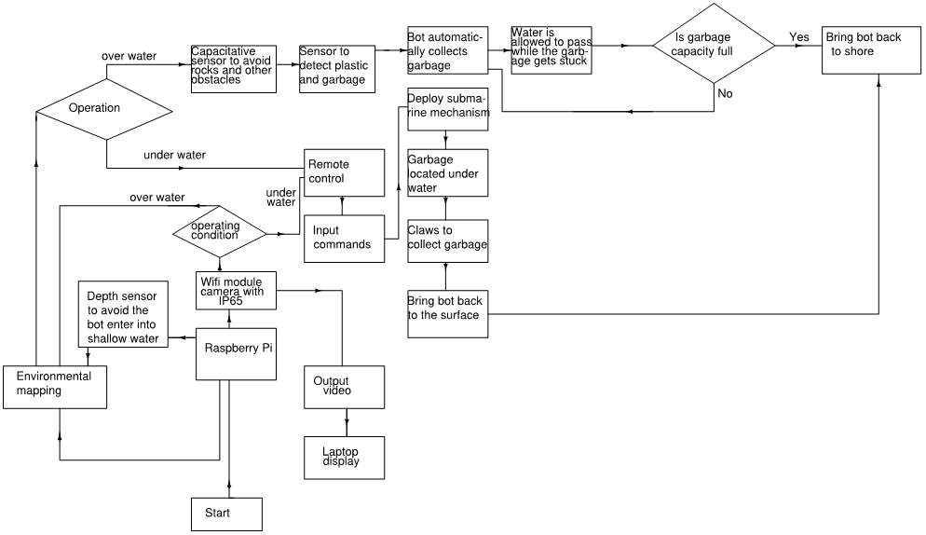
Conceptual & Detailed Design/ Methodology
Product architecture
PlasBot Architecture

Slide 16
Conceptual & Detailed Design/ Methodology
System-level design
For over water :-
First the Raspberry pie signals the depth sensor to check the depth of water and if it detects that the water is deep enough for operable conditions then it signals the PlasBot to search for garbage overwater.
The capacitive sensor and ultrasonic sensors work on detecting obstacles and metallic objects that must be avoided.
Now as the bot find garbage the vacuum pump starts and sucks the water with garbage which is then collected in the net attached at the back.
And at the end when garbage capacity limit has reached its maximum, the weight sensor signals the Raspberry Pi to stop the bot from further collecting the garbage.

Slide 17
Conceptual & Detailed Design/ Methodology
System-level design
For under water:-
First the raspberry pie signals the depth sensor to check the depth of water and if it detects that the water is deep then it signals the PlasBot accordingly.
At this time, the video camera turns on and starts displaying real time video on the LCD screen.
As the bot is manually controlled under water, the remote controller is used to control the bot.
And at the end when garbage capacity limit has reached its maximum, the weight sensor signals the Raspberry Pi to stop the bot from further collecting the garbage.

Slide 18
Conceptual & Detailed Design/ Methodology
System-level design
Functionalities of each component:
Raspberry pie- To control all other components.
Wi-Fi module-To control the bot wirelessly, transmit real time video output.
Depth sensor-To measure the depth of the water.
Video camera-To show real time videos of the objects underwater.
Capacitive, Ultrasonic sensors - To detect obstacles that have to be avoided.
Net : To collect the garbage and allow water to pass.
Vacuum pump- To suck in the garbage.
Remote control- To wirelessly operate the bot.
LCD display- To view the video which camera sends during underwater operation.
Batteries-To power the bot.
Motored propellors - To move the bot over and underwater.
Weight sensor- To measure the weight of the garbage collected in the net.

Slide 19
Conceptual & Detailed Design/ Methodology
Detailed Design
Electrical and Electronical aspect :-
During operation of PlasBot we need to detect the plastic wastage and obstacles in the path for the smooth working of the bot.
Capacitive, ultrasonic sensors are used that detect the objects in the view field of the Bot.
Raspberry Pi is used along with different elements like capacitors, resistors etc., to take control of various processing tasks like telling when to stop around obstacles, when to stop collecting garbage incase the garbage bag is full and many of such things.
The whole circuit does all the task of controlling work which in turn makes the Bot do what it is intended to do.

Slide 20
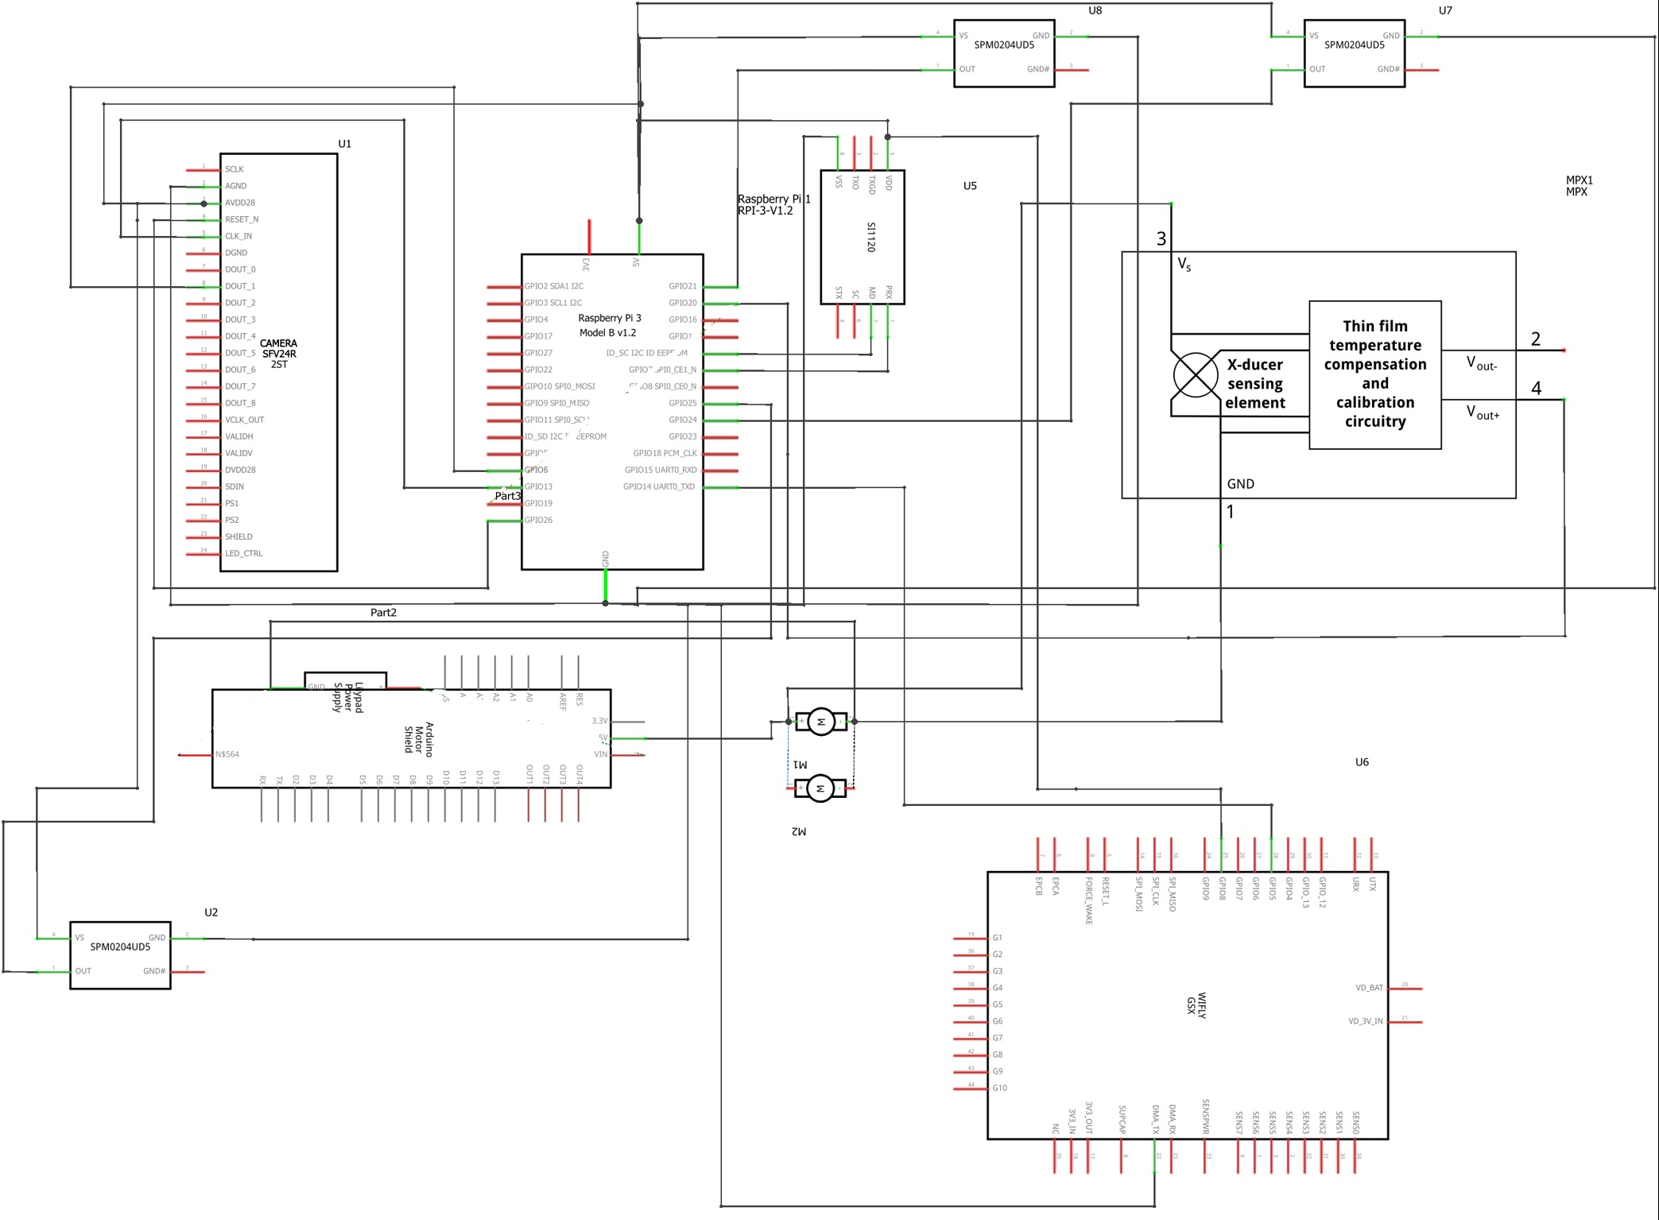
Schematic design of PlasBot

Slide 21
Conceptual & Detailed Design/ Methodology
Detailed Design
Mechanical aspect :-
Designed in such a way to reduce the drag due to water flow and thus resulting in efficient use of power required.
Designed model such that the mechanical aspects help decrease the computational load.

Slide 22
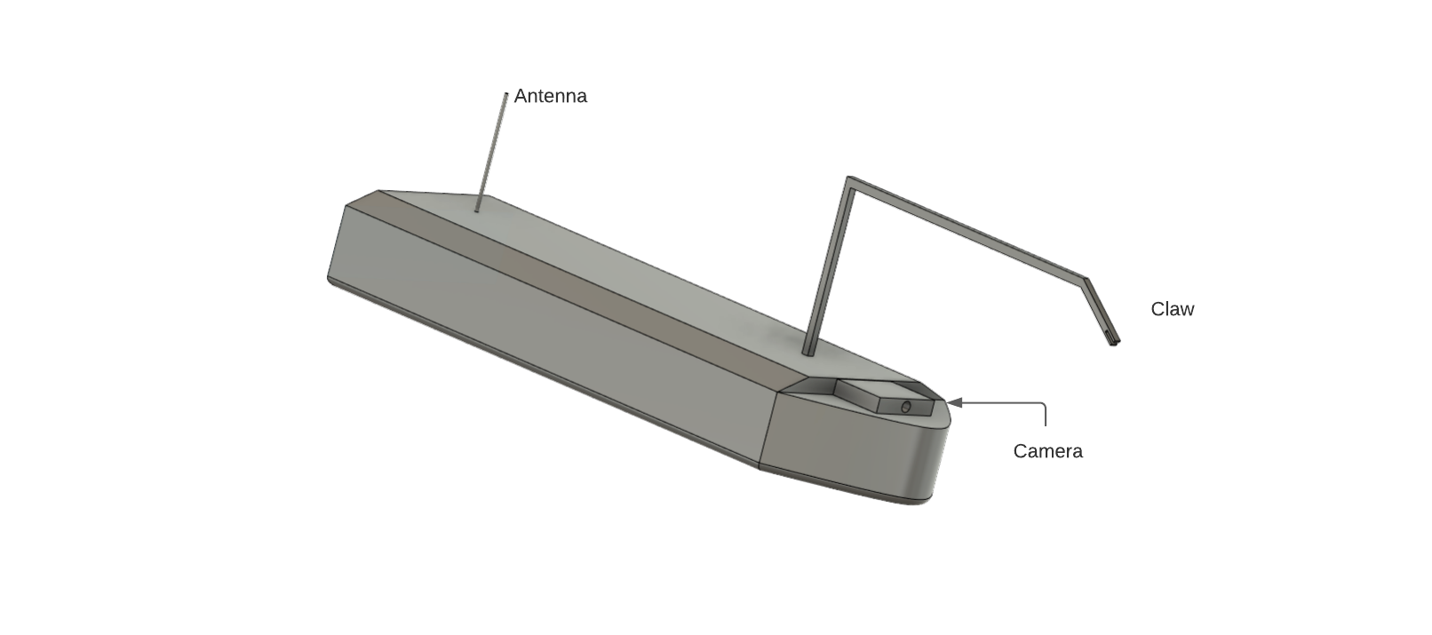
Isometric View

Slide 23
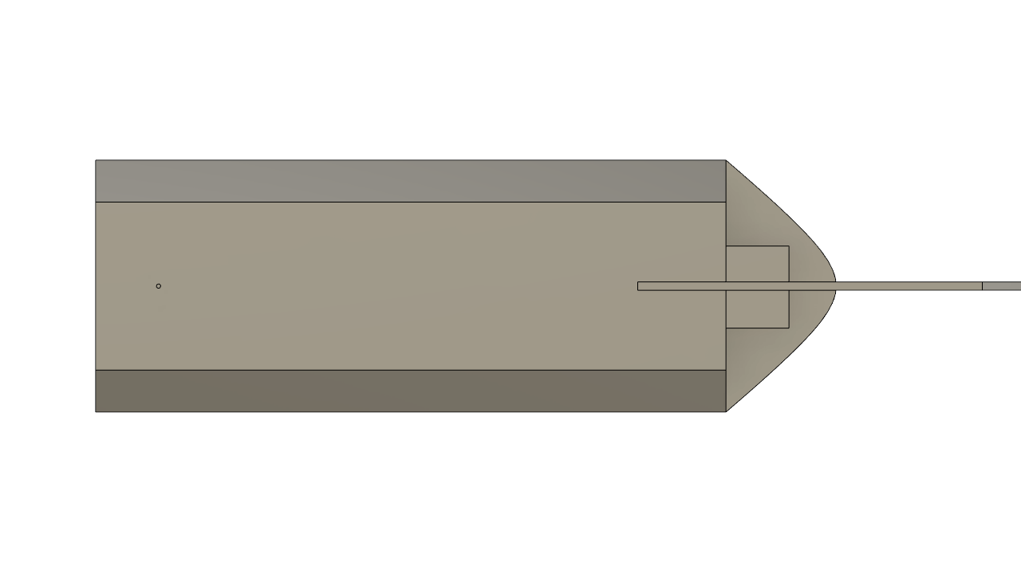
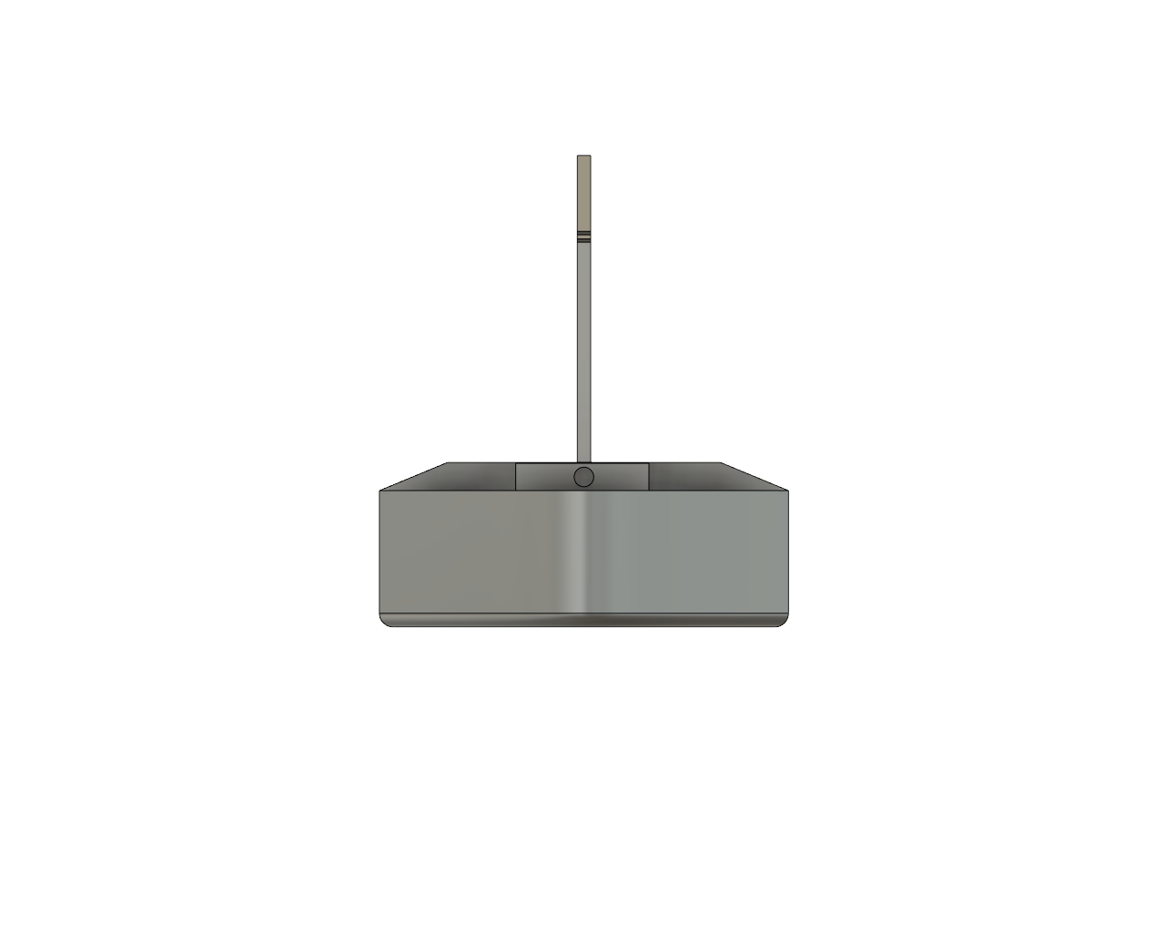
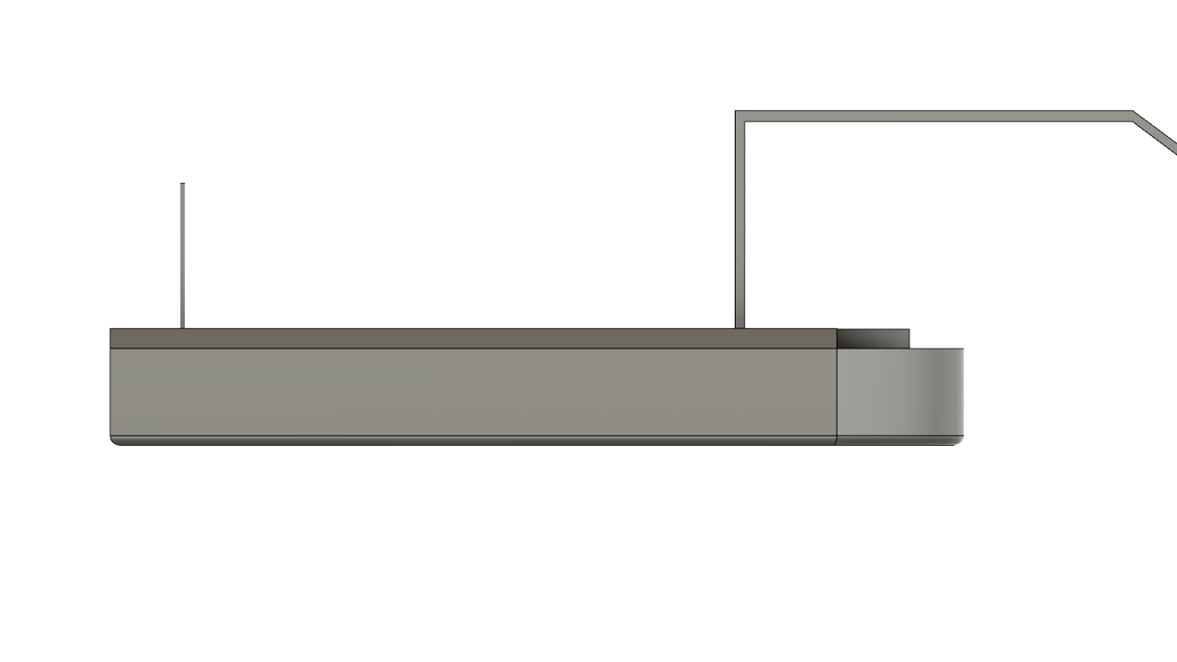
(Anticlockwise from top) Top View , Left View and Front View of PlasBot

Slide 24
Conceptual & Detailed Design/ Methodology
Detailed Design
Software Part :-
Detect if there is any obstacle present in its field of view.
If any object detect that is as big as the FOV of Bot hence it will be programmed to go around it.
To avoid blocking issues if a particular object cannot be picked over, the bot will send the user a signal to switch over to manual mode to pick it up and if the request is time out, its just ignore the same.
Programmed to indicate, when the garbage carrier is full and needs to be cleaned and when the battery life of the bot is about to run out.

Slide 25
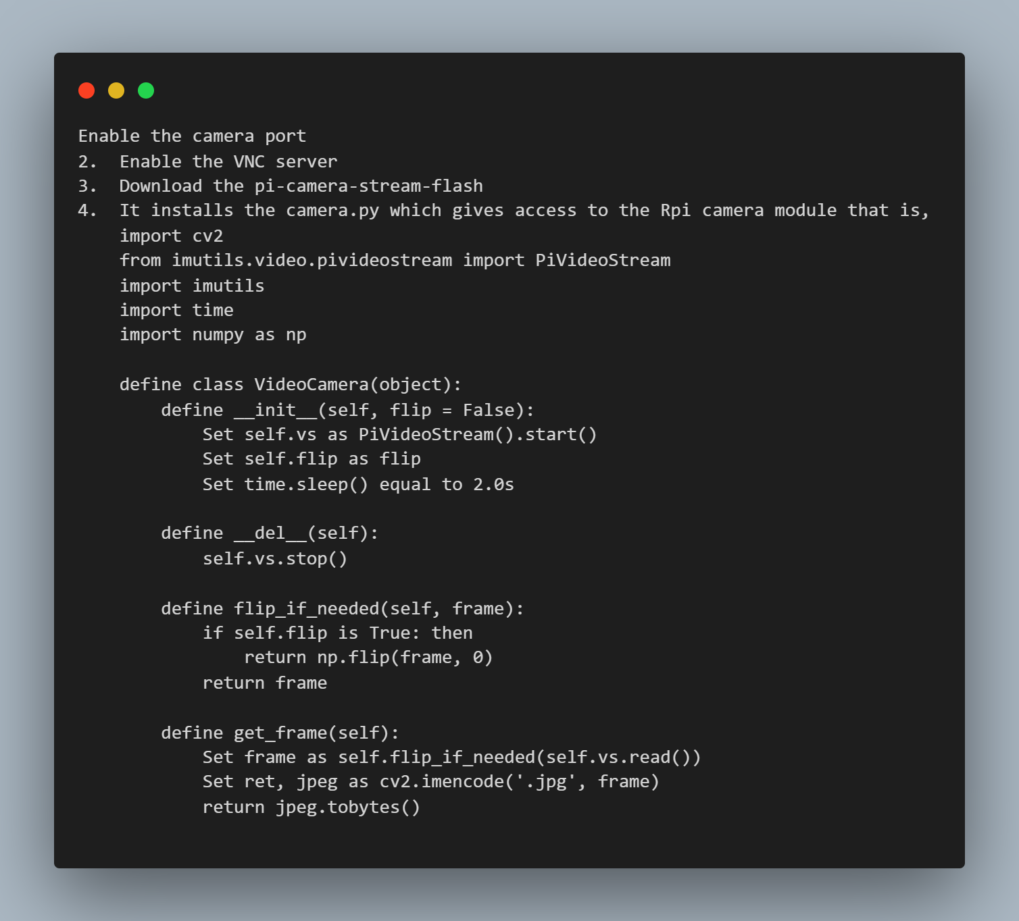
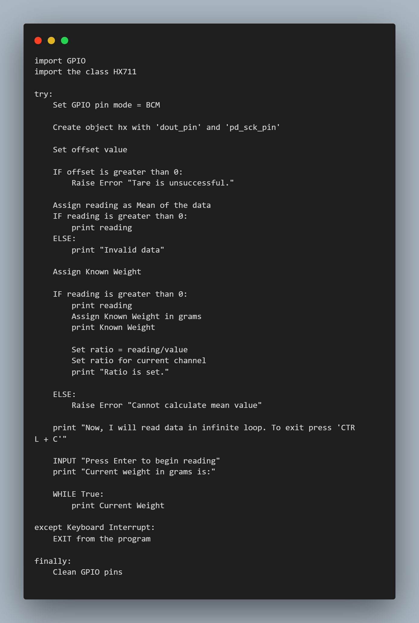
RPI Camera Weight Sensor

Slide 26
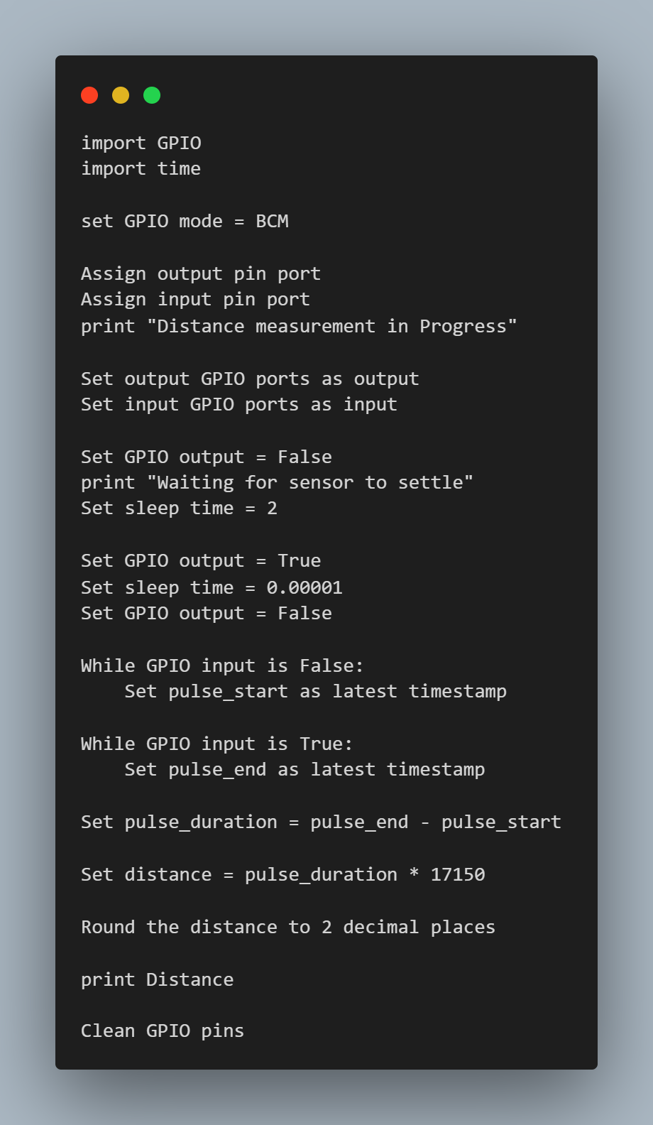
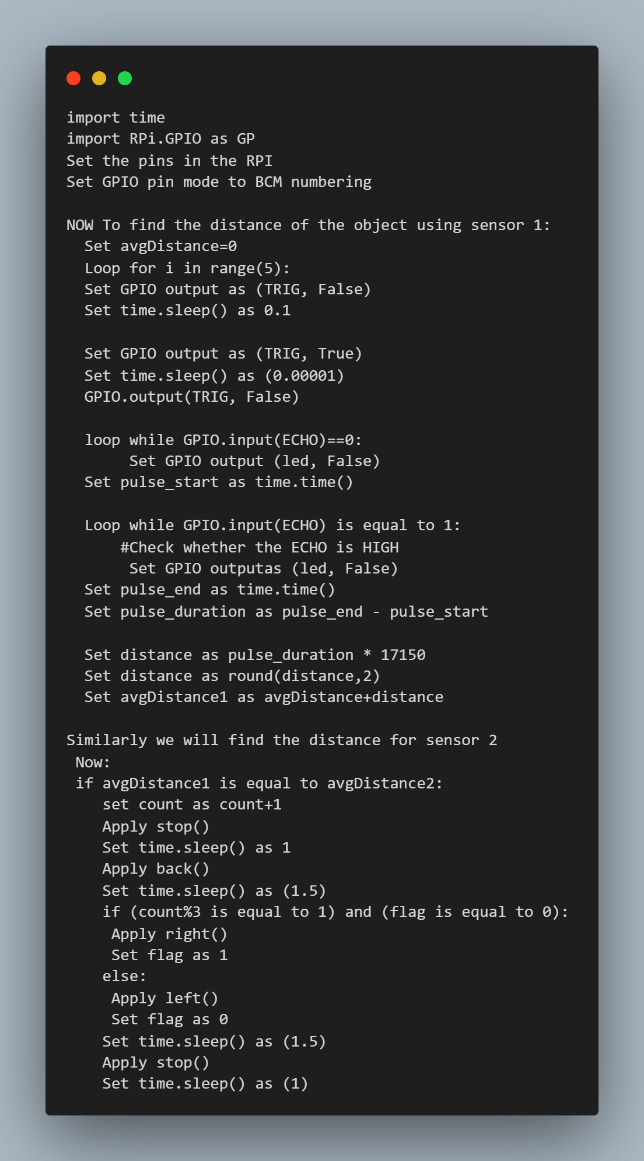
Depth Sensor Ultrasonic Sensor

Slide 27
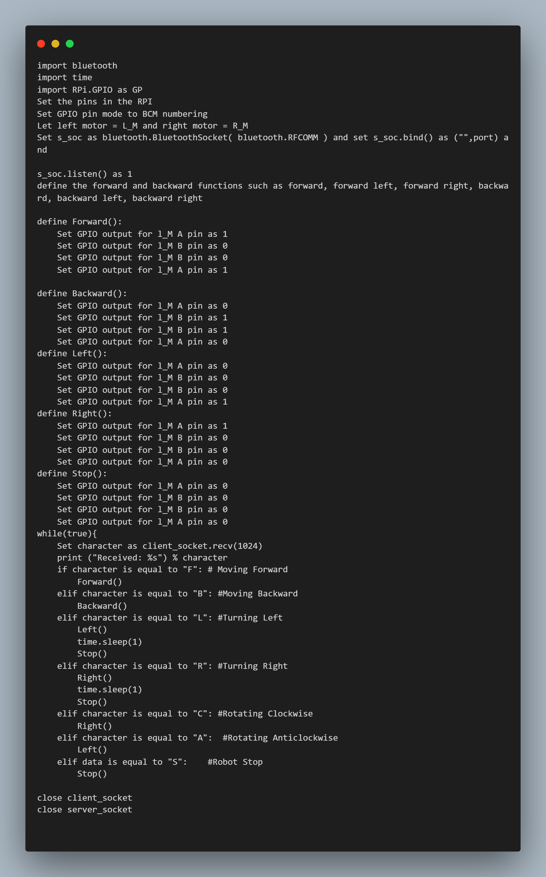
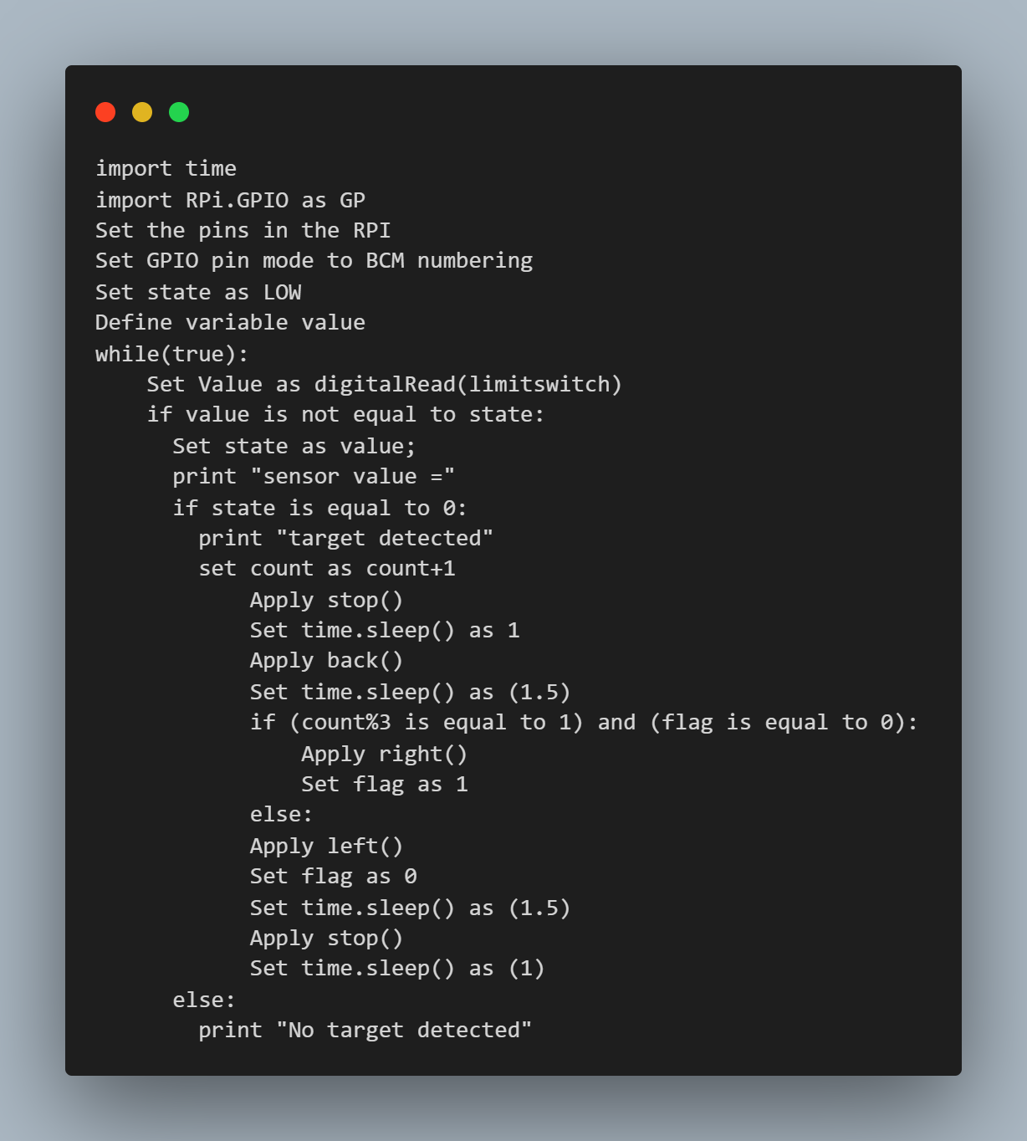
Bluetooth Controlled DC Propellors
Capacitive Sensors

Slide 28
Results & Discussion
We discussed the detailed design and the process which we followed in the connecting all the three major aspects (Software, Mechanical and Electrical/Electronic aspects).
The result is the PlasBot, which is a semi-automatic bot that will help tackle problem of increasing plastic in the floating waste in the water bodies.
This bot will help clean the water bodies without harm its life form.

Slide 29
Conclusion and Individual Learning
Conclusion for the Project
Due to increase in plastic garbage in water bodies, it is very difficult for marine life to survive
To tackle this problem, we made the semi- automatic bot called 'Plasbot' which helps to detect and collect garbage from both on surface and deep underwater.
It saves a lot of time, money, manpower and cleans the environment.
In future, bot can be made more compact as well as the capacity to collect garbage can be increased and also modified for automatically deep cleaning .

Slide 30
Conclusion and Individual Learning
Individual Learning
Pritish Chugh:
First and the most important thing I learnt was the teamwork. Working in a team has some challenges of coordination, bonding etc., but I learnt to manage things in team, how to work in team, that you can’t just deny that this wasn’t my part to do and work as a team.
I learnt how to think about building something, how to approach a problem. With the help of our mentors, who helped us in each step, I learnt how one does the research and how to start something new like startup.
From this project, I learnt how to do the market research, how to start designing the product, how to think from very basic to complex level.
About technical aspects, I learnt how to build the circuits, how to design models, various factors to choose the best choice, SWOT analysis, material deciding, Raspberry Pi.
While writing the pseudo codes for various sensors, I learnt deep about their working and how they could be used for our use, like we used Capacitive proximity sensor, Ultrasonic sensor, depth sensor, weight sensor, controlled motors with Raspberry pi etc.

Slide 31
Conclusion and Individual Learning
Individual Learning
Ayuj Panchal:
Learnt about proper way of building a project starting from problem identification, market research, figuring out components based on budget and needs, etc.
Learnt about various technologies like Raspberry Pi, ultrasonic sensor, weight sensor, etc.
Learnt how to do SWOT analysis to figure out best possible choice from pool of choices.
Learnt how to use XCircuit to build a proper block diagram for the project. Learnt how to write code to use various kinds of sensors with Raspberry Pi.
Learnt how to write a proper report for a project which covers every detail about the project.
Learnt about different kinds of product realization technologies like 3D printing, sheet shearing machine, etc.
Improved analytical skills to figure out scope of improvement, limitations, challenges, etc. of a project.

Slide 32
Conclusion and Individual Learning
Individual Learning
Nikhil :-
Learn about the different machines which help to make bot parts like 3D printer, gas tungsten arc welding, sheet shearing machine, etc.
Learn about which material is most suitable for parts.
Learn about how different devices work like capacitive proximity sensor, Raspberry pi, ultrasonic sensor so on.
Learnt to represent time scheduling by the help of Gantt chart.
Piyush Tejvan:
Learnt about how to select a problem in our society and try to fix it.
Learnt how to model a machine which helps save environment.
Learnt how to use different electrical and mechanical components and create a robot which indeed help people, society and government and motivate then for cleaner earth.

Slide 33
Conclusion and Individual Learning
Individual Learning
Sourav Sehgal:
I came to know about the working of Raspberry Pi and sensors like Capacitive Sensor, Ultrasonic Sensor, Weight Sensor and Depth Sensor.
Learnt about different mechanical structures to reduce drag force while operating underwater.
Learnt about methods used to make parts like 3D printer, Gas tungsten arc welding, Sheet shearing machine etc.,
Learnt about how to make choices considering factors like efficiency, affordability, impact on nature and SWOT analysis.

Slide 34
Conclusion and Individual Learning
Individual Learning
Tanmay:
The most important thing that I learnt during the course was team management. Being the team leader, I learnt how things have to be managed keeping in mind everyone’s strength and weakness and making everyone’s contribution a valuable part to the work being done.
Got to apply my knowledge of electronics into real life applications and see how things are different from that of theoretical simulations.
Learnt proper model making keeping in mind all the actual requirements and the budget.
Learnt planning a project financially when one has a specific amount of budget at hand and plan the spending wisely.

Slide 35
References
Omnipresent Robot Tech, Ro-Boat , referred in Slide 7
Financial Express, Kerala 's sewage cleaner boat , referred in Slide 9
The Logical Indian, Clearbot , referred in Slide 8
Dyson, ORCA: China's river cleaning boat , referred in Slide 8
Water Botics, Seaswarm , referred in Slide 8
Raspberry Pi Tutorials, Raspberry Pi with Weight Sensor , referred for Pseudo Code for Weight Sensor
The Pi Hut, Ultrasonic Range Sensor on the Raspberry Pi , referred for Pseudo Code for Depth Sensor, Pseudo Code of Ultrasonic Sensor

Slide 36
THANK YOU

