Slide 1
Robo Sapiens

Slide 2
IDEA
Our solution consists of two bots to automate the loading and unloading process. One bot picks up the parcel from the truck and the other takes the parcel and sorts it based on the barcode printed on it.

Slide 3
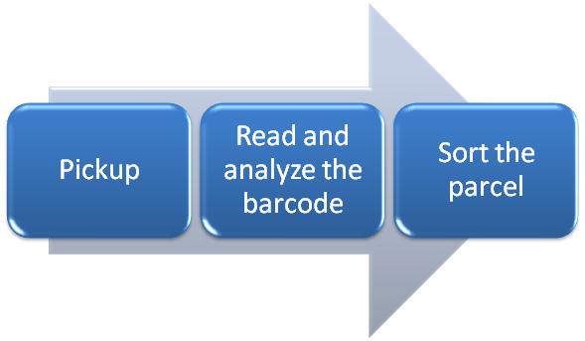
Workflow

Slide 4
Process
To automate the loading and unloading process, our solution consists of two robots to perform the given task. The first robot picks up the highest parcel from those piled up in the truck in multiple rows. It then rotates orthogonally and handovers the parcel to another bot standing beside it. The second bot has a cart like structure open at one end. It has cameras installed on all of its faces so as to detect and analyze the barcode which can be present on any of its faces. Using neural networks and machine learning algorithms, it analyses the barcode and then sorts it accordingly and puts them in cart A,B or C after travelling 50 metres from its initial point.

Slide 5
Explanation
Process:
The first bot detects the height of the parcel stack using an IR sensors and picks up the highest parcel.
It then places the parcel on a transparent table in bot 2 and then the lid of bot 2 is closed.
Bot 2 has two moving cameras placed horizontally and vertical to detect the barcode from right to left and top to bottom respectively.
After detecting the barcode, the second bot moves through an angle to place the parcel in the respective cart.
After that , it will retrace its path and continue the process.

Slide 6
Working of Picker Bot
Uses 1 IR sensors to detect height and size of object.
Reaches max. height of the pile. (constraints)
Once it reaches at top, two arms extends 1 meter apart.
Both arms contain 2 IRs which helps to estimate size of object.
After knowing 2 arms picks the parcel and comes down and places to the second bot.

Slide 7
Working of receiver Bot
It has a cube shaped chamber such that one face of it opens using IR.
Then, there are 2 cameras placed horizontally and vertically to detect bar code.
After detecting barcode, the bot rotates 30 degrees or 60 degrees or 90 degrees.
And it reaches to the carts and drops it.

Slide 8
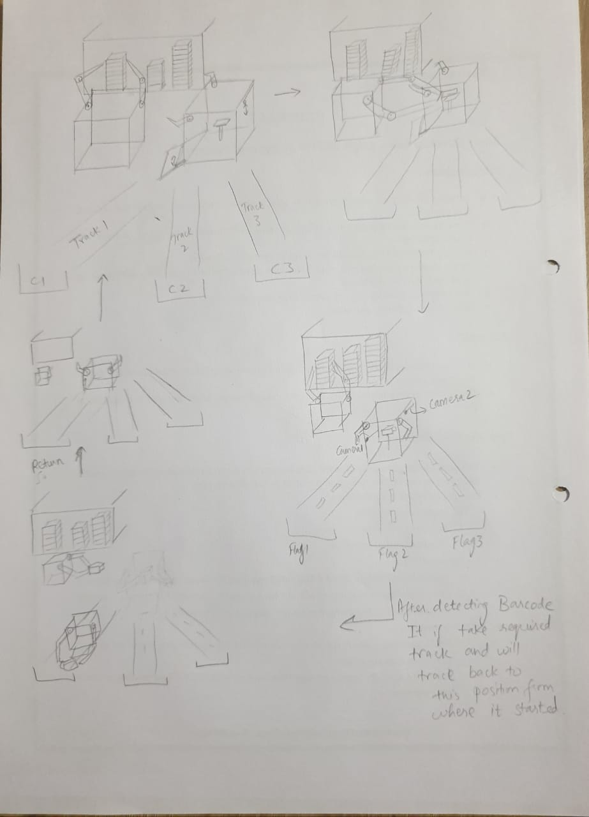
Design

Slide 9
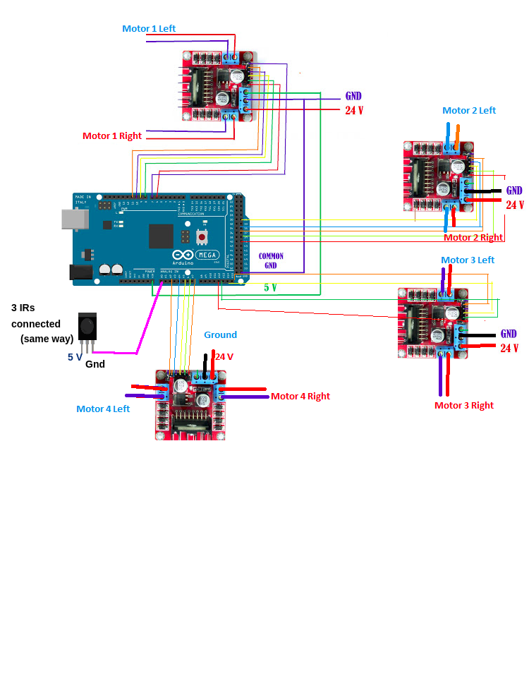
Picker Bot

Slide 10
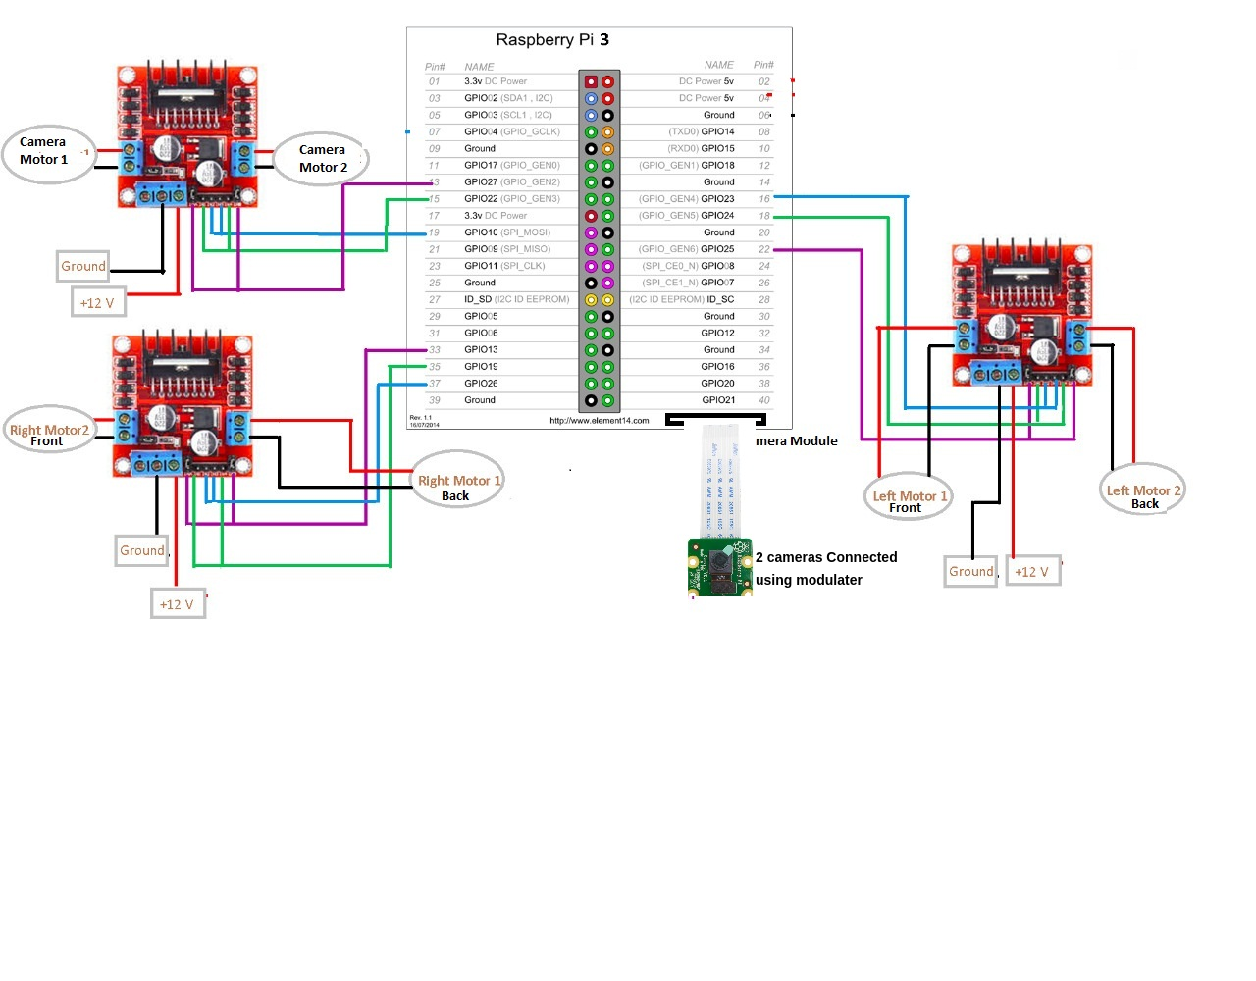
Receiver Bot

Slide 11
Implementation Cost
Components | Estimated Price(in Rs.)
Raspberry Pi | 3000 X 1
Raspberry Pi 5MP Camera Module | 450 X 2
Motor Driver | 125 X 4
Arduino Mega Board | 1000 X 1
Jumper Wires | 150 X 1
Motors | 200 X 14
IR Sensors | 45 X 1
Multi Camera Adapter Board | 500 X 1
Batteries | 30 X 2

Slide 12
Thank You!!

