Slide 1
Stock Market Analysis
​

Slide 2


Agenda
A
Team Members
Objective
KPI’s
Dashboard

Slide 3
TEAM
T
Priti Vartak
Laxmanan Rishikesh
Md Kashif Akhtar
Pallavi Bajaj
Akash Lomate
Devesh Mehare
Sindhuja Murugesan
Sachin Wankhede

Slide 4
Objective
Utilizing comprehensive stock market data to derive valuable insights and patterns, empowering informed decision-making for potential stock purchases, sales, or holdings. This analysis aims to equip stakeholders with actionable information, fostering a strategic approach to optimize investment choices and maximize returns in alignment with company goals..

Slide 5
Key Performance Indicators

Slide 6
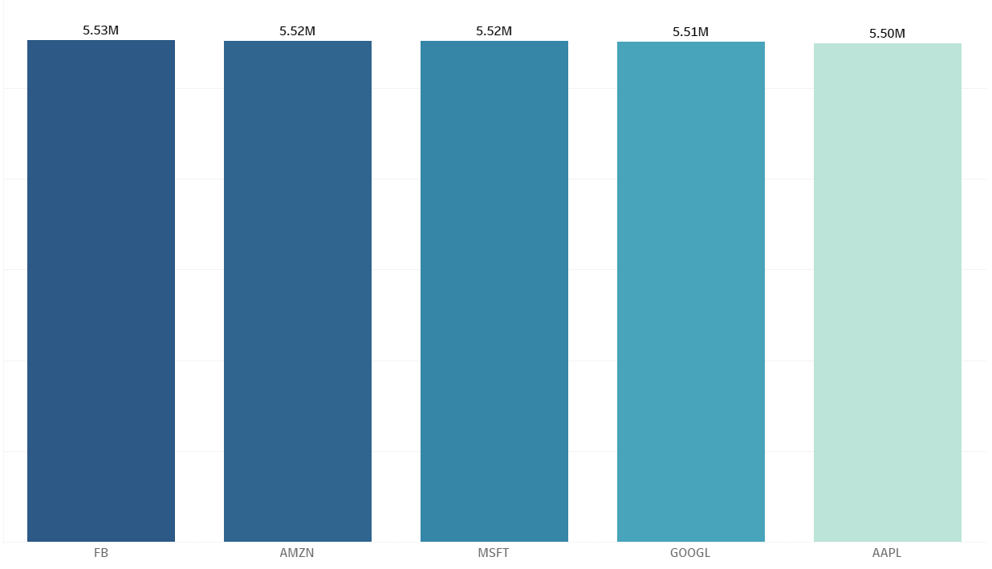
Average Daily Trading Volume
Observation :
FB has highest avg daily trading volume of 5.527 Million.
AAPL has lowest average daily trading volume.
AMZN daily trading volume is near to FB avg daily trading volume.
Conclusion :
FB's Stocks are highly liquid compared to other stocks.
AAPL Stocks has low liquidity as compared to other stocks.

Slide 7
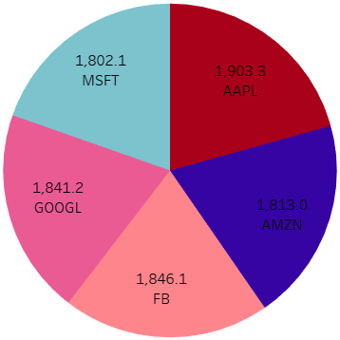
Most Volatile stocks
Observation :
AAPL has highest avg Beta value.
MSFT has lowest avg Beta value compare to other stocks.
Conclusion :
AAPL stocks are more volatile compare to other stocks and have higher price sensitivity to market movement.
MSFT stocks are less volatile compare to others and it shows less sensitivity to market movement.
AMZN, FB, and GOOGL has intermediate volatility.

Slide 8
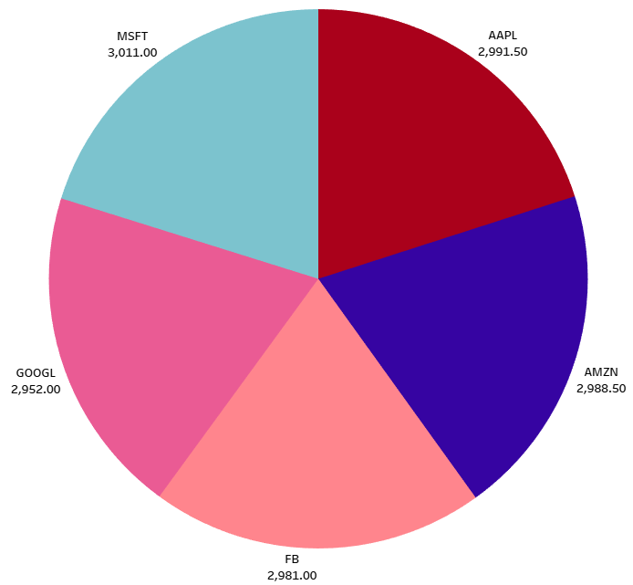
Dividend Amount
Observation :
MSFT and AAPL stocks gives highest dividend amount compare to other stocks.
GOOGL and FB stocks gives low dividend amount compare to AAPL and MSFT.
Conclusion :
MSFT and AAPL stocks gives good dividend amount to investors.
As GOOGL and FB stocks gives low dividend amount, so these companies use dividend amount for growth investing, research and development, and for fund expansion of company.

Slide 9
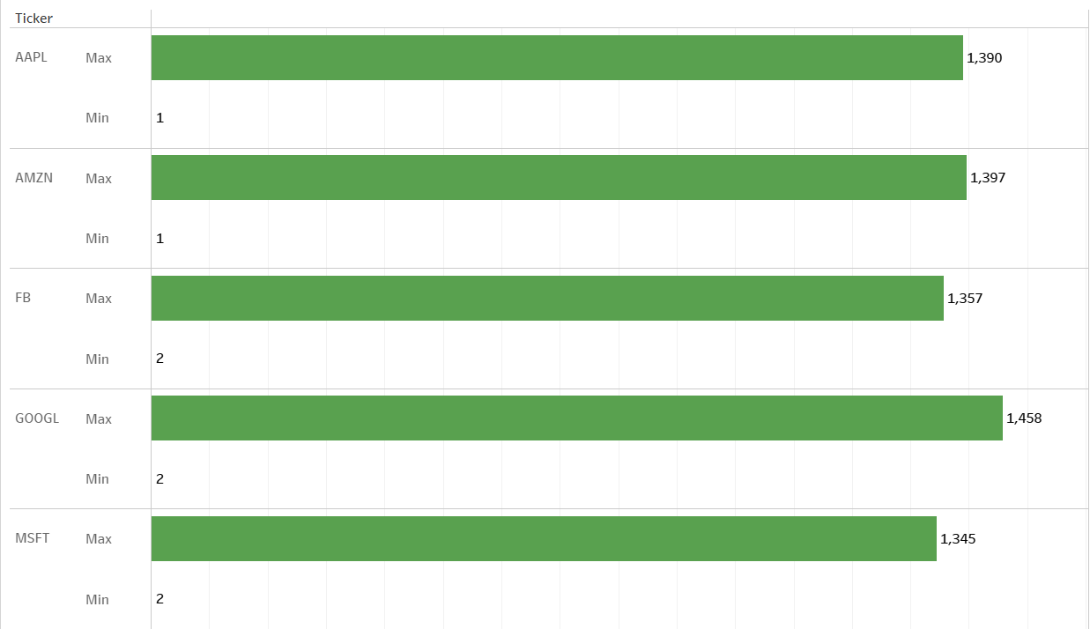
PE Ratio
Observation :
GOOGL has Max PE(price to earning ratio) of 1.46 K which is highest among all 5 stocks.
MSFT has Max PE ratio of 1.35 K which is lowest among 5 stocks.
AMZN, AAPL, and FB has intermediat max PE ratio.
Conclusion :
GOOGL shows the strong earning growth in future.
Investors are willing to pay premium for GOOGL stocks.
MSFT stocks are undervalued stocks compare to other stocks.
For undervalued stocks, investors may believe that these stocks do not show company's true worth.

Slide 10
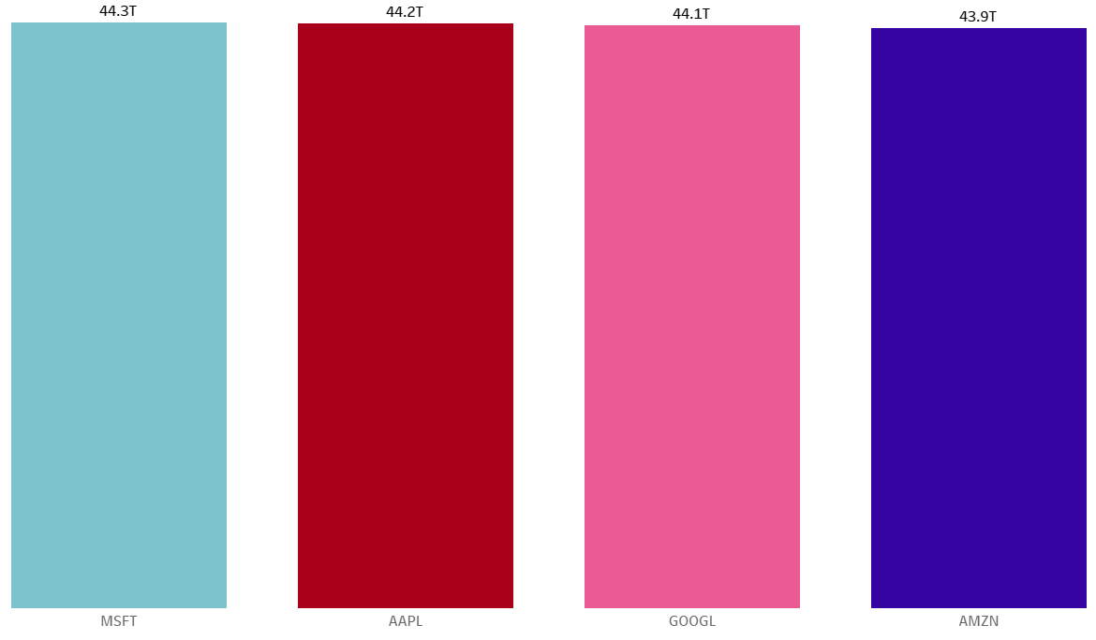
Highest Market Cap
Observation :
MSFT has highest market cap of 44317 Billion.
AMZN has lower market cap compared to other stocks.
FB and AAPL has nearly same market cap.
Conclusion :
MSFT provide better stability and liquidity to stocks.
MSFT has highest Stock market value.
AMZN has lowest stock market value compared to other 4 stocks.

Slide 11
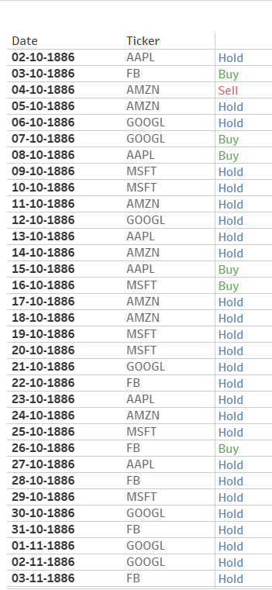
Stock With Buy , Sell & Hold Signals
Observation :
We need to observe RSI values and MACD values for determining the status of stock.
There is max number of stock to hold in all stocks i.e AAPL , GOOGL , AMZN , FB , MSFT.
Conclusion :
The stocks with hold status has max numbers i.e AAPL , GOOGL , AMZN , FB , MSFT.
We have stocks which we can buy & gain profits or stocks to put on hold compared to selling which is very less

Slide 12
Challenges & Problem Solving
Our team convened a comprehensive meeting to address challenges encountered during the process of importing MYSQL data into Power BI and Tableau,Through collaborative efforts, we strategized solutions to streamline and facilitate the data integration seamlessly.
In KPI 6 we faced difficulty for using the criteria that are given for are selling & buying Signal of stocks that MACD & RSI value is used for selling & buying & how that should be implemented in table to fetch the data.

Slide 13
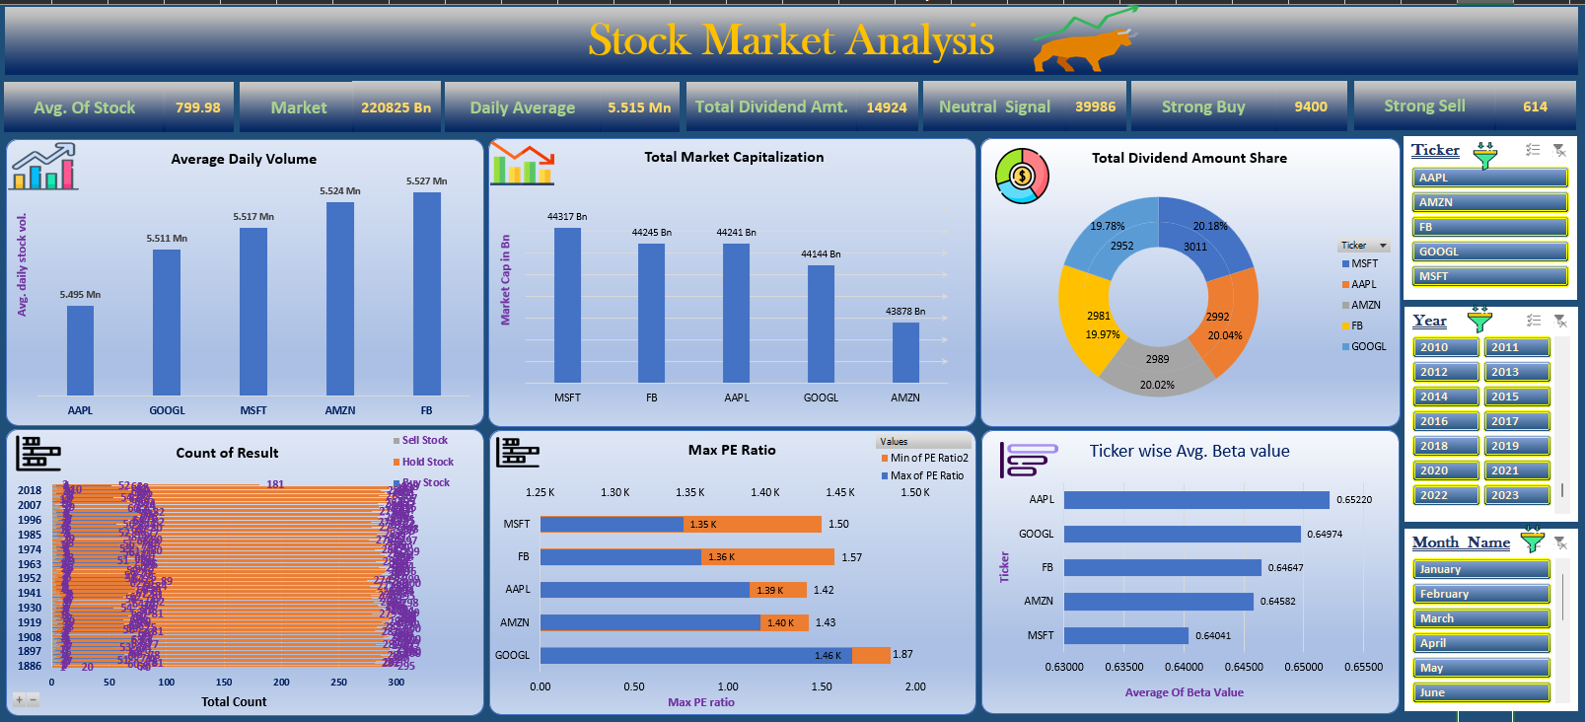
EXCEL DASHBOARD

Slide 14
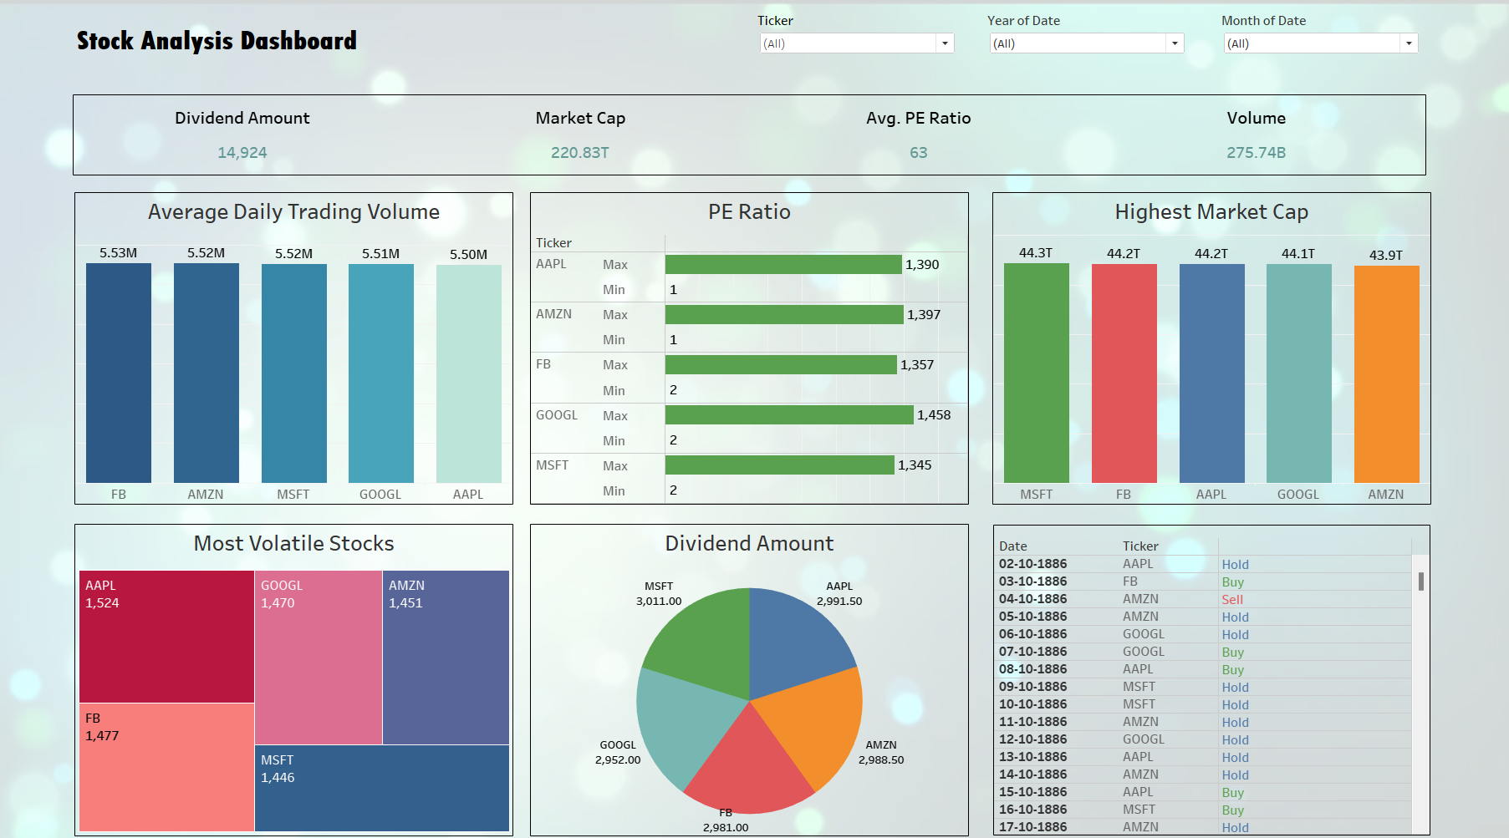
TABLEAU DASHBOARD

Slide 15
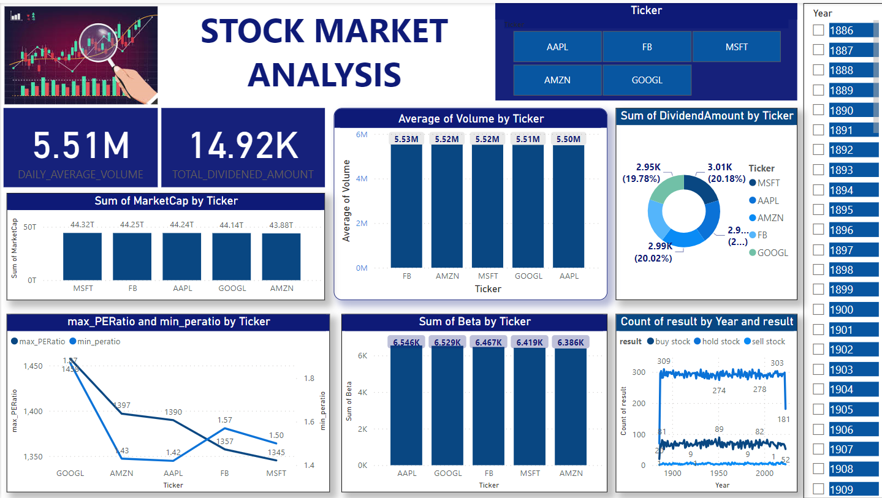
POWER BI DASHBOARD

Slide 16
Thank you

