Slide 1
Project Title: Arduino-Yun FTP Remote Control / Monitoring of Home
Name: Pritpal Sahota
ID: 11142375
Course: Computer Engineering
Supervisor: Dr. Karl Rinne

Slide 2
Contents
Objectives
Design: - Hardware
- Software
Configuration and Implementation
Testing and Results
Demonstration
Conclusion

Slide 3
Introduction
Smart Home – concepts implemented to meet certain requirements and expectations of residents in home.
Vital home functions controlled remotely at home through hand held devices.
This project gives proof of concept for home automation of certain devices at home.
This project gives the ability to monitor and control certain devices connected to Arduino Yun through an Android device.

Slide 4
Objectives
To sense the following parameters:
- Temperature, Presence of Gas, Water detection, Motion and Humidity
To automate to switch on/off:
- Heater, Cooler and LED Light
To develop an Android App to monitor and control remotely
To enable FPT protocol on Arduino Yun and Android App to communicate data with FTP server

Slide 5
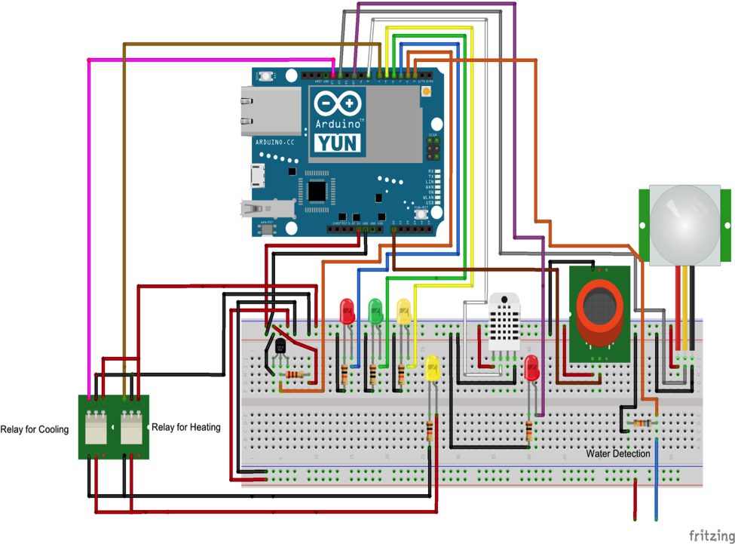
Hardware Design
Hardware Design for the whole system:

Slide 6
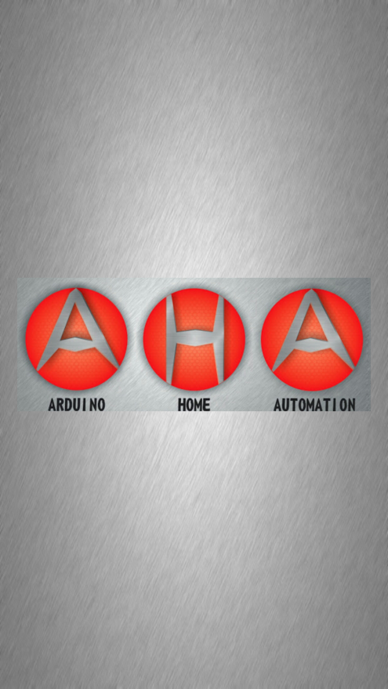
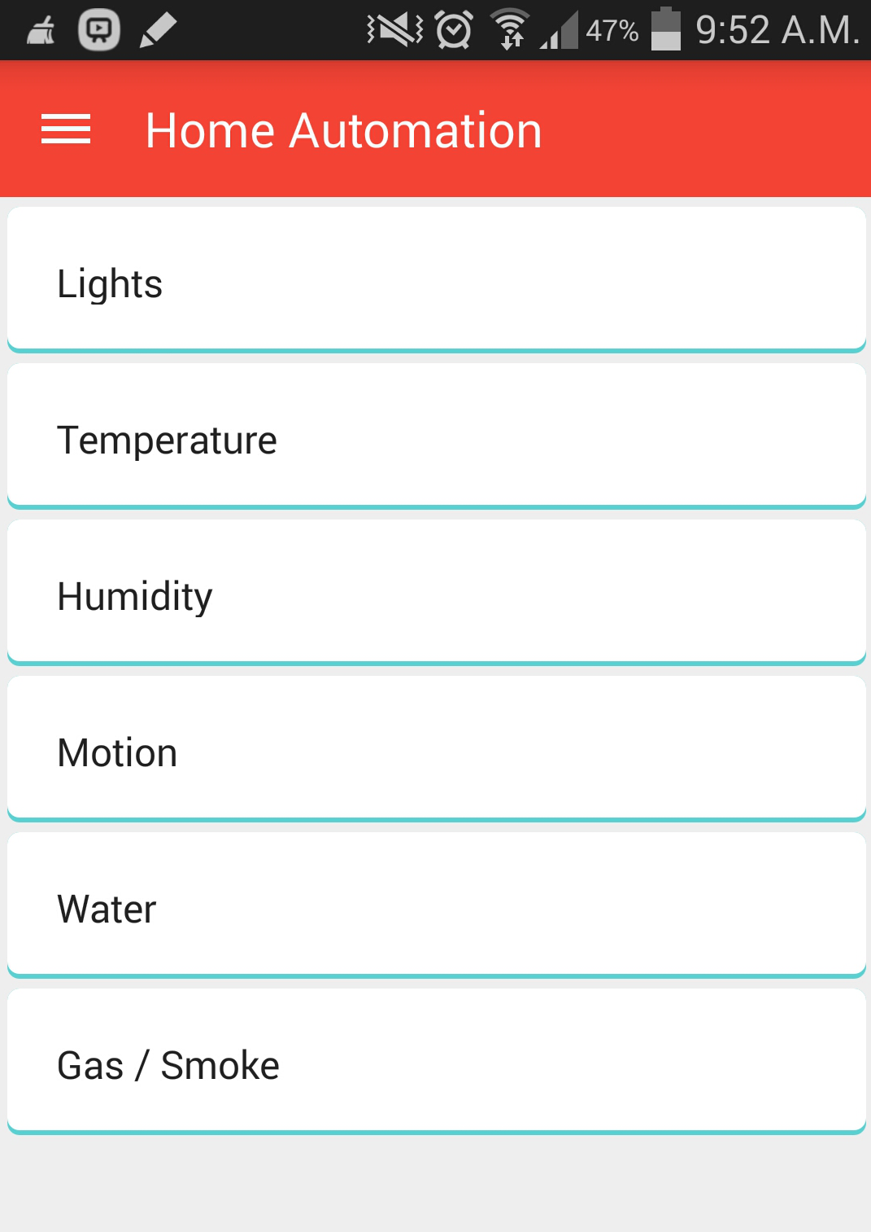
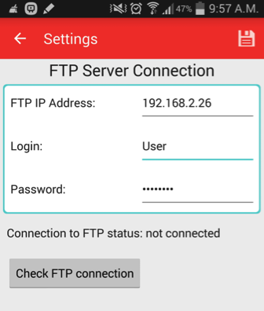
Software Design
Android App User Interface Design:
Splash Screen
Home Screen
FPT Server Connection Settings

Slide 7
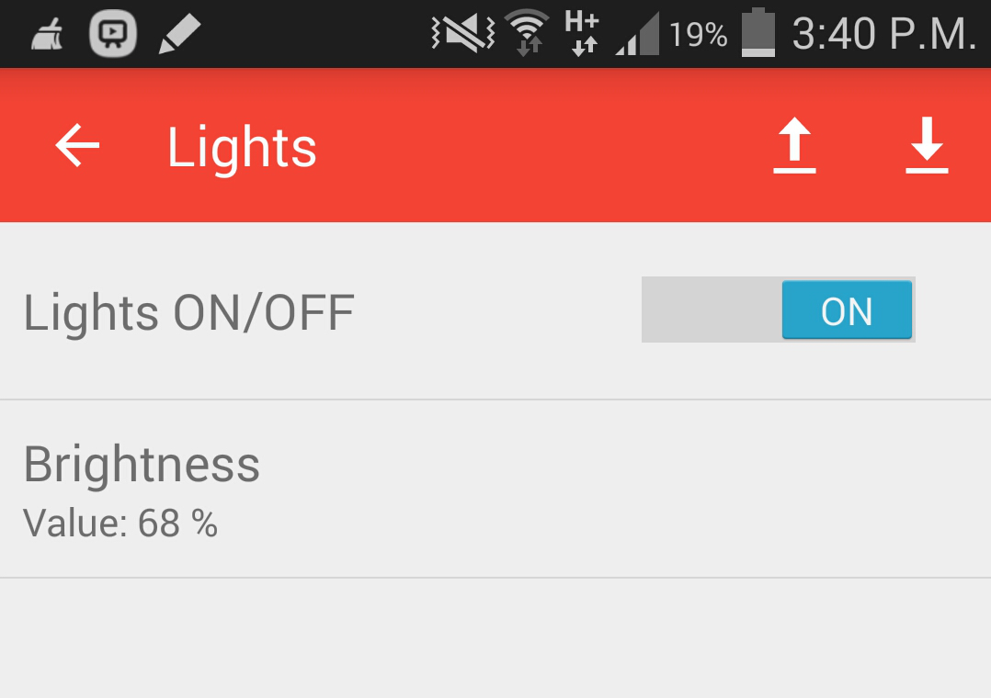
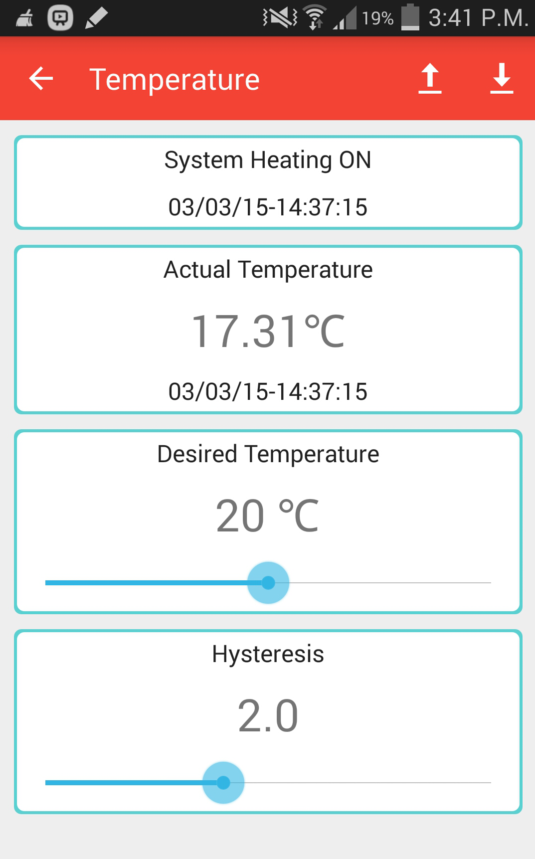
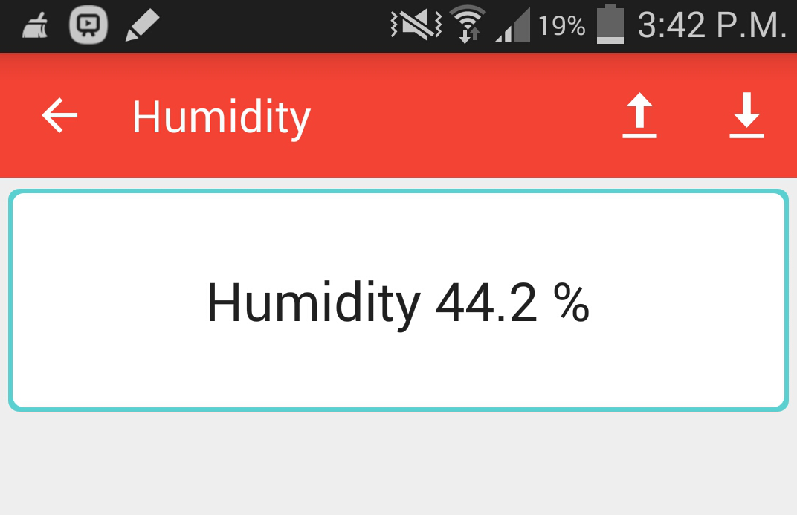
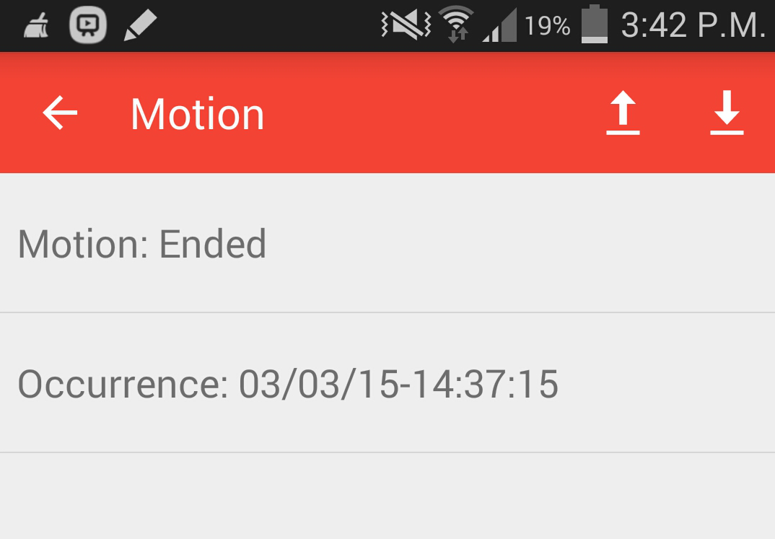
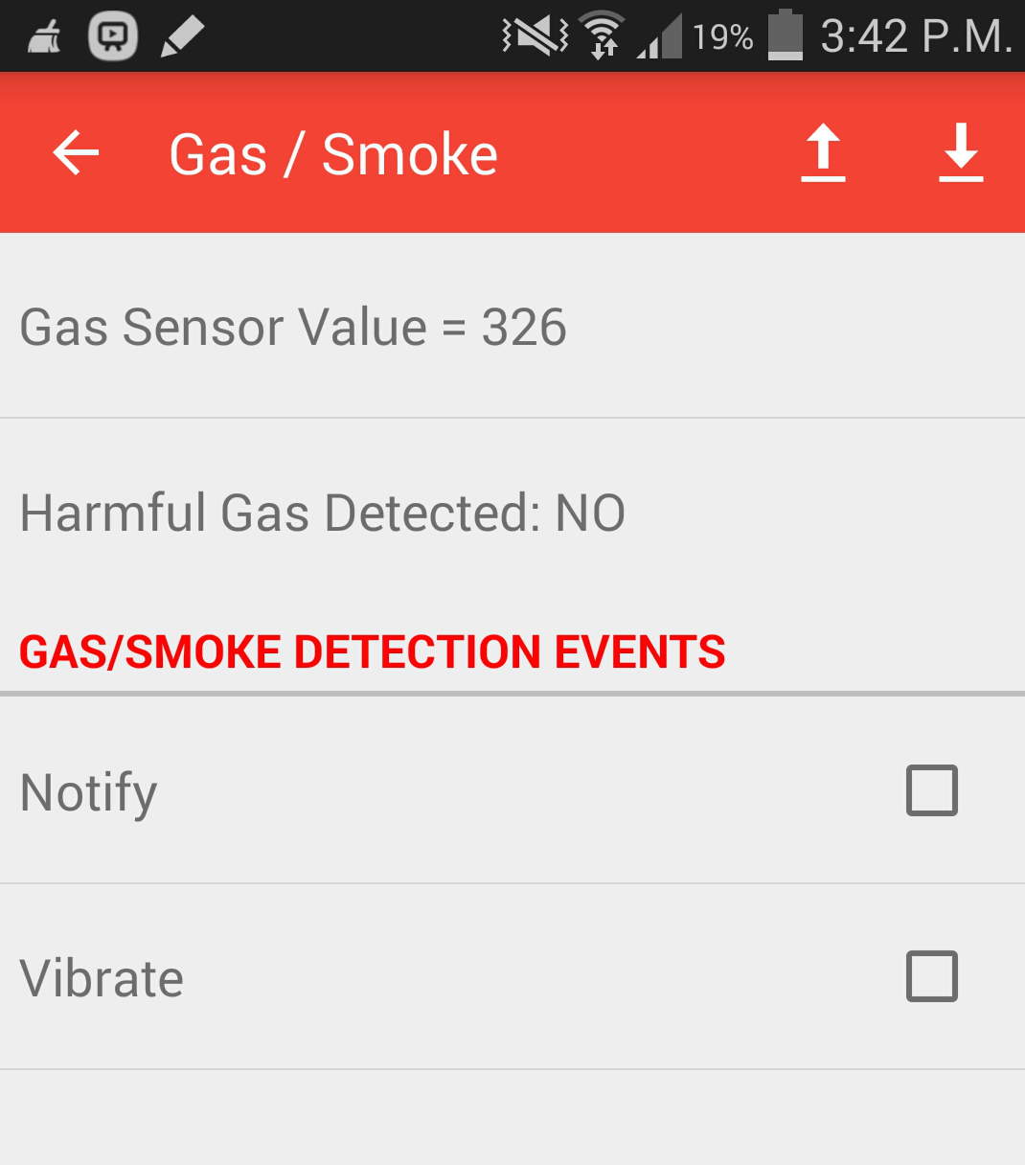
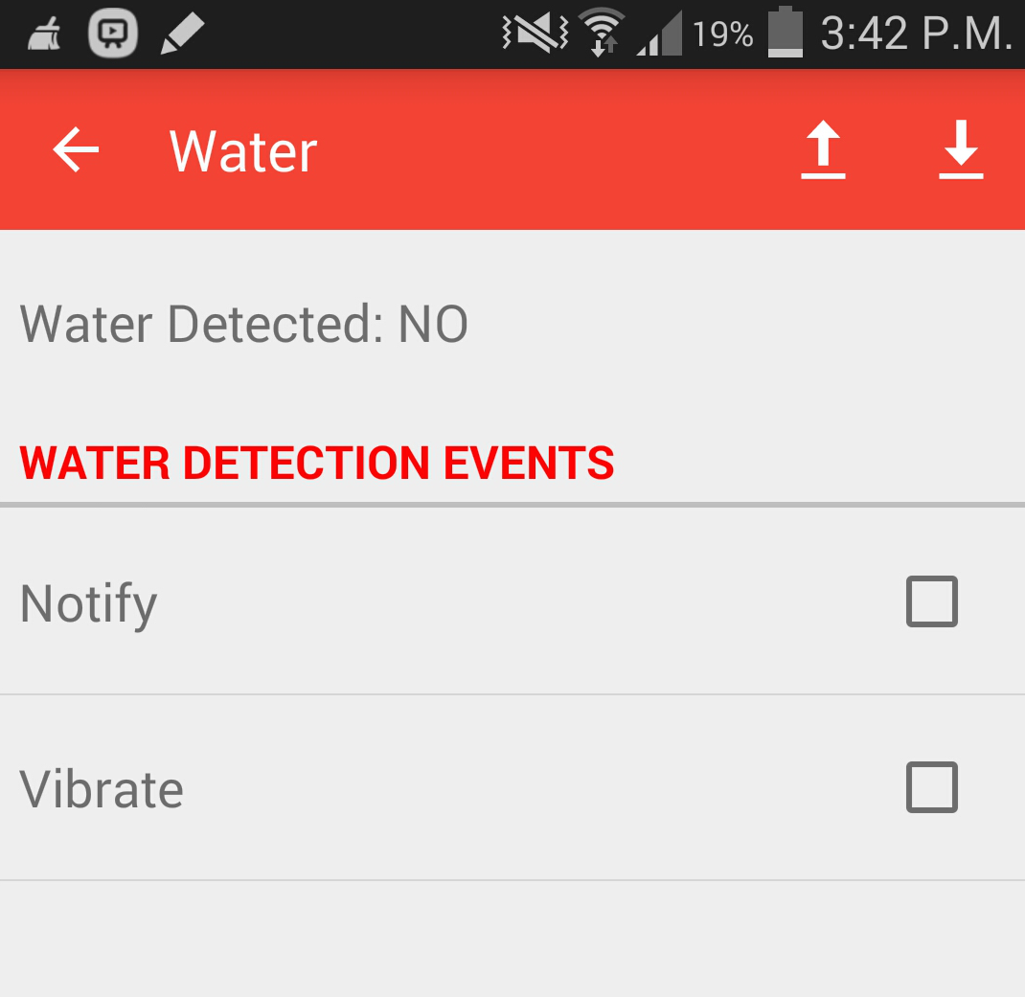
Software Design

Slide 8
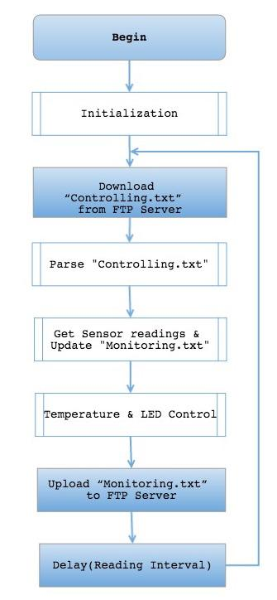
Software Design
Arduino Yun Software Design Flow
Initialization – Setting sensor (pins + definitions), FTP server & Time + Date
Parse “Controlling.txt” – Opening the file, obtaining user configured values & closing the file.
Get Sensor readings & Update “Monitoring.txt” – Receive current Date + Time and individual sensor readings & write this data to the file and close.
Temperature & LED Control – Compare desired temperature vs. sensor temperature and automatically control relay for heating & cooling ON/OFF.
Set LED light ON/OFF & set brightness according to user specified values.

Slide 9
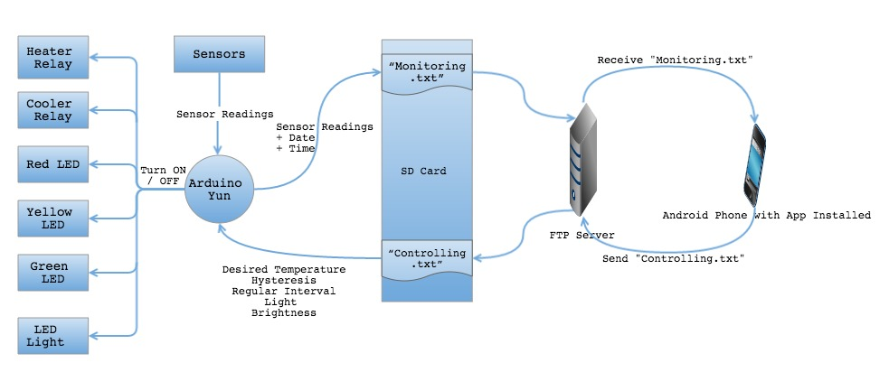
System Data Flow Diagram

Slide 10
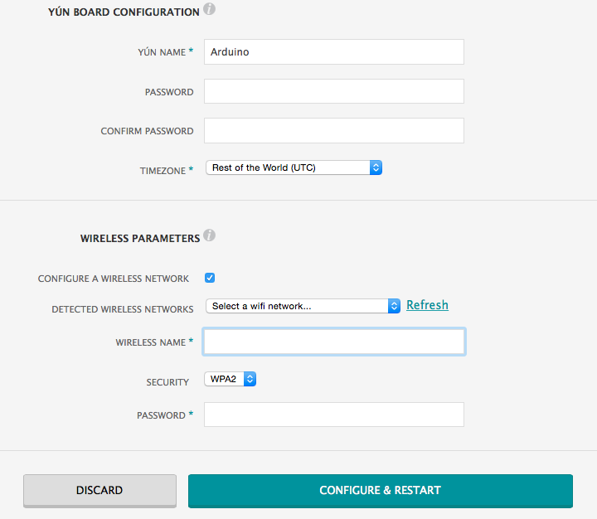

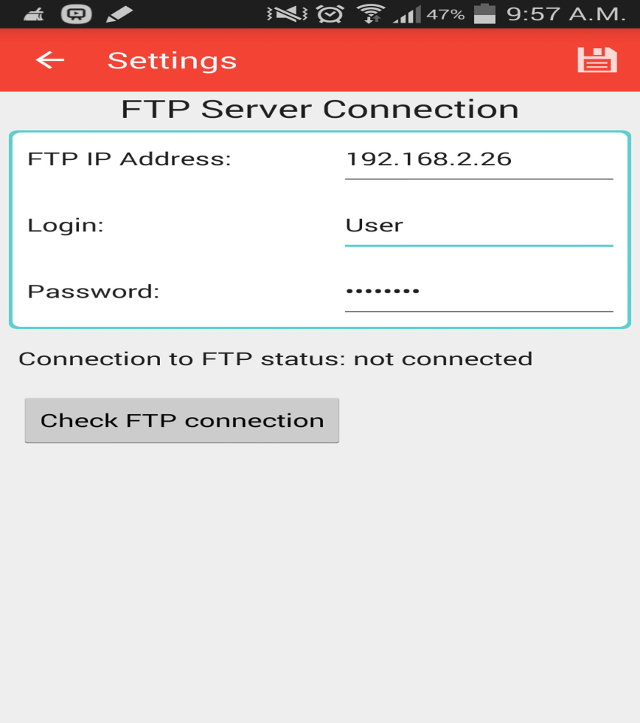
Configuration and Implementation
Locate the above code & Change IP address to your FTP server
Enter username and password in the above code of FTP server
Finally upload the program to Arduino memory
http://arduino.local
Select Wireless Network
Finish by pressing Configure & Restart
Configure FTP IP address, Login & Password in Settings screen
Lastly press Save button to connect to the FTP server.

Slide 11
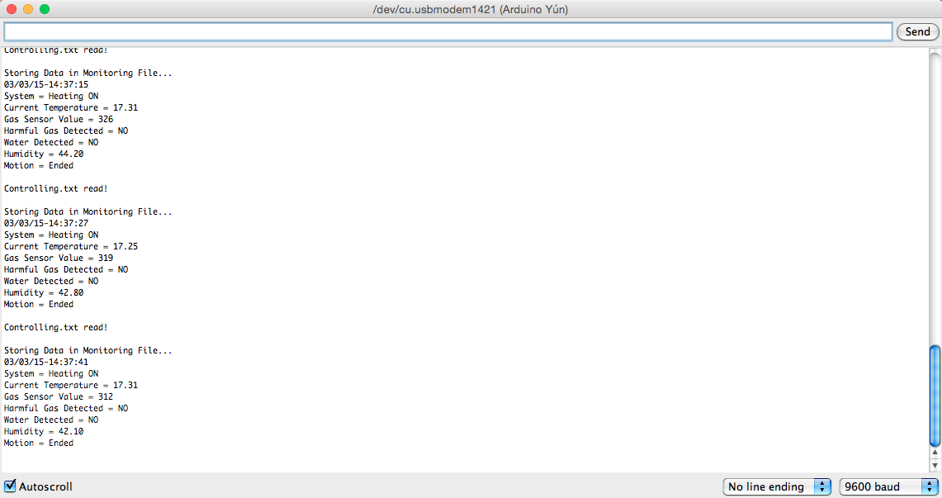
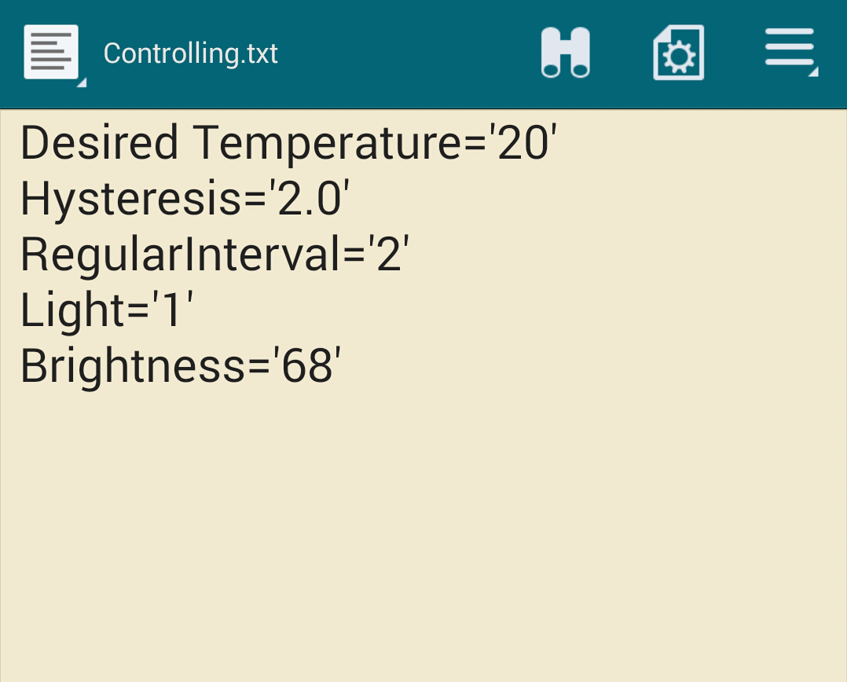
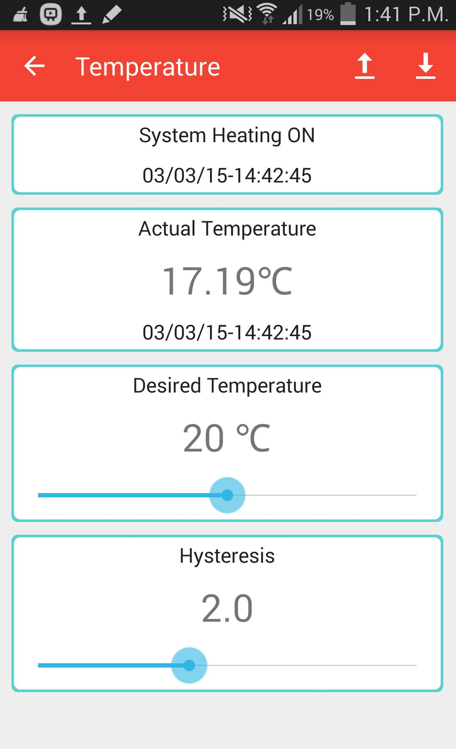
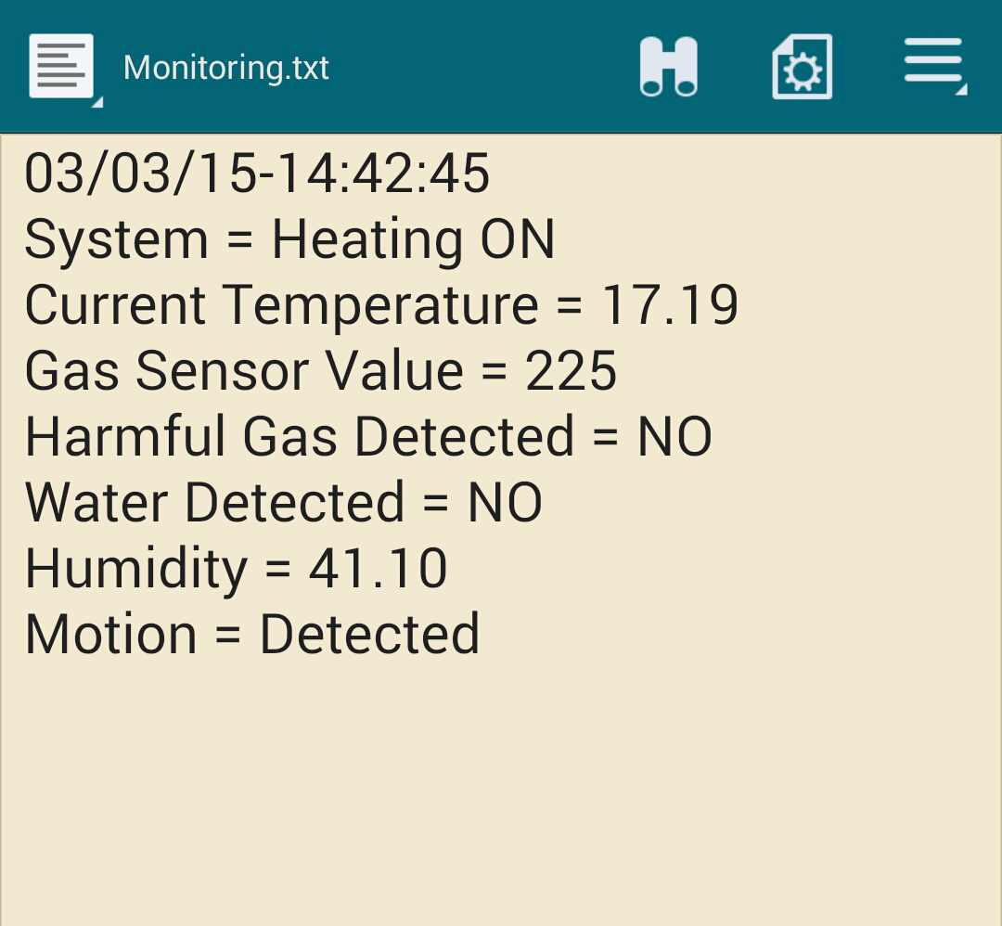
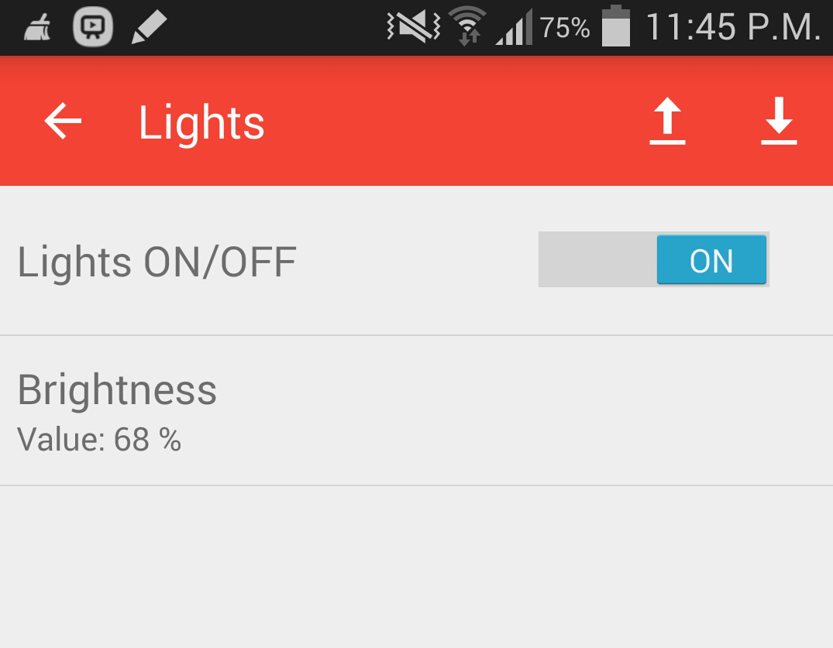
Testing and Results
Controlling.txt File created on Android Device
Serial Monitor Output of Arduino
Monitoring.txt File downloaded to Android Device

Slide 12
Conclusion
Monitoring of sensors and control of devices through Android App was achieved.
FTP protocol was successful to communicate with various devices.
Further improvement can be made to the system by adding other functionalities

Slide 13

Questions

