Slide 1


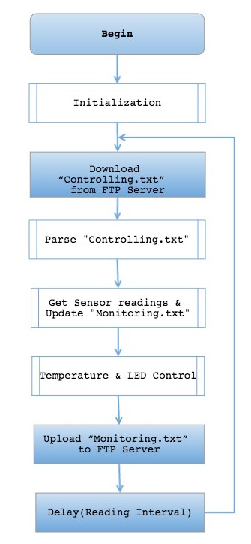
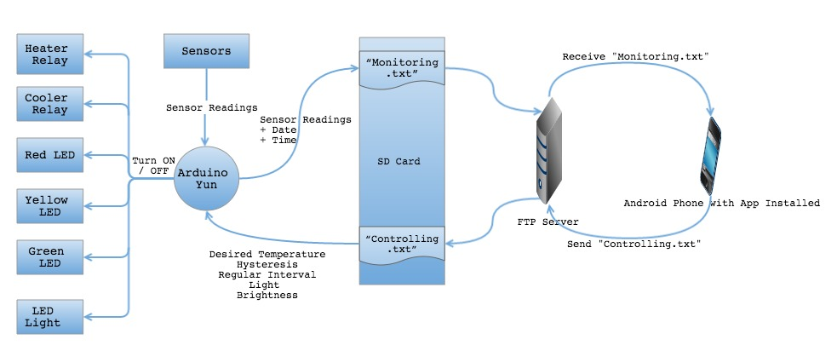
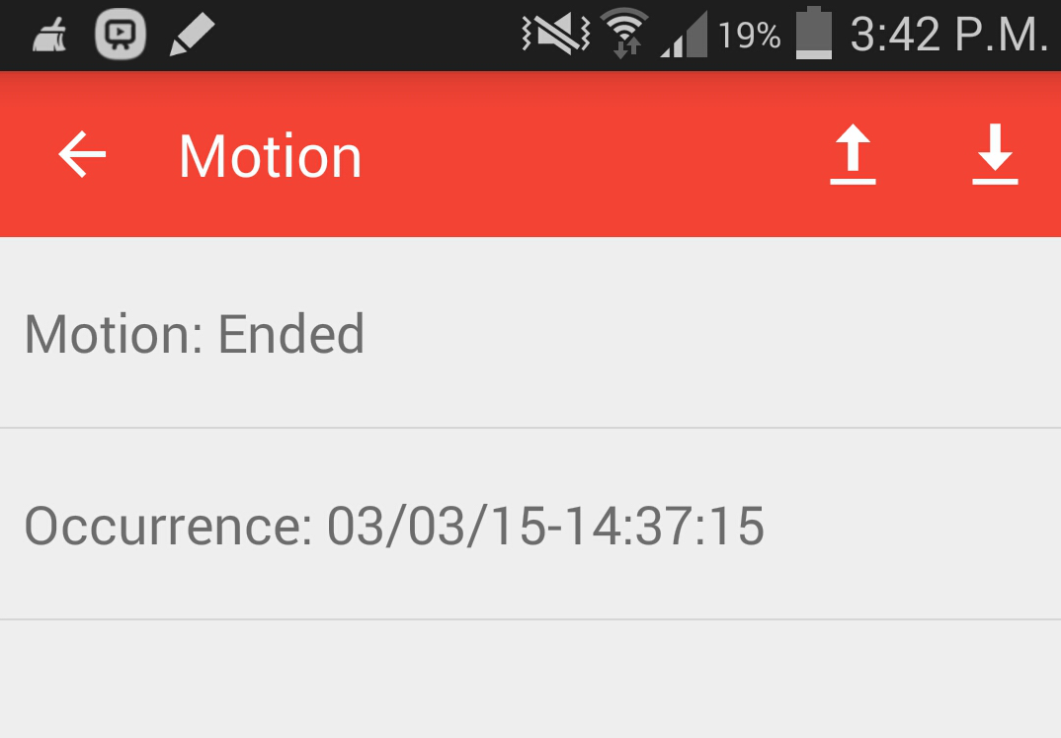
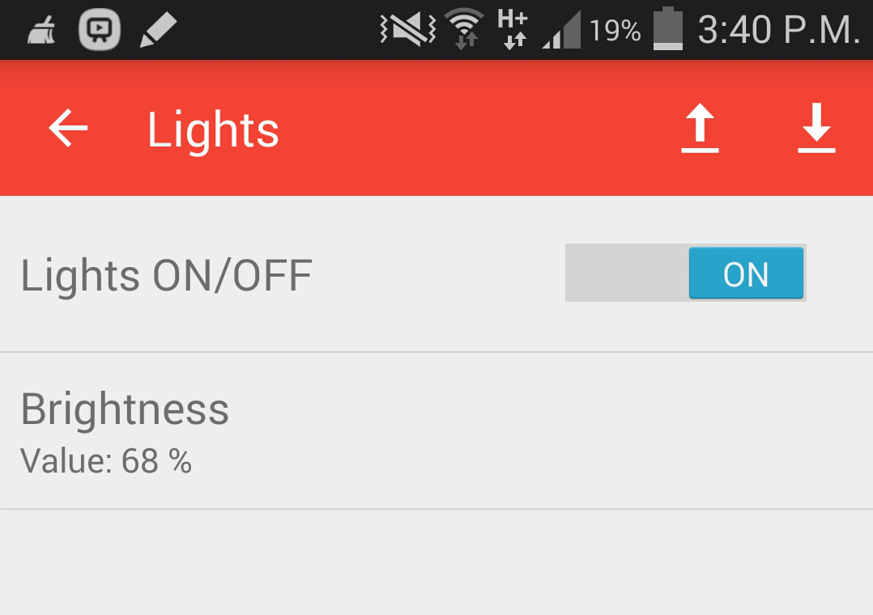
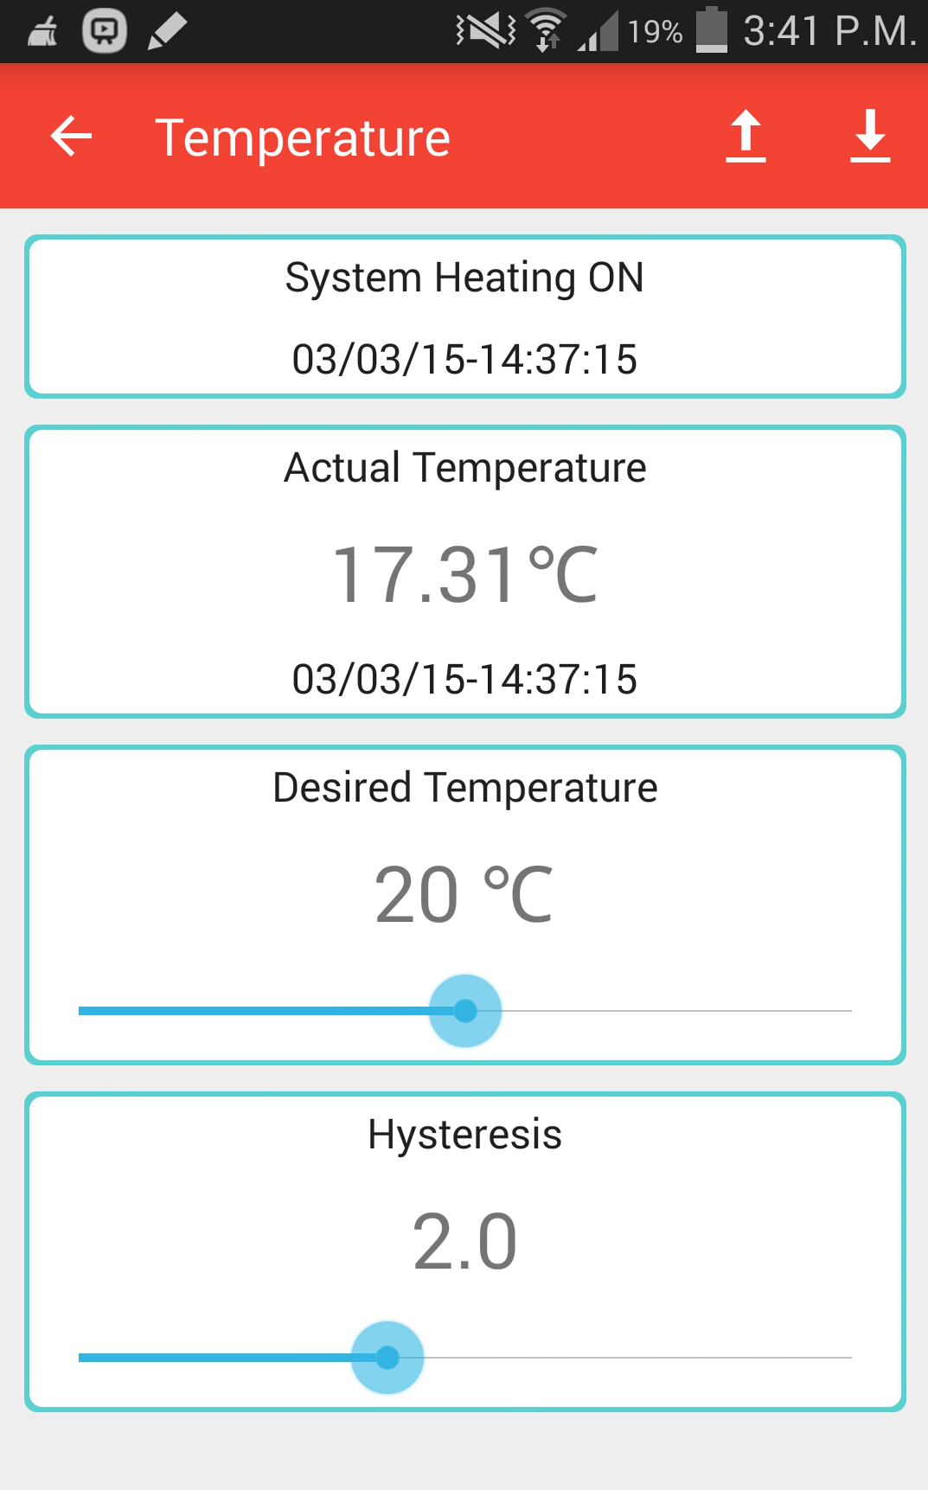
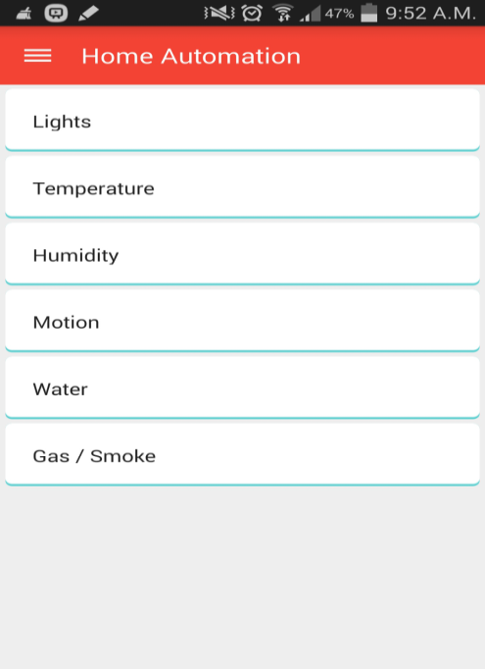
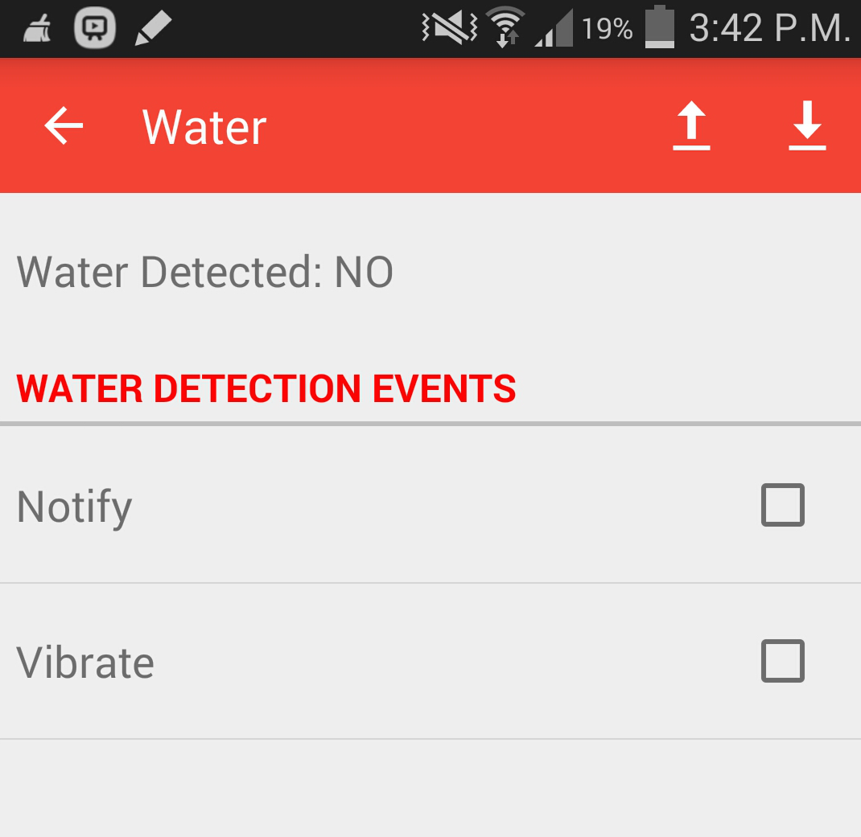
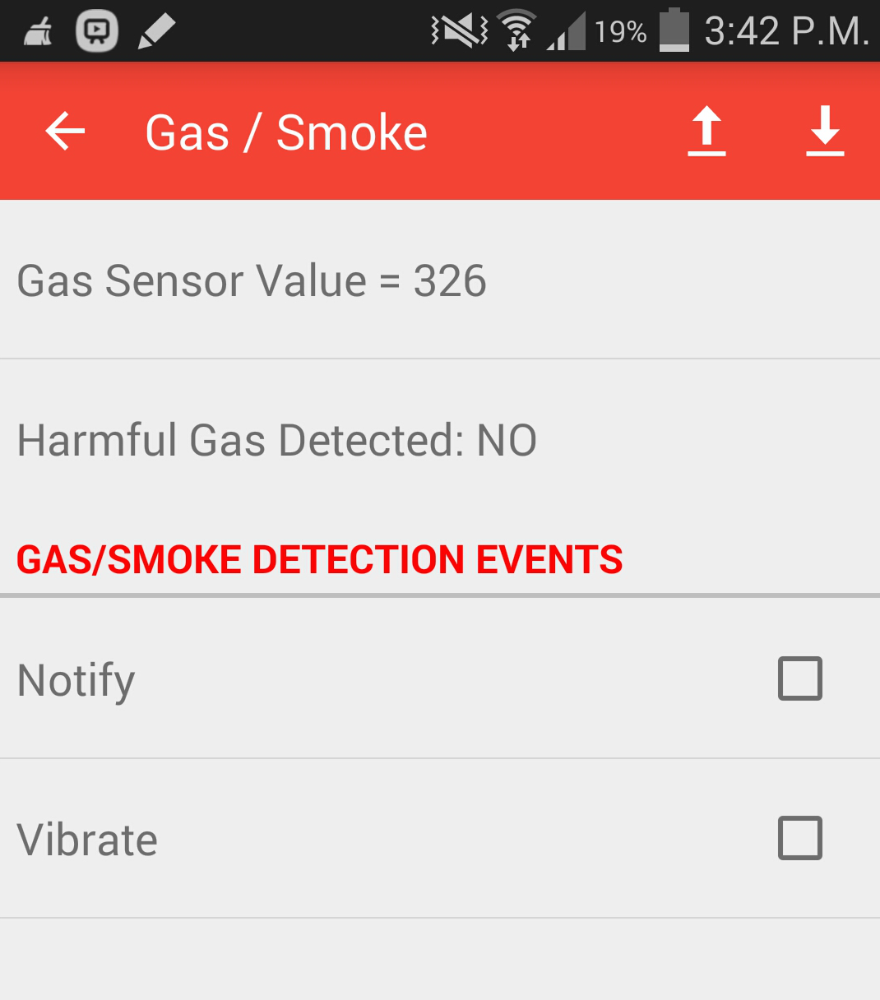
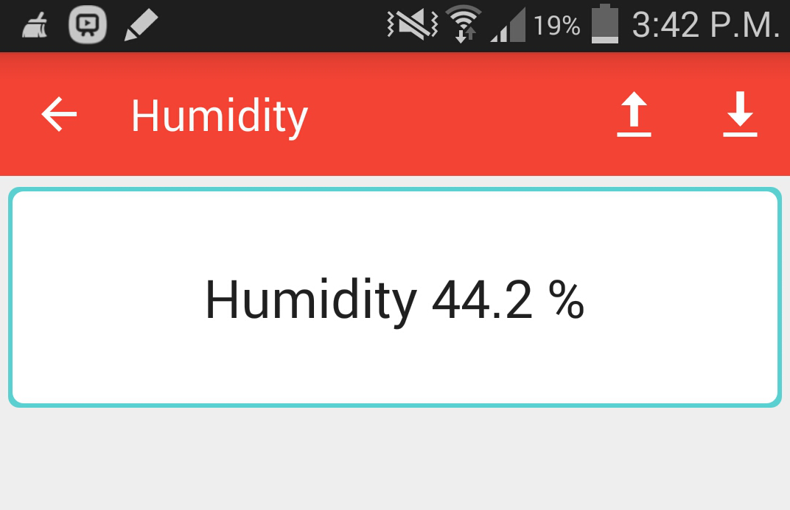
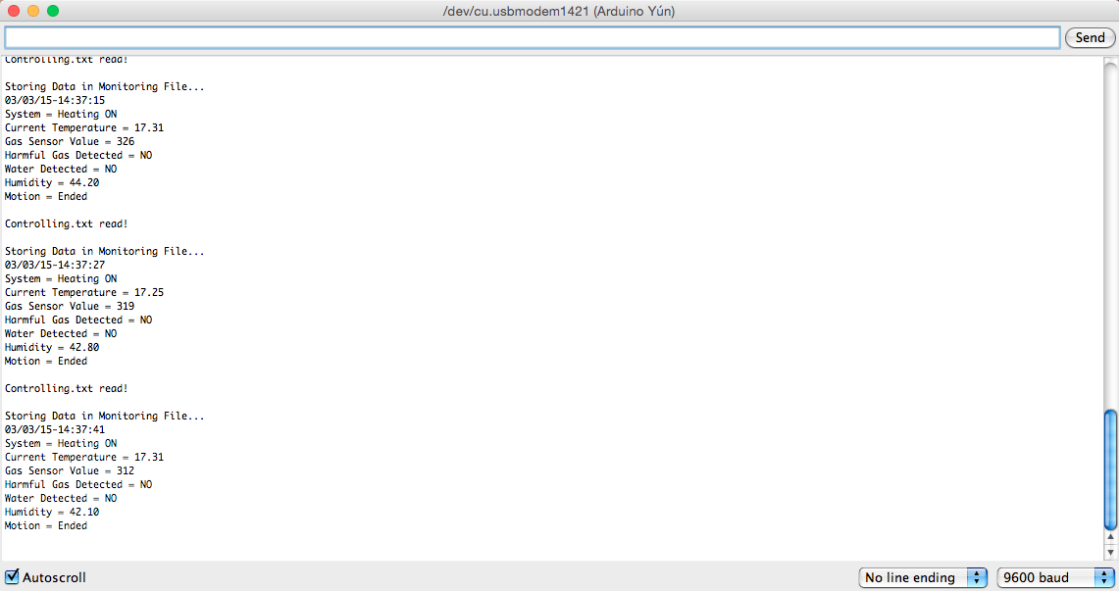
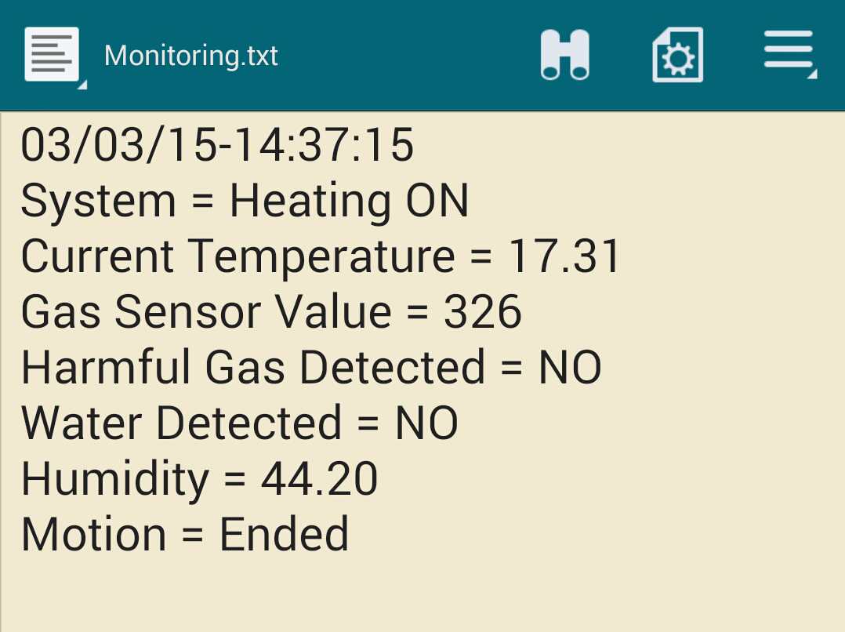
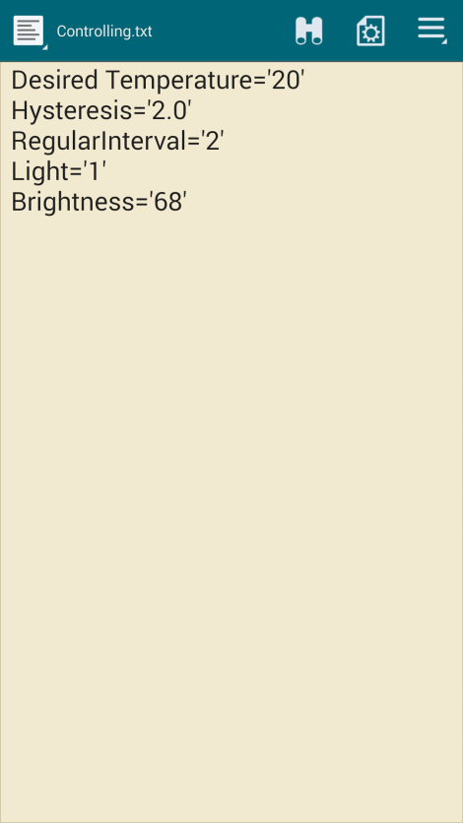
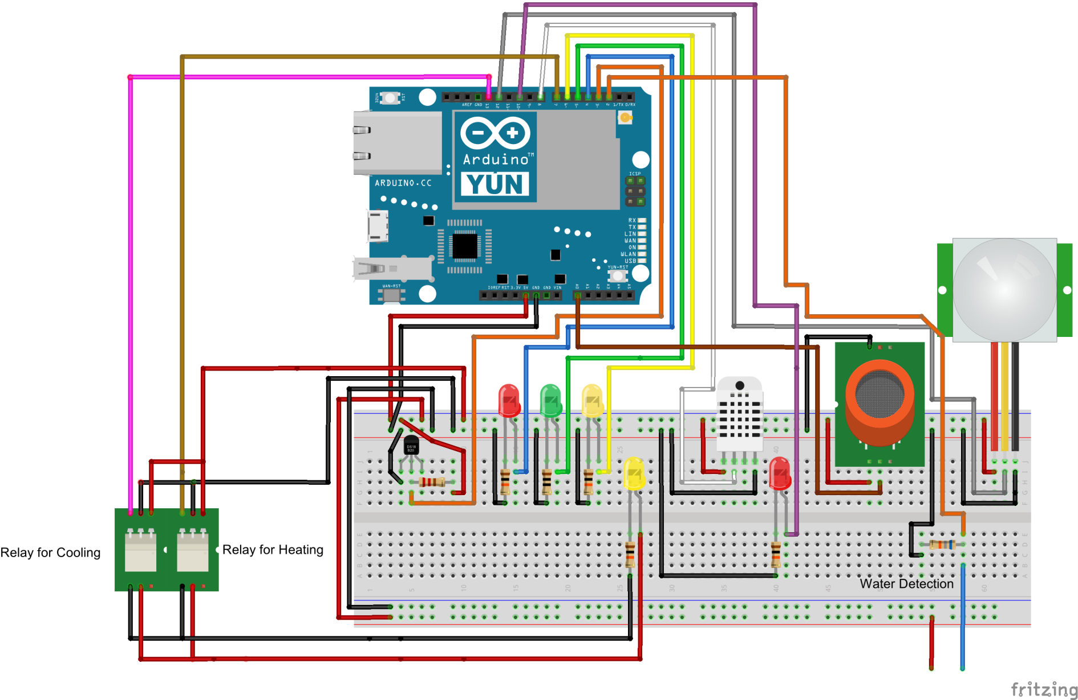
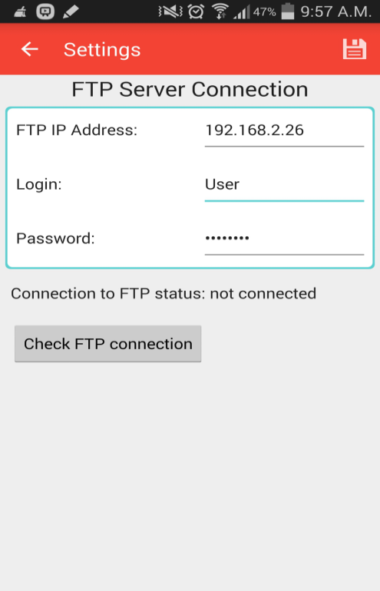

Arduino-Yun FTP Remote Control / Monitoring of Home
Pritpal Sahota
B.Eng in Computer Engineering
Introduction
With the increasing power of technology, information can be accessed from locations that are not within our visibility and we are able to communicate this information due to the availability of hardware and mobile devices.
The concept of controlling devices at home by an Android phone and a microcontroller is implemented in this project. It presents the design of Home Automation with low cost and wireless remote control. Such automation can be used to aid the needs of elderly and disabled, saves energy and improves the standard of living at home.
‘Arduino-Yun FTP Remote Control / Monitoring of Home’ is designed to sense parameters like temperature, presence of gases, water, motion and humidity, and automate to switch ON or OFF devices like heaters, coolers, etc. The controller used is Arduino Yun and FTP protocol is enabled to communicate with an Android phone to monitor & control the sensor parameters.
Arduino Yun Software Design Flow
Once the FTP Connection has been established. User can make a selection from the home screen.
From that selected screen, the monitoring.txt file can be downloaded from the FTP server to the Arduino folder on the device by the press of the download button at the top right hand corner of the App. The results are parsed from that file and displayed on the User Interface.
Tapping the upload button on the top right of the selected screen will synchronize the user configurable data such as desired temperature and light, to the controlling.txt file in Arduino folder. That file simultaneously gets uploaded to the FTP server.
The following screens display the results from downloaded monitoring.txt file. User configured values are also shown on the screens.
The software design flow on the left shows the steps undertaken to develop the software for Arduino Yun.
Initialization – Setting sensor (pins + definitions), FTP server & Time + Date
Parse “Controlling.txt” – Opening the file, obtaining user configured values & closing the file.
Get Sensor readings & Update “Monitoring.txt” – Receive current Date + Time and individual sensor readings & write this data to the file and close.
Temperature & LED Control – Compare desired temperature vs. sensor temperature and automatically control relay for heating & cooling ON/OFF.
Set LED light ON/OFF & set brightness according to user specified values.
Data flowchart - showing the flow of information taking place between various devices.
The event when motion has been detected will be notified along with the timestamp
User configurable Lights & Brightness
Heater / Cooler status
Temperature (Actual + Desired) & Hysteresis
Aim
Arduino Yun microcontroller measures certain parameters using the following sensors:
Temperature, Gas, Water, Motion and Humidity
User configured data is used by Arduino Yun to activate relays for heater/cooler & LED lights.
FTP protocol is enabled to communicate the data with an Android phone which is used to monitor and control the sensor parameters.
Future scope: It can be extended to remote controlling web cameras, telephones, answering machines, fax machines, amateur radios and other communications equipment, and home robots such as automatic vacuum cleaners.
Indicates presence of Water. Mode of alert - notification and/or vibration is selectable
Humidity measured from humidity sensor is displayed as percentage
Results
Serial Monitor Output of Arduino Yun
Value of Gas level & detection of harmful Gas is indicated.
Mode of alert – notification and/or vibration is selectable.
Method
As shown in the Systems Design below, the Arduino Yun microcontroller interfaces with the sensors and reads the data.
Conclusion and personal reflection
Based on the test cases, monitoring (through Android UI) the different sensors resulted in the correct monitoring of the parameters and controlling the temperature and LED Light resulted in the correct information being processed by the Arduino Yun. Performance is as designed, however there is 2-5 seconds gap in transferring data files.
The system was tested for stability by switching on for a prolonged period of time and the results were satisfactory.
Arduino has proven to be an effective microcontroller for monitoring various sensors and controlling different devices such as Relays and LEDs.
I have learnt the concepts involved with interfacing hardware and software with a microcontroller and communicate with an Android phone using FTP protocol. This project has helped me to update my Android-Java & Arduino-C programming skills.
DC5VGas Sensor
PIR Motion Sensor
AM2302 Humidity Sensor
After the sensors are polled by the microcontroller, a monitoring.txt file is sent to the App through the FTP Server. The file gets parsed & the App screens reflect the changed values.
Heat Relay
Arduino-YUN
Linino
SD Card
Cool Relay
LEDs
Water
Detector
DS18B20 Temperature Sensor
FTP Server
Android App
Monitoring.txt file downloaded by App From FTP Server
User's values gets stored into Controlling.txt file in Arduino folder from the App and then uploaded to FTP server.
The values sensed by Arduino are transferred through the Linux processor to the android app using FTP protocol. The android app on the mobile device is used to view the status of the sensors (using the monitoring file) and to set the thresholds against which the parameters measured are compared.
Output devices to the Arduino Yun are controlled (through the controlling file).
The above method of working is further elaborated in the results section.
In order to display the results from monitoring.txt file and control the hardware through controlling.txt file through the User Interface of the App. User must first connect to his/her FTP server through the screenshot shown below.
Acknowledgements
I would like to express my deepest appreciation to my Supervisor Karl Rinne, who has supported me throughout the course of this project. I am thankful to Jimmy O’Sullivan for ordering the Hardware components that was needed for the project.
Circuit details – Arduino Yun, Sensors, LEDs and Relays

