Slide 1


REAL-TIME WAREHOUSE OPERATIONS
AI Voice Inventory
Management
Manage inventory faster using only your voice.
Speak • Confirm • Update • Monitor

Slide 2
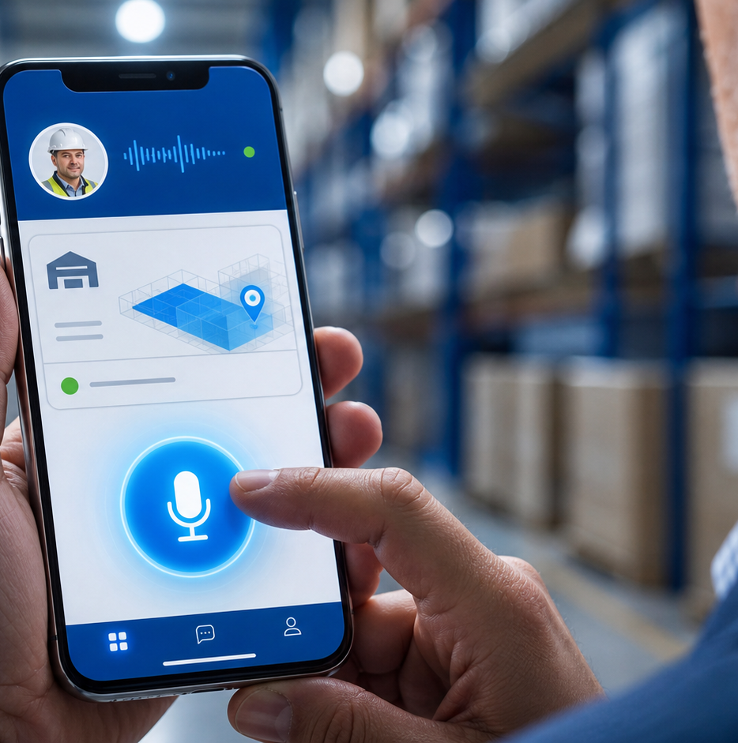
WAREHOUSE EXECUTIVE MOBILE EXPERIENCE
One tap.
Then speak.
The secure mobile web app confirms the worker, location and connection before recording begins.
WORKER
Priya Shah
ZONE
Central Warehouse
STATUS
Online • Secure

Slide 3
VOICE INTERACTION
The AI turns natural speech into a controlled transaction
“Received 50 Blue Widgets from Supplier X at Shelf B.”
ACTION
PRODUCT
QUANTITY
SUPPLIER
LOCATION
Receive
Blue Widget
50 units
Supplier X
Shelf B
AI: “Receive 50 Blue Widgets at Shelf B. Confirm?”
✓ CONFIRM
Inventory changes only after worker confirmation and business-rule validation.
AI VOICE INVENTORY • 03

Slide 4

REAL-TIME PROCESSING
Every update passes through a secure, auditable workflow
Speech-to-Text
AI Understanding
Inventory Rules
PostgreSQL
Live Dashboard
Audit History
Voice → AI → Validation → Database → Dashboard → Audit

Slide 5

MANAGER CONTROL CENTER
Low stock becomes an approved supplier action
TOTAL INVENTORY
PENDING APPROVALS
STOCK ACCURACY
CYCLE COUNTS
12,480
3
98.7%
24
LOW STOCK ALERT
Blue Widget below safety stock
Purchase-order draft created automatically
Manager approved → Email Sent ✓
AI VOICE INVENTORY • 05

Slide 6
ONE PLATFORM • COMPLETE INVENTORY CONTROL
Designed for the full warehouse workflow
01
02
03
04
CAPTURE
UNDERSTAND
CONTROL
PROVE
Voice updates
Hands-free operation
Offline synchronization
AI intent recognition
Cycle count
Damage reporting
Low-stock detection
Auto PO draft
Manager approval
Real-time dashboard
Inventory audit
Complete audit trail
Secure role-based access • Worker confirmation • Manager oversight • Every change recorded
AI VOICE INVENTORY • 06

Slide 7
AI Voice Inventory Management
Speak. Confirm. Update. Monitor.
REAL-TIME • AI POWERED • SECURE • ENTERPRISE READY
A faster, safer and fully auditable way to run warehouse operations.

