Slide 1


REAL WAREHOUSE • REAL APPLICATION • REAL DATABASE
AI Voice Inventory
Management
A Warehouse Executive speaks. The system validates. The manager sees the result instantly.
VOICE CONTROLLED
AUDIT READY
Manage real inventory operations faster using only your voice.

Slide 2
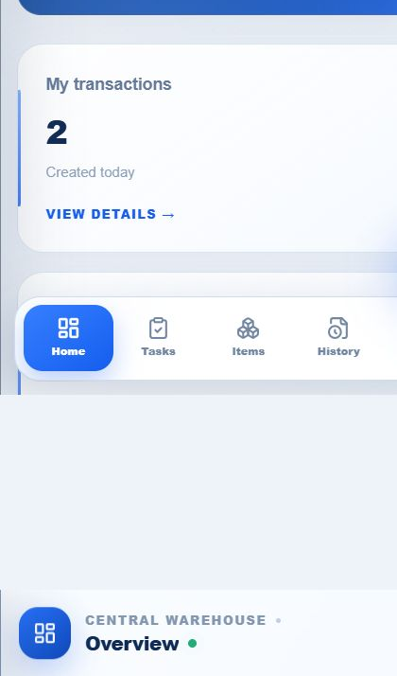
WAREHOUSE EXECUTIVE MOBILE WORKSPACE
One tap starts a controlled inventory action
The responsive web application confirms the worker, warehouse and connection before recording begins.
USER
Warehouse Executive
WORKSPACE
Central Warehouse
STATUS
Online • Secure
Open voice entry
The mobile web app works on warehouse phones, tablets and desktop browsers.

Slide 3
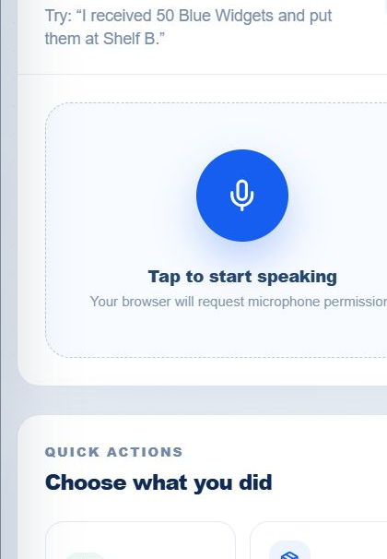
LIVE VOICE CAPTURE
The worker speaks naturally
VOICE TRANSACTION
WAREHOUSE EXECUTIVE
“Counted fifteen boxes of Nitrile Safety Gloves at Rack A-01.”
Counted 15 boxes of Nitrile Safety Gloves at Rack A-01.
LISTENING • SPEECH DETECTED
“Counted fifteen boxes of Nitrile Safety Gloves at Rack A-01.”

Slide 4
AI CLARIFICATION
The AI asks only for missing information
ALREADY UNDERSTOOD
Product: Nitrile Safety Gloves • Quantity: 15 boxes • Location: Rack A-01
AI ASKS
WORKER ANSWERS
“What inventory action did you perform?”
“Cycle count.”
AI keeps all previous details and merges only the missing answer.
The worker never has to repeat information the AI has already understood.

Slide 5
AI UNDERSTANDING
Voice becomes structured inventory data
ACTION
PRODUCT
QUANTITY
LOCATION
CONDITION
Cycle count
Nitrile Safety Gloves
15 boxes
Rack A-01
Good
AI READ-BACK
“Cycle count: 15 boxes of Nitrile Safety Gloves at Rack A-01. Confirm?”
✓ CONFIRM
The worker reviews and confirms the structured transaction before anything changes.

Slide 6
SECURE REAL-TIME PROCESSING
Every update passes through controlled business rules
1
2
3
4
5
6
Speech-to-Text
→
AI Extraction
→
Inventory Rules
→
PostgreSQL
→
Manager Dashboard
→
Audit History
SMART DISCREPANCY FLAG
System stock: 35 boxes → Physical count: 15 boxes → Difference: −20 boxes
Cycle-count differences require manager review. Stock remains unchanged until approval.
A large difference is flagged automatically and sent to the manager for review.

Slide 7
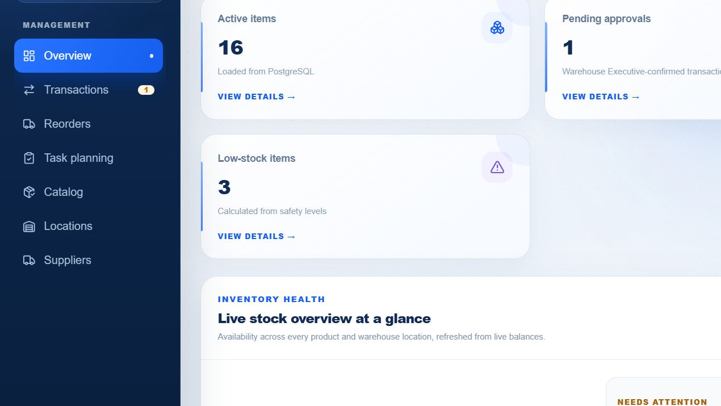
LIVE MANAGER DASHBOARD
The manager sees the request immediately
PENDING APPROVALS
1
LIVE FROM POSTGRESQL
Cycle count discrepancy
Nitrile Safety Gloves
Rack A-01 • 15 boxes
REVIEW
The manager dashboard updates in real time with one new approval request.

Slide 8
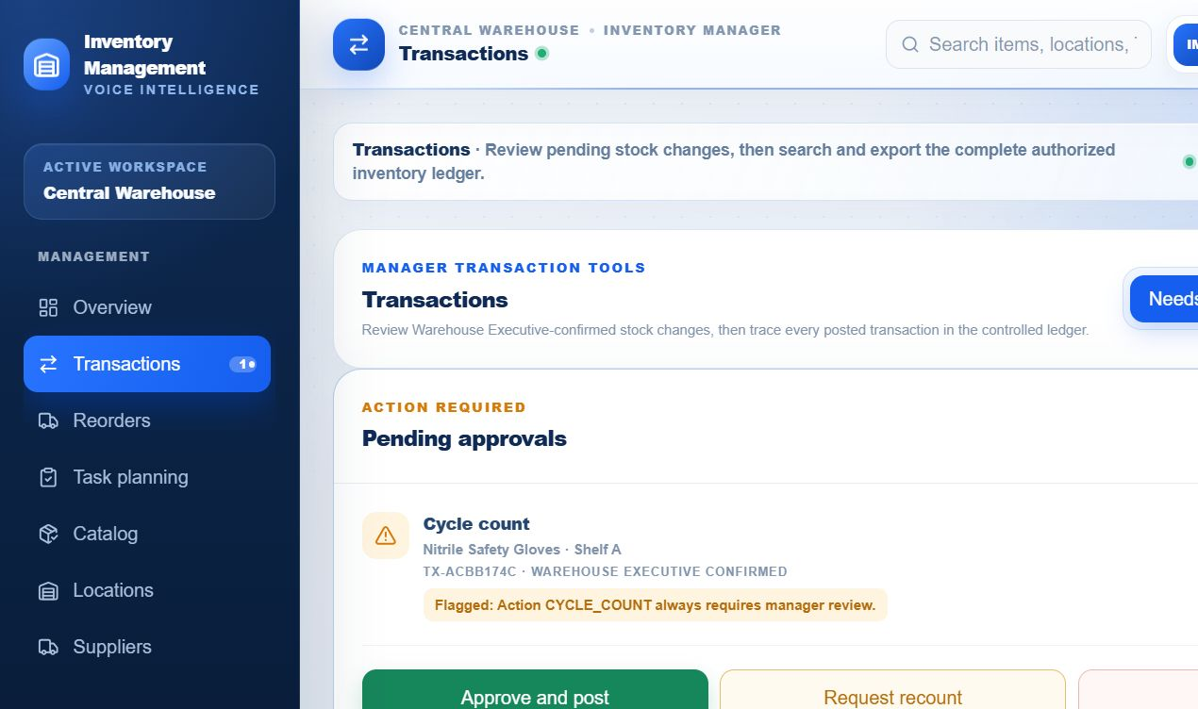
CYCLE COUNT • MANAGER DECISION REQUIRED
Nitrile Safety Gloves • Rack A-01
System: 35 boxes Counted: 15 boxes Difference: −20
APPROVE AND POST
REQUEST RECOUNT
REJECT
Manager selects Approve
The manager reviews the difference and selects Approve and Post.

Slide 9
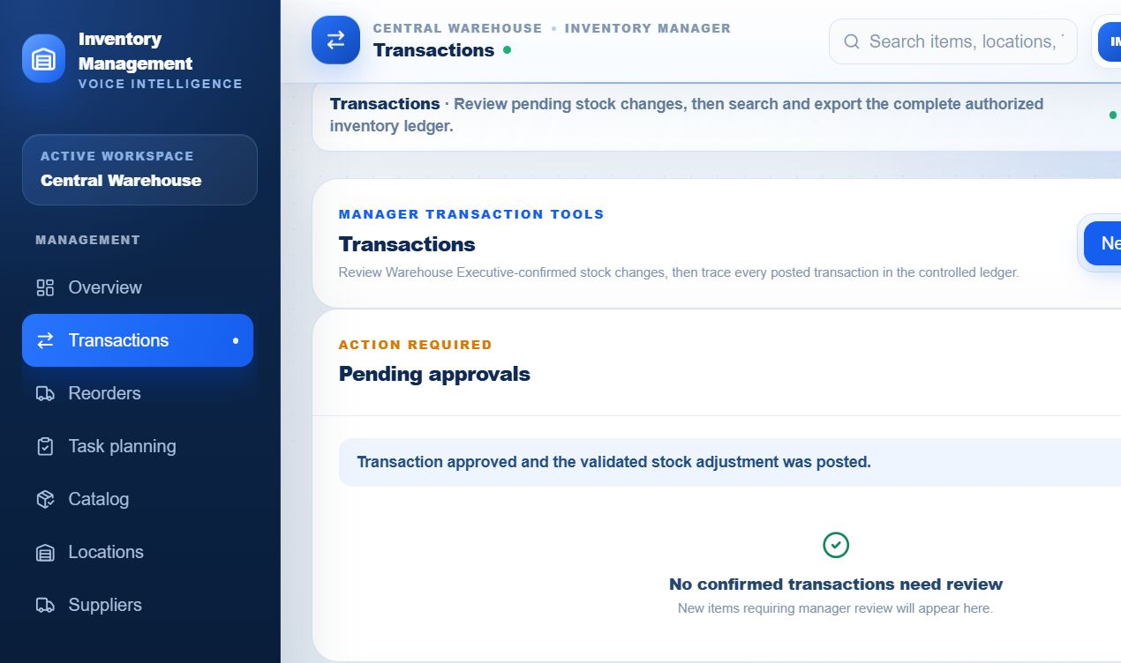
✓
Adjustment approved and posted
Available stock updated: 35 → 15 boxes
Pending approvals updated: 1 → 0
POSTGRESQL UPDATED
The stock balance and manager KPIs update immediately after approval.

Slide 10
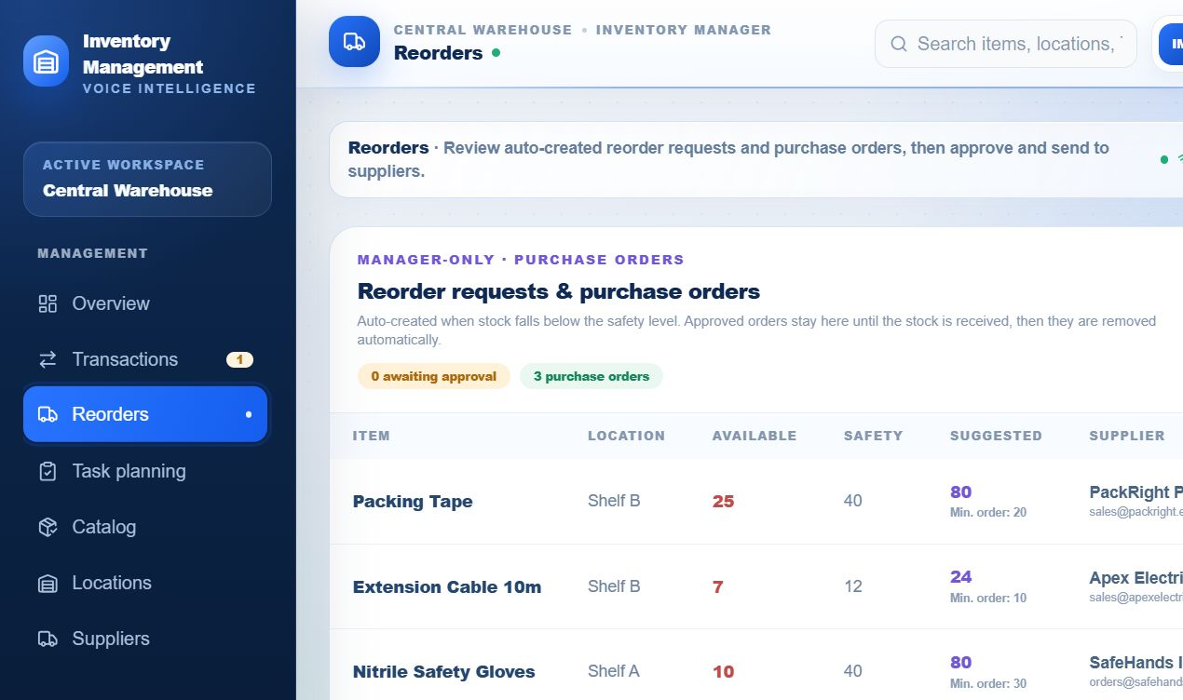
AUTOMATIC REORDER CONTROL
Low stock creates a purchase-order draft
AVAILABLE
15 boxes
SAFETY STOCK
40 boxes
SUGGESTED ORDER
80 boxes
SUPPLIER
SafeHands Industrial
AFTER MANAGER APPROVAL
Supplier email queued → Sent ✓
PO DRAFT • PO-2026-0815
Because 15 is below the safety stock of 40, the system drafts an order for 80 boxes.

Slide 11
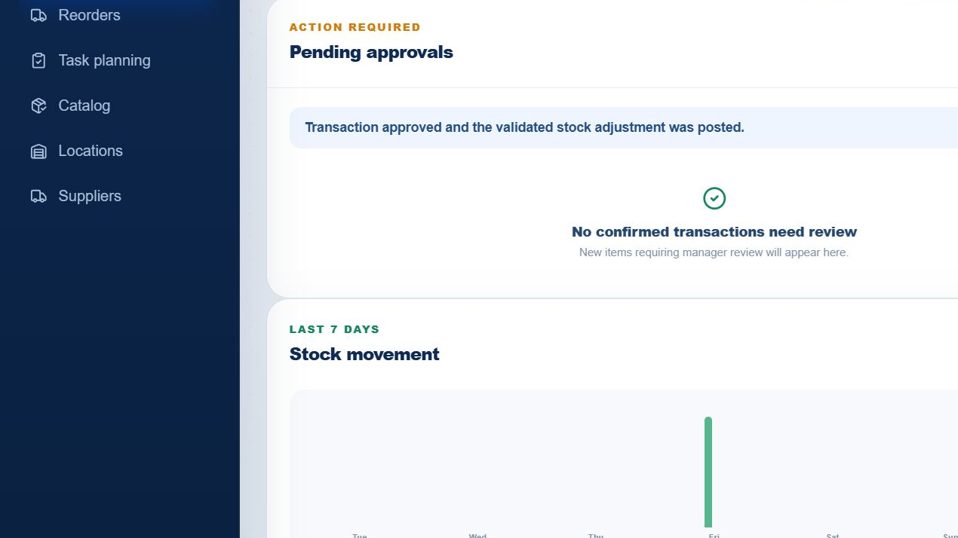
COMPLETE ACCOUNTABILITY
Every inventory decision is recorded
TRANSACTION
TX-ACBB174C
ACTION
Cycle count
PRODUCT
Nitrile Safety Gloves
PREVIOUS STOCK
35 boxes
NEW STOCK
15 boxes
CREATED BY
Warehouse Executive
REVIEWED BY
Inventory Manager
STATUS
POSTED
The audit trail records the worker, manager, timestamps, transcript and final stock result.

Slide 12
SIMPLE CONTROLS • CLEAR RESPONSIBILITY
The right approval rule for every inventory action
RECEIVE
SHIP / USE
TRANSFER
Posts after worker confirmation and validation
Posts after validation; unusual or near-zero movements are flagged
Moves stock between approved warehouse locations
CYCLE COUNT
DAMAGE / LOSS
LOW STOCK
Differences require manager approval
Always requires manager approval and an audit reason
Creates a purchase-order draft for manager approval
Routine work stays fast, while risky adjustments receive the correct manager oversight.

Slide 13
ENTERPRISE-READY WAREHOUSE OPERATIONS
AI Voice Inventory Management
Faster inventory updates • Fewer manual errors • Complete accountability
Speak. Confirm. Update. Monitor.
REAL-TIME • AI POWERED • SECURE • AUDIT READY
A faster, safer and fully auditable way to manage warehouse inventory.

