Slide 1
IBM University Engagement Project Submission
“Exploring the Power of Agentic AI with IBM Granite and LangFlow”

Slide 2

Project Tile – Smart Study Generator Agent
Domain of Project – Education
Faculty Name | Recent Passport Photo | Email ID | Mobile number [WhatsApp]
Prit Vyas |  | vyasprit962@gmail.com Prit.vyas.foict@monarkuni.ac.in EFIBM26B2614180115@edunetmail.com | 9265068824 9909264531

Slide 3
Problem Statement -
Problem Statement : Smart Study Generator Agent
The Challenge
Students today face an overwhelming flood of information—lecture notes, textbooks, research papers, YouTube tutorials, and online resources. This content is scattered, unorganized, and often not personalized to their learning pace or style. As a result, students struggle with finding the right study material, summarizing key concepts, and staying exam-ready. Traditional study tools only provide static notes or flashcards, failing to adapt dynamically to student needs. The challenge is to move beyond static resources toward an intelligent, adaptive study companion. .
The Objective
Build an agentic AI-powered Smart Study Generator that personalizes and streamlines learning for students. The solution should:
Fuse Learning Resources: Aggregate content from class notes, textbooks, research articles, and online tutorials into structured, easy-to-digest study material.
Enable Multimodal Input: Allow students to upload notes, voice queries, or images (e.g., textbook pages), and generate concise summaries, flashcards, or concept maps.
Create a Predictive & Agentic Layer: Recommend personalized study plans, highlight important topics based on syllabus or past exams, and provide predictive alerts (e.g., “Focus on Topic X—frequently asked in exams”).
Visualize Study Progress: Offer a real-time dashboard showing learning milestones, weak areas, practice quizzes, and performance forecasts.

Slide 4
Proposed Solution -
Proposed Solution: Smart Study Generator Agent
The proposed solution is an AI-powered Smart Study Generator built using LangFlow, IBM watsonx.ai, and IBM Granite Models. The system acts as an intelligent study assistant that helps students convert scattered learning resources into structured study material.
Students can upload lecture notes, PDFs, textbook pages, or ask questions directly. The AI processes the uploaded content and generates concise summaries, important points, flashcards, practice quizzes, and personalized study plans.
The solution consists of multiple AI agents working together inside LangFlow.
Study Material Agent – Generates summaries and important notes from uploaded documents.
Flashcard Agent – Creates question-answer flashcards for revision.
Quiz Generator Agent – Generates MCQs, True/False, and short-answer questions.
Study Planner Agent – Creates personalized study schedules based on exam date and available study hours.
Question Answering Agent – Answers questions only from uploaded notes using Retrieval-Augmented Generation (RAG).
The generated study material is displayed through a user-friendly interface, enabling students to prepare efficiently and improve learning outcomes.

Slide 5
Technology Used
These are the technologies/platforms your project uses.
LangFlow – Visual AI workflow builder for designing agentic workflows.
IBM watsonx.ai – Provides access to IBM Granite models and AI services.
IBM Granite 4.0 8B Instruct – Large Language Model used for summarization, quiz generation, flashcards, and study planning.
IBM Cloud – Hosts LangFlow and IBM watsonx.ai services.
RAG (Retrieval-Augmented Generation) – Retrieves information from uploaded study materials before generating responses.

Slide 6
Langflow component Used -
These are the technologies/platforms your project uses.
1. Chat Input
Provides the interface where students enter their study-related queries, upload requests, or interact with the Smart Study Generator using natural language.
2. File Upload
Allows students to upload study materials such as PDF notes, textbooks, lecture slides, and documents for AI-based processing.
3. File Loader
Extracts textual content from the uploaded files, making the study material ready for further processing within the LangFlow workflow.
4. Text Splitter
Divides large documents into smaller, manageable chunks, improving retrieval accuracy and enabling efficient processing by the AI model.
5. Embeddings
Converts the text chunks into high-dimensional vector representations, enabling semantic search and similarity-based information retrieval.
6. Chroma Vector Store
Stores the generated embeddings in a vector database, allowing fast and accurate retrieval of relevant study content during user queries.
7. Retriever
Searches the vector database to find the most relevant information related to the student's question before sending it to the AI model.
8. Prompt Template
Defines structured instructions for the IBM Granite model, ensuring responses such as summaries, flashcards, quizzes, and study plans are generated in the desired format.
9. IBM watsonx Model
Uses the IBM Granite 4.0 8B Instruct model to generate intelligent, context-aware responses including summaries, personalized study plans, flashcards, and practice quizzes.
10. Chat Output
Displays the AI-generated results, such as summaries, answers, quizzes, flashcards, and study recommendations, to the student in an easy-to-read format.

Slide 7
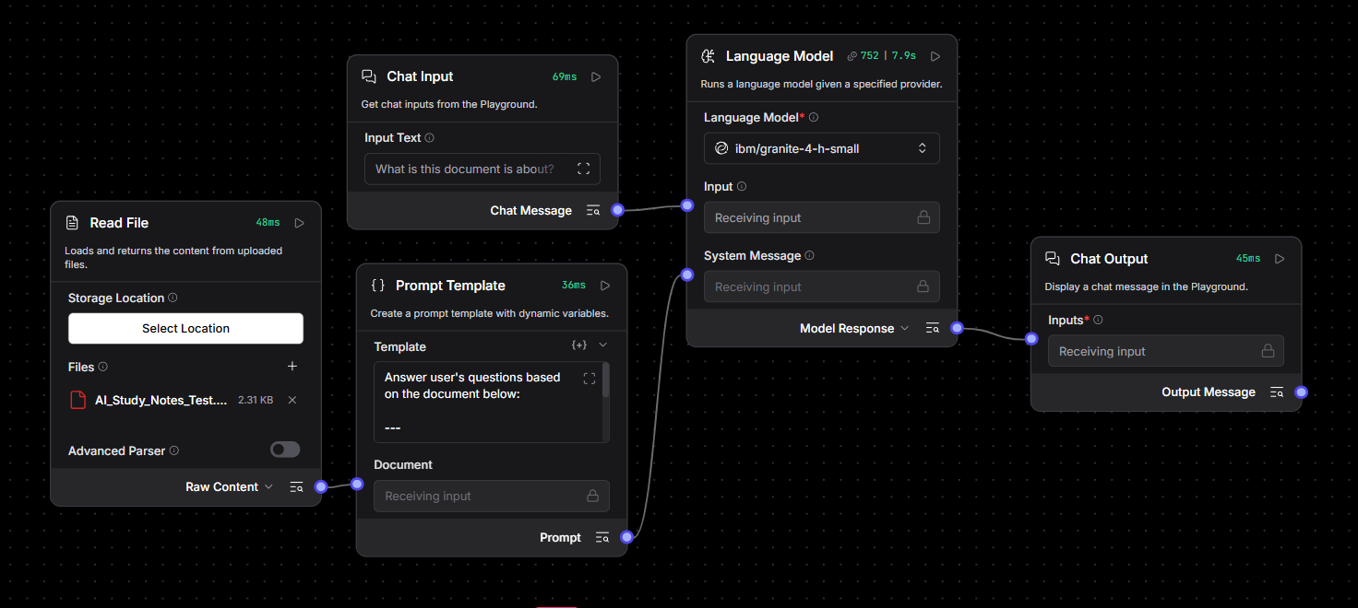
Langflow workflow -

Slide 8
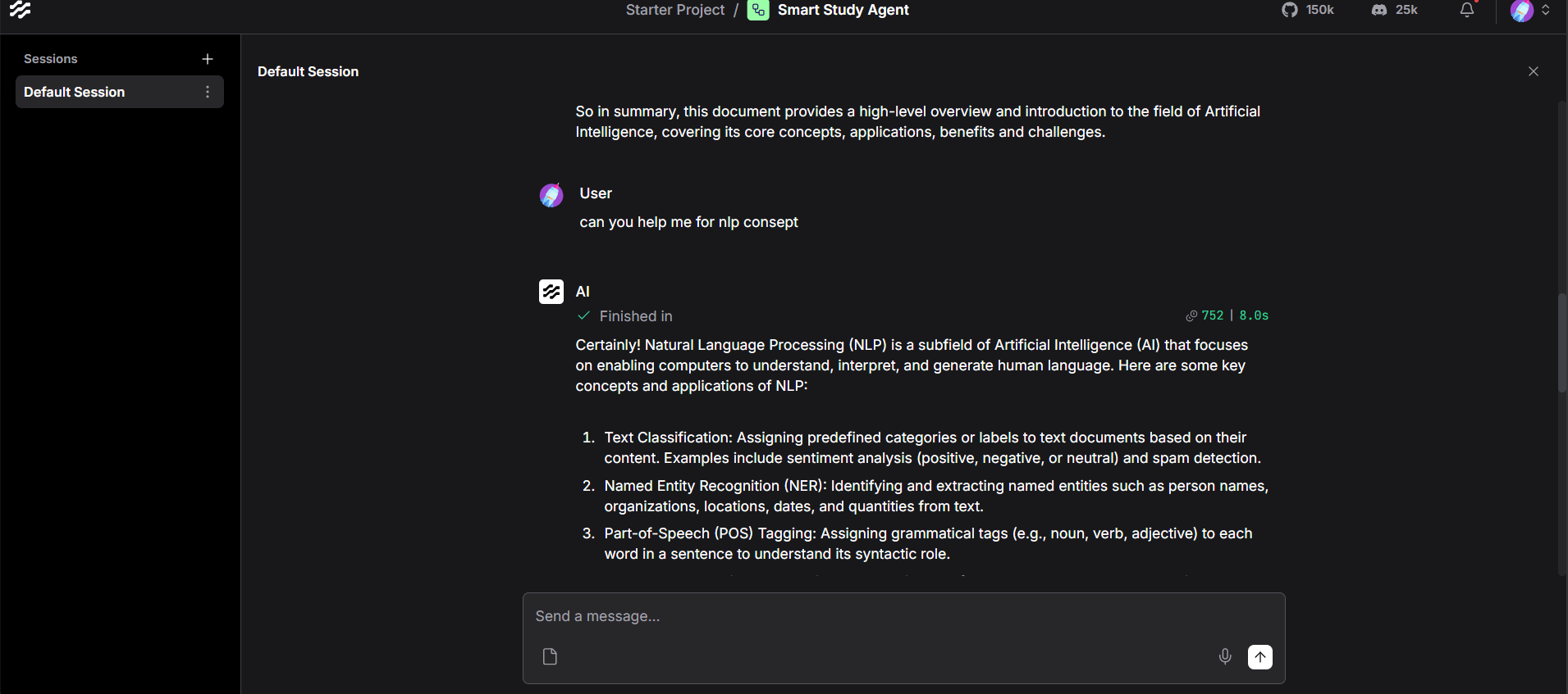
Smart Study Generator Agent - Output

Slide 9
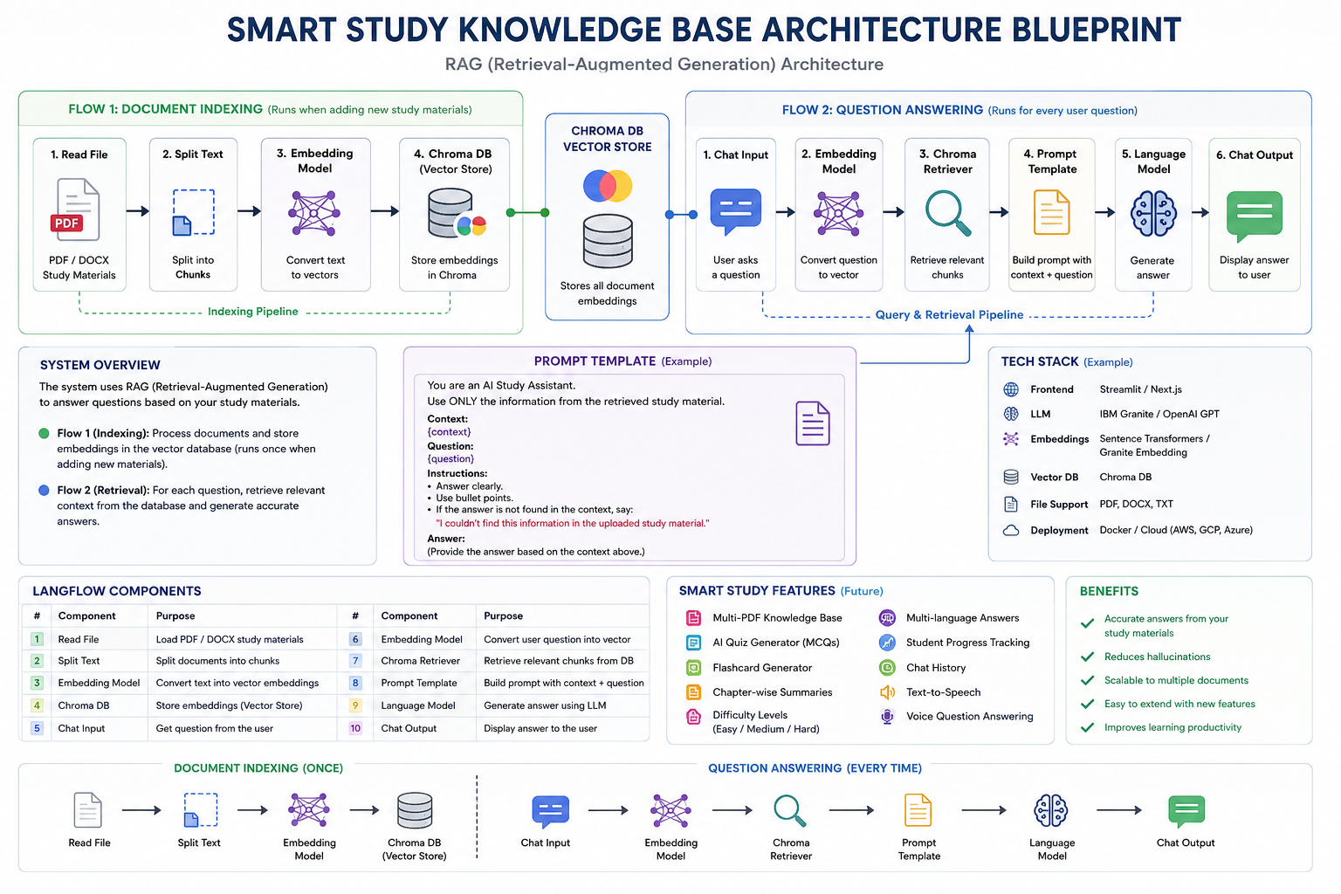
Architecture blueprint

Slide 10

Role of Agentic AI in Smart Study Generator\
Role of Agentic AI in Smart Study Generator
Agentic AI enables the Smart Study Generator to function as an intelligent and autonomous learning assistant rather than a traditional chatbot. Powered by IBM watsonx.ai, IBM Granite Models, and LangFlow, the system understands students' learning requirements and generates personalized study resources from uploaded documents.
The AI agent automatically analyzes study materials such as lecture notes, PDFs, textbooks, and research articles. It performs multiple learning tasks including summarization, concept explanation, flashcard generation, quiz creation, and personalized study planning, allowing students to prepare more effectively.
Unlike conventional study tools, the Agentic AI continuously adapts to the student's queries and learning context. It retrieves relevant information from uploaded documents using Retrieval-Augmented Generation (RAG), ensuring accurate, context-aware, and reliable responses while reducing hallucinations.
The agent is also capable of organizing scattered learning resources into structured study content, identifying key concepts, and recommending important topics for revision. This enables students to save time, improve understanding, and focus on high-priority exam topics.
Overall, Agentic AI makes the Smart Study Generator proactive, personalized, and goal-oriented, acting as a smart digital study companion that supports efficient learning, exam preparation, and continuous knowledge enhancement.

Slide 11
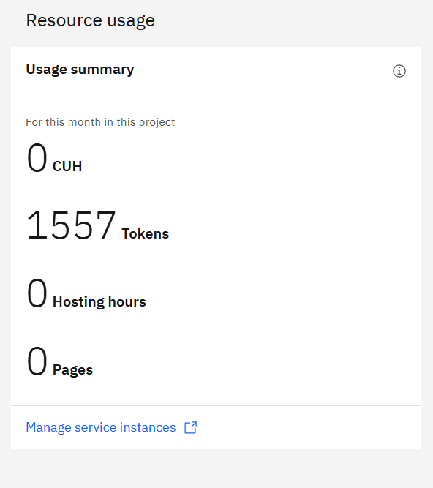
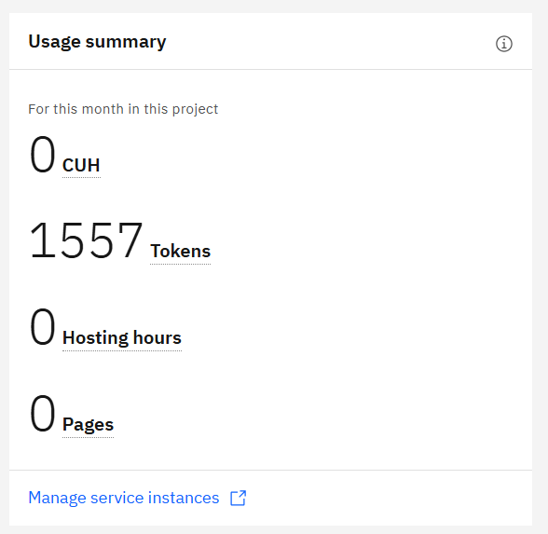


Token Usage
11,761 token are used
Before Prompt
After the Prompt
·
·
·

Slide 12
Novelty and Uniqueness
The proposed Smart Study Generator Agent combines Agentic AI, Retrieval-Augmented Generation (RAG), IBM Granite Models, and LangFlow to create an intelligent and personalized learning assistant for students.
Agentic AI-Powered Learning – Unlike traditional study tools, the AI agent autonomously understands user requirements, analyzes uploaded study materials, and performs multiple learning tasks such as summarization, quiz generation, flashcard creation, and study planning.
RAG-Based Knowledge Retrieval – Integrates Retrieval-Augmented Generation (RAG) to retrieve relevant information from uploaded documents before generating responses, ensuring accurate, context-aware, and trustworthy study material.
Personalized Study Experience – Generates customized study plans, revision notes, and practice questions based on the student's uploaded content and learning goals.
Multi-Document Learning – Combines information from lecture notes, textbooks, PDFs, and research materials into a single, organized knowledge base for seamless learning.
Interactive AI Study Assistant – Enables students to ask natural language questions and receive intelligent answers directly from their uploaded study resources.
Automated Exam Preparation – Creates summaries, flashcards, MCQs, True/False questions, and important topic lists automatically, reducing manual effort and improving revision efficiency.
Built with IBM AI Technologies – Developed using LangFlow, IBM watsonx.ai, and IBM Granite Models, providing a scalable, secure, and enterprise-ready AI solution.
This makes the Smart Study Generator more than just a chatbot—it acts as an intelligent digital study companion that simplifies learning, enhances exam preparation, and delivers a personalized educational experience.

Slide 13
Git Hub Link
· Please create public github repository (Enable Add README button while creating repository) with format –
Please test and Paste the working Github URL –
https://github.com/Pritvyas1510/Smart-Study-Generator-Agent.git
·
·
·

Slide 14
Future Scope
1. AI-Powered Voice Learning & Multilingual Support –
The Smart Study Generator can be enhanced with a voice-enabled learning assistant and multilingual capabilities. Students will be able to ask questions using voice commands and receive explanations in their preferred language, making learning more accessible, interactive, and inclusive for users from diverse linguistic backgrounds.
2. Intelligent Learning Analytics & Progress Tracking –
Future versions can include a personalized learning dashboard that tracks study progress, identifies weak topics, recommends revision schedules, and predicts exam readiness using AI-driven analytics. This will help students focus on areas that require improvement and optimize their learning journey.
3. OCR & Handwritten Notes Recognition –
The system can be extended to support Optical Character Recognition (OCR), enabling students to upload handwritten notes, textbook images, or whiteboard photos. The AI will automatically extract text, generate summaries, flashcards, quizzes, and provide explanations from the extracted content.
4. Adaptive Study Planner & Exam Prediction –
The AI agent can analyze syllabus coverage, previous study performance, and upcoming examination schedules to generate adaptive study plans. It can also prioritize frequently asked topics and send intelligent reminders to improve exam preparation.
5. Mobile Application & Cloud Synchronization –
A mobile application can be developed to allow students to study anytime and anywhere. Cloud synchronization will securely store study materials, AI-generated notes, quizzes, and learning progress across multiple devices.
6. Collaborative Learning Platform –
Future enhancements may include collaborative study groups where students can share notes, discuss concepts, solve quizzes together, and receive AI-assisted recommendations, creating a more engaging and interactive learning environment.
·
·
·

Slide 15
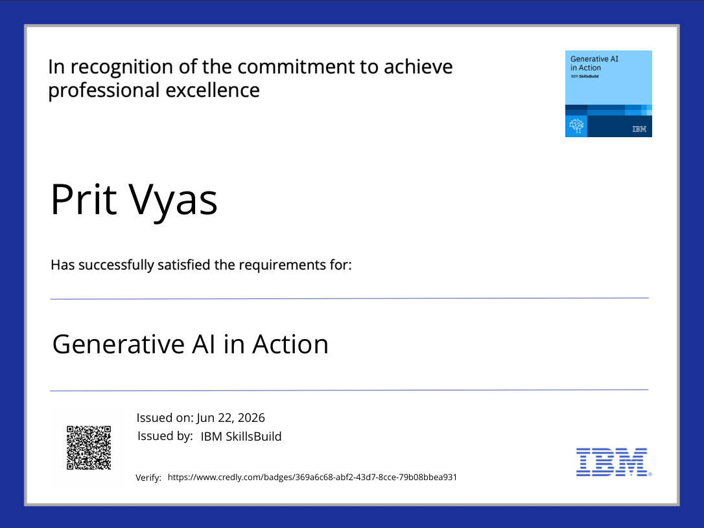
Certificates Earned:
Please add your credly certificate

Slide 16
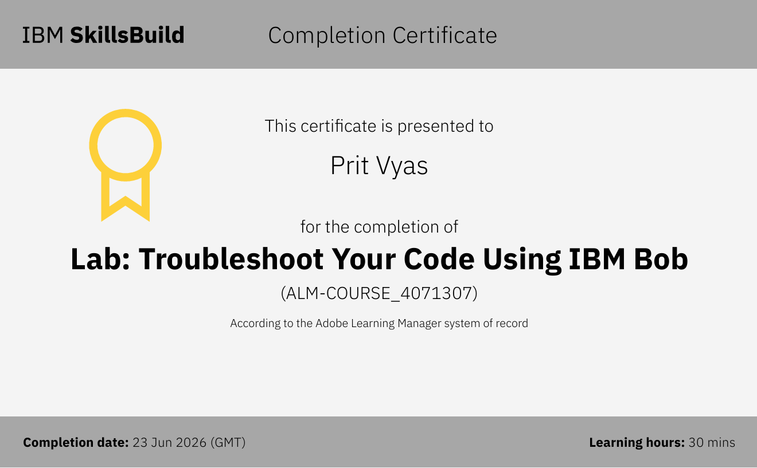
Certificates Earned:​
Add your IBM BOB Certificate

Slide 17


