Slide 1
PRIVACY AND DATA PROTECTION

Slide 2
Every citizen has the right of access to all computerised data that concern him, which he may require to be corrected and updated, and the right to be informed of the purpose for which they are intended, as laid down by law.
The law shall define the concept of personal data, together with the terms and conditions applicable to its automatised treatment and its linkage, transmission and use, and shall guarantee its protection, particularly by means of an independent administrative entity.
Information technology may not be used to treat data concerning philosophical or political convictions, party or trade union affiliations, religious faith, private life or ethnic origins, save with the express consent of the datasubject, or with an authorisation provided for by law and with guarantees of nondiscrimination, or for the purpose of processing statistical data that are not individually identifiable.
Third-party access to personal data is prohibited, save in exceptional cases provided for by law.
The allocation of a single national number to any citizen is prohibited. 6. Everyone is guaranteed free access to public-use information technology networks. The law shall define the regime governing cross-border data flows, and the appropriate means for protecting both personal data and other data whose safeguarding is justified in the national interest. 7. Personal data contained in manual files enjoy the same protection as that provided for in the previous paragraphs, as laid down by law.
Artigo 35.º Constitution of the Portuguese Republic - Use of information technology

Slide 3
Charter of Fundamental Rights of the European Union
Article 7.º - Respect for private and family life
Everyone has the right to respect for his or her private and family life, home and communications.
Article 8.º - Protection of personal data
1. Everyone has the right to the protection of personal data concerning him or her.
2. Such data must be processed fairly for specified purposes and on the basis of the consent of the person concerned or some other legitimate basis laid down by law. Everyone has the right of access to data which has been collected concerning him or her, and the right to have it rectified.
3. Compliance with these rules shall be subject to control by an independent authority.

Slide 4
Diretive 96/45/CE
'personal data’- shall mean any information relating to an identified or identifiable natural person ('data subject'); an identifiable person is one who can be identified, directly or indirectly, in particular by reference to an identification number or to one or more factors specific to his physical, physiological, mental, economic, cultural or social identity.

Slide 5

Principles of the Processing of Personal Data
Principle of legitimate purpose – what will be done with the data, clearly, and why the data need to be. If this is not completed, it does not make sense to provide the data.
Principle of transparency – the data subject has to know how, what, in what way, explicitly, hoe data will be processed
Principle of proportionality – analysed in the light of purpose of data processing.

Slide 6

General Data Protection Regulation

Slide 7
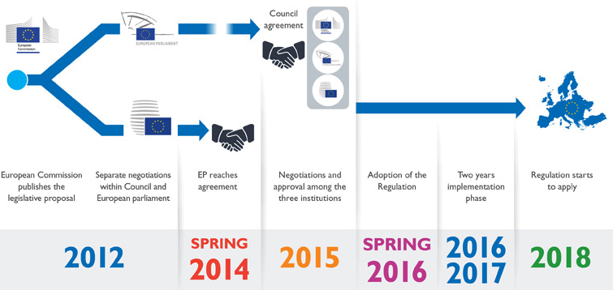

Slide 8
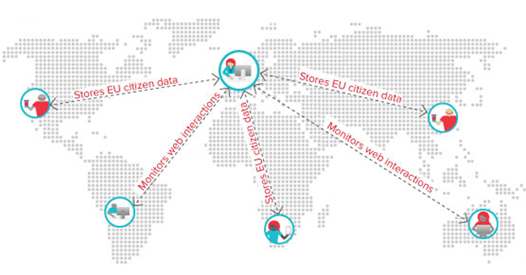

Slide 9

Comissão Nacional de Protecção de Dados
The CNPD – Comissão Nacional de Protecção de Dados – is the Portuguese Data Protection Authority.
The CNPD is an independent body, with powers of authority throughout national territory. It is endowed with the power to supervise and monitor compliance with the laws and regulations in the area of personal data protection, with strict respect for human rights and the fundamental freedoms and guarantees enshrined in the Constitution and the law.

Slide 10

General Data Protection Regulation
give citizens the power and control over their personal data.

Slide 11
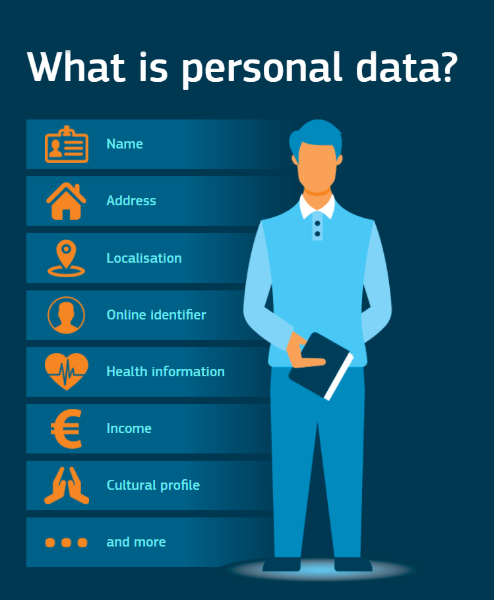
Personal Data - GDPR
‘personal data’ means any information relating to an identified or identifiable natural person (‘data subject’); an identifiable natural person is one who can be identified, directly or indirectly, in particular by reference to an identifier such as a name, an identification number, location data, an online identifier or to one or more factors specific to the physical, physiological, genetic, mental, economic, cultural or social identity of that natural person;

Slide 12
Data Protection Impact Assessment
Notification of Personal Data Breaches
Data Protection Officer
GDPR
Consent
Right to erasure (‘right to be forgotten’)
Personal Data
Data Portability

Slide 13
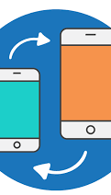
Data Portability
To further strengthen the control over his or her own data, where the processing of personal data is carried out by automated means, the data subject should also be allowed to receive personal data concerning him or her which he or she has provided to a controller in a structured, commonly used, machine-readable and interoperable format, and to transmit it to another controller. Data controllers should be encouraged to develop interoperable formats that enable data portability.

Slide 14

Data Protection Impact Assessment
Where a type of processing in particular using new technologies, and taking into account the nature, scope, context and purposes of the processing, is likely to result in a high risk to the rights and freedoms of natural persons, the controller shall, prior to the processing, carry out an assessment of the impact of the envisaged processing operations on the protection of personal data. A single assessment may address a set of similar processing operations that present similar high risks.

Slide 15

Data Protection Officer
Is an independent person .
The organizations that can be consulted for database-personal and one of its main supervisory authorities.
Must be a person who specializes in technology and data protection law.
Appointment is only mandatory in some situations, eg hospitals.

Slide 16

Right to erasure (‘right to be forgotten’)
The data subject shall have the right to obtain from the controller the erasure of personal data concerning him or her without undue delay and the controller shall have the obligation to erase personal data.
Corteja vs Google.
Right to erasure (“right to be forgotten”) vs freedom expression.

Slide 17
Lawfulness of processing
The data subject has given consent to the processing of his or her personal data for one or more specific purposes;
Processing is necessary for the performance of a contract to which the data subject is party or in order to take steps at the request of the data subject prior to entering into a contract;
Processing is necessary for compliance with a legal obligation to which the controller is subject;
Processing is necessary in order to protect the vital interests of the data subject or of another natural person;
Processing is necessary for the performance of a task carried out in the public interest or in the exercise of official authority vested in the controller;
Processing is necessary for the purposes of the legitimate interests pursued by the controller or by a third party, except where such interests are overridden by the interests or fundamental rights and freedoms of the data subject which require protection of personal data, in particular where the data subject is a child.

Slide 18

Notification of Personal Data Breaches
The obligation of organizations to notify the CNPD whenever there is a breach of personal data. Organizations have 72 hours to communicate after their knowledge.
As of February 22, 222 personal data breaches had been reported since May 25, 2018.

Slide 19

Complaint - CNPD
Send an e-mail to geral@cnpd.pt with the subject matter, describing the situation and attaching relevant information with subject compliant.
https://ec.europa.eu/justice/article-29/structure/data-protection-authorities/index_en.htm

Slide 20
Thank you for your attention!

