Slide 1
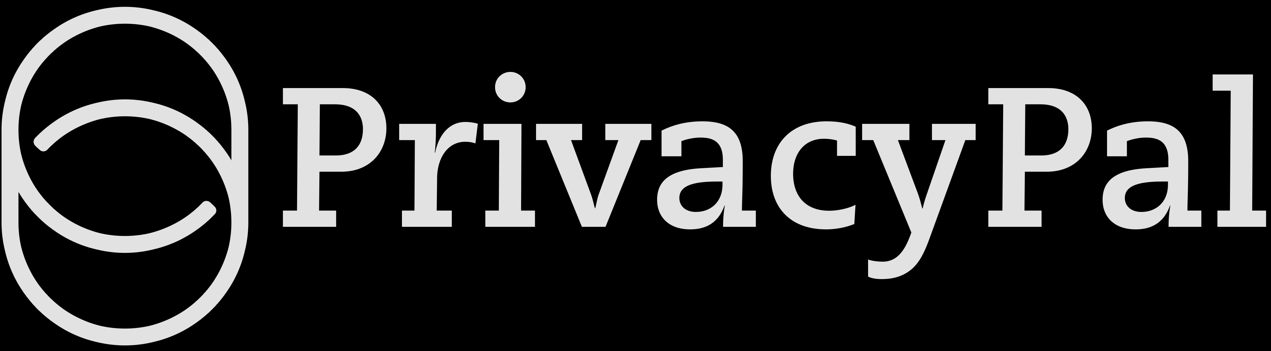
PRIVACYPAL FOR ENTERPRISE
Govern every AI.
The governance and enablement layer for AI — so your enterprise can adopt AI everywhere it creates value, with trust and compliance built in. Not a brake on innovation. The layer that unlocks it.
Book a demo →
Watch the product intro

Slide 2
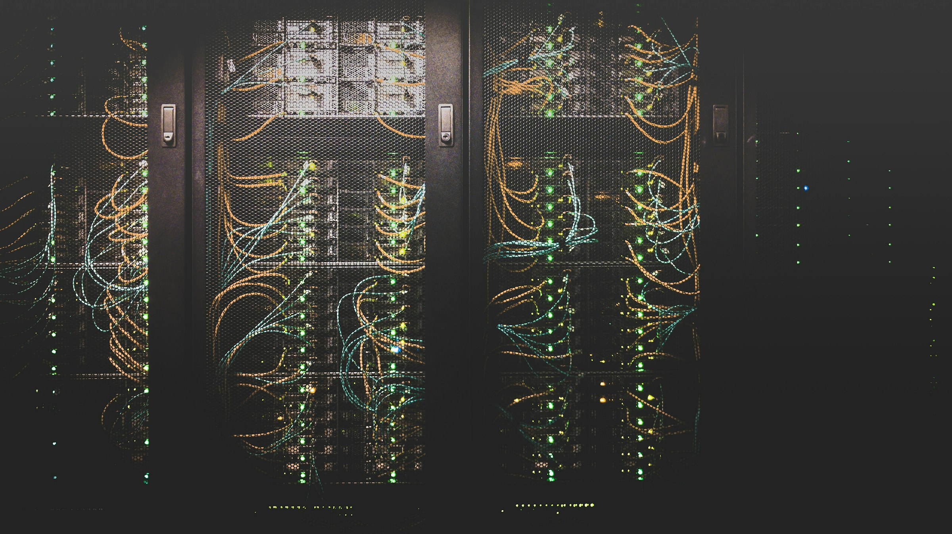
THE GOVERNANCE GAP
Your people are already all-in on AI.
Your governance isn't.
01
AI is already ~60% of the workday.
Teams run client data, code and strategy through ChatGPT, Claude and Copilot every day — with or without you.
02
Block it, and innovation stalls.
The only lever most security teams have is “no.” AI initiatives die in the review queue while competitors ship.
03
Allow it ungoverned, and trust is on the line.
Unprotected prompts leak PII, PHI and IP to third-party models — risking trust your firm spent a lifetime earning.
Stop blocking AI. Start governing it.
02 / 11

Slide 3
THE GOVERNANCE & ENABLEMENT LAYER
The trust layer beneath your AI operating system.
# Install on any desktop or server
$ curl -sSL https://get.privacypal.ai | sh
# Every AI agent on this machine is
# now protected by PrivacyPal Cloud.
$ privacypal status
✓ Gateway running on 127.0.0.1:7878
✓ Watching 4 local AI processes
✓ Routing via privacypal.yourco.internal
✓ 0 prompts left this network
One layer. Every AI, every endpoint, every data store — governed and enabled.
03 / 11

Slide 4
THE MECHANISM · PRIVACY TWINS
Language-based privacy for a language-based threat.
Others stop at redaction — which breaks the model's output and kills adoption. PrivacyPal substitutes a context-preserving Privacy Twin, then restores the real values on the way back.
① IN YOUR NETWORK — REAL DATA
② WHAT THE MODEL SEES — TWINS
③ WHAT YOU GET BACK — RESTORED
"Summarize Margaret Chen's chart — MRN 4471-8829, admitted March 14."
→
"Summarize Nancy Grace's chart — MRN 8826-3142, admitted April 22."
→
Accurate clinical summary for Margaret Chen — full context intact, 100% faithful to the model's answer.
swap
restore
The work gets done. The data never leaves.
40ms avg interception
47 PII · PHI · PCI · IP classes
100% on-device · zero-knowledge
04 / 11

Slide 5
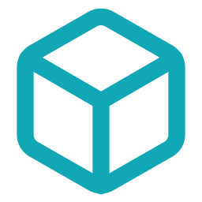





THE DEPLOYMENT CHECKLIST
Sovereign by design. Drop in anywhere your workloads live.
Zero code changes
AWS · Azure · GCP · bare metal
Air-gapped option
Intercepts AI traffic at the network edge. Existing agents, copilots and SDKs keep their config — every request twin-swapped.
Terraform, Helm, or single-container deploy. Production-ready in an afternoon, inside your tenancy — no third-party DPAs.
Run detection with on-prem models. No outbound traffic. Built for regulated enterprises — Healthcare, FSI, Defense.
Provider-agnostic gateway
Streaming-safe
Horizontal scale & 24/7 SLA
OpenAI / Anthropic / Google compatible. Route to GPT, Claude, Gemini, Mistral, Llama or your own fine-tune.
Detects and swaps mid-stream without breaking token-by-token responses. Users never see a hitch.
Stateless workers scale to 100k req/s. P99 under half a second. Dedicated SE. 24/7 support included.
05 / 11

Slide 6

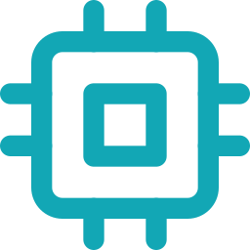


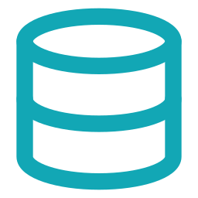

INCLUDED WITH CLOUD · NETWORK DSPM
Govern the AI data layer like the database layer.
Agentless discovery
Context-aware classification
Risk that's actually risk
Connect a store and it's in the scan queue. SQL, Mongo, Supabase, Drive, object storage — read in place, no agents.
The intelligence behind Privacy Twins reads data like a human. PII, PHI, financials, schemas — no regex to maintain.
Sensitivity tied to access, exposure and business purpose. An SSN in a public bucket is critical; a dev fixture is not.
One-click remediation
RAG, vector & agent memory
Sovereign by design
Privacy Twin protect columns, trigger a workflow, or route findings to the owner with full context.
Scan the AI data layer the way you scan the database layer — where models read from, and where data quietly leaks in.
Scans run inside your network against the same gateway. Findings, classifications and remediation never leave your tenancy.
06 / 11

Slide 7


VERIFIABLE TRUST LAYER · POWERED BY PEAQ
Every twin and action, anchored on-chain.
Tokenized, never exposed
Sensitive values become Privacy Twins. Only cryptographic hashes and content IDs go on-chain — never the PII.
PEAQ · PRIVACY_TWIN_BATCH_AUDIT
✓ confirmed
tx 0x9f3c…a847 block #4,182,663
AI activity, audited on-chain
3a7f…e1 → c19e…b4
name
Each session is one immutable peaq transaction — user, machine identity, model and twin hashes. Tamper-proof.
88b2…9c → 4471…42
mrn
d04a…7f → a8e2…10
address
DID-secured vault access
machine DID
did:peaq:0x0841…84ef
A peaq DID is each machine's cryptographic identity. An encrypted vault and DID-gated endpoints guard every twin.
IPFS CID
QmP8Ud…1YGT ✓ pinned
payload
hashes only · 0 bytes PII
07 / 11

Slide 8
ARCHITECTURE
Stateless. Sovereign. Throughput-grade.
YOUR ENVIRONMENT
PRIVACYPAL CLOUD · IN YOUR VPC
OUTBOUND
AI agents & copilots
→
Sovereign gateway + DSPM
→
LLM providers
Chat, IDE, RAG apps, internal agents
Twin-swap in motion · agentless scan at rest
GPT · Claude · Gemini · Llama — twins only
100k
<0.5s
Zero
Air-gap
requests / sec
P99 latency
knowledge · your keys
ready · no egress
08 / 11

Slide 9

TOTAL GOVERNANCE & VISIBILITY
Total governance. Full visibility. Provable trust.
Full visibility
Every prompt to every model — logged: who, tool, data type, when.
Findings, classifications & remediation never leave your tenancy.
Immutable on-chain audit trail for high-assurance evidence.
Compliance-ready exports
GDPR
CCPA
HIPAA
SOC 2
ISO 27001
09 / 11

Slide 10

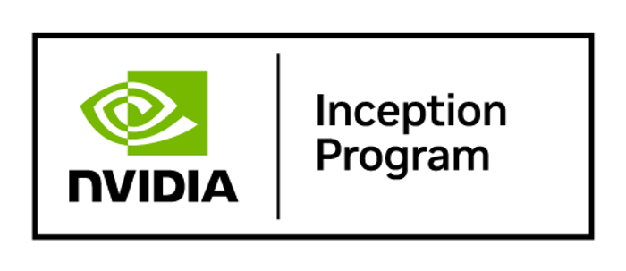
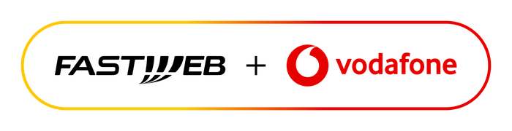
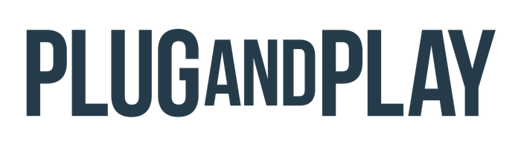
PROOF · INNOVATION WITH TRUST
“
We shipped an AI assistant on patient records in six weeks. Legal signed it in two days. That's PrivacyPal Cloud.
— CTO, healthcare SaaS · Series B
10M+
Days
ELEMENTS GOVERNED IN REAL TIME
NOT QUARTERS, TO LAUNCH
10 / 11

Slide 11

● THE GOVERNANCE LAYER FOR AI
Stop blocking AI.
Start governing it.
The layer that turns AI from your biggest risk into your biggest advantage.
Book a demo →
Watch the product intro
privacypal.ai · Book a demo · Solution Engineering

