Slide 1
A Visualization Tool to Help Technical Practitioners of Differential Privacy
Liudas Panavas, Saeyoung Rho, Hari Bhimaraju, Wynee Pintado, Rebecca N. Wright, Rachel Cummings
Notes:
I’ll be presenting our work in progress project titled A visualizaiton tool to help practitioners of differential privacy

Slide 2


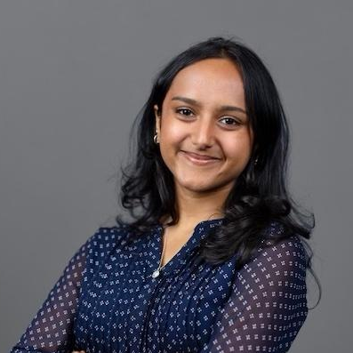






Research Team
Liudas Panavas
Saeyoung
Rho
Hari Bhimaraju
Wynee Pintado
Rebecca Wright
Rachel Cummings
Notes:
Words are good, Make the logos match the people
First I wanted to introduce the team working on this. I’m liudas panavas, from Northeastern. The rest of my collaborators are Saeyoung, hari … Again, we are currently working on this project and we’d love to talk to anyone who is interested or has feedback. I’ve dropped some rectangles around my collaborators that are here at the conference
Notes – add university affiliations

Slide 3
Project Goal
Create a visualization tool that allows practitioners to experiment with privacy/accuracy tradeoffs across a broad spectrum of differential privacy implementation decisions.
Notes:
We want to create a visualization tool that helps people experiment with different privacy accuracy tradeoffs to better understand differential privacy implementation decisions and challenges.
We think that interactive visualizations can help bridge some of the knowledge gaps between the theory we see and the decisions people need to make in practice.
Right now this work is a work in progress so I want to introduce it and talk about some preliminary results

Slide 4


Motivation
Implementations require a variety of different people working together
Notes:
Can do this slide faster
Make sure I focus on software engineers not all the stakeholders.
So why do we need this kind of educational resource
First, we all know that implementing differential privacy is not just one person implementing software. There are a lot of different parties all working together to decide on a system.

Slide 5
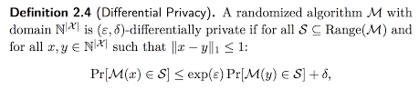
Motivation
Implementations require a variety of different people working together
Most people do not have a background in differential privacy
Notes:
Here is a formal definition –If it seems confusing That’s the point - I’ll explain what I mean by this in a few slides
Differential privacy is new and a lot of people don’t really have a background in privacy or differential privacy. This whole concept is brand new

Slide 6
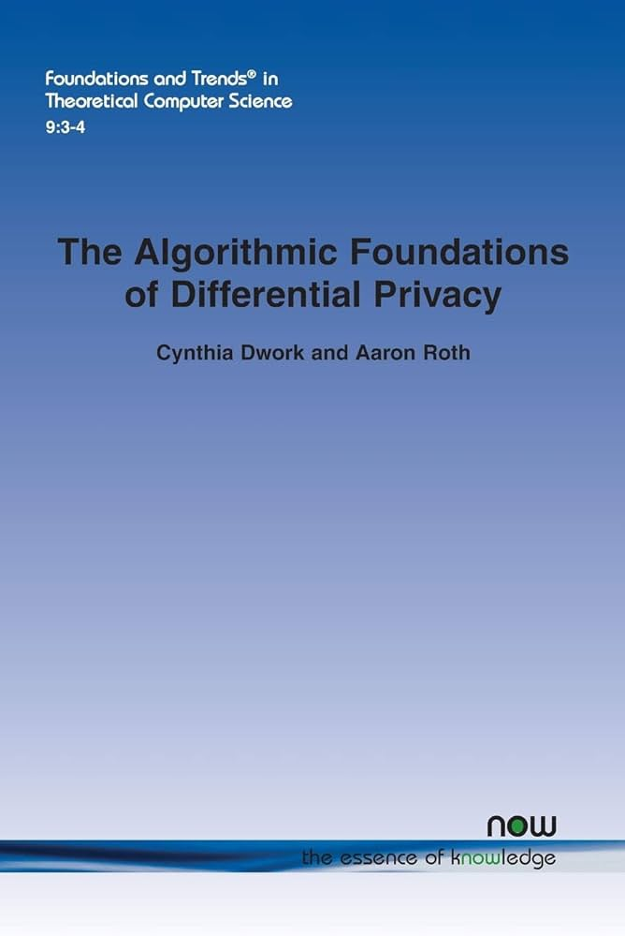
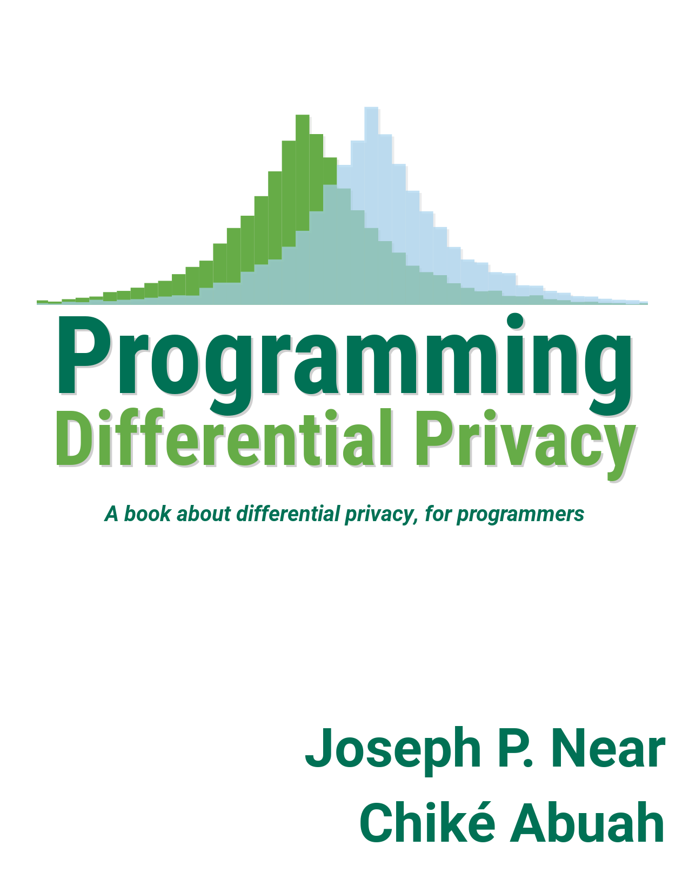
Motivation
Implementations require a variety of different people working together
Most people do not have a background in differential privacy
Available resources are often too technical
Notes:
Done a lot faster – The key distinction – Aimed at a more a technical audience – Software engineers don’t have time to read textbooks
When we look at existing resources we find that sometimes they can be insufficient.
I don’t mean to critisize what is out there because theres been a lot of new and better resources being put out there, but for awhile all we had was research papers and theorems. Now we can see a move towards easier to understand textbooks and blogs.

Slide 7
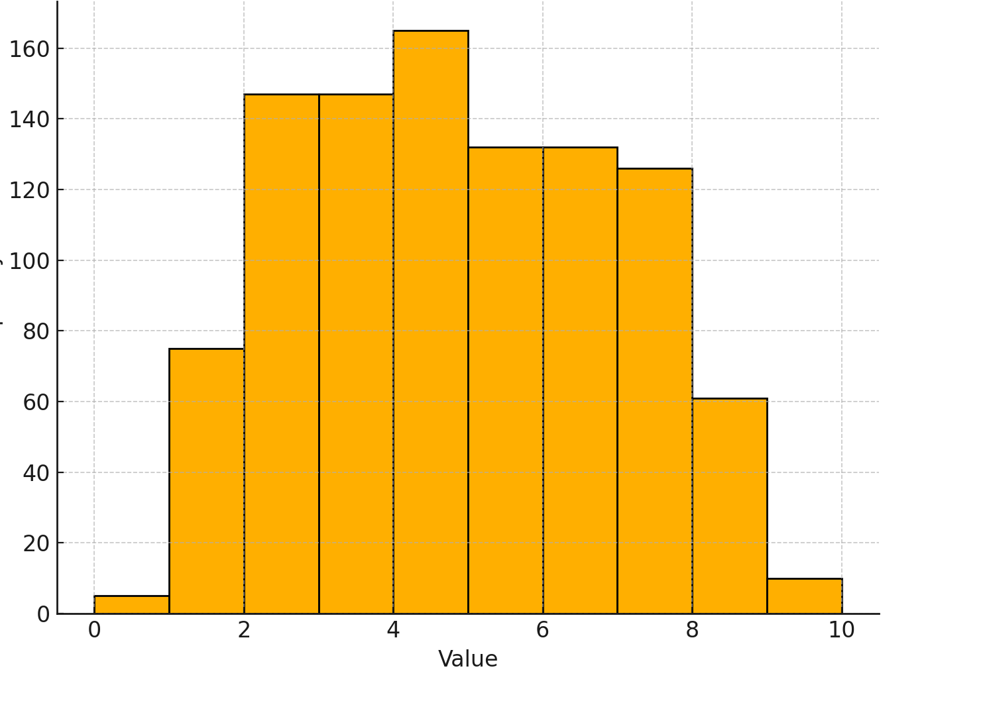
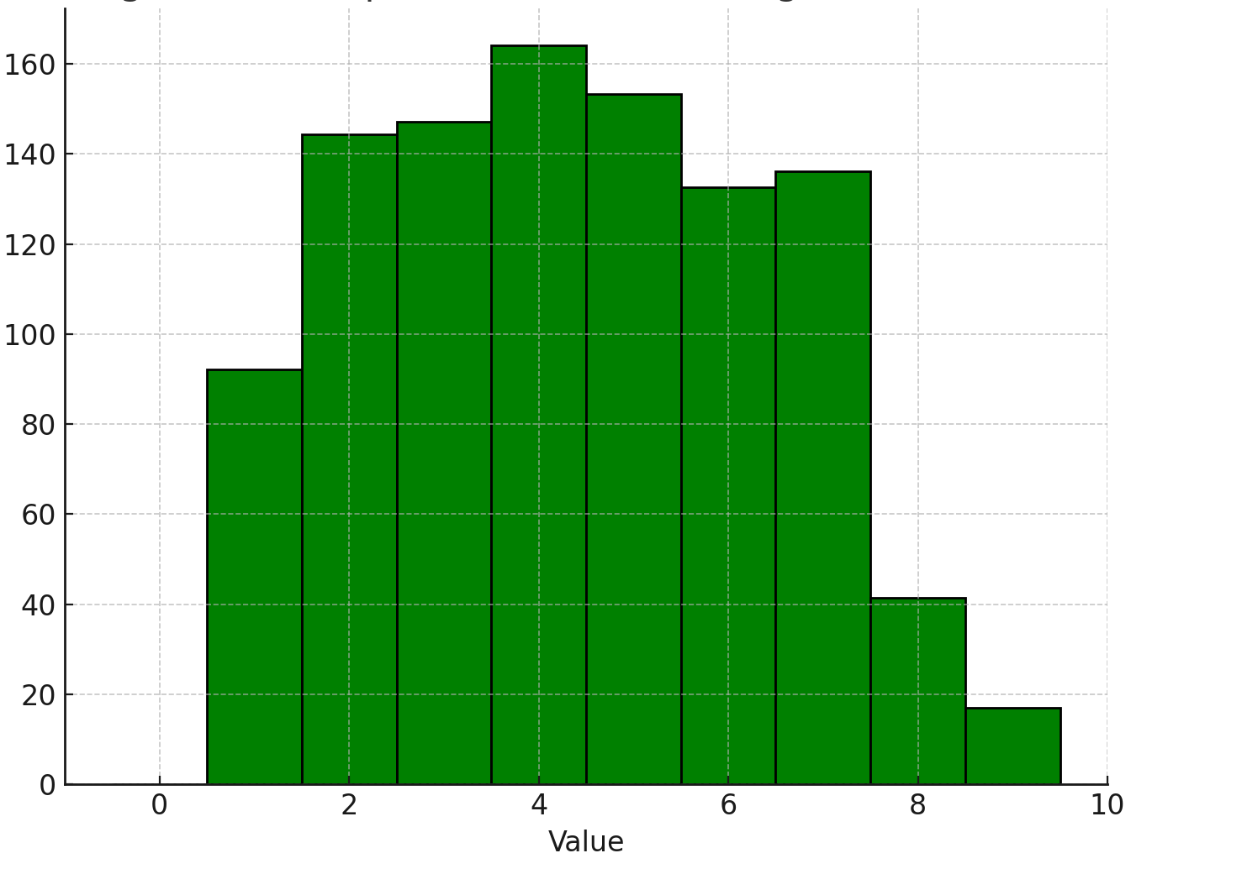
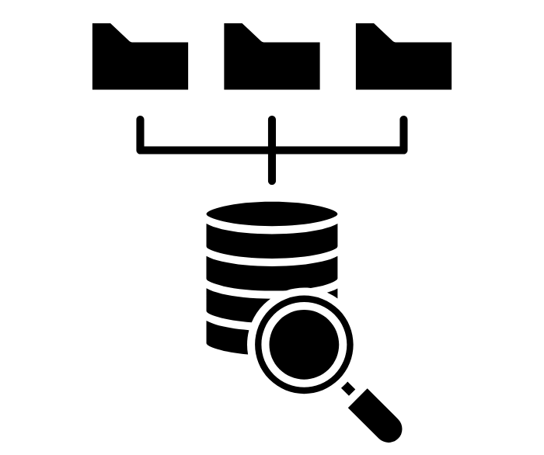

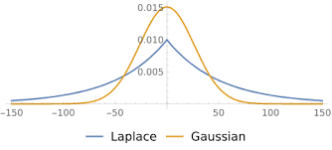
Differential Privacy Introduction
A method of data anonymization that mathematically guarantees user privacy
Cannot say if any individual is or is not in the data
Counts, histograms, means
Notes:
Introduce DP and give some background on it

Slide 8
Privacy accuracy tradeoff
Inherent tradeoff between privacy and accuracy
Epsilon = tuning knob between privacy and accuracy

Slide 9
Visualizations help intuition
Vs.

Slide 10
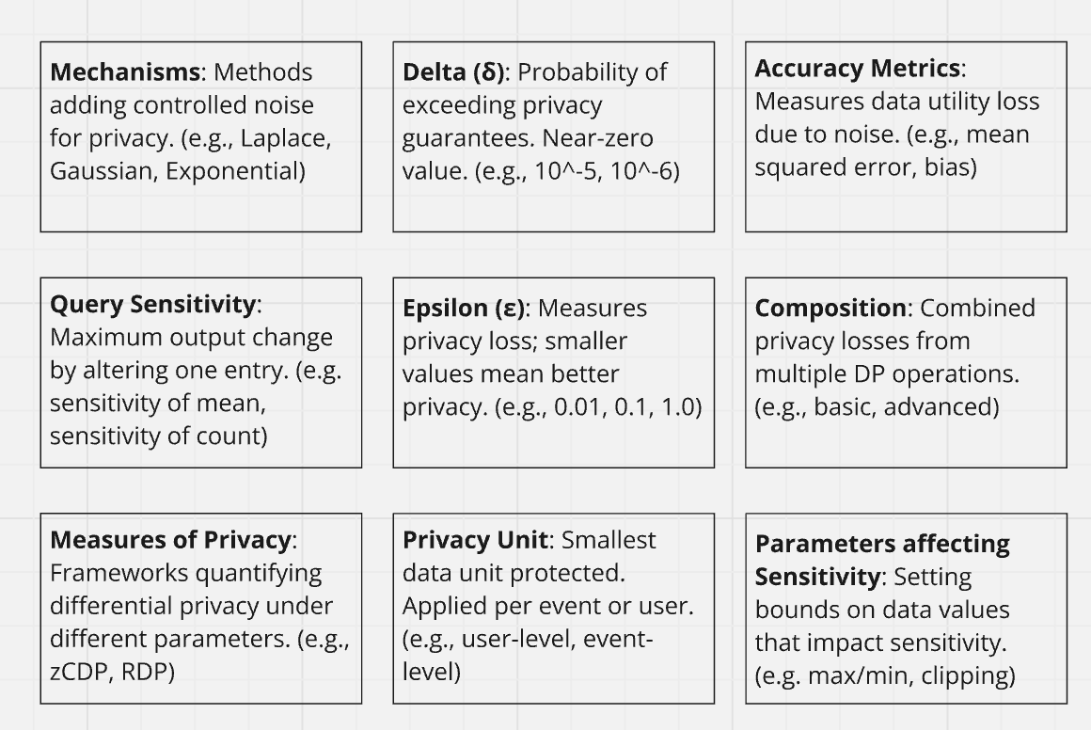
Implementation decisions
Notes:
We talked about epsilon earlier – theres a lot of other decisions that you need to make – Prior work mostly just focuses on epsilon
They probably don’t know any of these – If you want to have this slide
Could move it to later
We have some great visualizations comparing epsilon to certain utility metrics, but we have little guidance or visuals which look at many of the other implementation parameters that affect the accuracy of an output
We don’t have good visualizations that show the effects of clipping, different data distributions, different accuracy metrics

Slide 11
Implementation decisions
Notes:
We talked about epsilon earlier – theres a lot of other decisions that you need to make – Prior work mostly just focuses on epsilon
They probably don’t know any of these – If you want to have this slide
Could move it to later
We have some great visualizations comparing epsilon to certain utility metrics, but we have little guidance or visuals which look at many of the other implementation parameters that affect the accuracy of an output
We don’t have good visualizations that show the effects of clipping, different data distributions, different accuracy metrics

Slide 12
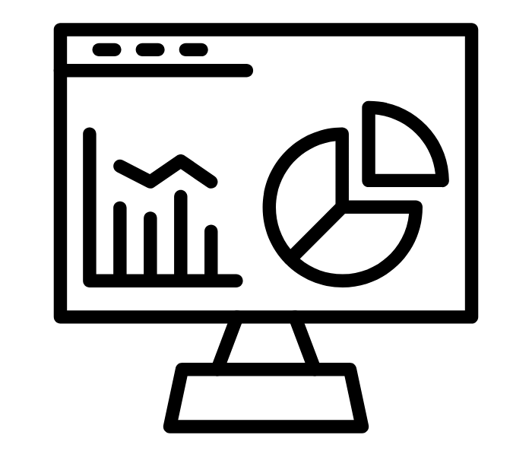
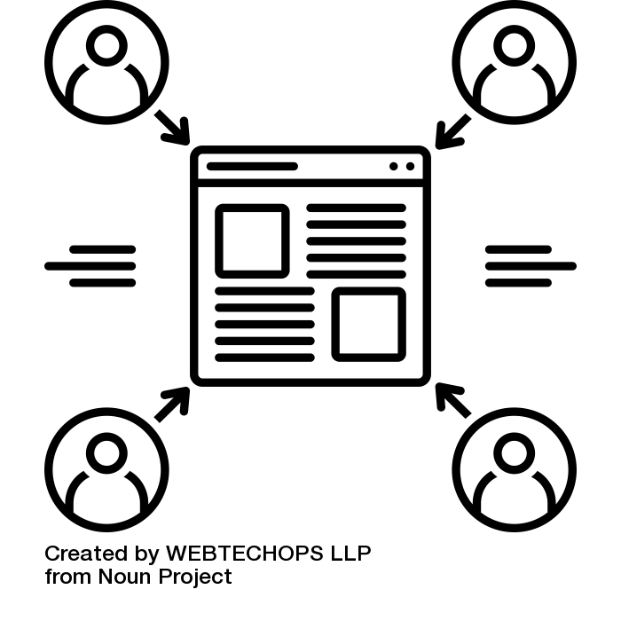

Methodology
Design visualization prototype
Interviews with technical managers
Refine prototype based on user experiences
User studies of system
What we’ve done
What we’re doing
What is left to do
Notes:
Refine initial prototype
Four parts – Make a visualization prototype - add before interviews
So how are we going to get to a visualization tool that can help technical individuals better understand differential privacy
Our research is going to have three parts
Interviews where we understand the in practice needs
Designing and engineering the system based off those needs
User studies where see the effects of our system
For this talk I’m going to focus on our interviews
I’ll discuss what we have found so far and show some aspects of the visualization system people have enjoyed

Slide 13
Interview research questions
For technical individuals newly introduced to differential privacy, which concepts are most challenging to grasp, and what factors contribute to these challenges?
RQ1
Which visualization strategies would improve new technical users' comprehension and implementation of differential privacy?
RQ2
Notes:
For our interviews, we are interviewing managers who have worked with a variety of people implementing differential privacy in a real world context
We hope to get to the bottom of two research questions
Research questions

Slide 14

Interviews
Real world experiences and challenges with implementation decisions
Notes:
I would not put the census image – Change it to something else

Slide 15
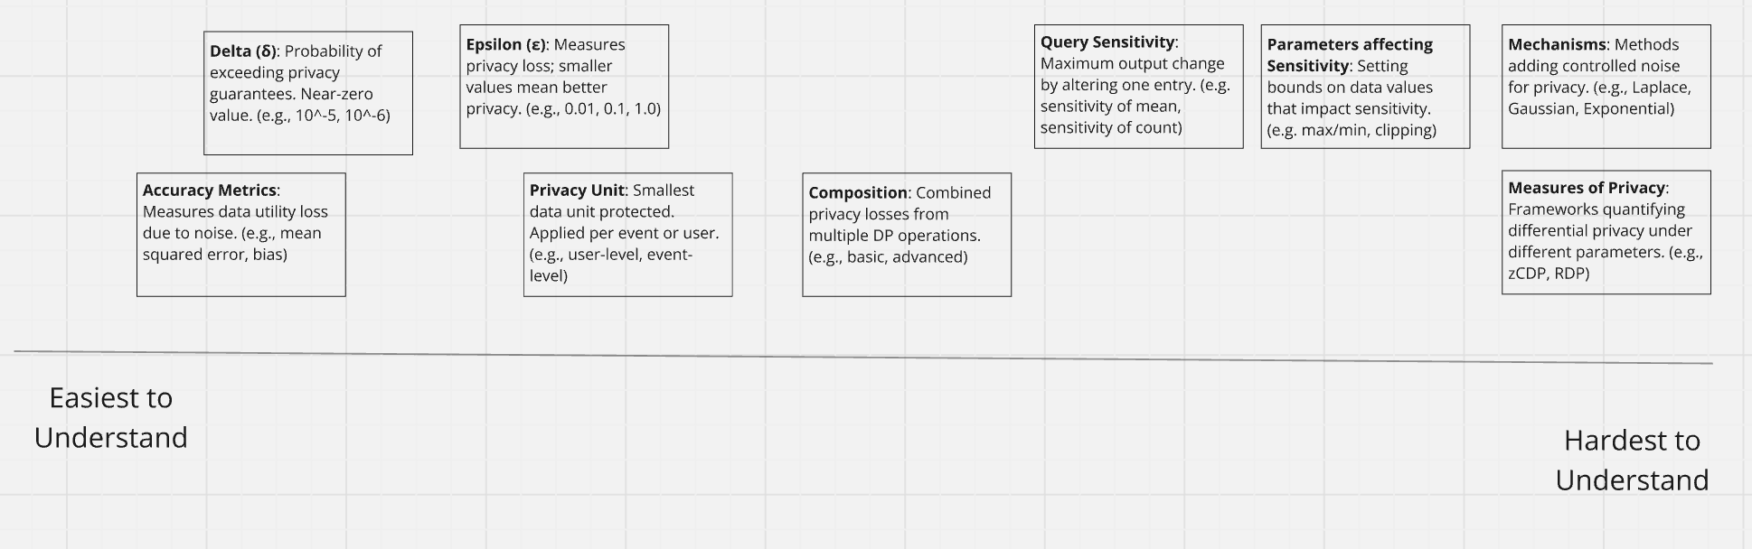
Interviews
Real world experiences and challenges with implementation decisions
Sort implementation parameters
Notes:
Say it the miro board is an interactive whiteboard
It was an interview aid to help get concrete sorting of all these parameters

Slide 16
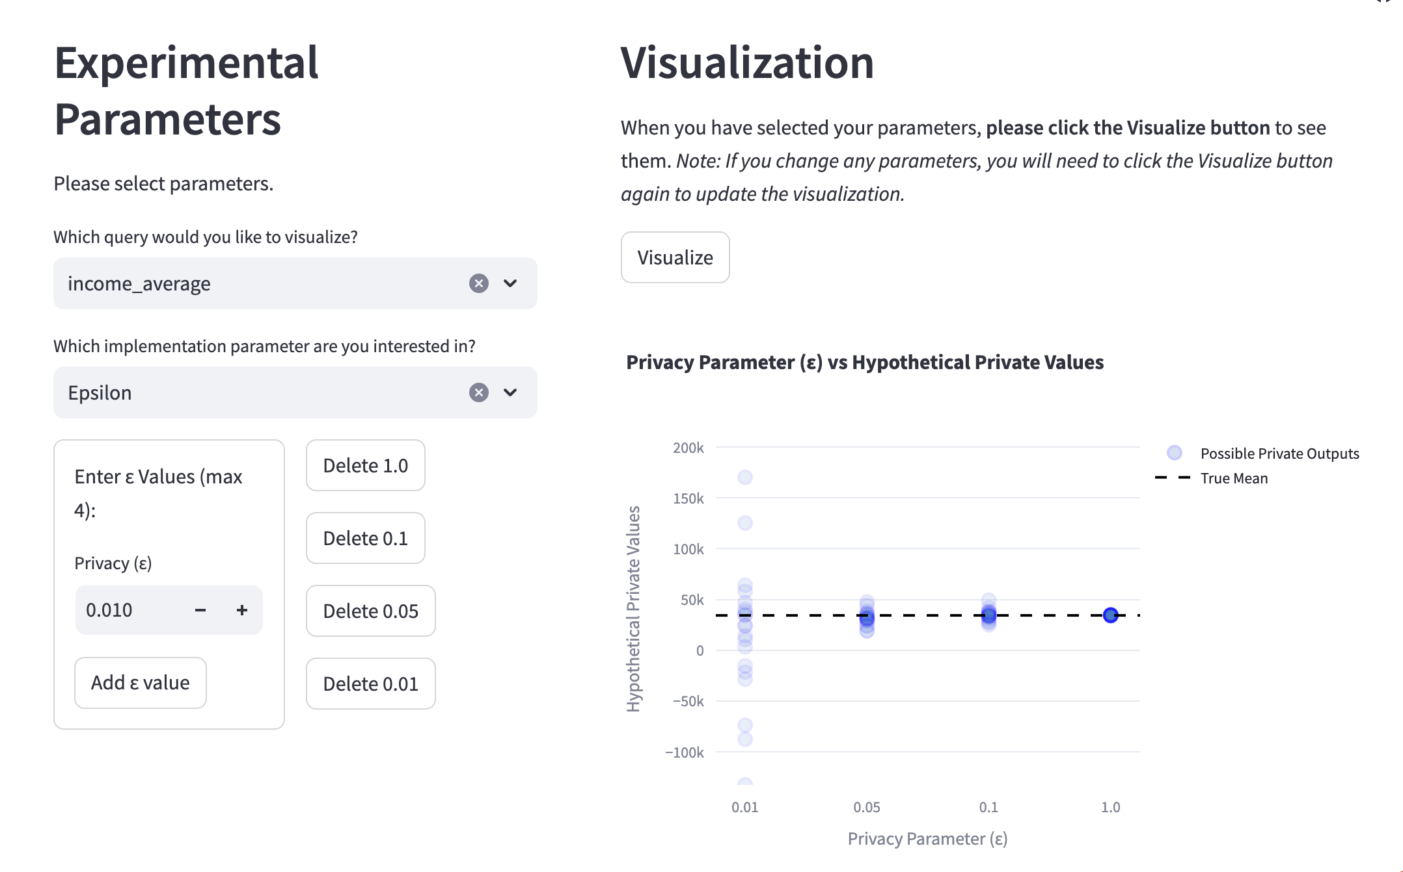
Interviews
Real world experiences and challenges with implementation decisions
Sort implementation parameters
Use a visualization prototype to get feedback on design choices
Notes:
Drop design probe. Say we want a medium to get feedback on.

Slide 17
Visualization Prototype
Connect DP parameters to concepts people are familiar with
Use interactive sliders for simple interaction
Notes:
Use this slide to explain what the visualization prototype is

Slide 18

Initial interview findings
Setting parameters requires different resources
Accuracy metrics ground privacy loss parameters
Communication challenges stall implementations
Visualizations can facilitate communication

Slide 19
Finding 1
Understanding of a parameter vs. choosing the right parameter
Understanding general principles can be simpler but setting and choosing a good value is difficult.
“If we’re talking about understanding what sensitivity means, I think that’s relatively on the easier end. But understanding how to adjust your queries to get the best sensitivity is actually quite complicated”.
Notes:
Number these findings –
Educational resources typically cover the general function of parameters, like the relationship between epsilon, privacy, and utility.
Participants identified the challenge not in understanding these parameters, but in setting and justifying specific parameter values.
There is a pressing need to uncover best practices, understand decision-making processes, and provide generalized guidance for informed parameter selection.

Slide 20
Finding 2
Privacy is ambiguous, accuracy is tangible
Accuracy metrics are easier to grasp due to their familiarity, while privacy concepts like epsilon are more abstract.
“If we’re talking about understanding what sensitivity means, I think that’s relatively on the easier end. But understanding how to adjust your queries to get the best sensitivity is actually quite complicated”.
Notes:
The biggest takeaway – privacy concept is inherently ambiguous but it can hopefully be explained by concrete accuracy metrics – Don’t use specific accuracy metrics
Confidence interval is not so much accuracy

Slide 21
Finding 3
Ambiguous language and experience gaps stall implementations
Communication challenges arise from conflicting priorities and varying levels of understanding between teams.
“I think that's what gets really tricky between privacy experts and then policymakers is policymakers saying I really need it to be accurate for all these policy changes and privacy people saying like, can't have your cake and eat it too.”
Epsilon needs to be below 1
I want less than 10% error
Notes:
Make the finding more descriptive – language gap and ambiguous terms
Communication challenges arise from conflicting priorities and varying levels of understanding between teams.
Teams often overlook each other's critical thresholds, with statisticians and privacy engineers focusing on different outcomes.
Effective resources are essential to foster mutual understanding and prevent implementation issues.
Early alignment on goals and collaborative approaches can bridge understanding gaps, though a common language for privacy discussions is often missing.

Slide 22
Finding 4
Visualizations facilitate communication
“In an educational context, something that allows you to move the sliders and show people what changes in the shape of things is very powerful for getting intuition. This is awesome for that.”
“A tool like this doesn’t require them to understand much about differential privacy—they can look at the epsilon and see that the bar gets too big. I think you could use it in that context, in negotiations between teams, to convince someone that it can’t be the way they want it to be.”

Slide 23
Next steps
~10 more interviews
Refine visualization based on user needs + lack of existing resources
User study with end users
End results
Primary implementation decision challenges in practice
Web-based tool for exploring these decisions
Quantitative insights into effective visualization strategies

Slide 24
Conclusion
Creating a visualization tool that allows practitioners to experiment with privacy/accuracy tradeoffs across a broad spectrum of implementation decisions.
We are currently conducting interviews to better understand implementation decision challenges
Our initial findings show that interactive visualizations can help ground DP concepts and facilitate communication
If you’re excited about visualization and differential privacy come talk to us!
Email: panavas.l@northeastern.edu
Notes:
Talked too much about the interview findings – Don’t go into much detail
Don’t re explain the Findings – Trim it down

