Slide 1
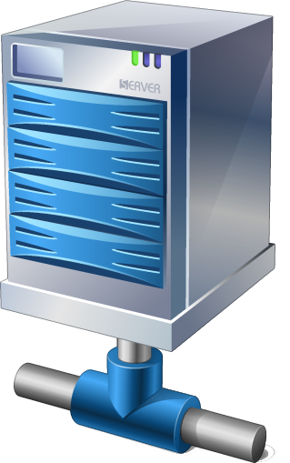





Storage owner
DNS
Guest /
shared
Guest /
shared
Storage owner
DNS

