Slide 1
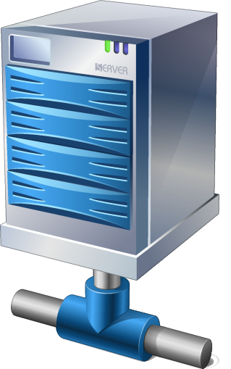


User /
Resource owner
DNS
guest
guest
User /
Resource owner
DNS
Relationships between parties in Web style Federation

