Slide 1
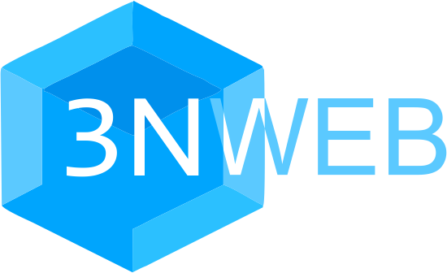
Group under IEEE umbrella
(for January 5, 2022, meeting)
Synopsis:
Architectures on the Internet and User Interests in a tussle
3NWeb: principle, set of protocols, base for user apps
Group’s activity: standards and tests to help different implementors.

Slide 2
1.1. Tussle in the Cyberspace
2. PRINCIPLES
The thesis of this paper is that the future of the Internet will increasingly be defined by tussles that arise among the various parties with divergent interests, and that the technical architecture of the Internet must respond to this observation. If this is so, are there principles to guide designers, and mechanisms that we should use in recognition of this fact?
"Tussle in Cyberspace: Defining Tomorrow's Internet", DOI 10.1145/633025.633059, August 2002, https://groups.csail.mit.edu/ana/Publications/PubPDFs/
Tussle2002.pdf

Slide 3
1.2. 18 years later, RFC 8890,
The Internet is for End Users
Many who participate in the IETF are most comfortable making what we believe to be purely technical decisions; our process favors technical merit through our well-known mantra of "rough consensus and running code."
Nevertheless, the running code that results from our process (when things work well) inevitably has an impact beyond technical considerations, because the underlying decisions afford some uses while discouraging others. While we believe we are making only technical decisions, in reality, we are defining (in some degree) what is possible on the Internet itself.
This impact has become significant. As the Internet increasingly mediates essential functions in societies, it has unavoidably become profoundly political; it has helped people overthrow governments, revolutionize social orders, swing elections, control populations, collect data about individuals, and reveal secrets. It has created wealth for some individuals and companies while destroying that of others.

Slide 4
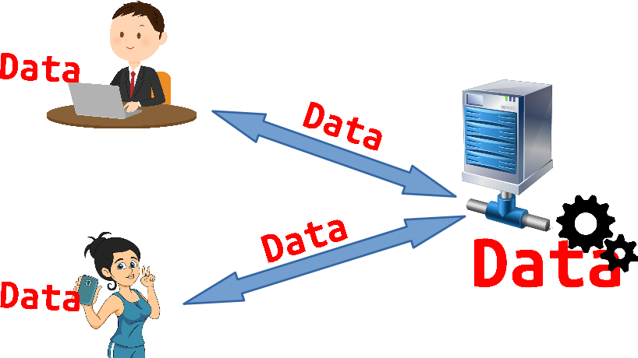
1.3.1. Simple Architecture, dating well back

Slide 5

1.3.2 Architecture helps Digital Feudalism
Computation on server gives someone else
total, abusive feudal control
over end users’ digital lives.
It’s a feudal world out there. ...
Traditional computer security centered around users. ... This model is breaking, largely due to two developments:
1. New Internet-enabled devices where the vendor maintains more control over the
hardware and software than we do — like the iPhone and Kindle; and
2. Services where the host maintains our data for us — like Flickr and Hotmail.
Bruce Schneier, December 2012 in https://www.schneier.com/blog/archives/2012/12/feudal_sec.html

Slide 6
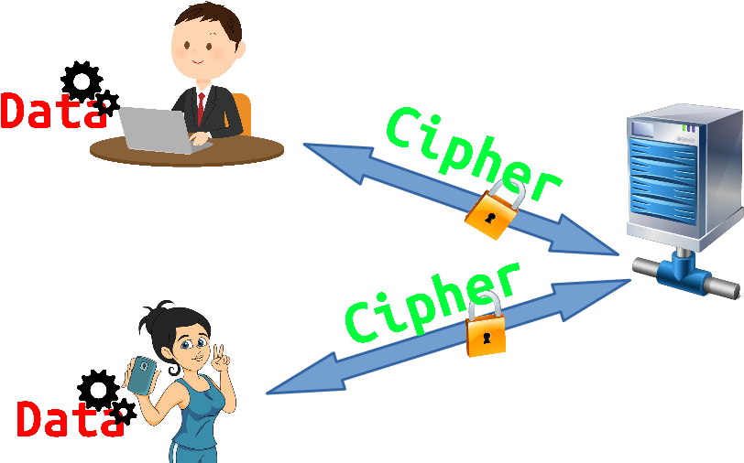
1.4.1. Architecture with E2E encryption

Slide 7
1.4.2. Architecture promotes data ownership
Computation on client sides returns data ownership to users
Server still looks
too centralized,
too monopolistic

Slide 8
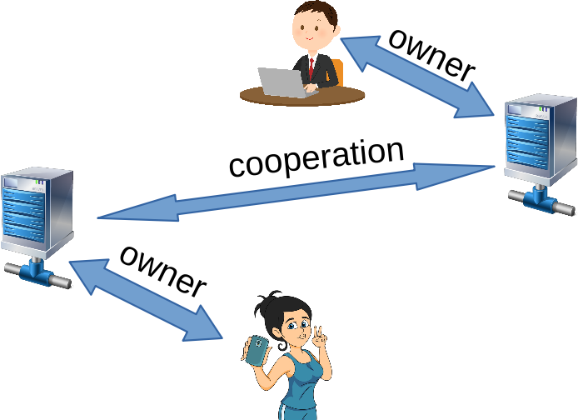
1.5.1. Classical Federation
e.g.
SMTP
XMPP

Slide 9


1.5.2. Classical Federation in a tussle
e.g.
SMTP
XMPP
https://www.eff.org/deeplinks/2013/05/google-abandons-open-standards-instant-messaging

Slide 10
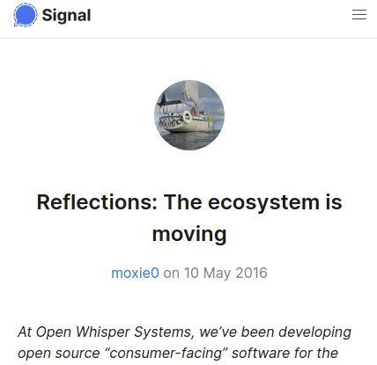

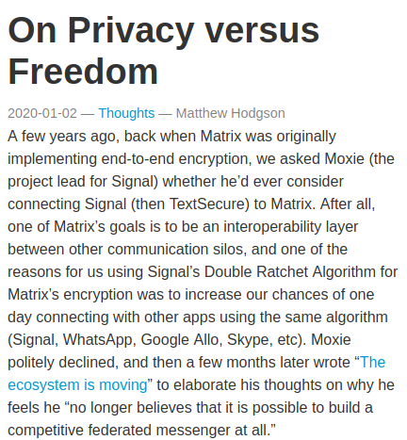
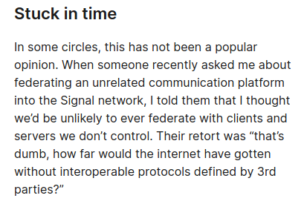
1.5.3. Arguments with the false choice?

Slide 11
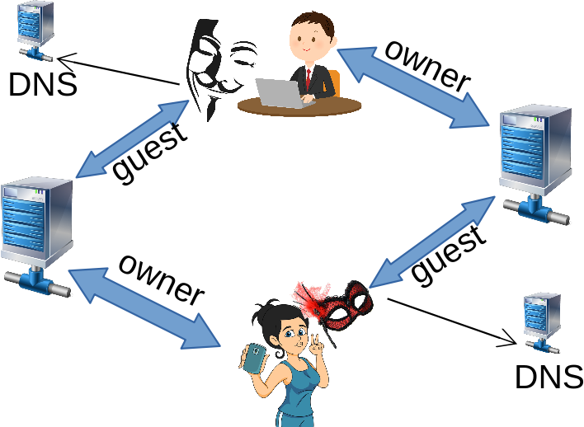
1.5.4. Web-style Federation
(federated experience without server-to-server cooperation)
e.g.
Wordpress,
NextCloud

Slide 12
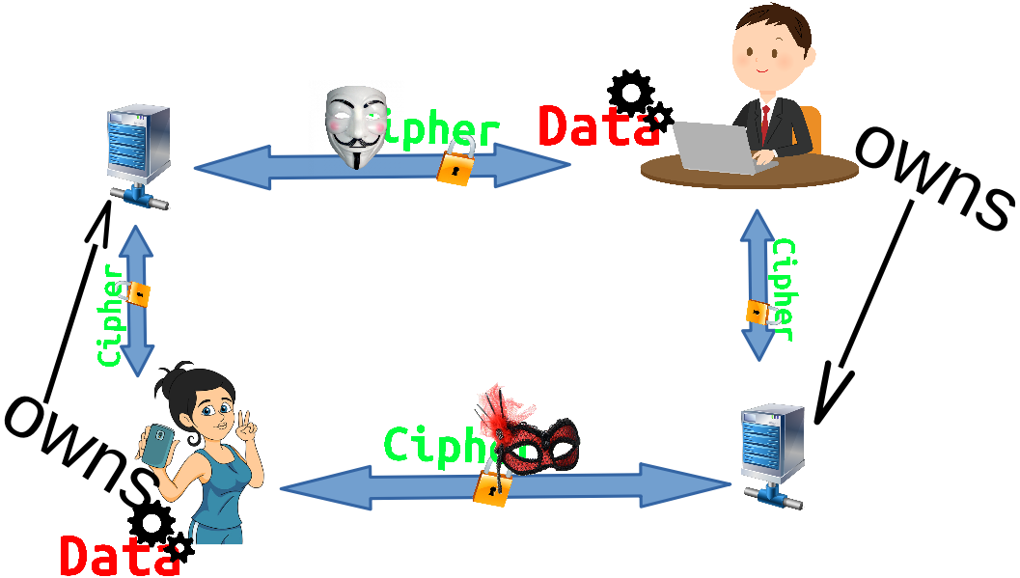
1.5.5. We must combine best for End Users

Slide 13
2.1. 3N principle for tussle-safe client-server communication
No plain text user content should be given to server.
No unnecessary metadata should be present or generated in client-server interaction.
Nothing can be abused on the server, when the first two criteria are met.

Slide 14

2.2. 3NWeb protocols
(Application Layer 7 in OSI model)
3N + Web-style Federation
3NWeb is a set of utility services forming base for apps
App needs | Functionality | Protocol
Disk | Persisting data | 3NStorage
Pipe | Messaging | ASMail
User creds | Identification | MailerId

Slide 15

2.3. Overall stack
Apps: what users use, what ultimately has value for end users
API and formats’ on 3NWeb App and OS boundary
“OS”: environment layer for apps on user device(s)
3NWeb protocols
Utility Services: 3NStorage, ASMail, MailerId

Slide 16
2.4. APIs, formats & protocols
Standards | Type | Needed by | Details
Public Key Login (PKL) | protocol | MailerId, ASMail, 3NStorage | Credentials based access without 3rd parties (e.g. identity providers).
MailerId | protocol | ASMail, 3NStorage | Non-tracking identity, based on Mozilla’s BrowserId approach, minus hacked browser part.
ASMail | protocol | OS’ messaging functionality | 3N-observing Web-style federated messaging protocol
3NStorage | protocol | OS’ data persistence | 3N-observing Web-style federated bulk storage protocol
XSP file format | format | ASMail, 3NStorage | AEAD (Authenticated-Encryption with Associated Data) format to pack NaCl ciphers (XSalsa+Poly)
File content packing | format | OS’ file system functionality | While XSP packs encrypted segments it is beneficial to also have an additional file content segments’ packing for efficiency in always encrypting, atomic versioning, and reduction of metadata in synchronization via servers.
OS to Apps IPC | api | Apps | Base approach to IPC between 3NWeb Apps and OS layers
File system objects | api | Apps | File system objects (capabilities) given to Apps
ASMail messaging | api | Apps | ASMail messaging object (capability) given to Apps
Apps and services IPC | api | Apps, OS | Meshing functionality as an application of UNIX philosophy
App manifest | format | OS | App manifest asks for capabilities, else OS doesn’t give them

Slide 17
3. 3NWeb group
Have 3NWeb group in GitLab to house all projects for 3NWeb standards.
Write both text of standards, and tests that can be used by different implementors. Tests will live longer than any implementation.
Noting intellectual property tussle, tests can be under Apache license, allowing implementors to freely adopt copy -right, -left and -center.

