Slide 1
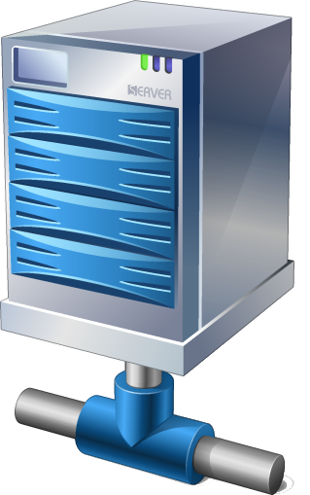




Where is
capulet.it ?
DNS
montague.it
guest
User of resource
Bob@montague.it
- has message(s)
- asks to allow guest with given access token to save/read encrypted objects
User of resource
Alice@capulet.it
- has message(s)
- asks to allow guest with given access token to save/read encrypted objects
guest
capulet.it
Where is
montague.it ?
DNS
Information flows in Web Federation

