Slide 1

Sprocket Central Pty Ltd
Data analytics approach

Slide 2


Agenda
The approach will be implemented in three stages :
Data Exploration
Model Development
Interpretation

Slide 3
Agenda
Approach for New Customer Data analysis :
Age distribution
Bike purchase
Job industry
Number of cars owned

Slide 4

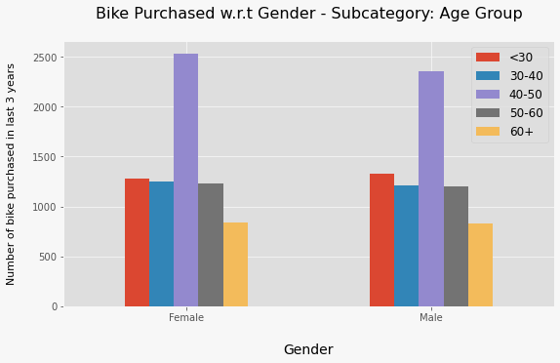
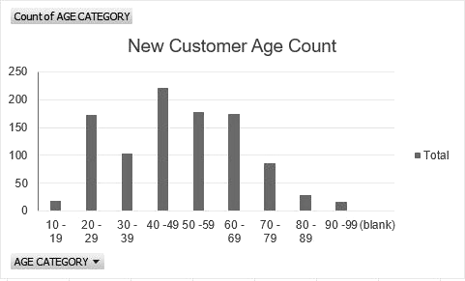
Data Exploration : Age Distribution & Bike Purchases
New customers are more from the age group of 40-49 , followed by 50-59 & 60-69.
Fewer customer are from 10-19 & 90-99 for obvious reasons.
Data shows age group 40-50 has high count in terms of bike purchased in last 3 years with a slightly greater female ratio.
The target audience for our marketing and advertising should be inclined to provide focus on females than males.

Slide 5
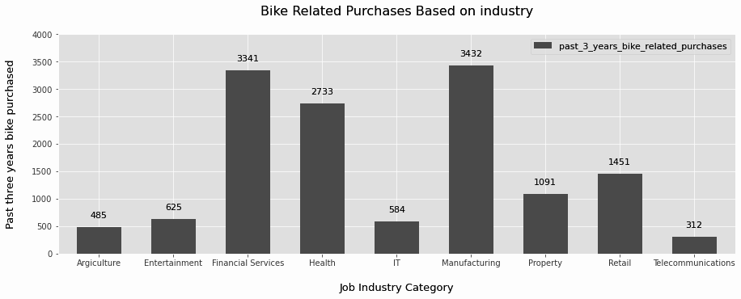
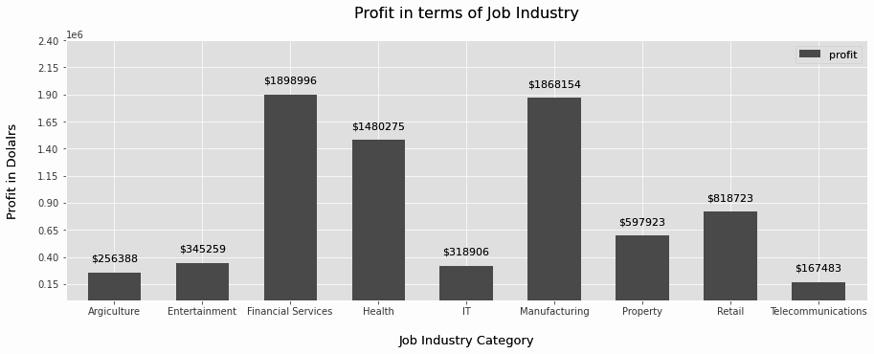
Data Exploration : Job Industry
Financial Services, Manufacturing, and Health are the top three profit-generating industries, followed by retail and property.
The highest profits are also Financial Services, Manufacturing, and Health as seen in the second chart.

Slide 6
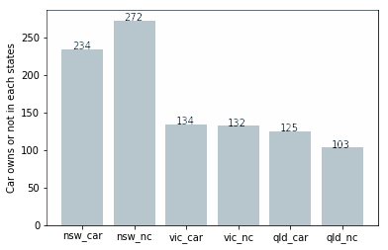
Data Exploration : Number of cars owned
Out of three states, New South Wales, could be potential market opportunities for the company.
New South Wales has the biggest potential since the number of people who own vehicles is nearly equal to the number of individuals who do not own cars, indicating that there is room for value customers there.
VIC and QLD has more customers that own car that who don’t but we can try to have something so that those owns car will buy bikes.

Slide 7
Model Development
CUSTOMER CLASSIFICATION – Targeting High Value Customers
The following are the high-value clients to target from the new list :
Aged between 40 – 50.
Most of the high value customers are female compared to male
Working in Financial Service, Manufacturing and Health.
Who are currently living in New South Wales and Victoria.

Slide 8
Interpretation
HIGH-VALUE CUSTOMER SUMMARY TABLE
Customer ID | Bike Related Purchases for the last 3 years | Age | Job Industry | Wealth Segment | Owns Cars | State
1842 | 445 | 44 | Financial Services | Mass Customer | No | New South Wales
2001 | 168 | 44 | Manufacturing | Mass Customer | Yes | New South Wales
650 | 486 | 44 | Health | Mass Customer | No | New South Wales
3297 | 234 | 46 | Manufacturing | Mass Customer | No | Victoria
50 | 266 | 41 | Manufacturing | Mass Customer | Yes | New South Wales

Slide 9
Note: The data and information in this document is reflective of a hypothetical situation and client. This document is to be used for KPMG Virtual Internship purposes only.
THANK YOU

