Slide 1




World Happiness Report with R
Presented by:
PRIYA KATTIGEHALLI MATA
Professor:
Valeriy Shevchenko
ALY 6015: Intermediate Analytics

Slide 2
Introduction
The analysis utilizes data from the World Happiness Report spanning 2005–2023, with 2,363 observations across various countries.
This report is a globally recognized resource for understanding national well-being and happiness factors.
Key Determinants: Identify the primary drivers of national happiness, such as GDP, social support, and life expectancy.
1. Relationships: Examine correlations between socio-economic factors and happiness scores.
2. Forecasting Trends: Analyze historical data to predict future happiness trends.
3. Policy Insights: Provide evidence-based recommendations for enhancing national well-being.
It Provides a data-driven framework for policymakers to enhance quality of life.
Highlights the importance of areas such as economic growth, healthcare, social support systems, and corruption reduction.

Slide 3
Research Questions
1. What factors most strongly influence happiness scores?
Findings: Regression analysis reveals that both GDP per capita and social support significantly affect happiness scores.
GDP per capita: For each unit increase in GDP, the happiness score increases by 0.52, holding social support constant.
Social support: A unit increase in social support raises the happiness score by 3.40, holding GDP constant.
Conclusion: While both factors are important, social support has a larger effect on happiness than GDP.
2. How much of the variation in happiness scores can be explained by economic and social factors?
Findings: The regression model explains 67.2% of the variance in happiness scores (R-squared = 0.672).
Conclusion: GDP and social support are crucial, but other unexamined factors also contribute to happiness.

Slide 4
3. Is there a relationship between a country's economic status and its happiness level?
Findings: There is a strong positive correlation (0.79) between GDP per capita and happiness scores.
Economic stability and growth: Countries with higher GDP tend to have better access to services like healthcare, education, and infrastructure, which enhance quality of life.
Outliers: While GDP is a strong predictor, some countries with lower GDPs, like Costa Rica and Bhutan, have relatively high happiness scores, indicating that economic status is not the sole determinant of happiness.
Conclusion: Countries with higher economic output generally experience higher happiness, but the relationship is not perfect, and other factors also influence well-being.
4. How does social support impact happiness scores?
Findings: Social support has a strong positive correlation (0.72) with happiness scores.
Community and networks: Countries with strong community ties and social safety nets tend to report higher happiness, suggesting the importance of social capital in shaping well-being.
Interpersonal relationships: Stronger social networks and family connections correlate with higher happiness, indicating the significant role of personal relationships in well-being.
Conclusion: Social support plays a vital role in improving happiness and might have a more substantial impact than GDP, as stronger social connections and community support can mitigate other life stresses.

Slide 5
Statistics Description
Variable | Mean | Median | Std Dev | Min | Max
Life Ladder | 5.484 | 5.508 | 1.145 | 1.281 | 8.019
Log GDP per capita | 9.400 | 9.543 | 1.191 | 5.527 | 11.676
Social support | 0.809 | 0.842 | 0.119 | 0.228 | 0.987
Healthy life expectancy | 63.40 | 65.70 | 8.020 | 6.720 | 74.600
Freedom to make life choices | 0.742 | 0.781 | 0.142 | 0.258 | 0.985
Generosity | 0.000 | -0.017 | 0.159 | -0.335 | 0.686
Perceptions of corruption | 0.740 | 0.786 | 0.187 | 0.035 | 0.983
The dataset includes variables measuring subjective well-being, economic factors, social support, health, freedom, generosity, and corruption, with key statistics such as the Life Ladder’s mean of 5.484, Log GDP per capita’s mean of 9.400, and Social Support’s mean of 0.809. Healthy life expectancy averages 63.4 years, while Freedom to make life choices has a mean of 0.742. Generosity shows variability, and Perceptions of corruption have an average of 0.740, reflecting diverse national conditions.

Slide 6
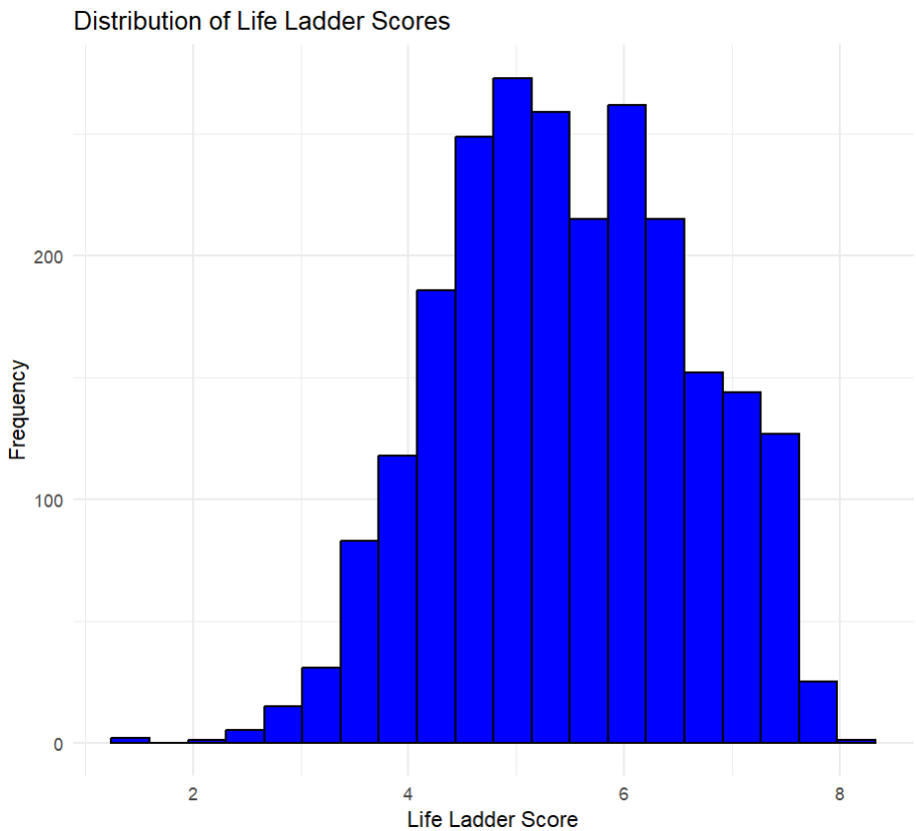
Exploratory Data Analysis
Most Common Scores: The majority of people seem to rate their life satisfaction around 4.5 to 5.0, as the bars in this range are the tallest. This means many people report being moderately happy.
Skewness: The chart is slightly "lopsided," with a longer tail stretching toward the lower scores (2-3). This shows there are fewer people with very low happiness levels, but they still exist.
Higher Scores: After the most common scores (4.5-5.0), the number of people reporting higher happiness levels (6-8) gradually decreases. By the time we reach scores above 7.5, only a small number of people fall into this range.
Extremes: Very few people reported extremely low (below 3) or extremely high (above 7.5) life satisfaction levels. This suggests that extreme happiness or unhappiness is less common, with most people falling somewhere in the middle.
Design Choices: The graph is simple and easy to read. The blue bars with black borders stand out against a clean background, helping us quickly notice patterns like the peak and gradual decline.

Slide 7
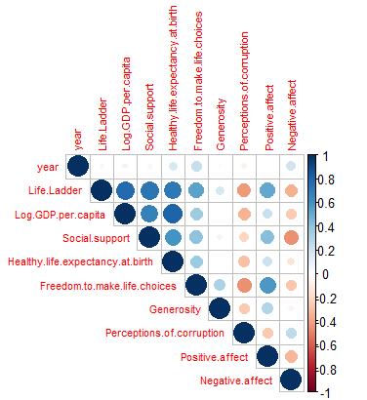
Correlation Analysis
What Increases Happiness?
Higher income (GDP per capita) and strong social support have the biggest positive impact on happiness, shown by the dark blue circles.
Better health (healthy life expectancy) also connects to higher happiness, as it’s linked to income and social support.
What Decreases Happiness?
Negative feelings like sadness and anger, as well as perceptions of corruption, reduce happiness. This is shown by the pink/red circles, meaning these factors have a negative impact.
Freedom to make life choices is moderately linked to happiness and social support.
Generosity has weaker connections, so it’s less influential compared to other factors.

Slide 8
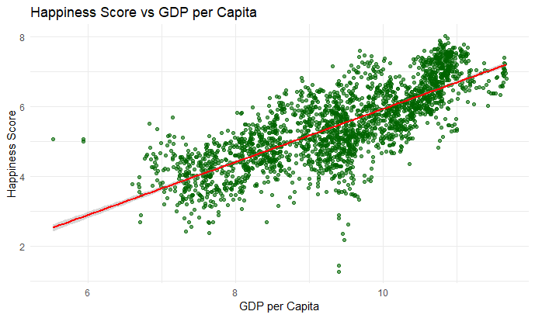
LINEAR REGRESSION ANALYSIS
The upward slope of the red line shows that higher GDP per Capita is generally associated with higher Happiness Scores.
In simple terms: wealthier countries tend to report higher happiness.
Cluster of Countries:
Most data points are clustered between GDP values of 8–10, indicating that most countries fall within this range of wealth.
As GDP increases, the happiness scores show more variation (wider spread).
This suggests that while GDP matters, other factors also play a role in happiness at higher GDP levels.
Some countries (dots below the red line) have lower happiness scores than expected for their GDP.
These outliers indicate that economic wealth alone doesn’t guarantee happiness.

Slide 9
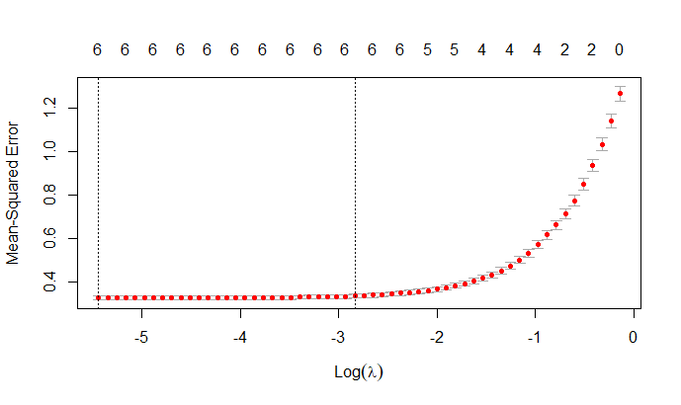
LASSO REGULARIZATION ANALYSIS
The flat portion (left) shows stable error rates with strong regularization (fewer predictors).
The sharp rise (right) indicates overfitting as regularization weakens (λ approaches 0).
Optimal Lambda (λ):
Found near log(λ) = -3, where the model achieves the lowest prediction error, balancing simplicity and accuracy.
Error Bars and Predictor Count:
Vertical lines indicate consistent performance across cross-validation folds.
Numbers at the top show the number of predictors retained at each λ value.
Outcome:
The final model selects only the most relevant predictors, improving interpretability while maintaining predictive power.

Slide 10
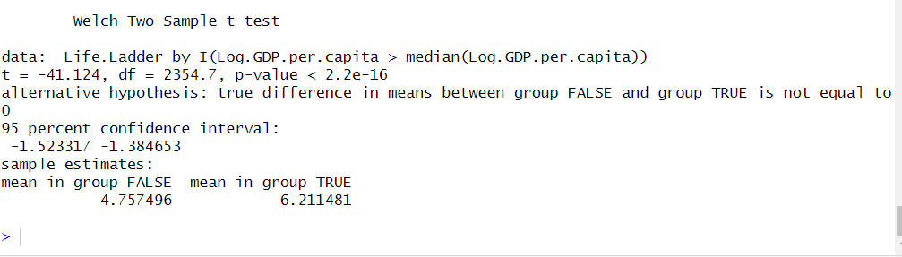
Hypothesis Testing
Mean happiness score for below-median GDP: 4.757496
Mean happiness score for above-median GDP: 6.211481
t = -41.124, p < 0.001
Significant difference: Countries with above-median GDP have higher happiness scores (mean difference ≈ 1.45 points)

Slide 11
Conclusion
Determinants of Happiness:
Social support, freedom to make life choices, GDP per capita
Economic Impact:
Strong positive correlation between GDP and happiness
Social Factors:
Social support as the strongest predictor of happiness
Corruption:
Negative correlation with happiness
Temporal Trends:
Slight upward trend in happiness from 2005 to 2023
Model Performance:
Explained 74.23% of variance in happiness scores
Future Projections:
Stable trend in happiness scores for the next 5 years

Slide 12
Recommendations
Strengthen Social Support Systems
Focus on Economic Growth
Enhance Personal Freedoms
Combat Corruption
Improve Healthcare Systems
Limitations
Self-reported happiness scores may have cultural biases
Potential lag effects between predictors and outcomes not accounted for
Imputation of missing data may introduce slight biases
Promote Generosity
Holistic Approach to Well-being
Continued Research
Address Inequality

Slide 13
References
Jainaru. (2024). World happiness report 2024 (yearly updated) [Data set]. https://www.kaggle.com/datasets/jainaru/world-happiness-report-2024-yearly-updated?resource=download

Slide 14


Slide 15
THANK YOU!

