Slide 1
Unleashing insights from Football data
By Priya m
Mentor: jaya pandey

Slide 2
Introduction:
Analysing the football dataset to delve into various facets of the sport, from individual player attributes to overarching team strategies. By analysing this data, we can uncover patterns and insights that inform performance analysis, market valuations, and strategic decisions. This project leverages comprehensive football datasets to explore key areas such as player profiles, team comparisons, stadium attendance, and competition analyses, aiming to provide actionable insights.

Slide 3
Objectives
Data cleaning & pre-processing
Player’s performance Analysis
Player’s profile and Market value
Team comparison
Stadium and Attendance Analysis
Referee Analysis
Substitution patterns
Event Analysis
Competition Analysis
Player’s attributes and Demographics
Contract Management

Slide 4
Tools & Techniques
Python
Data Cleaning, Preprocessing, Manipulation , Visualization and ML Model creation.
SQL
Store the capstone results in the database
Excel
Save the merged and cleaned file in the excel format to connect with Tableau
Tableau
EDA, Presented the Capstone Analysis through Dashboard

Slide 5
Data cleaning & pre-processing
Merge (inner)
Drop duplicate columns
Rename columns
Missing value treatment
Outlier Analysis
‘Age’ column from date of birth
Check for irrelevant entries ( excel )

Slide 6
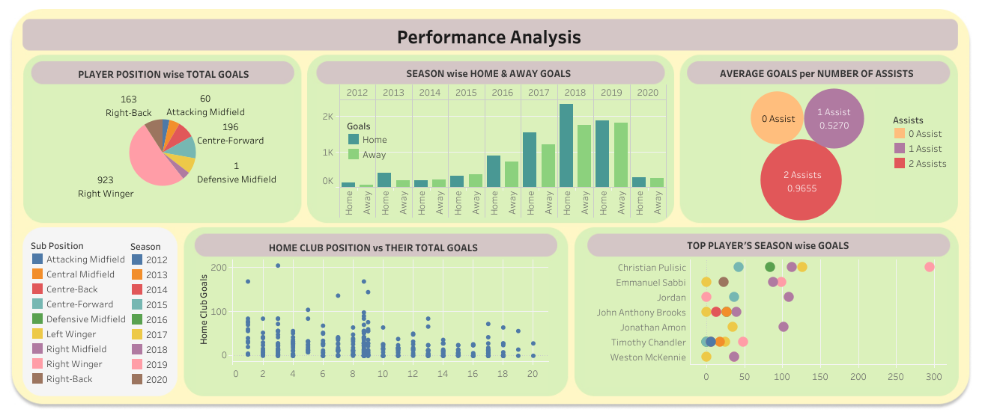

Slide 7
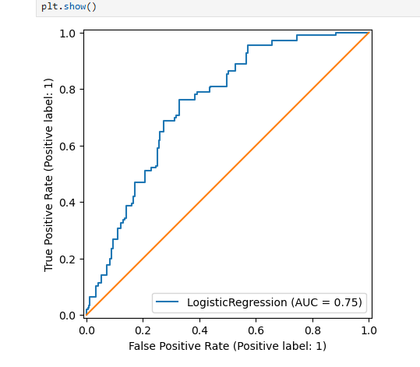
Logistic Regression:
1. Predict whether yellow card warning will be issued or not?
Roc auc score: 0.748
Confusion Matrix: [[1044 11] [198 7]]
Accuracy: 0.8341
Precision: 0.3888
Recall: 0.03414
F1: 0.06278
Good logistic Model to predict whether a warning will be issued in game or not?

Slide 8
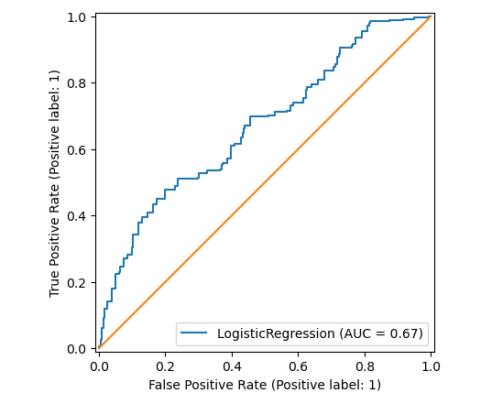
Logistic Regression (contnd): Predict whether goal will be scored in the game or not?
Roc auc score: 0.668
Confusion Matrix: [[704 84] [ 310 162]]
Accuracy: 0.6873
Precision: 0.6585
Recall: 0.34322
F1: 0.45125
Moderate Model to distinguish between goal scored and not scored in the game

Slide 9
Probability on performance:
1.The probability of scoring 3 goals in a game is, 1%
2.The probability of player from England scoring goal is 2%
3.The probability of player whose age is above 28: 32%
4.The probability of receiving yellow card given that the player is left footed 24%
5.The probability of receiving yellow card given that the player is right footed 14%
6.The probability that the attendance is at most 50000 given its an international cup is 60%

Slide 10
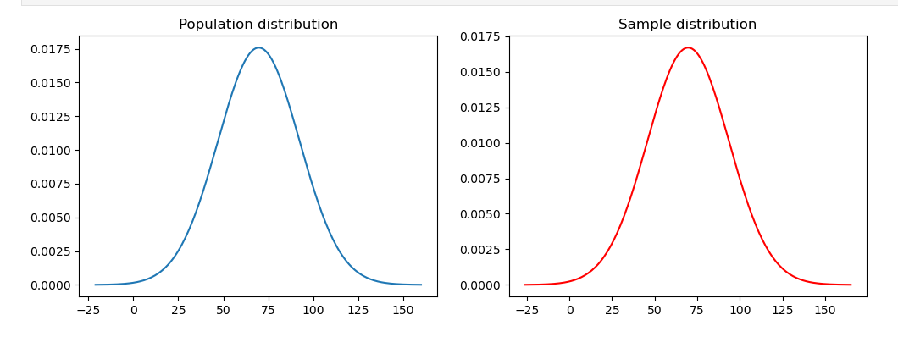
Central Limit Theorem
Mean and median of both the population and the sample are approximately equal to each other.
standard deviation of 20 number of sample mean ~ standard deviation of sample from population divided by sqrt of sample size (size 40).
Minutes played follows central limit theorem.

Slide 11
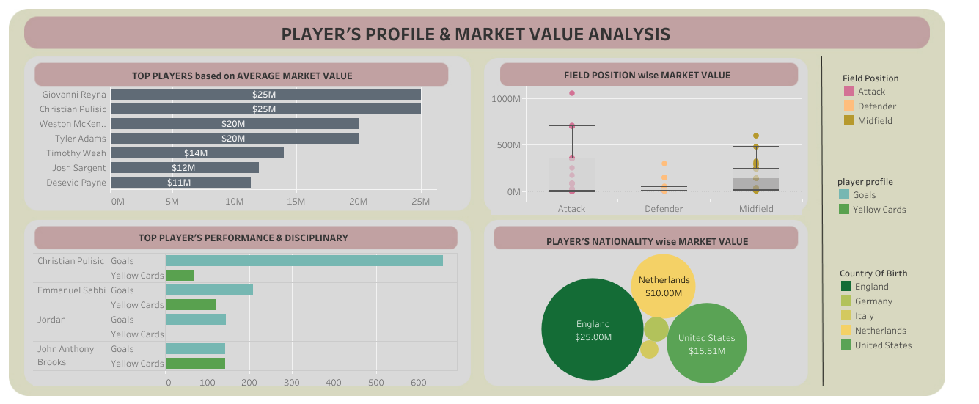

Slide 12
Regression to predict Market value
Model | Equation | R2 square | Mean squared error
Linear | Y= 0.00377271 + 0.54514261X1 | 0.305114 | 0.6869
Multi linear1 | Y= 0.001419 + 0.56X1- 0.558X2 | 0.6072 | 0.38832
Multi linear2 | Y= 0.003 + 0.538X1 -0.493X2+ 0.163X3 | 0.62759 | 0.36817
Multi linear3 | Y= 0.002 +0.453X1 -0.468X2+ 0.201X3 -0.248X4 | 0.68016 | 0.31619
Multi linear4 | Y= 0.00262 + 0.459X1 -0.4439X2 + 0.1804X3 -0.24482X4 -0.0645X5 | 0.68096 | 0.3154
X1=attendance
X2=Age
X3=foot
X4=line up /substitutes
X5=height in cm
Y=Market value in euro
The model shows good improvement and reduced errors as the number of feature increases.
There is a drastic change when age is added along attendance feature
The model with 5 features shows better performance than rest of the model.

Slide 13
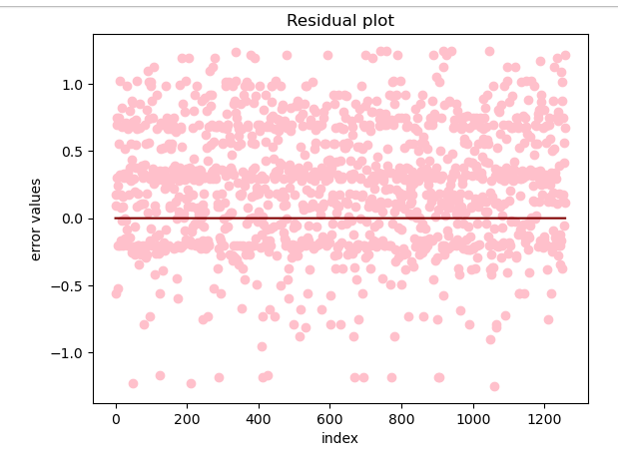
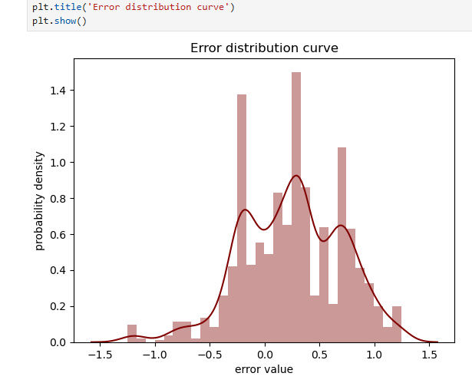
Regression (contnd)

Slide 14
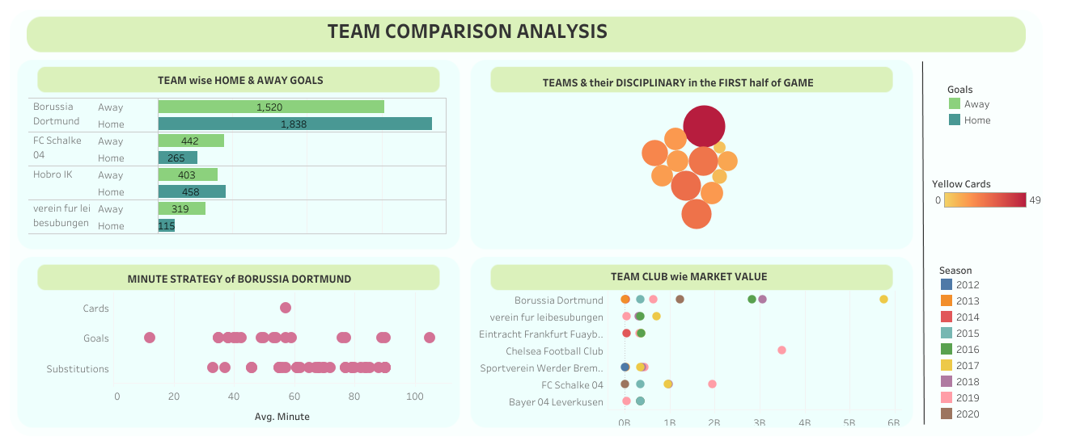

Slide 15
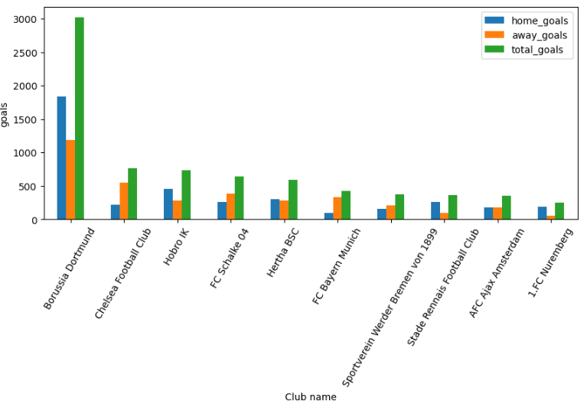
MYSQL work
Home team wise home club goals into SQL Db
Away team wise away club goals into SQL Db
Inner join on club name to get total goals per team
Read from MySql

Slide 16
Hypothesis Testing ( Team comparison)
1. Is there a significant difference between the average number of goals scored in 2018 and 2019 by Team Borussia Dortmund in their Home ground?
→ Two tailed Z test →Reject null hypothesis.
Yes, there is significant difference between the average number of goals scored in 2018 and 2019 by Team Borussia Dortmund in their Home ground
2. Is there a significant difference between the average number of goals scored by Hoboro IK in home ground and away ground?
→ Two tailed t test →Accept Null hypothesis.
No, there is no significant difference between the average number of goals scored by Hoboro IK in home ground and away ground

Slide 17
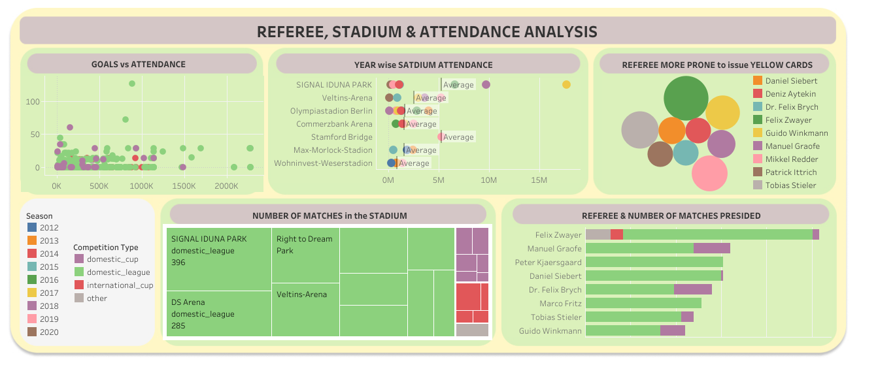

Slide 18
KN Neighbours classifier:
1.Prediction of High, medium and low attendance in the game:
Factors considered: goals, minutes played, stadium, competition type, yellow cards and season.
Score (accuracy, f1, recall, precision) = 0.98174
Roc auc = 0.98634
2.Prediction of competition type based on attendance and stadium.
Score (accuracy, f1, recall, precision) = 0.9746
Roc auc = 0.8939
Confusion Matrix( 4 types of competition):
 | 0 | 1 | 2 | 3
0 | 105 | 10 | 0 | 0
1 | 4 | 1037 | 0 | 14
2 | 0 | 4 | 80 | 0
3 | 0 | 0 | 0 | 6

Slide 19
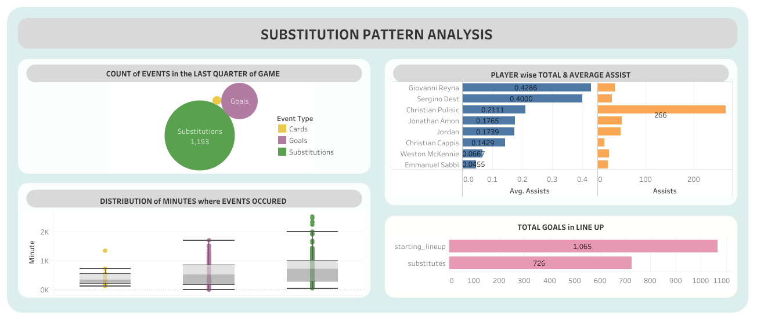

Slide 20
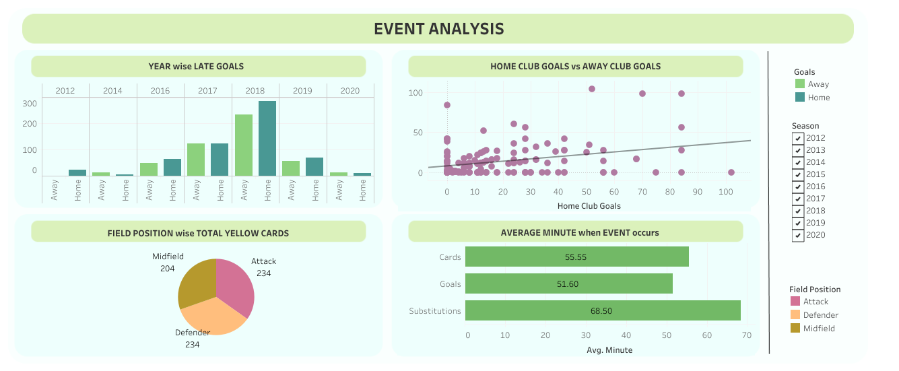

Slide 21
Hypothesis testing ( event analysis)
1. The average number of yellow cards drawn in domestic league is 0.174. To check whether the average is higher than that of 0.174.standard deviation of the population is 0.379. with 5% significance level.
→ One sided Z test → Accept Null hypothesis
The average number of yellow cards drawn in domestic league is lesser than or equal to 0.174

Slide 22
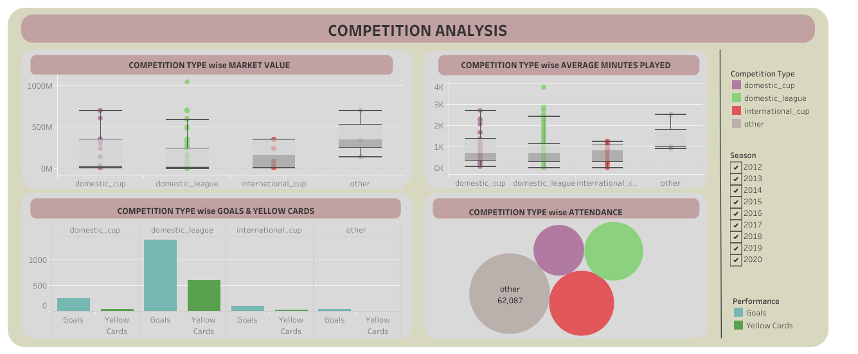

Slide 23
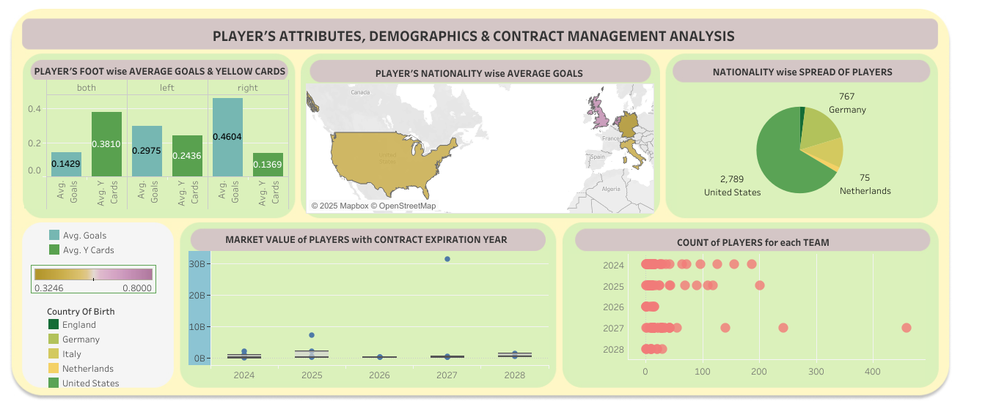

Slide 24
Contract Management ( Key points)
The players contract expiration year in all clubs vary from 2024 to 2028.
Football club nords has highest number of players for contract expiration in the year 2024.
The highest number of players are in Borussia Dortmund whose contract are to be expired in 2027
Market value of players who contract expires in 2028 has range in higher scale from 13M to 20M while players whose contract expires in 2024 has very small range lying lower scale of maximum up to 10M
June is the only month where all 24 players contract expires irrespective of the year.

Slide 25
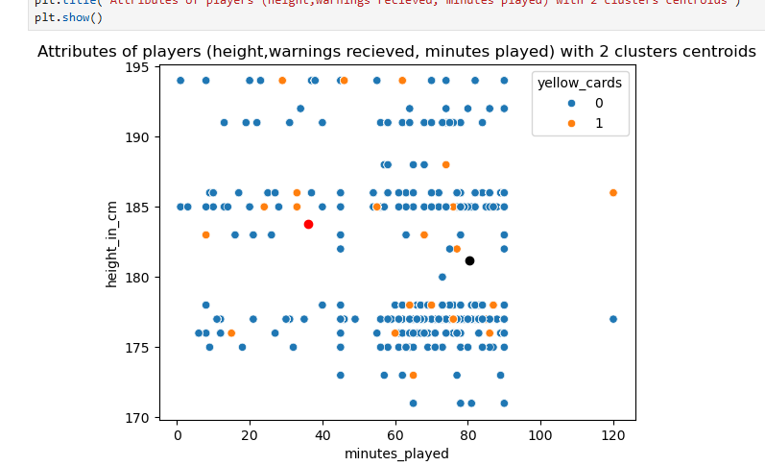
K Means Clustering
Calinski Harabasz index:
7770.968
Davies Bouldin index:
0.6168
Silhouette score:
0.5972

Slide 26
Key In takes
Player performance:
Christian Pulisic scores highest number of goals and also shows good performance growth every year.
Christian Pulisic scores 20% Of his goals with the help of assist
Giovanni Reyna and Christian Pulisic has the highest average market value
Position:
Right winger scores more than 50% of goals compared to other position
Both Midfielder and defender scores goals on same scale except. Attackers and defenders are more prone to receive warnings than midfielder.

Slide 27
(contnd)
Mostly home teams score more goals than away teams. Analysing top performing teams, more than 60% of the teams perform better in home ground while the rest teams perform better in away ground. Especially FC Schalke 04 and Hamburger SV significantly score more goals in away ground
Foot: The probability of receiving yellow card given that the player is left footed 24% which is higher than for right footed 14%. Right footed players scores high number of goals and less number of yellow cards received. It is reverse in case of both footed players. Right footed players are ideal for matches while both footed affects the performance.
The maximum number of assist a player had in these games is 2. higher the number of assist, higher the chance for goals.
Nationality: Players from United states are high in numbers. Despite producing moderate players, players from Netherland has the highest average goals scored. Players from England followed by United States yield more market value.

Slide 28
(contnd)
Borussia Dortmund team has the highest goals. Chelsea football club has the highest market value of 3500M in 2020. Hoboro IK team receives most yellow cards.
There is no significant difference between the average number of goals scored by Hobro IK in home ground and away ground
Borussia Dortmund:
There is significant difference between the average number of goals scored in 2018 and 2019 by Team Borussia Dortmund in their Home ground
In average, most goals are scored at the later part of first half and the initial part of second half.
Borussia Dortmund receives only half the yellow cards of Hoboro IK
Teams peak market value in 2017 and has been decreasing most in recent years.
Most players in Borussia Dortmund contract are to be expired in 2027

Slide 29
(Contnd)
Competition Type:
Goals are highly scored in competition type other than domestic and international cup. Domestic league receives high number of yellow goals in average.
The highest number of audience is in category which is displayed as other. In international cup, there is no relation between audience and number of goals scored. While competition type other than domestic league and international cup, shows good relation
Domestic league has high spread of market value compared to other competition types.
Stadium: signal iduna park holds the most number of matches
Referee: Felix Zwayer issues the most number of yellow cards and presides most number of matches.
Minute: 50% of the substitution occurs between 60 to 80 minutes, while goals are spread from 10 to 110 minutes and cards are mostly issued between 30 to 70 minutes. In the last quarter, very few yellow cards issued and high number of substitution occurs.

Slide 30
Conclusion
Extracted valuable insights into various aspects of football, helping to understand performance trends, market value, and game dynamics. The predictive models and statistical analysis highlighted key patterns in player attributes, team strategies, and match events. The dashboards offer a user-friendly way to explore data and make informed decisions. This study showcases the power of data science in sports analytics, providing actionable insights.
Thank you

