Slide 1
AUTOMOBILE SALES TREND
By M PRIYA
Mentor: JAYA PANDEY

Slide 2
INTRODUCTION
To conduct an exploratory data analysis utilizing Tableau’s visualization capabilities and dashboards. For in depth analysis of sales data of miniature automobiles that are sought after by hobbyists and collectors all over the world. To extract actionable insights focusing on key areas such as sales analysis, customer segmentation, product performance, stock and order status.

Slide 3
OBJECTIVE
Data cleaning
Data pre processing
Sales performance
Customer segmentation
Sales forecast
Product performance
Inventory management
Order fulfilment analysis
Pricing strategy

Slide 4
Data cleaning & pre processing
The type of information given in data set was looked upon.
Missing value treatment: The columns with missing values were filled with the most occurring value in the column for categorical type column and mean for the column of numerical type column.
Outlier treatment: The outliers in the columns if exist were replaced with average of the column.

Slide 5
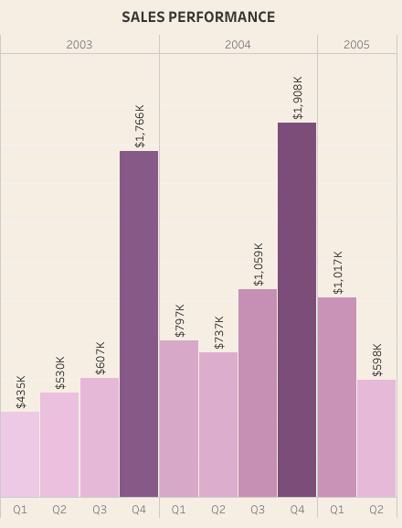
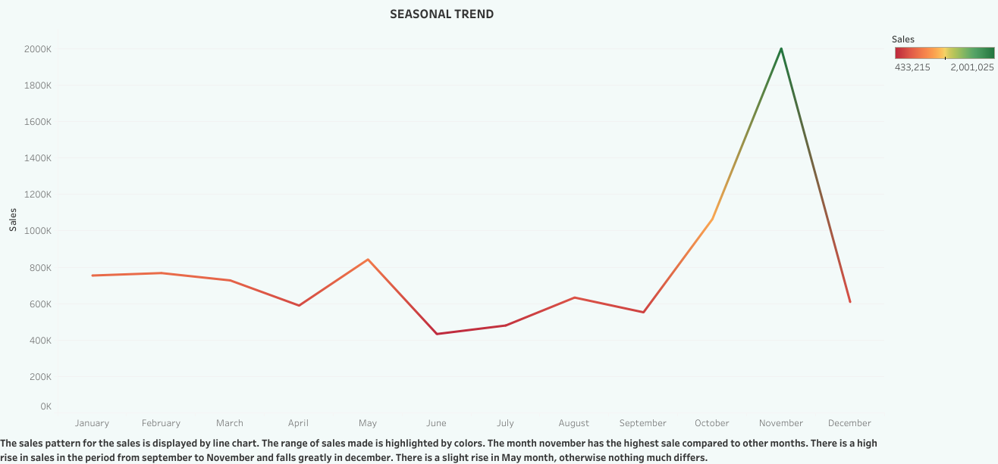
Sales performance
The sales performance quarter and yearly wise are shown:
November month sees hike in sales.
Quarter 4 does better than any other quarters.
2004 shows better sales compared to 2003 and 2005

Slide 6
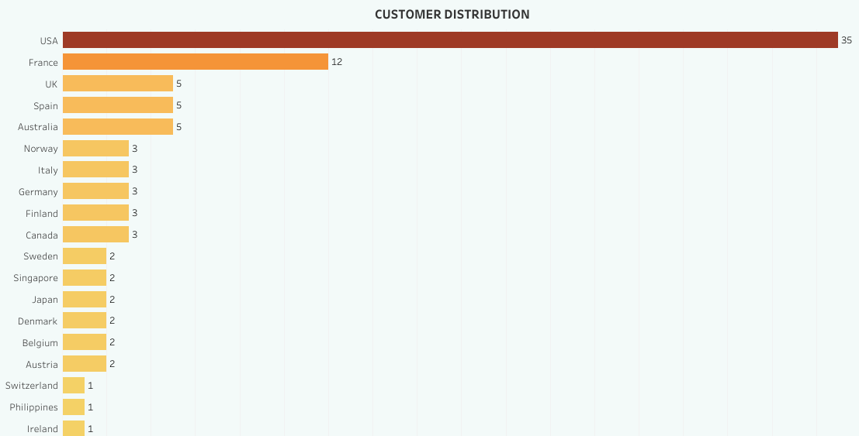
Customer segmentation
The distribution of customers is listed here. USA has high number of customers followed by France, while rest countries has less that 6 dealers each.

Slide 7
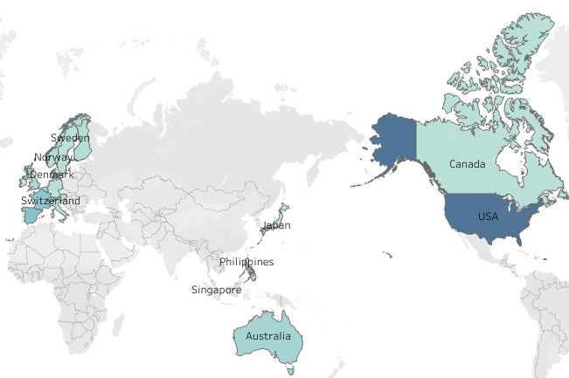
Regional performance
The regional sales is shown in choropleth map. The colour intensifies as the total sales increases.
USA has the highest sales
Upon further analysis, California state in USA makes highest sales.
San Rafael is the highest sales making city in California

Slide 8
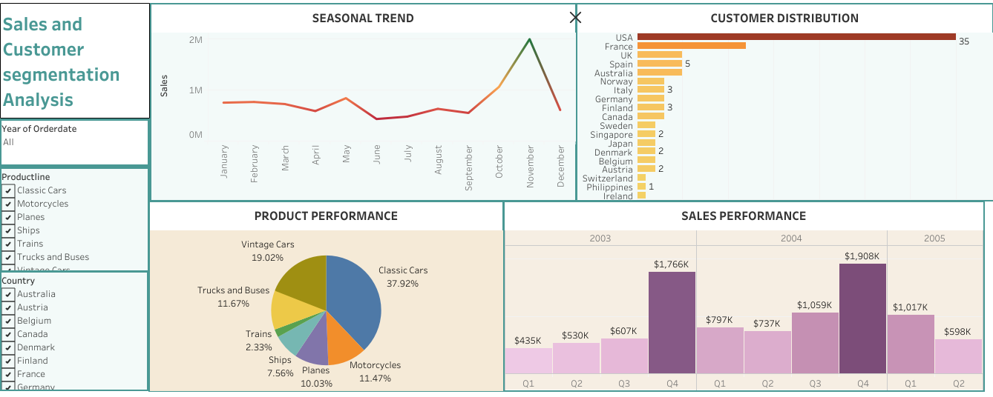

Slide 9
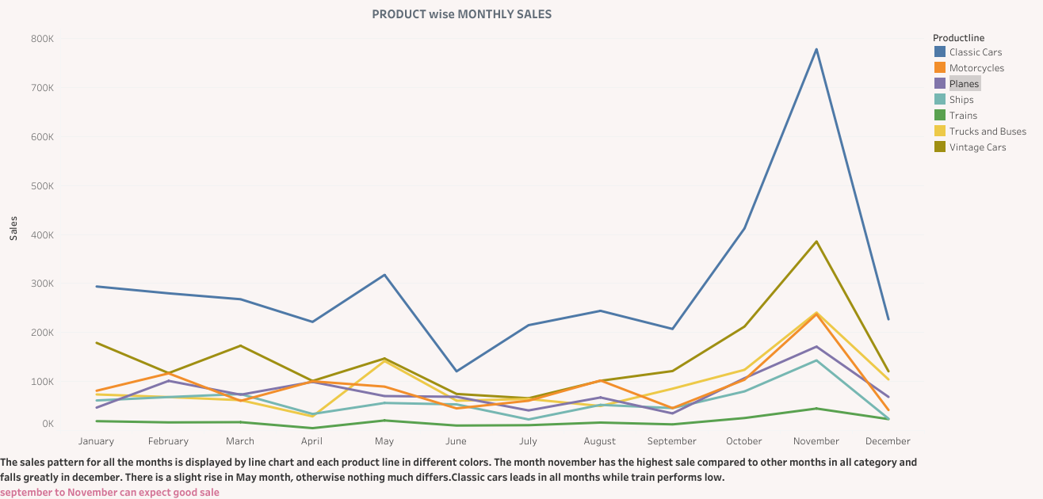
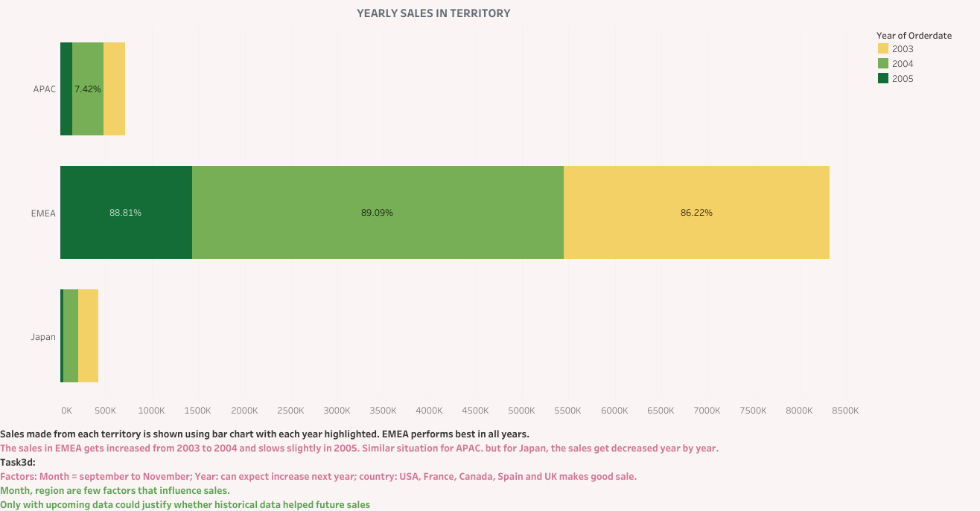
Sales forecast

Slide 10
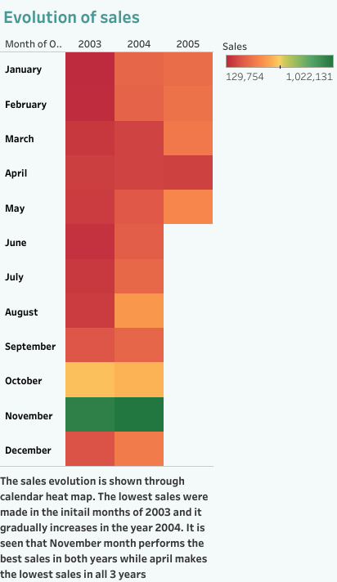
Trend analysis
There seems to be a seasonal trend during the period September to November.
Month wise, August, January, February, December,.. month has increased in sales highly from 2003 to 2004.
April month has constantly low sales for all years.
Territory wise EMEA has highest sales.
Year wise, Japan has decline in sales year by year.
In case of EMEA, 2004 has better sales than 2003 but slight decline in the year 2005.
Product line wise, all category has similar performance in sales.
Classic cars and trucks have 2nd high sales in May
Vintage cars has 2nd high sales in March while motorcycle has its least sale in the month

Slide 11
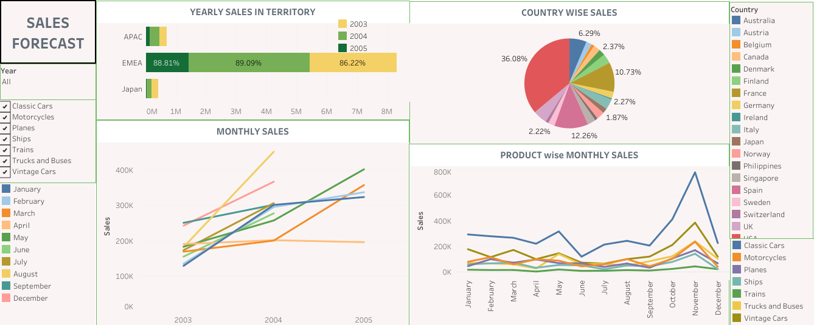

Slide 12
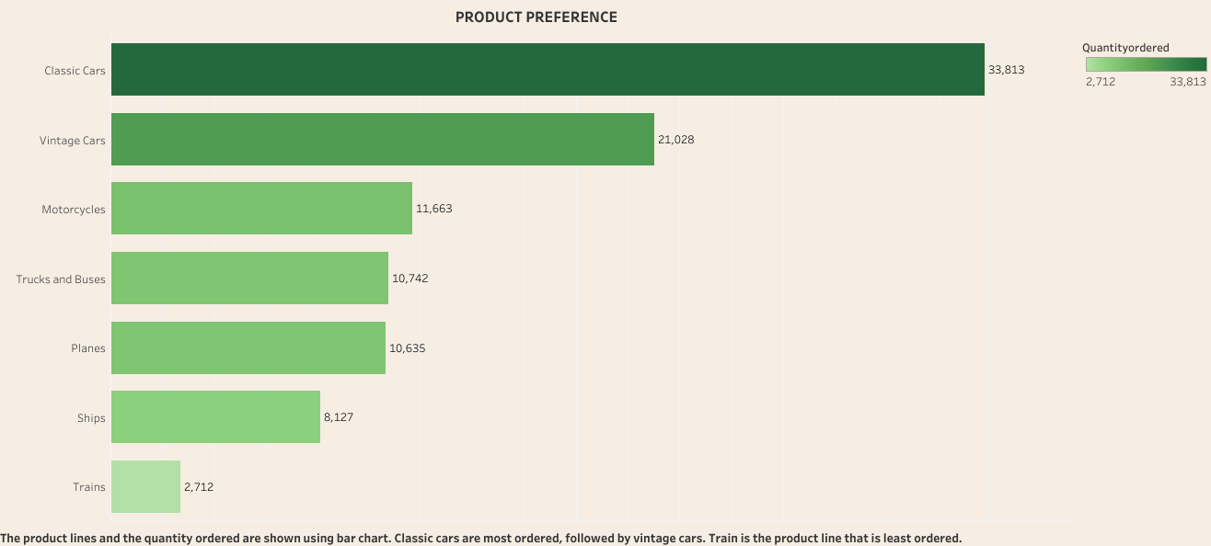
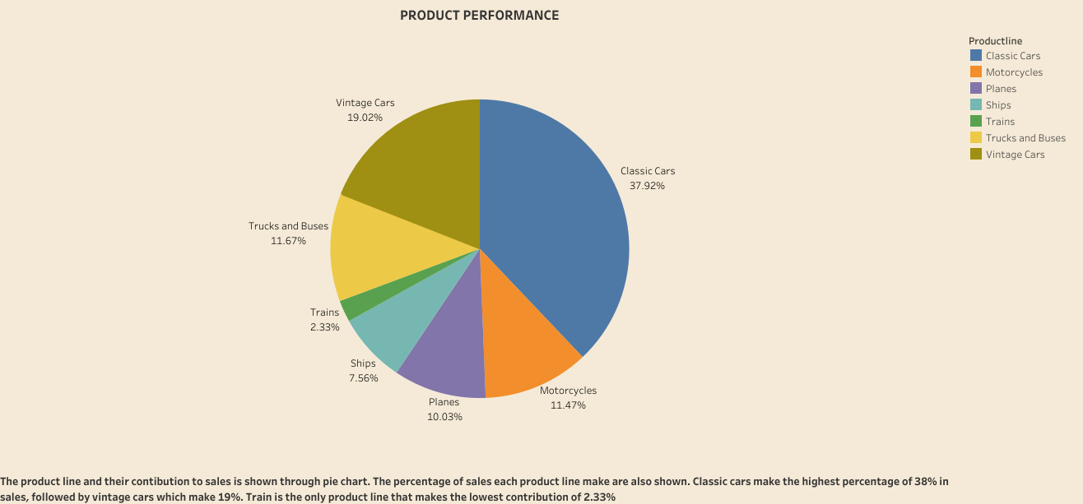
Product performance
Both in quantity ordered wise an total sales wise classic cars dominates while trains perform least in both criteria

Slide 13
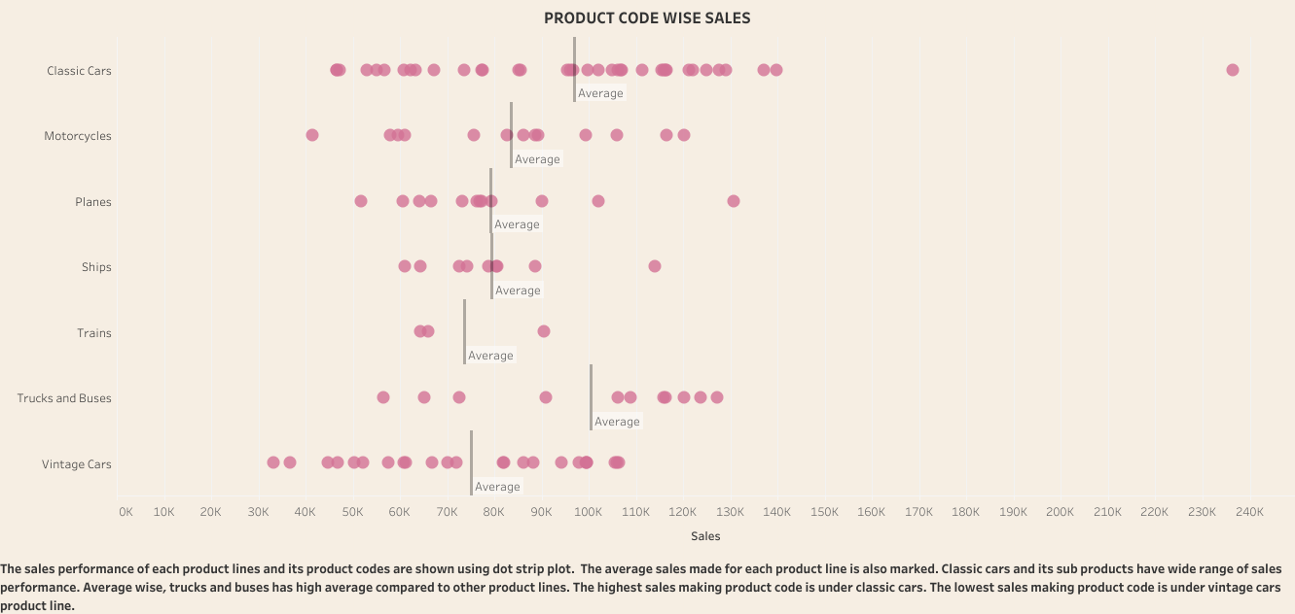
Total sales of each variant in all product line.
The distribution of total sales of variants under each product line is shown using dot strip plot.
A product under classic cars has highest sales
Train has the highest minimum sales made
Range wise, classic cars are widely spread
Trucks and buses have highest average

Slide 14
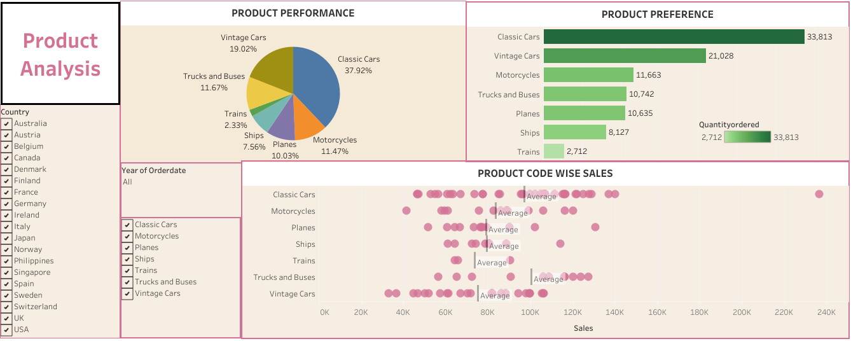

Slide 15
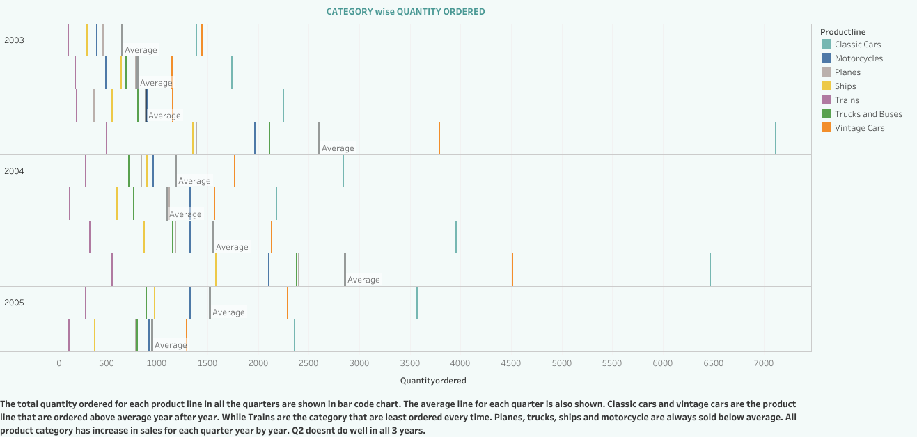
Inventory management
The quantity ordered for each product line on every quarter of the years from 2003-2005 is shown using bar code plot.
Every quarter classic cars and motorcycles are ordered above average
Trains are least ordered every time
Quarter wise there is increase in orders every year except quarter 2.
Especially quarter 2 in 2005 has the least quantity ordered in all categories

Slide 16
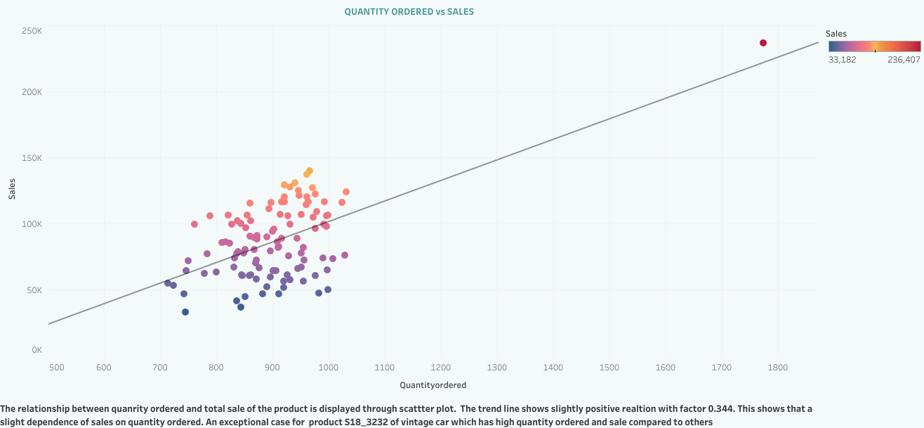
Relationship of sales with quantity ordered
The relationship is shown using scatter plot.
A moderate positive relation with 0.344, implying sales slightly depends on quantity ordered
S18_3232 of classic cars has both high sales and quantity ordered

Slide 17
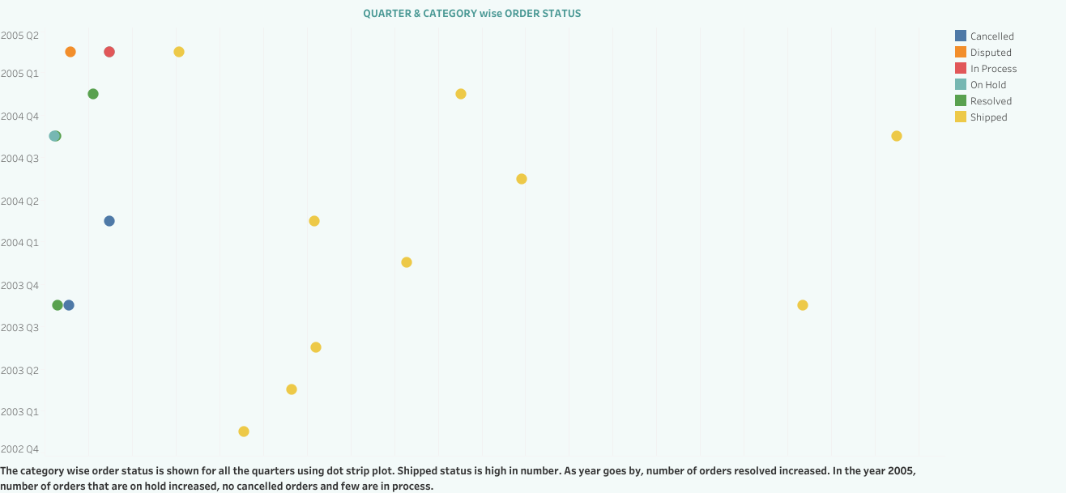
Order fulfilment analysis
The orders are categorised under status and the count is shown for each quarters.
Shipped orders gets increased every year.
Few orders are under dispute and in process for 2005

Slide 18
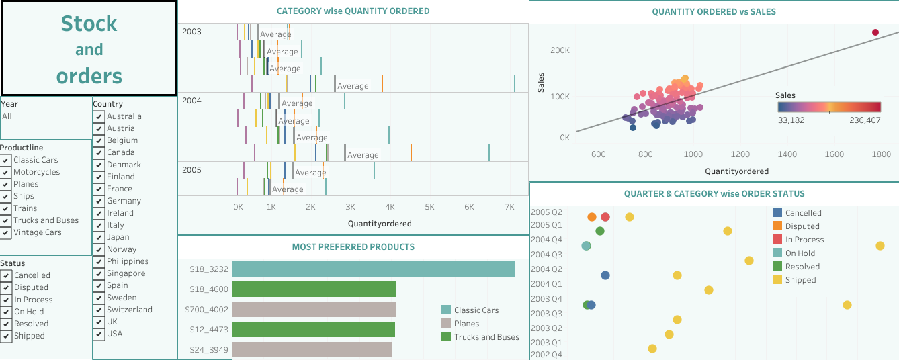

Slide 19
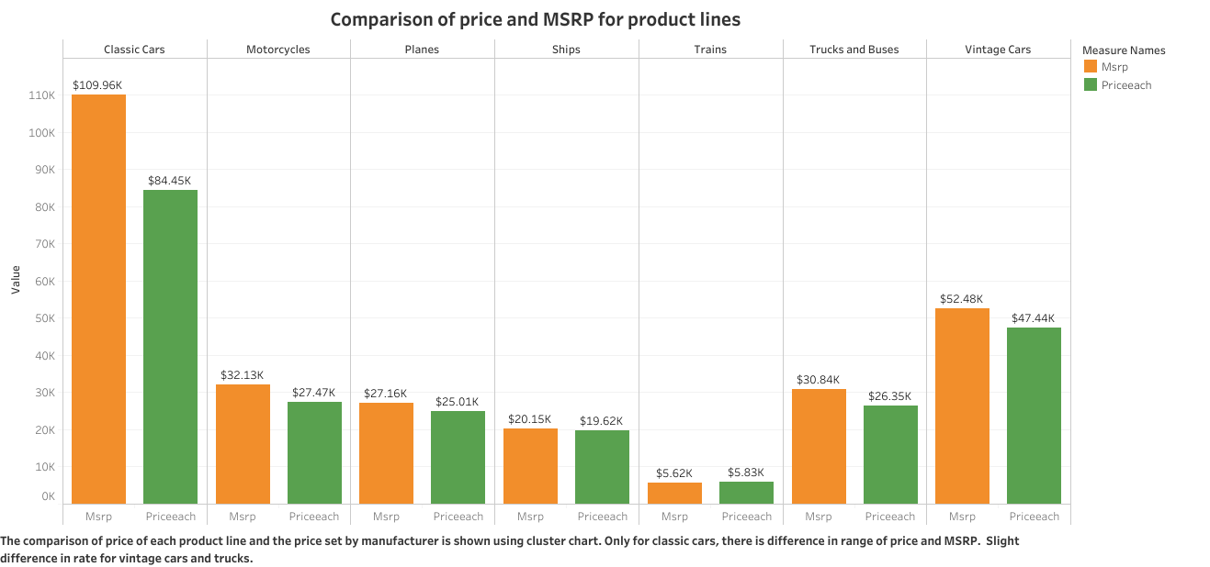
Pricing strategy
The comparison of MSRP and price of each product line is shown. Only classic cars, trucks and buses have slight variation while other product line are similar.

Slide 20
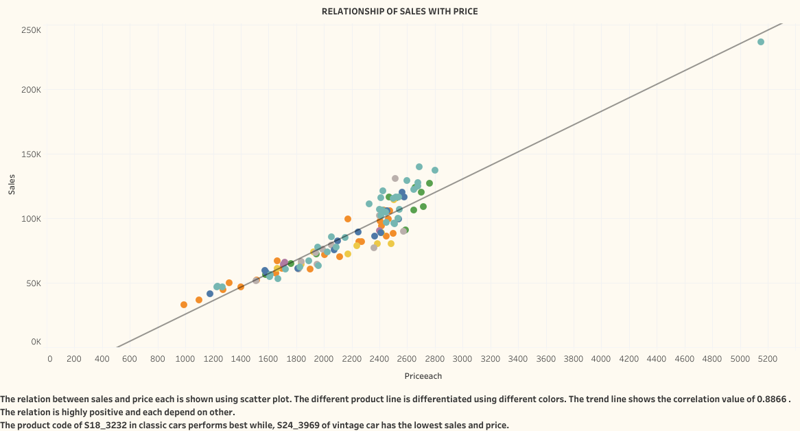
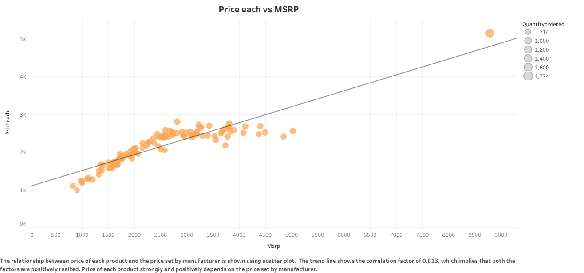
Relationship of price with sales and msrp
Strong positive relation between sales & price, with factor 0.886
Strong positive relation between price and MSRP, with factor 0.813

Slide 21
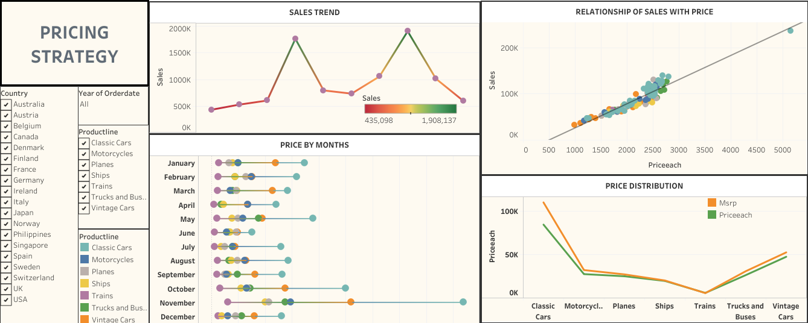

Slide 22
summary
Year: Year wise, 2004 performs best compared to 2003 and 2005
Quarter: Quarter 4 has the highest sale every year and also highest number of orders, while Quarter 2 does poorly.
Month: November high sales, while April has lowest sales in all years
Customer distribution: USA high number of customer, followed by France.
Regional sales: USA has the highest sales. California state in the US makes the highest sale and San Rafael is the highest sales making city in California.
EMEA has sales increase in 2004 compared to 2003 but decline in 2005
Japan has gradual decline in sales year after year
Product line: Classic cars dominates sales and number of quantity ordered while trains has lowest performance in both criteria
Best product: S18_3232 of classic cars does an exemplary performance in sales

Slide 23
summary
Key points observed:
Classic cars and motorcycles are ordered above average every year while trains are ordered the least every time
Quarter wise considering quantity ordered, it seems that quarter 2 in every years gets low orders especially in the year 2005
There seems to be a moderate dependency of sales on quantity ordered
Few orders are under dispute, on hold, in process, cancelled,… The number of cancelled orders is 0 in 2005.
The comparison of MSRP with price for each product line shows not much difference except for classic cars, trucks and buses.
Relationship of price with sales and MSRP is strongly positive.

Slide 24
CONCLUSION
The analysis of miniature automobile sales data was conducted. This includes examining on sales performance, customer segmentation, sales forecast and product performance. Further analysis on inventory management, order fulfilment and pricing strategy were also done. The factors affecting all these features were looked upon and summarized for better insights.

Slide 25
✈
Thank you
🚚🚗

