Slide 1
Mitigating Bird Strikes in Aviation
By Priya m
Mentor: jaya pandey

Slide 2
Introduction
To conduct an exploratory data analysis on wildlife strike in Aviation. To identify patterns and discover key risk factors contributing to bird strikes. To extract actionable insights focusing on key areas such as operational efficiency, injury prevention, wildlife conservation, cost reduction, safety management. To analyse communication and training of pilots, risk management and regulatory compliance. Actionable insights to reduce the number of insights to be given from the analysis.

Slide 3
Objective
Data cleaning and pre processing
Safety improvement
Regulatory compliance
Injury prevention
Wildlife conservation
Operational efficiency
Cost reduction
Risk management
Communication management

Slide 4
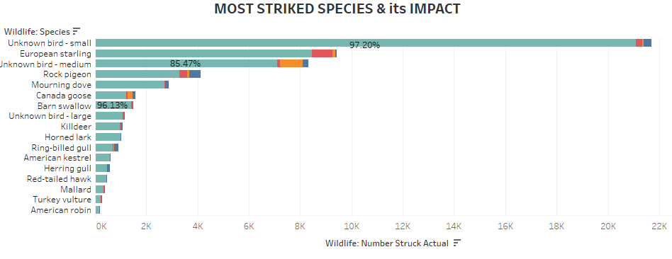
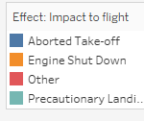
Safety Improvement
The small sized unknown birds are the most common species that strike the flight. Mostly, flight has to land with precautions

Slide 5
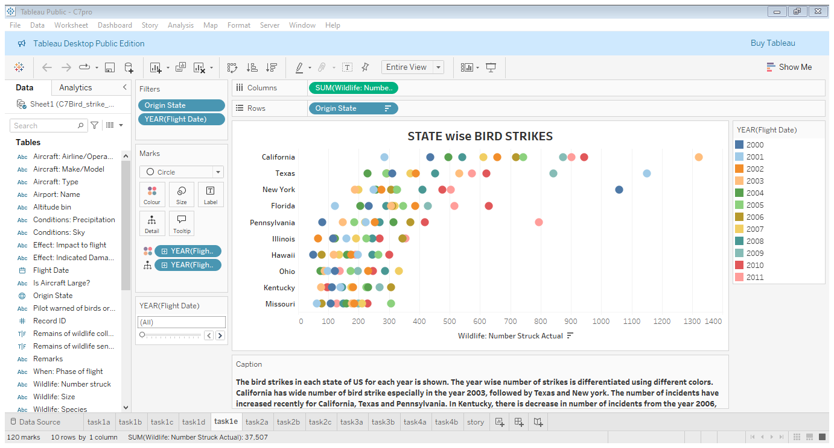
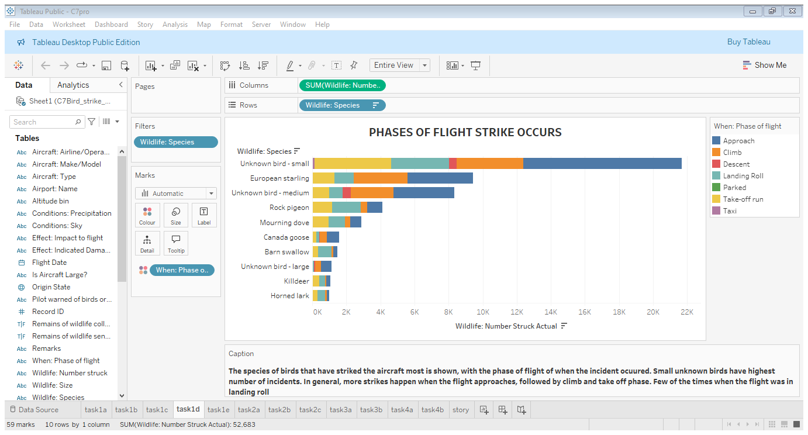
State wise & year wise number of attacks: California has wide range of attacks
Unknown small sized birds mostly strike the flight when the flight approaches

Slide 6
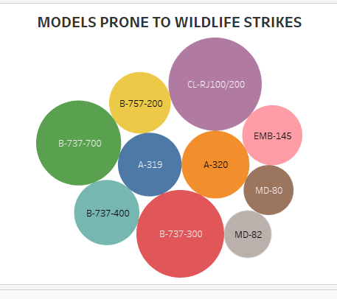
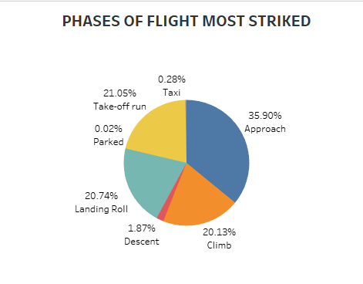
Top 10 aircraft based on number of bird strike each faced is shown. CL-RJ100/200 has faced high number of attacks compared to others
Most bird strike occurs when the flight approaches, also when landing

Slide 7
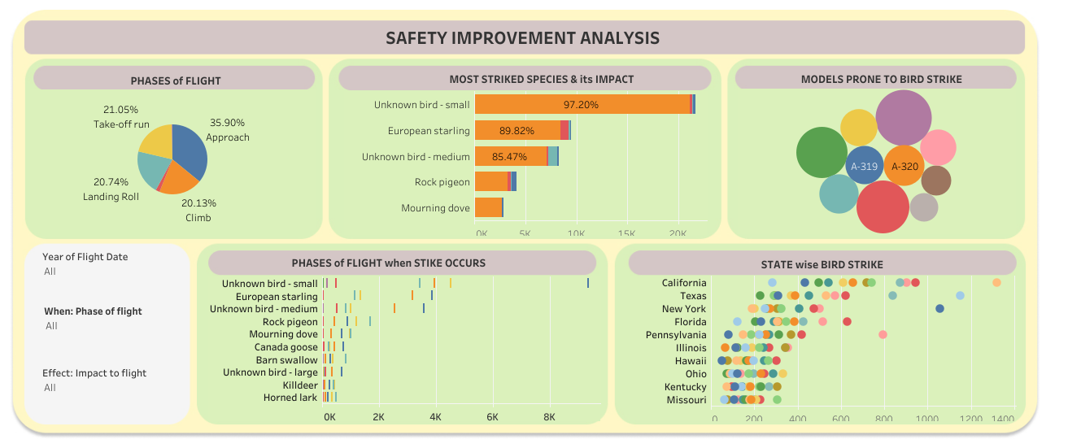

Slide 8
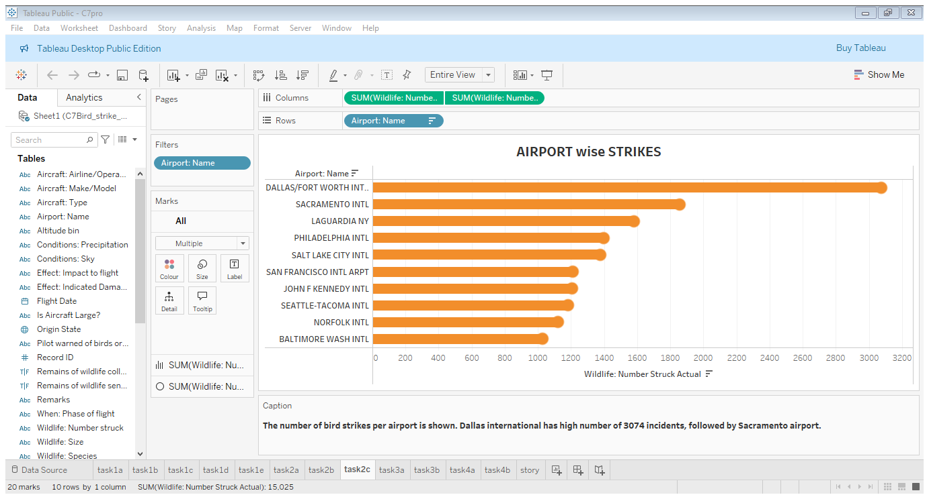
Regulatory Compliance
Dallas / Fort worth international airport has faced high number of strikes compared to other airports

Slide 9
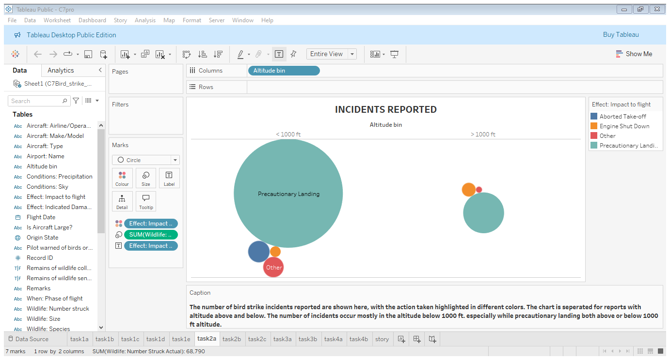
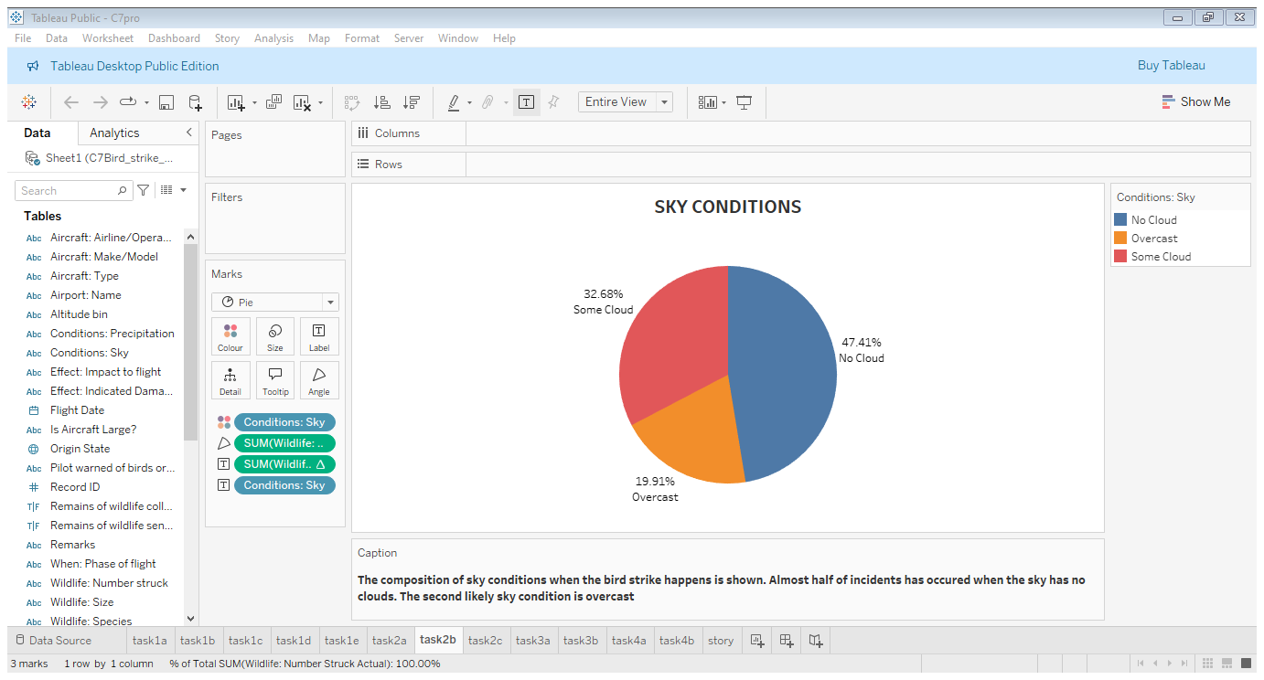
The bird strikes above & below 1000 ft with different impact is shown. Most strikes happen below 1000 ft.
There are some cloud when most of the strike happens.

Slide 10
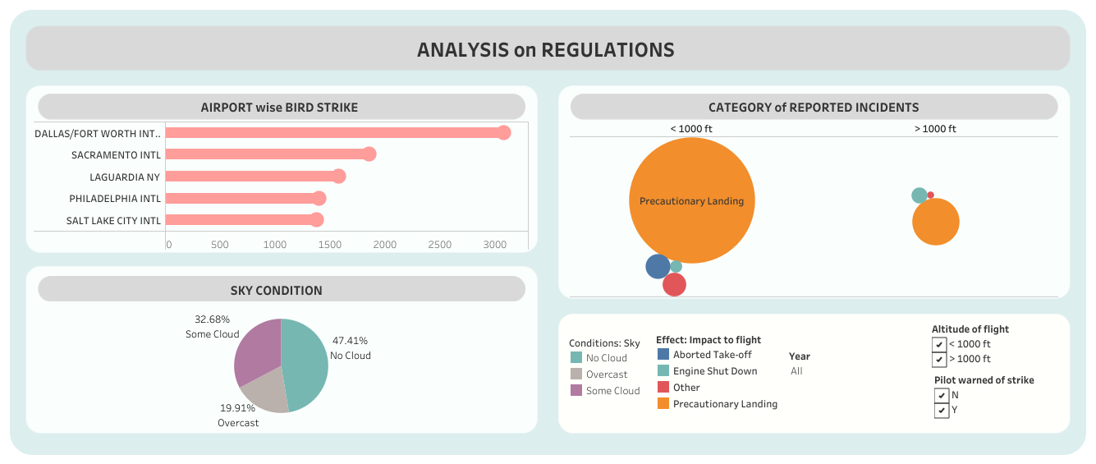

Slide 11
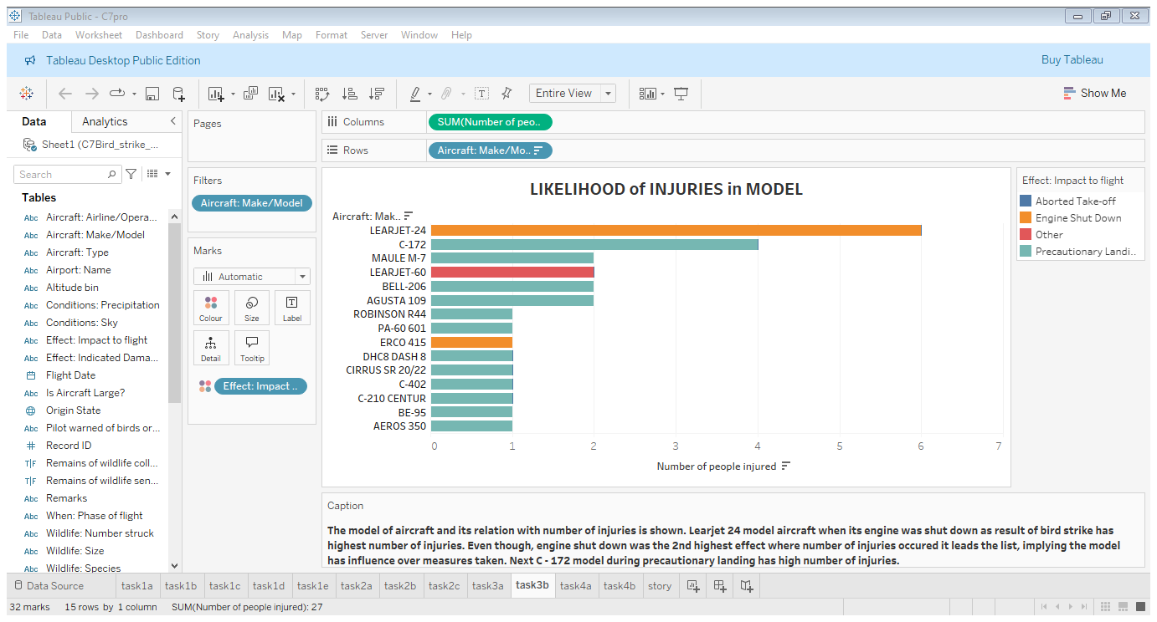
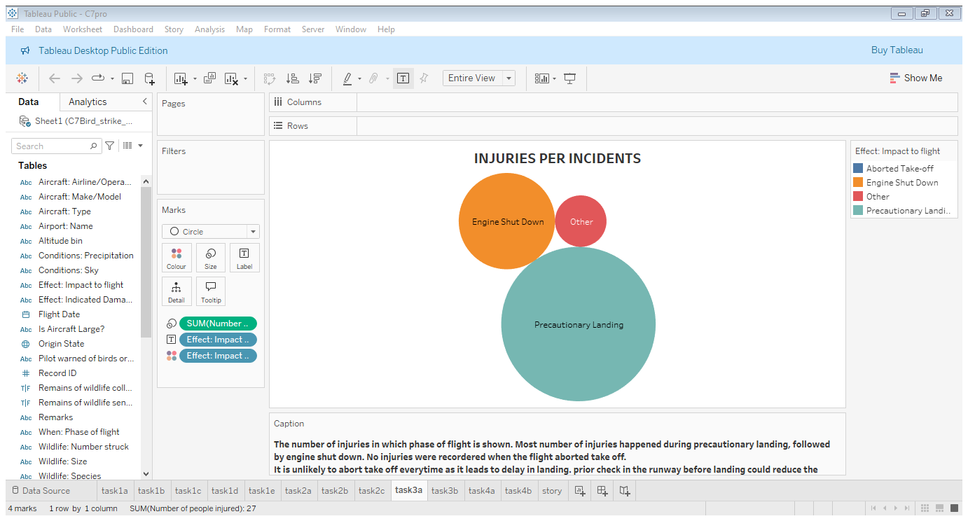
Injury Prevention
Lear jet 24 ahs recorded much injuries compared to other aircraft model
Precautionary landing causes more number of injuries followed by engine shut down

Slide 12
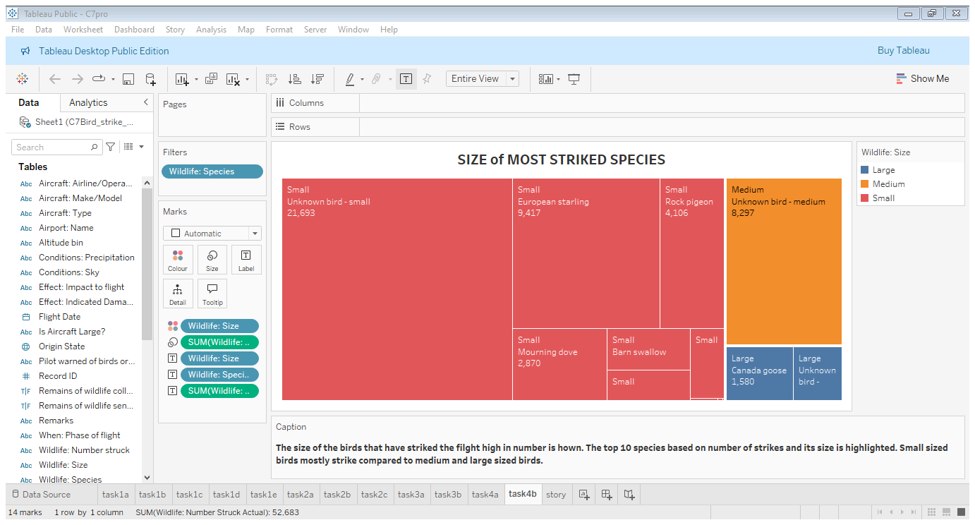
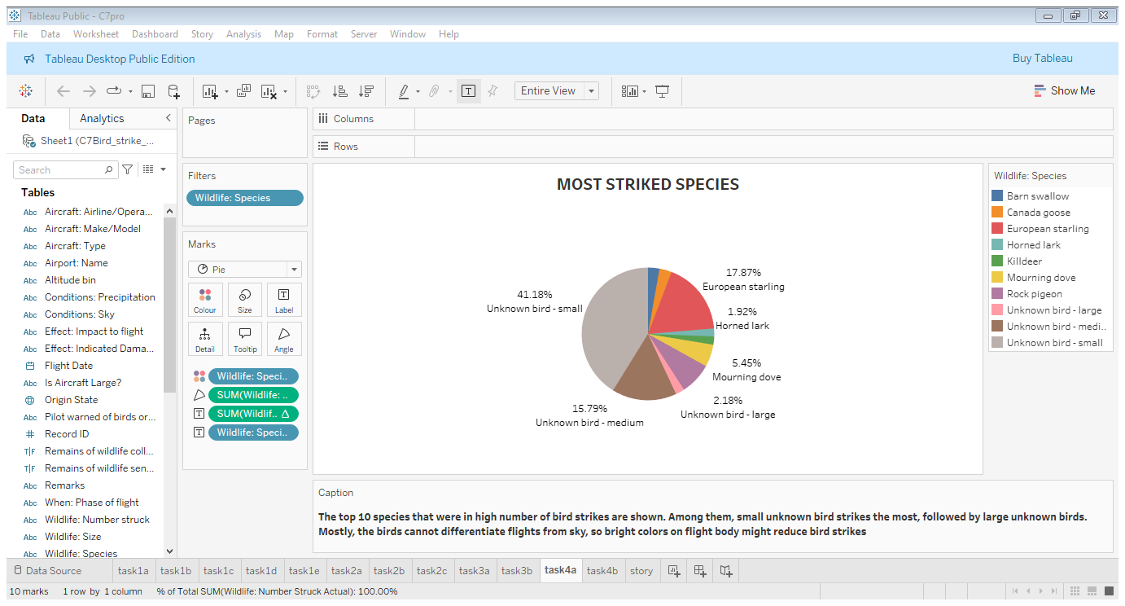
Wildlife conservation
Small size species are most likely to strike and very few large species attack the flight.

Slide 13
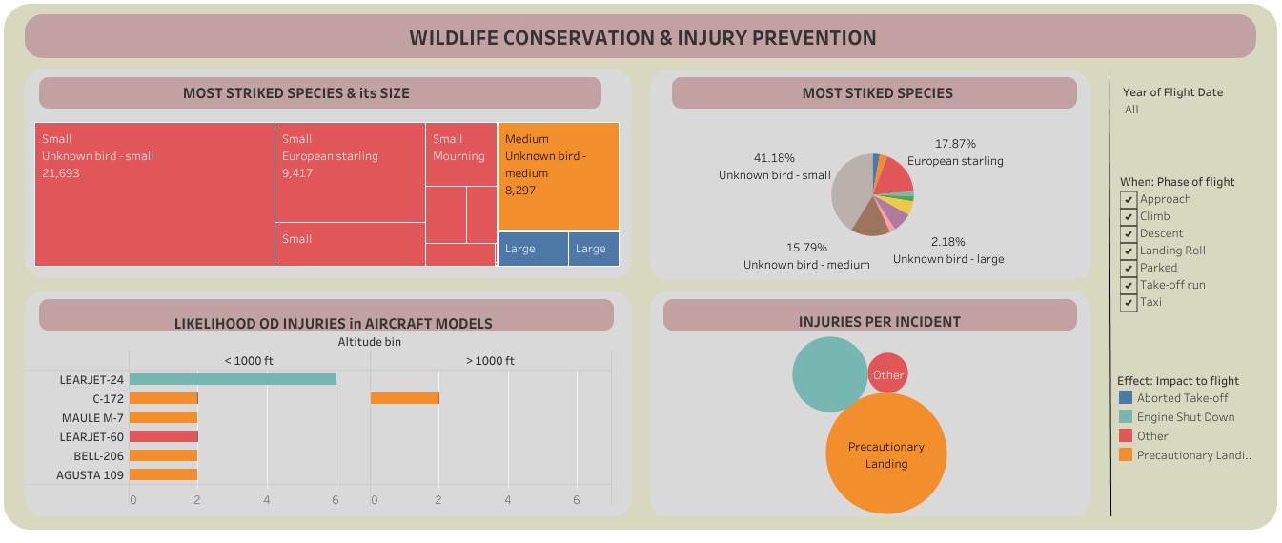

Slide 14
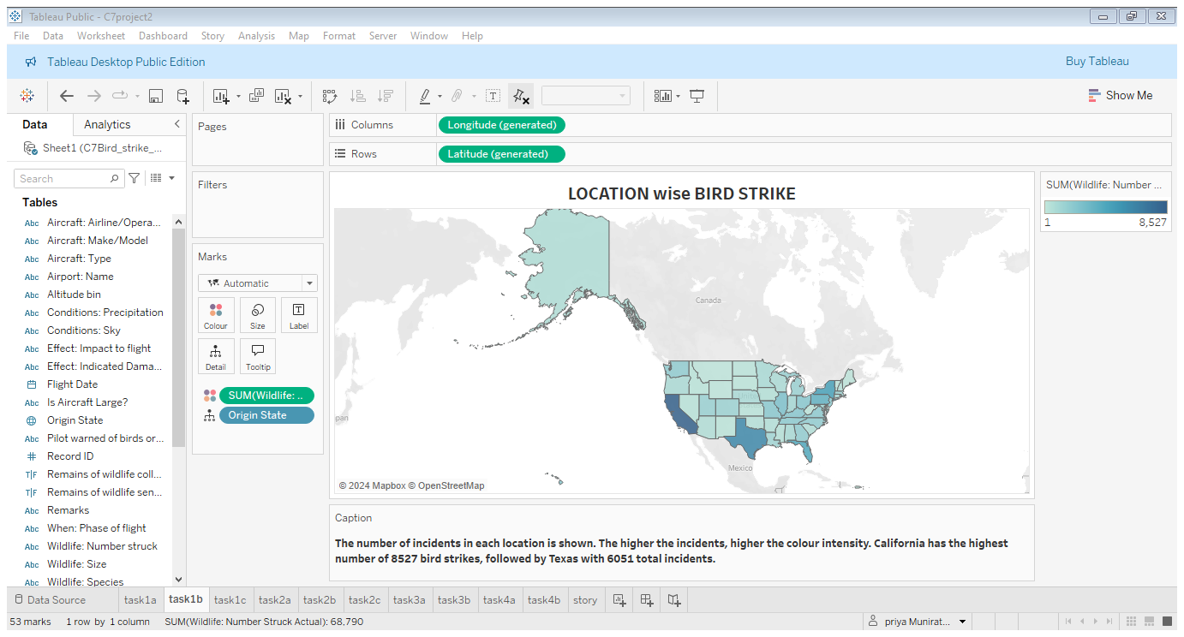
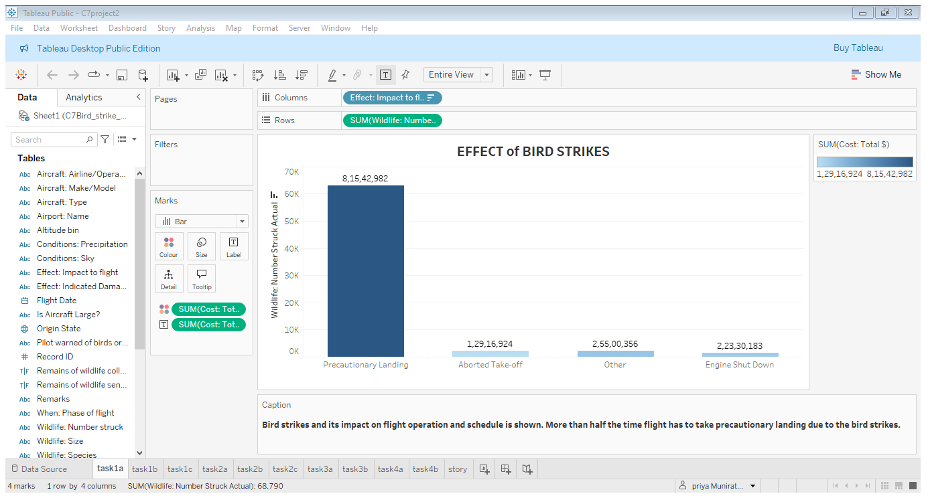
Operational efficiency
California followed by Texas are highly risk of bird strikes
Due to bird strike flights mostly land precautionarily

Slide 15
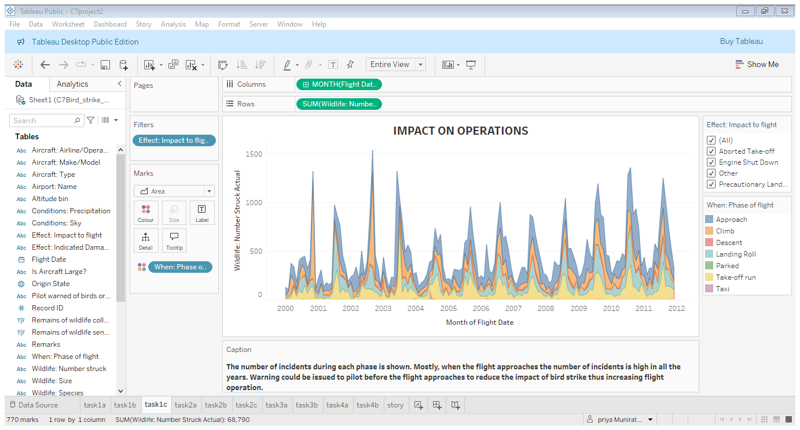
Mostly, when the flight approaches the number of incidents is high in all the years. Warning could be issued to pilot before the flight approaches to reduce the impact of bird strike thus increasing flight operation.

Slide 16
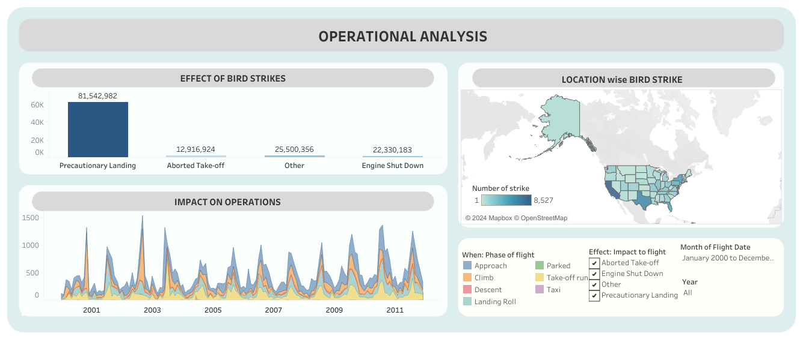

Slide 17
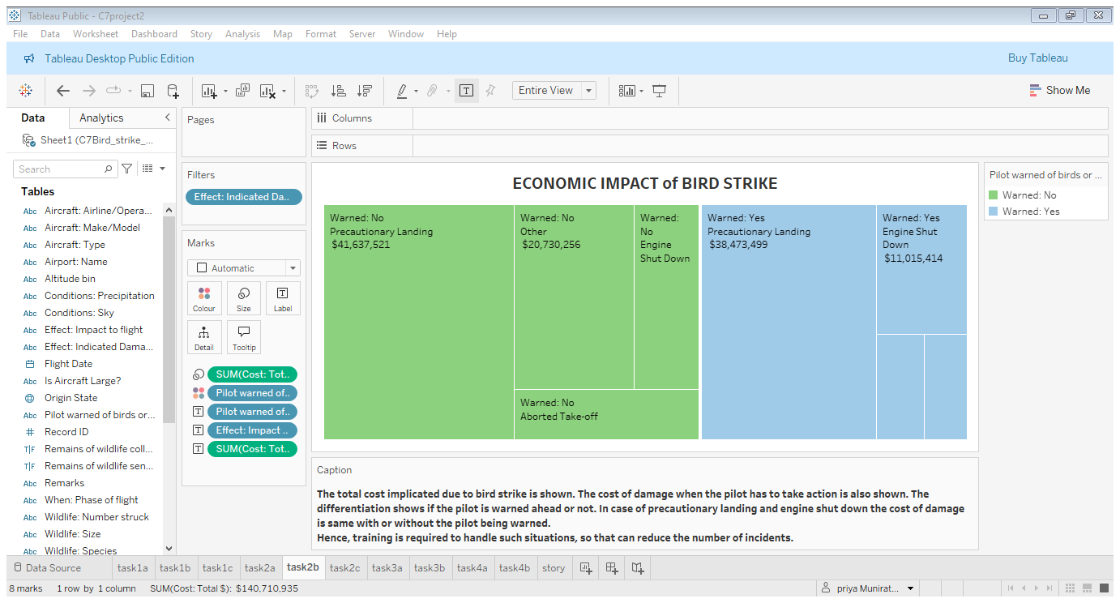
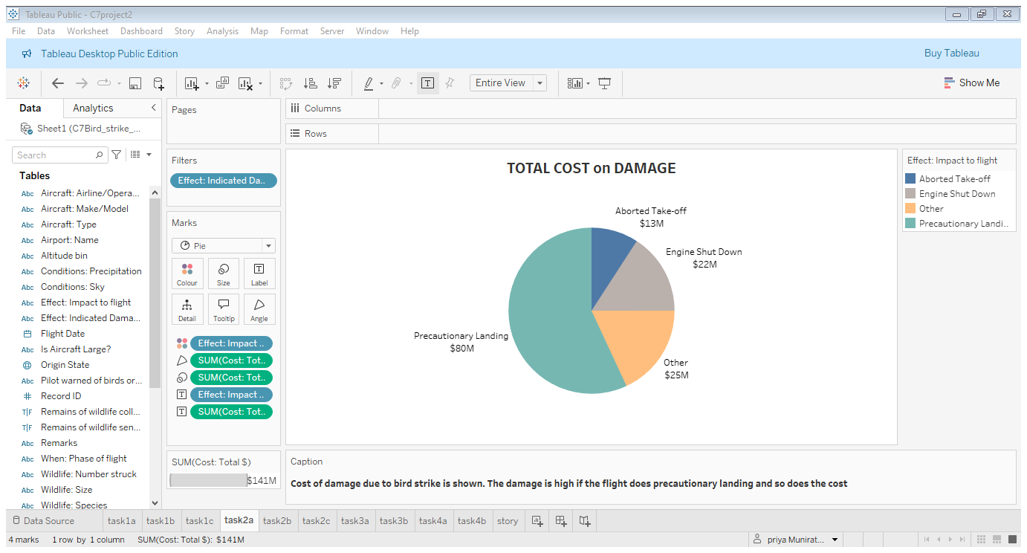
Cost reduction
In case of precautionary landing and engine shut down the cost of damage is same with or without the pilot being warned.
Hence, training is required to handle such situations, so that can reduce the number of incidents.
Precautionary landing does much damage and leads to more spending on cost

Slide 18
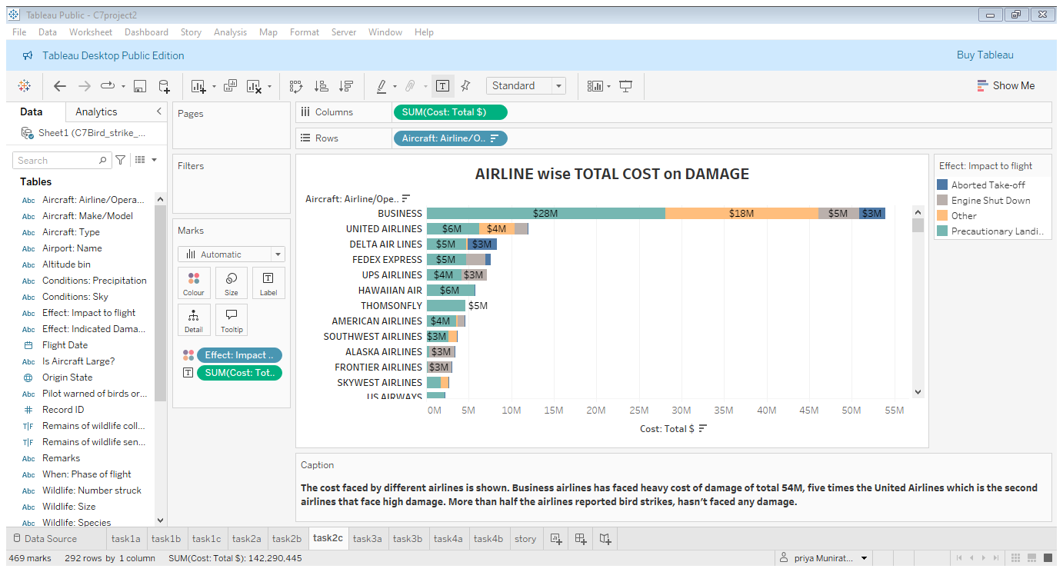
Aircraft wise total cost is shown. Business airlines inflicted much cost damage. Cost due to various action because of bird strike

Slide 19
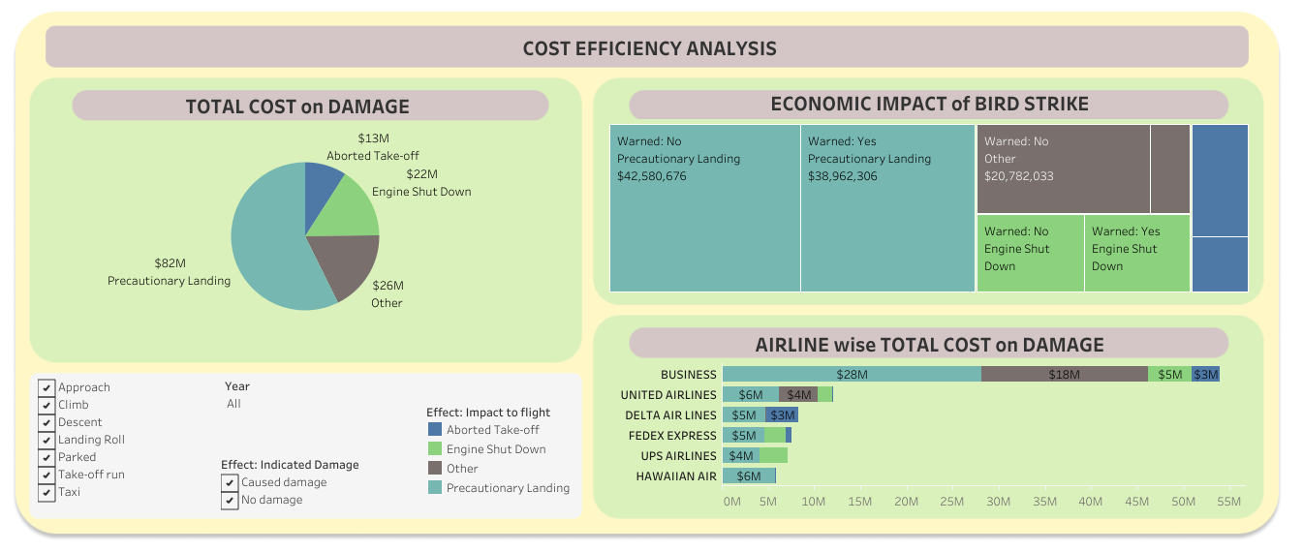

Slide 20
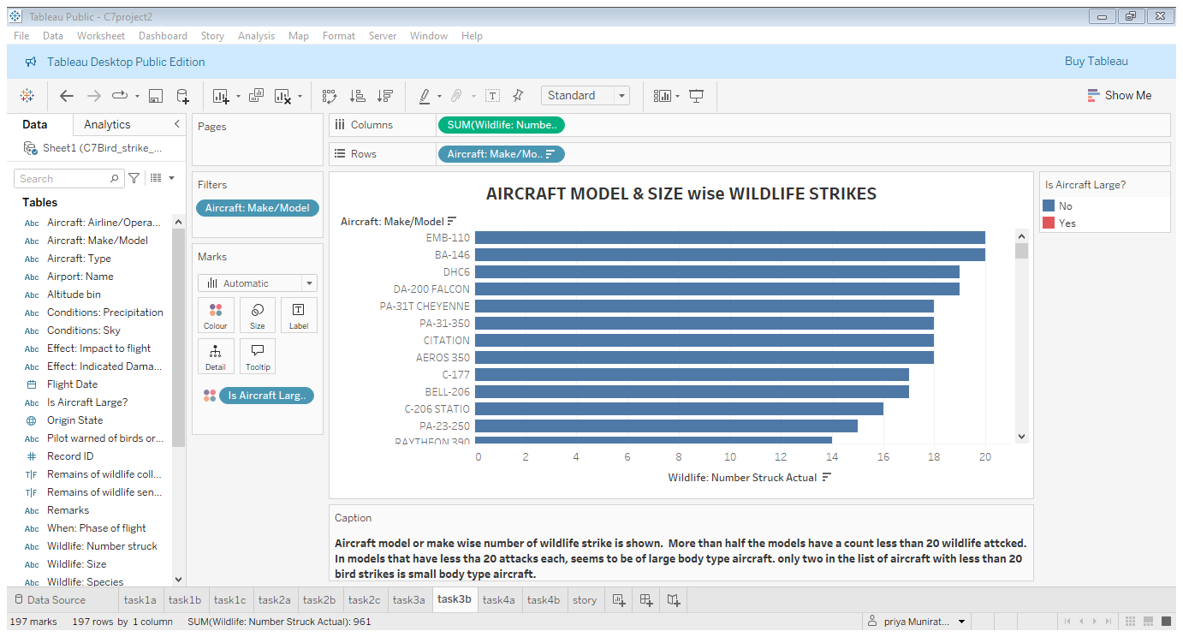
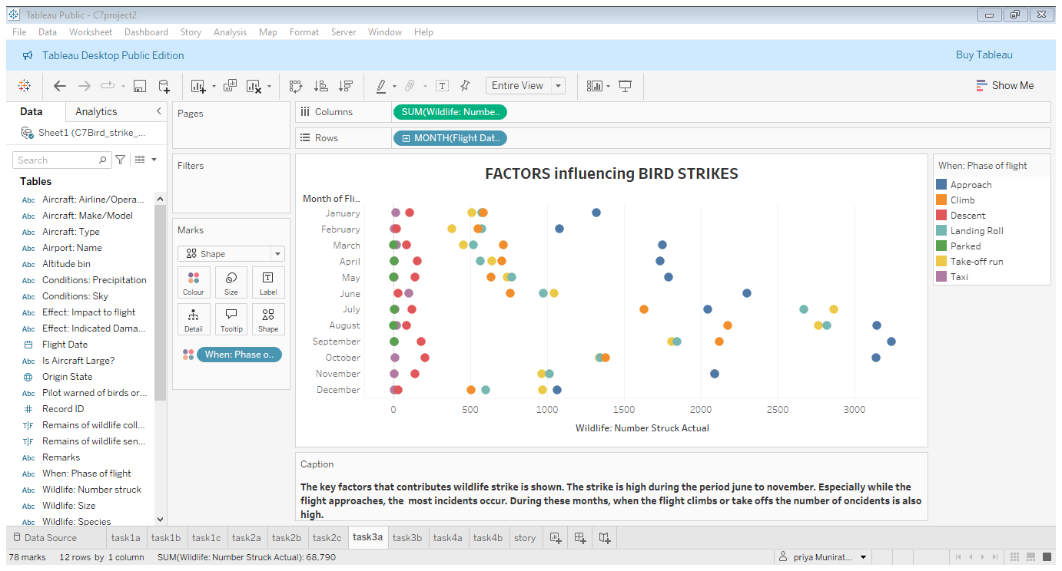
Risk Management
Only few large sized models are attacked. Large & visible aircraft can reduce number of incidents
July to November has high number of incidents and most strikes happen during approach or landing.

Slide 21
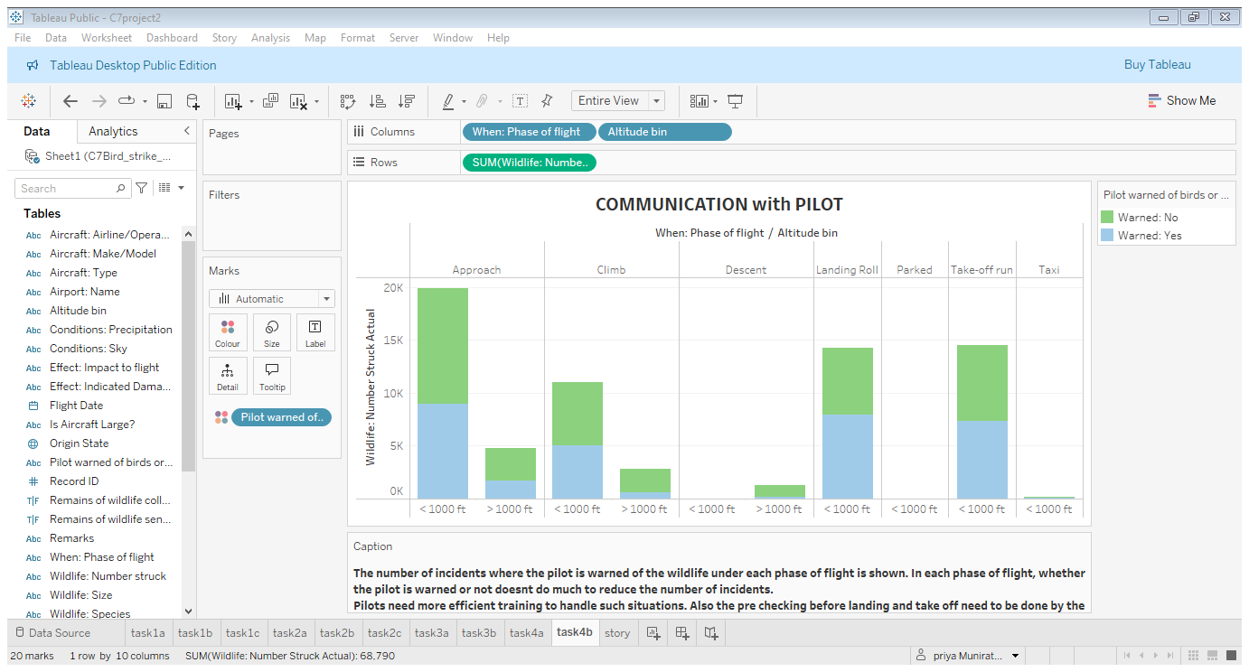
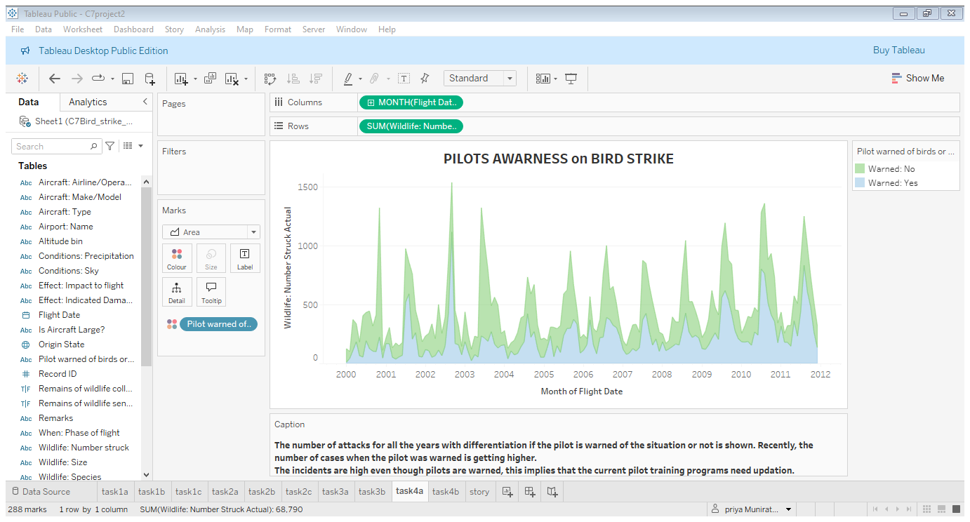
Communication & Training
Pilot warned or not doesn’t differentiate number of cases. Hence, need more efficient training to handle such situations.
Also pre checking before landing and take off can be done by the respective airports to reduce number of incidents

Slide 22
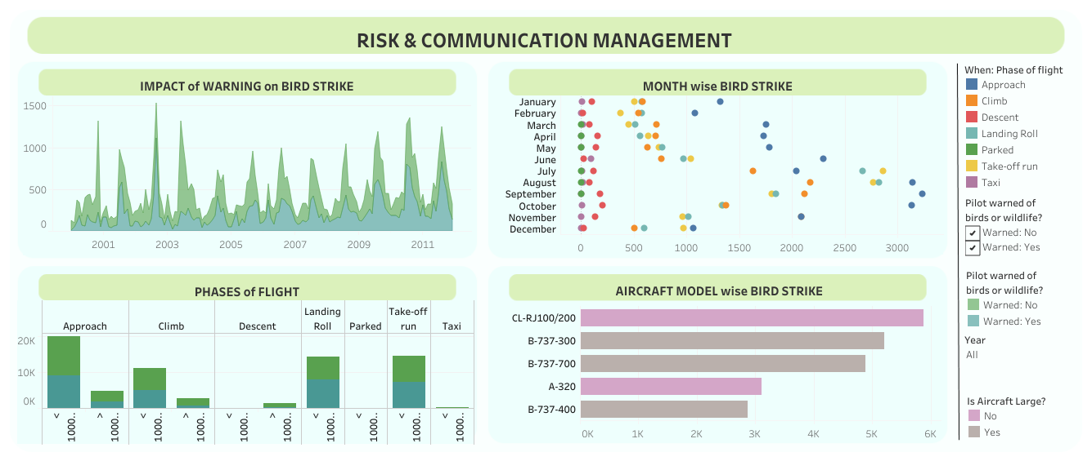

Slide 23
Summary
Effect: Most of the bird strikes lead to precautionary landing, while small number of incidents resulted in engine shut down and take off abort.
Phase of flight : Most incidents happened during flight approach; the next more incidents occur when flight in landing roll phase.
Most striked species: Small unknown birds have highest number of incidents.
Year & State: California has wide number of bird strike especially in the year 2003, followed by Texas and New York. The number of incidents has increased recently for California, Texas and Pennsylvania. In Kentucky, there is decrease in number of incidents from the year 2006, except at 2009
Altitude: The number of incidents occur mostly in the altitude below 1000 ft. especially while precautionary landing both above or below 1000 ft altitude.
Sky conditions: Almost half of incidents has occurred when the sky has no clouds. The second likely sky condition is overcast
Airport: Dallas international has high number of 3074 incidents, followed by Sacramento airport.

Slide 24
Injury: Most number of injuries happened during precautionary landing, followed by engine shut down. No injuries were recorded when the flight aborted take-off. Lear jet 24 model aircraft when its engine was shut down has highest number of injuries
Period: The strike is high during the period June to November.
Size: Small sized birds mostly strike compared to medium and large sized birds
State: California has the highest number of 8527 bird strikes, followed by Texas with 6051 total incidents
Cost: Expenditure is high if the flight does precautionary landing. Business airlines has faced heavy cost of damage of total 54M
Aircraft size: In models that have less than 20 attacks each, seems to be of large body type aircraft. only two in the list of aircraft with less than 20 bird strikes is small body type aircraft. This implies that, the aircraft of notable size avoids wildlife strike. No particular type is prone to bird strike
Pilot warned: Recently, the number of cases even though the pilot was warned is getting higher.

Slide 25
Suggestion:
Visibility: The aircrafts could be coloured in bright colours for better visibility.
Size: Notable size aircrafts can reduces the number of incidents
Training: The incidents are high even though pilots are warned, this implies that the current pilot training programs need updates.
Communication: better communication need to be done between pilot and airports. Warning could be issued to pilot before the flight approaches to reduce the impact of bird strike thus increasing flight operation.
Airport Check: Prior check before landing and take off need to be done by the respective airports to reduce number of incidents.

Slide 26
Story 1
Bird strikes are most common during the flight approach phase, followed by the landing roll. The majority of incidents result in precautionary landings, with a smaller number leading to engine shutdowns or aborted take-off. Small unknown birds are the most frequent cause of strikes, particularly during the approach, climb, and take-off phases. These incidents mostly occur at altitudes below 1,000 feet. Weather conditions with no clouds are associated with nearly half of all bird strikes, while overcast conditions are the second most likely scenario.
Geographically, California reports the highest number of bird strikes, especially in 2003, with Texas and New York following closely behind. The frequency of bird strikes in California, Texas, and Pennsylvania has increased in recent years. Notably, the Learjet 24 model is linked to the highest number of injuries due to engine shutdowns, while the C-172 model also sees injuries during precautionary landings.
To reduce bird strike incidents, implementing bright- coloured aircraft and conducting thorough pre-landing checks could help mitigate risks, especially during low-altitude flight phases when strikes are most likely to occur.

Slide 27
Story 2
Bird strikes are a growing concern for airlines, with California reporting the highest number of incidents at 8,527, followed by Texas with 6,051. Most bird strikes occur when flights are approaching their destination, suggesting that earlier warnings could help pilots take precautionary measures. Despite pilot warnings, the damage from bird strikes remains the same, indicating that current training programs may not be sufficient.
Also, there seems to be a peak in number of incidents during the period June to November. More prudent pre checks might reduce the number of incidents.
Business airlines have faced significant costs incurring $54 million in damage, much higher than the $10 million for United Airlines. However, more than half of the airlines reporting bird strikes have not suffered economically. Larger aircraft tend to have fewer bird strikes, suggesting that size and visibility might play a role in avoiding wildlife collisions.
To reduce incidents, better pilot training, pre-checks by airports, and possibly brighter aircraft colours for better visibility could help minimize the risk of bird strikes, especially from June to November.

Slide 28
Conclusion
Detailed analysis on bird strike in aviation was done. Analysed the frequency of incidents based on sky condition, phase of flight, aircraft type, altitude, bird species, etc.. Some of key factors influencing wildlife strike were found. The cost implicated due to damage created from bird strike were looked upon. Various factors were analysed to increase operational efficiency. Preventive measures were recommended to reduce wildlife strike increasing operational efficiency, also wildlife conservation.
Thank You

