Slide 1
Unlocking Automative Trends
By M.Priya
Mentor: Jaya pandey

Slide 2
Introduction:
To analyse the car data set of global car manufacturers so as to extract insights for launching promising car models. Addressing areas such as fuel efficiency, weight distribution, category performance and so on to reach our goal
Additional to performance, numerous features for comfort purpose, safety purpose, etc are to be analysed for detailed analysis. Undergo various analyses on many features, to understand the market preferences and identify its key factors that could help in designing product.

Slide 3
Objective
Data Pre-processing
Market Segmentation analysis
Fuel Efficiency analysis
Performance comparison analysis
Weight distribution study
Safety feature assessment
User comfort exploration
Alert systems analysis
Dimensional analysis

Slide 4
Data pre-processing:
Presence of duplicate rows were checked
All categorical data that had missing values were filled with ‘Not Available’
All numerical data type that had missing value were filled with its mean
Especially for city mileage and highway mileage, missing values were filled with average of mileage of the respective manufacturers; it was done using loc and iterrows function;
Some of columns like hill assist, door ajar warning, fasten seat belt warning were filled with 1’s for ‘yes’ and 0’s for missing values, to know the presence of feature
Conversion of data type was done for Kerb weight and gross value weight column; its units were stripped using rstrip function; the column was converted to numeric type data using to_numeric function

Slide 5
Car categorization

Slide 6
Cars that adapt to various modes: normal, comfort, eco, sport, power mode
Features Audi Q8 Audi A8 L
Model Q8 A8 L
Variant 55 Tfsi Quattro Tiptronic 55 Tfsi Quattro
Displacement 2995 2995
Cylinders 4 8
Valves_Per_Cylinder 4 4
Fuel_Tank_Capacity 85 82
Fuel_Type Petrol Petrol
Height_mm 1740 1485
Length_mm 5052 5302
Width_mm 1968 1945
Body_Type SUV Sedan
features Audi Q8 Audi A8 L
Doors 5 4
City_Mileage_km/l 12.08 12.0
Highway_Mlg km/l 12.94 12.94
Kerb_Weight 2115 kg 2030 kg
Power 340 340
Torque 500 500
Gross_Vehicle_Wt 2830 kg -
Seating capacity 7 4
Airbag: both cars has airbag
Driver head airbag, Front passenger head airbag, Drive side airbag, Curtain airbags, Driver frontal airbag, Front passenger frontal airbag, Front passenger side airbag
Both cars have features :Central Locking, Child Safety Locks, Hill Assist, Drive Modes, High Speed Alert System, ABS(Anti-lock Braking System), Door Ajar Warning

Slide 7
Fuel Efficiency analysis

Slide 8
Top 10 Makers based on city mileage for non electric category

Slide 9
Displacement for top 10 best mileage cars
Make | Model | City_Mlg_km_litre | Displacement
Mahindra | E Verito | 110 | 72
Mahindra | E Verito | 110 | 72
Mahindra | E Verito | 110 | 72
Mahindra | E2O Plus | 80 | 1858.804589
Mahindra | E2O Plus | 80 | 1858.804589
Maruti Suzuki | Dzire | 28.4 | 1248
Maruti Suzuki | Dzire | 28.4 | 1248
Maruti Suzuki | Dzire | 28.4 | 1248
Maruti Suzuki | Dzire | 28.4 | 1248
Maruti Suzuki | Dzire | 28.4 | 1248
The top 10 car models from various manufacturers with their displacement is listed
It can be seen that, displacement is lowest for the highest mileage cars
Implies, displacement is inversely proportional to the mileage of cars

Slide 10
Correlation between factors:
Column1 | Dsplcmnt | Fuel Tank cap | City_Mil | High_Mil | Height | Length | Power | Torque
dsplmnt | 1.000 | 0.847 | -0.594 | -0.396 | 0.707 | 0.786 | 0.933 | 0.876
Fuel_Tank cap | 0.847 | 1.000 | -0.548 | -0.448 | 0.729 | 0.735 | 0.777 | 0.803
City_Mlg | -0.594 | -0.548 | 1.000 | 0.464 | -0.396 | -0.536 | -0.646 | -0.381
Highway_Mlg | -0.396 | -0.448 | 0.464 | 1.000 | -0.454 | -0.265 | -0.470 | -0.254
Height | 0.707 | 0.729 | -0.396 | -0.454 | 1.000 | 0.536 | 0.633 | 0.724
Length | 0.786 | 0.735 | -0.536 | -0.265 | 0.536 | 1.000 | 0.824 | 0.692
Power | 0.933 | 0.777 | -0.646 | -0.470 | 0.633 | 0.824 | 1.000 | 0.790
Torque | 0.876 | 0.803 | -0.381 | -0.254 | 0.724 | 0.692 | 0.790 | 1.000
Strong negative corelation: power-mileage=0.635,displacement- mileage = -0.59,
fuel tank capacity-
mileage has -0.55 and
with length -0.54
slightly negative:
mileage-torque -0.38
Mileage with power, displacement and fuel tank capacity has the strong negative corelation

Slide 11
Safety features: Top 10 manufacturers and their safety features
Features considered for safety are:
ABS(Anti-lock Braking System)
Airbags availability
Hill Assist
3- all 3 features
2- 2 of above features
1- 1 of above features

Slide 12
Comfort Features: Top 10 manufacturers and their Comfort features
Features considered for comfort are:
Central Locking
Child safety locks

Slide 13
Alert system features: Top 10 manufacturers and their Alert features
Features considered for alert are:
High speed alert system
Fasten seat belt warning
Door Ajar warning

Slide 14
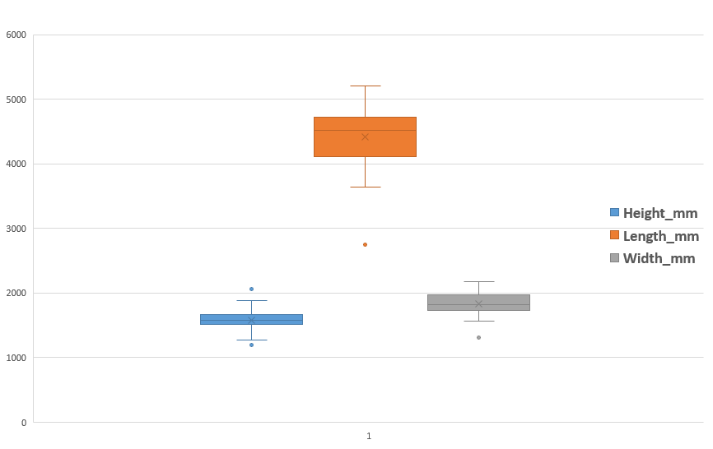
Car size dimension analysis

Slide 15
Challenge faced:
Data conversion on kerb weight & gross vehicle weight were complicated. Both columns involved kg as units which should be removed in order to be converted into numeric type data, this could be easily done using rstrip or replace function and then use to_numeric function to convert the columns to numeric data type.
But the issue was on the error values in the columns, for example in Gross_vehicle_weight column, there were values such as ‘215â€¯’. Such values hindered the conversion and was showing error. Every time removing such rows from the data frame, another such error value like ‘kg kg’ stooped the execution. In case of Kerb weight column various values like Na, kg kg, 1050-1083, â€¯,.. were in the column.
So one by one had to remove such values, data cleaning is much easier in python compared to excel but only in this case, I felt excel would have been much easier as it would have shown all distinct values in the column using filter list.
Only after such tedious process, kerb weight and gross vehicle weight columns were converted from kg system to pound by multiplying each values in the columns by 2.2 scale.

Slide 16
Summary
Market Segmentation analysis: Almost 90% of body type are SUV, sedan and hatchback with SUV the highest where 447 variants are manufactured
Fuel Efficiency analysis: Maruti Suzuki has the highest average city mileage km per litre also in case of non-electric cars; on average, Datsun and Maruti Suzuki has highest average city and highway mileage; Basically the top 20 manufacturers has average mileage range from 14 to 21 km per litre
Performance comparison analysis: Bajaj has the lowest dispersion
Weight distribution study: kerb weight and gross vehicle weight were looked into and nothing peculiar was noticed
Safety feature assessment : Audi, Jeep and Volvo all their variants has safety features like hill assist, airbag and ABS
User comfort exploration: Skoda, Honda and Volkswagen produces all their variants with features such as child lock system and central locking; More than 50% manufacturers has an average seating capacity for 5 to 6 people.
Alert systems analysis: All manufacturers produce at least 2 out of 3 alert system such as seat belt, door ajar and high speed alert system
Dimensional analysis: Length of the car varies quietly while not much variation in height or width of the car

Slide 17
Conclusion
In this project, we analysed the given car data to categorise various cars based on market segmentation, fuel efficiency analysis, weight distribution study and perform comparison. Derived insights on key factors that may influence in modelling new products. Additionally features such as safety feature assessment, user comfort exploration, alert system analysis and dimensional analysis were also explored to get in-depth understanding on current trend in the market.

Slide 18
Thank you

