Slide 1
Employee Absenteeism using ml
By m.Priya
Mentor: jaya pandey

Slide 2
Introduction
To analyse Employee absenteeism dataset and understand various aspects of employee absence, identify patterns and reasons, and conduct predictive analysis to predict future absenteeism. To predict absenteeism duration and to identify employees at risk of high absenteeism and to group employees with similar absenteeism patterns. So as to tailor absenteeism management strategies. This will help in optimizing workforce management, streamline operations, boosting productivity and creating more efficient work environment for employees.

Slide 3
Objective
Data collection
Data exploration
Data pre-processing
Build & training
Predict new data
Evaluation of Model

Slide 4
Data pre-processing
Understand & clean the data set
Missing value treatment
Feature engineering: numerical to categorical and vice versa
Segregation of numerical columns
Outlier analysis
Feature selection
Data scaling: standard scaler

Slide 5
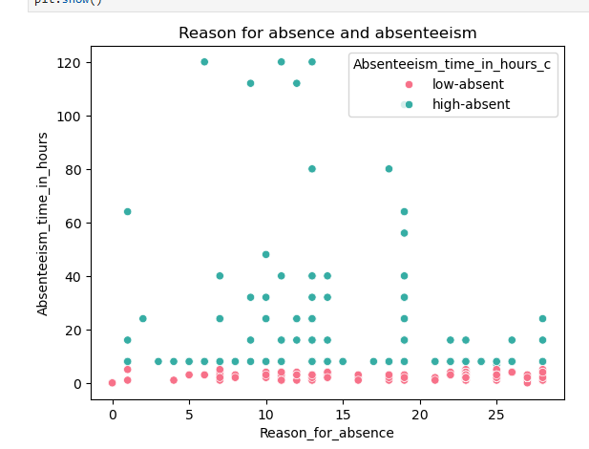
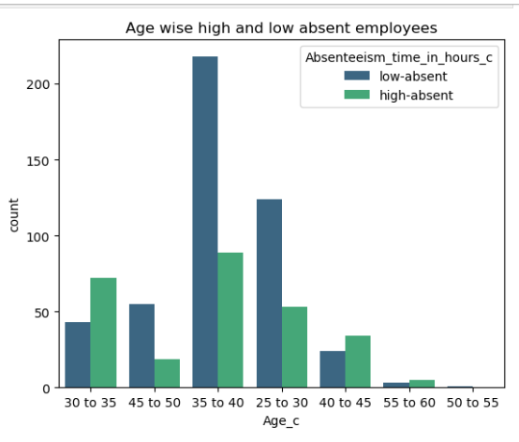
Data Exploration (Understanding Absenteeism):

Slide 6
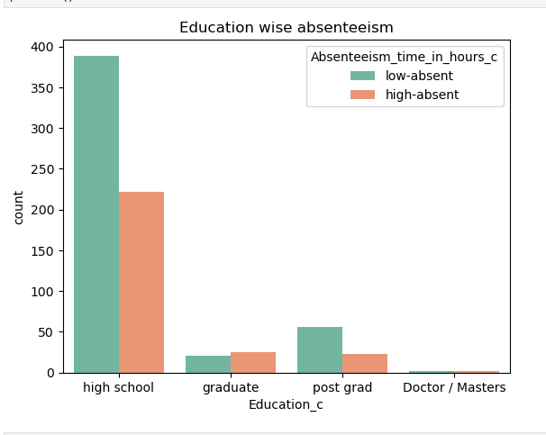
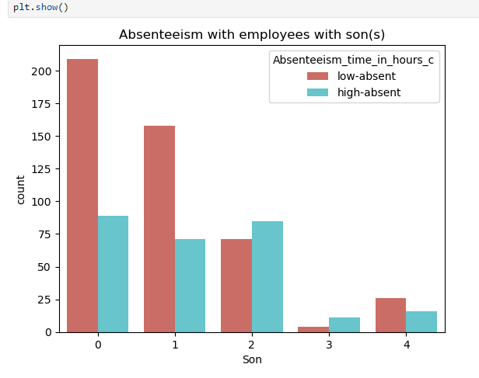

Slide 7
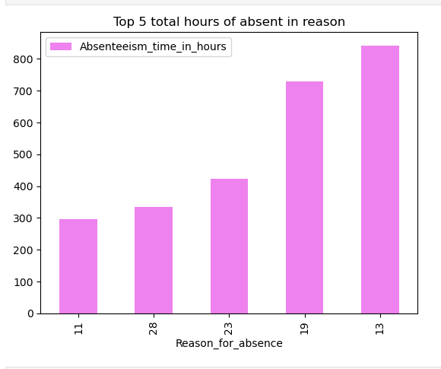
Top 5 reasons for absence (based on total hours of absent)
13 Diseases of the musculoskeletal system and connective tissue
19 Injury, poisoning and certain other consequences of external causes
23 Medical consultation
28 dental consultation
11 Diseases of the digestive system

Slide 8
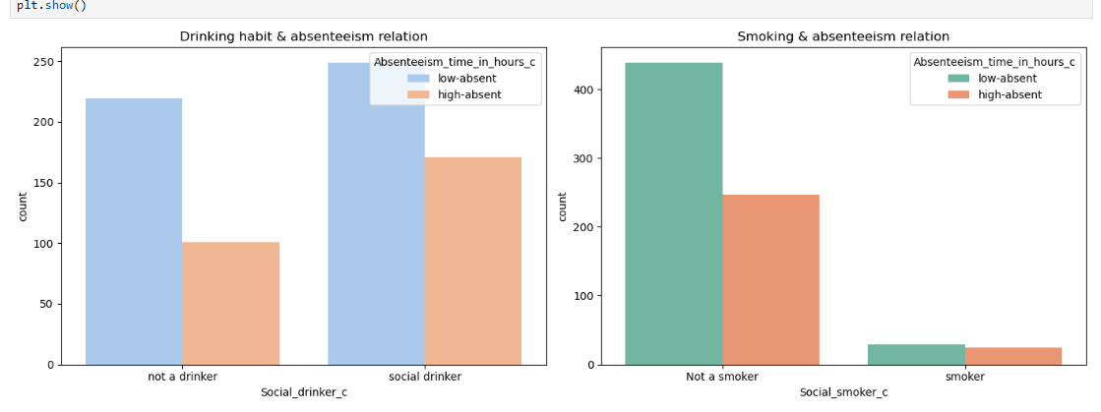

Slide 9
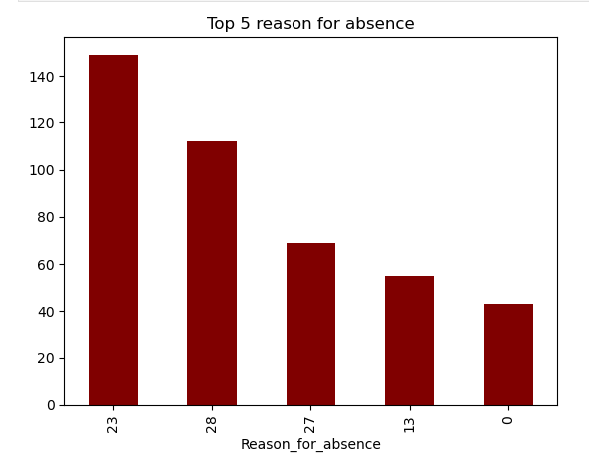
Pattern in High absentees:
23: Medical Consulatation
27: Physiotherapy
28: Dental Consulatation

Slide 10
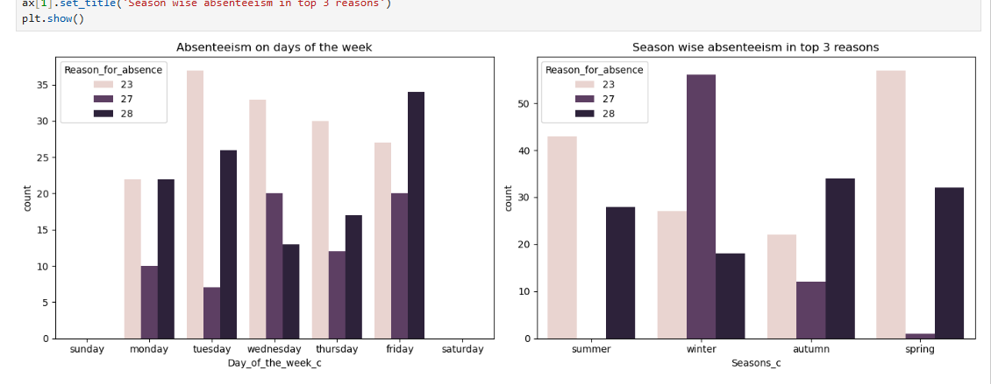

Slide 11
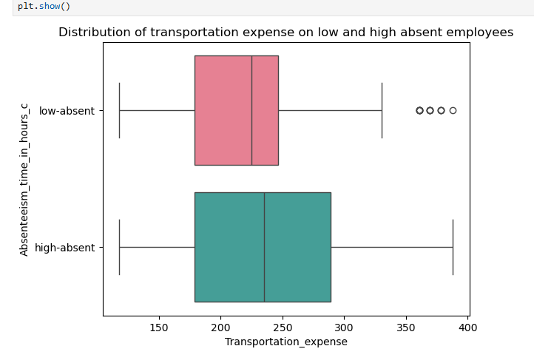
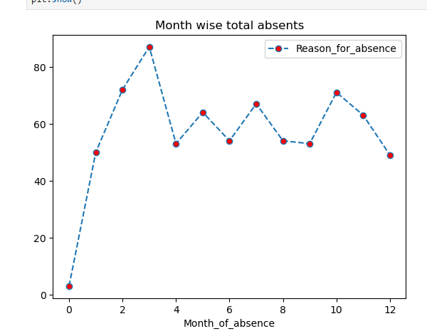

Slide 12
Build & train the model
Data splitting
Model building
Multi Linear Model 1:
One Target & 2 Features
Equation:
Y= 0.00224 -0.34432(x1) -0.3124(x2)
Y= Absenteeism(hrs)
X1= Reason For Absence
X2= Disciplinary Failure
Linear Model:
One feature & 1 target
Equation: Y=0.00015003 + (-0.1683)X
Y= Absenteeism(hrs)
X= Reason For Absence

Slide 13
Multi Linear Model 2:
One Target & 3 Features
Equation:
Y= 0.003 -0.3372(X1) -0.3106(X2) -0.0379(X3)
Y= Absenteeism(hrs)
X1= Reason For Absence
X2= Disciplinary Failure
X3= Distance From Home To Work
Multi Linear Model 3:
One Target & 4 Features
Equation:
y= 0.003 -0.3373(X1) -0.3108(X2) -0.03809(X3)
+0.00126(X4)
Y= Absenteeism(hrs)
X1= Reason For Absence
X2= Disciplinary Failure
X3= Distance From Home To Work
X4= Body Mass Index

Slide 14
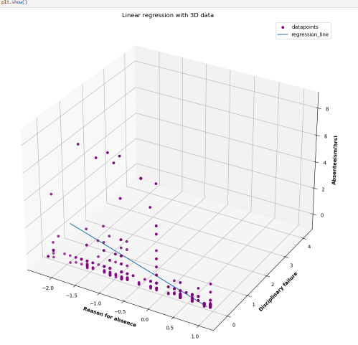
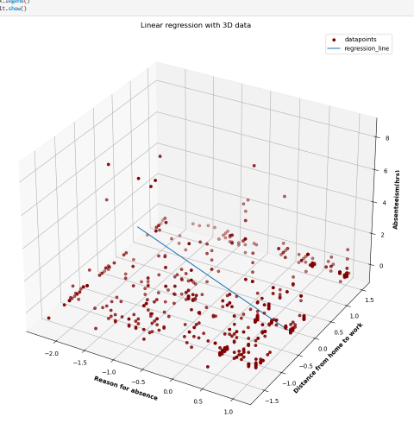

Slide 15
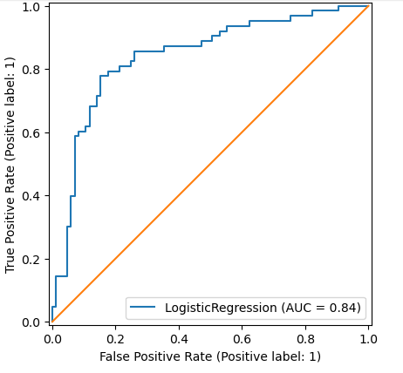
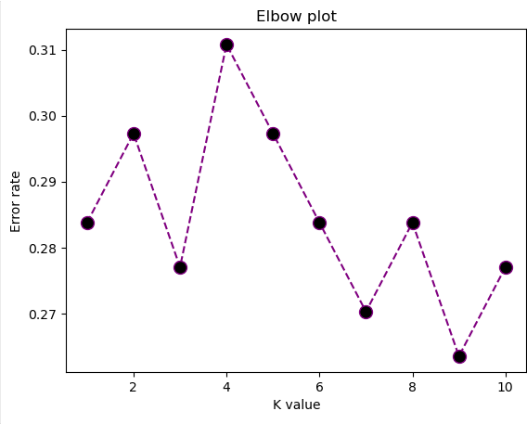
Logistic Regression:
K Nearest Neighboring

Slide 16
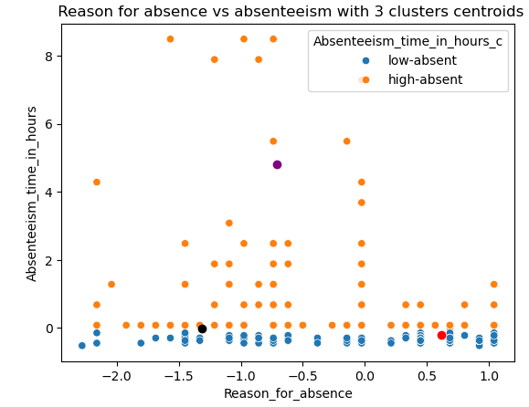
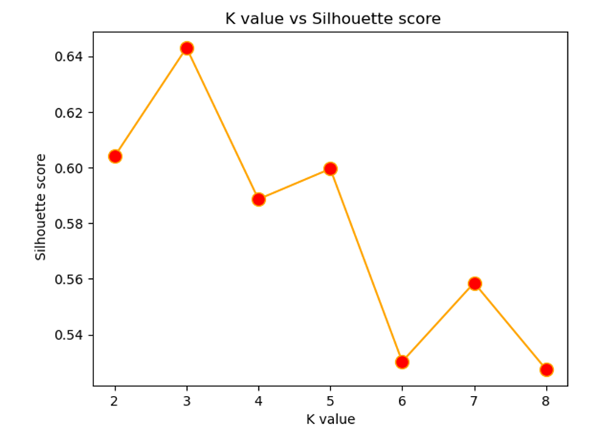
K Means Clustering: 3 ideal clusters
Optimal K value from Silhouette score:

Slide 17
EVALUATION OF MODELS:
Regression Algorithm based Models
 | Linear Model | Multi Model 1 | Multi Model 2 | Multi Model 3
Mean squared | 0.825813 | 0.756650 | 0.751809 | 0.75187
Mean absolute | 0.435346 | 0.412486 | 0.416456 | 0.41647
Root mean squared | 0.908742 | 0.869856 | 0.867069 | 0.86710
R^2 score | 0.041176 | 0.121478 | 0.127099 | 0.127026

Slide 18
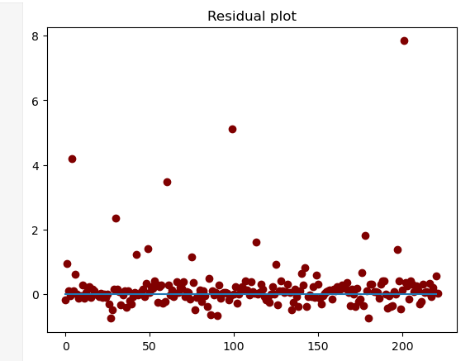
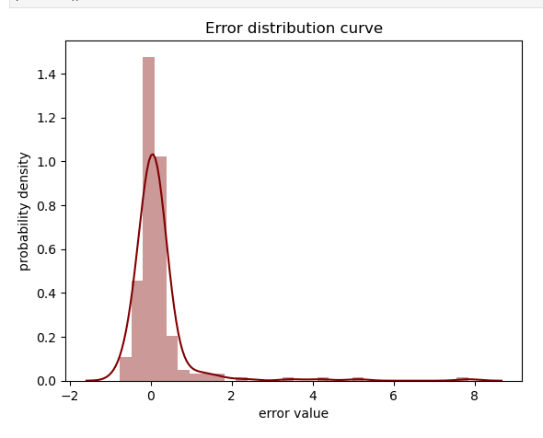
Homoscedasticity & Error distribution plots

Slide 19
Classification Models:
 | Logistic Regression | K Nearest Neighbors
Accuracy | 0.77702 | 0.73648
Precision | 0.82608 | 0.73648
Recall | 0.60317 | 0.73648
F1 | 0.69724 | 0.73648
Roc Auc score | 0.754528 | 0.70690
Roc (predict_proba) probability of positive class | 0.84183 | 0.79047

Slide 20
Clustering:
Calinski Harabasz score index: 1146.2631
Davies Bouldin score index: 0.55318
Silhouette score: 0.63950

Slide 21
SUMMARY
March month is when most employees are absent.
Reason: The most hours of absence are due to muscle related complications followed by injuries.
Education: Employees who are post graduates, are mostly under high absentee category than low absentee category.
Most of the employees age in the range, 30 to 35 and 40 to 45 are absent above average.
Family oriented employees who has 2 or 3 children are more prone to take leave than any other employees.
Transportation expense also plays a vital role in employee absenteeism, forcing the employees to miss work. Most employees who are less absent spend around 200 to 250 for transportation while employees who are highly absent spend around 180 to 300. So, employees who spend more in transportation are absenting themselves more frequently
Certain habits of employee like smoking habit and drinking influences the rate if high absenteeism.

Slide 22
Employees who are absent due to physiotherapy are more likely to be absent in winter than any other seasons. While in summer very few employees are absenting for physiotherapy reasons
Employees who are absent for dental consultations are highly absent on Friday than any other day of the week
Regression: No line or plane best suited for the dataset was identified using linear and multi linear models.
Classification: Models created from Logistic regression and K nearest neighbouring showed good performance in predicting employees who are more likely to be high absentee. Comparitively, Logistic model showed better result than KNN
Ideal Model: The dataset yields better model by classification than regression. Implying, the absenteeism on employees based on this dataset helps predict categorical data than numerical data
Clustering: The dataset wasn’t good enough to create well defined and unique characteristic clusters.

Slide 23
CONCLUSION
The given data set is analysed for prediction of absenteeism in employees. Factors leading to high absenteeism of employees were looked upon. Traits that are common in high absent employees were identified.
Various Machine learning techniques like linear, multi linear, logistic regression and KNN classifier were applied to yield best model. The Logistic regression classifier predicts absenteeism on employees more accurate than other techniques. The data was clustered using K means into well defined clusters with overlapping boundaries.

Slide 24
Thank you

