Slide 1



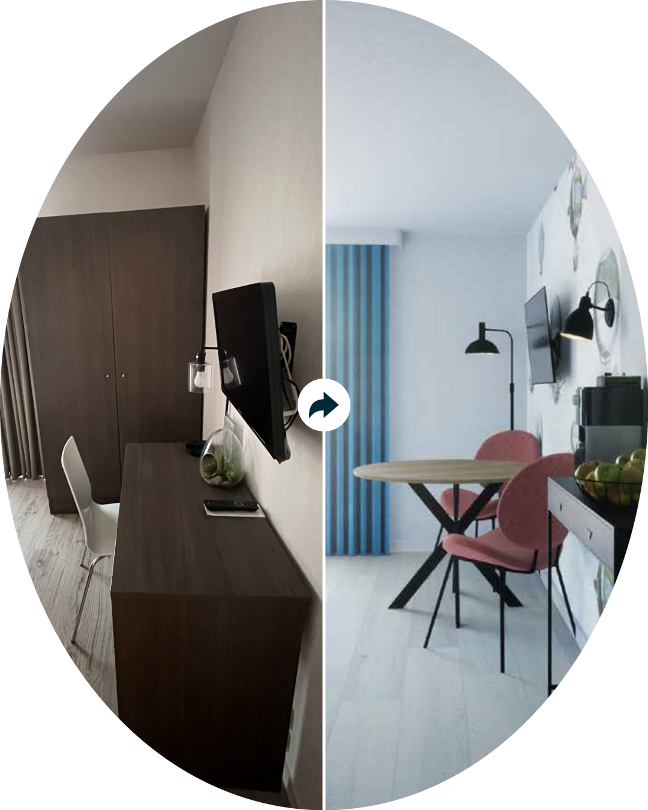






NEW
PROJECT
Skysuites @ Anson
Residential
SPACE TO BE DESIGNED
Living Room
ROOM SIZE
45cm /m2
STYLE(S) SELECTED
Asian/Zen, Tropical, Country
LOCATION
Singapore, Singapore
WINNING PROJECT DESIGN FEES
<< Filled by Admin
WEBINAR BRIEF
<< Filled by Admin

Slide 2
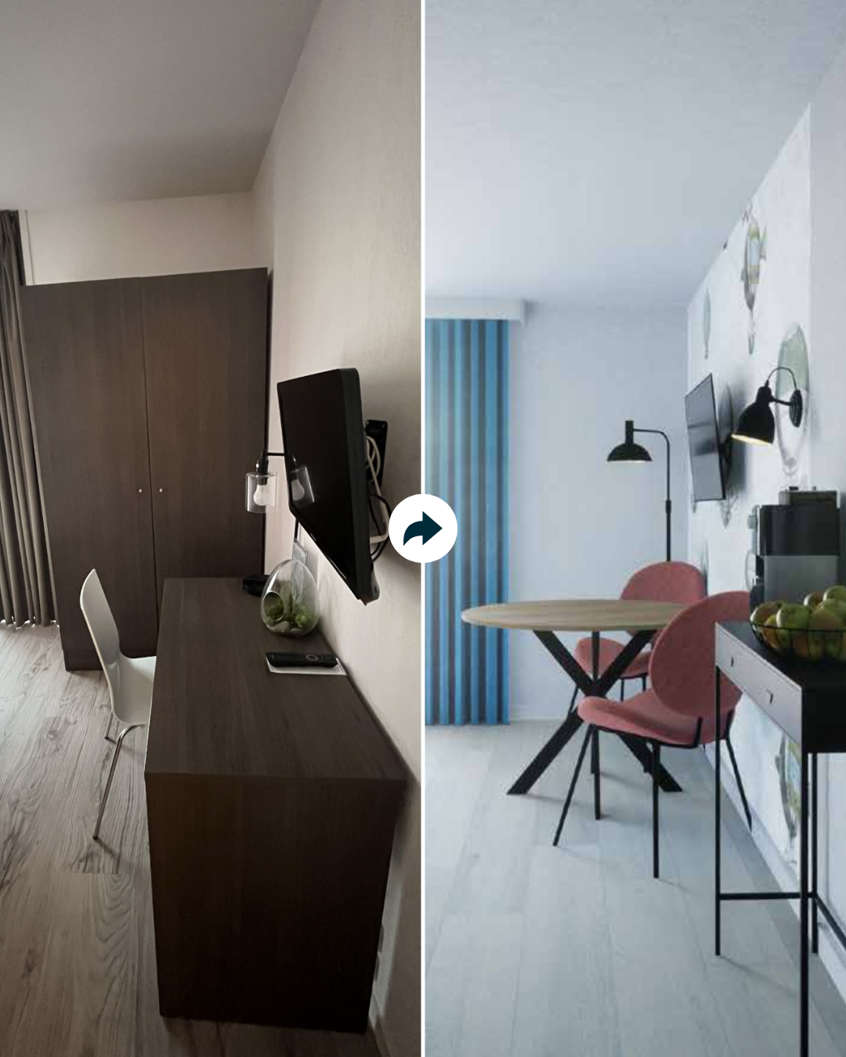


PROJECT TIMELINE
Fri | Sat | Sun | Mon | Tue | Wed | Thu
5-Sep | 6-Sep | 7-Sep | 8-Sep | 9-Sep | 10-Sep | 11-Sep
12-Sep | 13-Sep | 14-Sep | 15-Sep | 16-Sep | 17-Sep | 18-Sep
19-Sep | 20-Sep | 21-Sep | 22-Sep | 23-Sep | 24-Sep | 25-Sep
All Deliverables (highlighted in yellow) must be submitted via Monday.com at 23:59 your local time.
You’ll receive a booking link a few days before to schedule your optional Feedback Call. Make sure to submit your Version 1.1 before your call.
Client review timing may vary. Please review the timeline before signing up to ensure you can manage your time well alongside school, work, or other commitments.

Slide 3
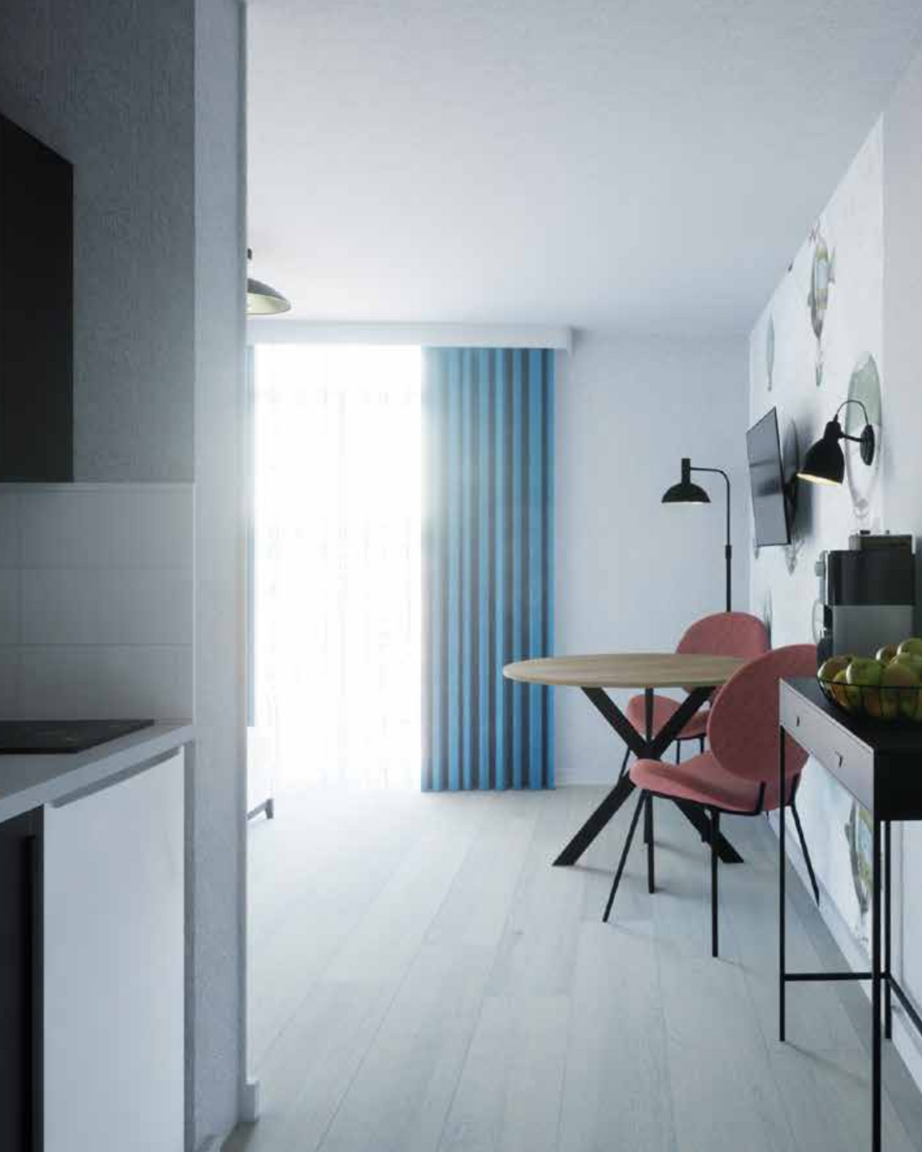


LAYOUT PLAN

Slide 6
