Slide 1



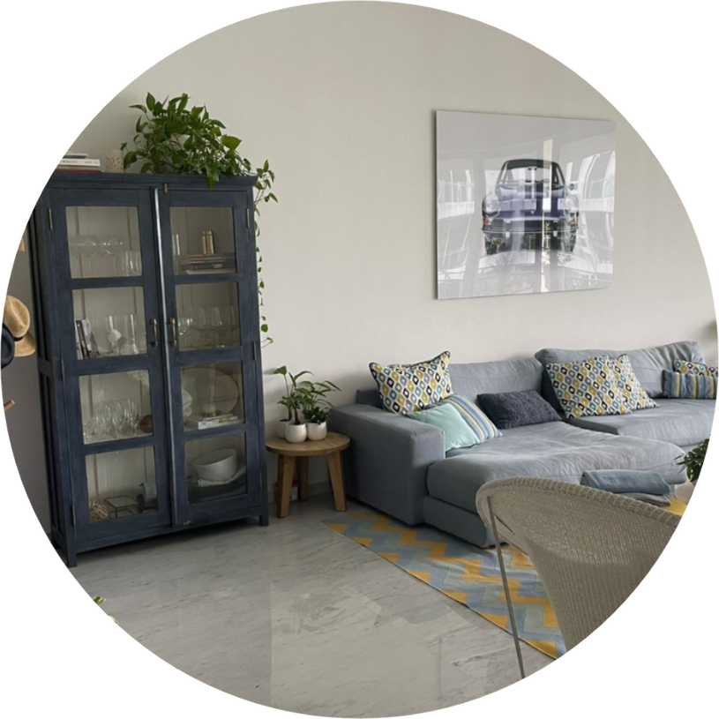






NEW
PROJECT
Project Name
Residential
SPACE TO BE DESIGNED
space To be Designed
ROOM SIZE
Room size
STYLE(S) SELECTED
style(s) selected
LOCATION
Location
WINNING PROJECT DESIGN FEES
<< Filled by Admin
WEBINAR BRIEF
<< Filled by Admin

Slide 2
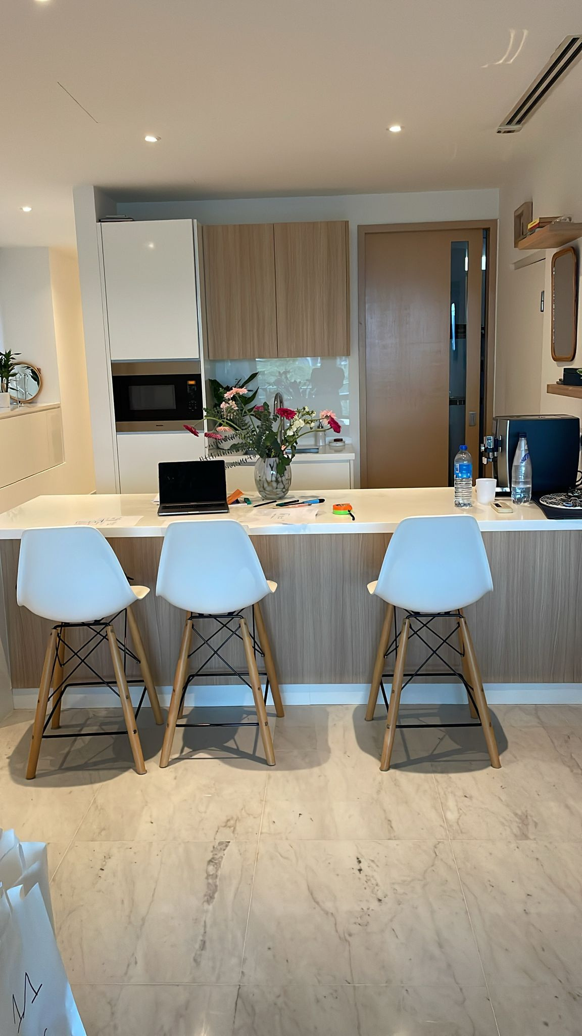
PROJECT TIMELINE
Webinar Brief by Mentor
<< Filled by Admin
1 Concept Board + 1 Layout + 3D Perspectives (Ver. 1.1)
<< Filled by Admin
Mentor’s Review
<< Filled by Admin
Revised Deliverables (Ver. 1.2)
<< Filled by Admin
Client’s Review
<< Filled by Admin
Please consider this timeline before signing up to ensure full commitment and manage your time effectively alongside other obligations.

Slide 3
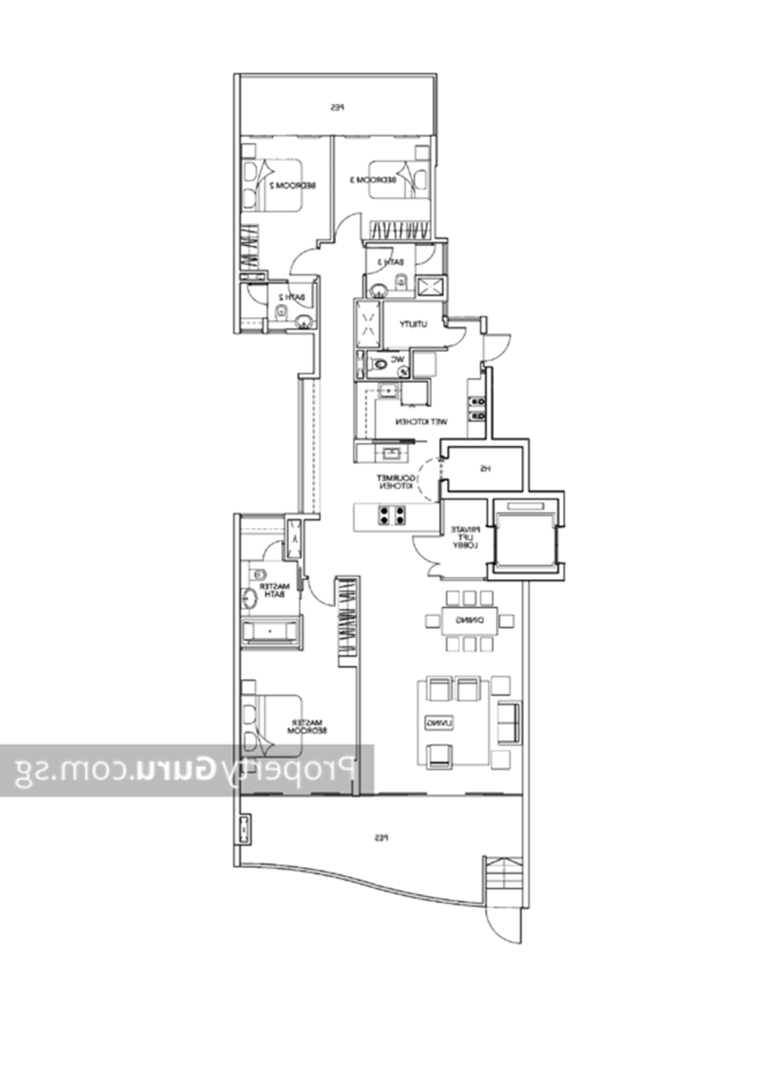

LAYOUT PLAN

Slide 4
{{Image1}}

Slide 5
{{Image2}}

Slide 6
{{Image3}}
{{Image4}}

