Slide 1



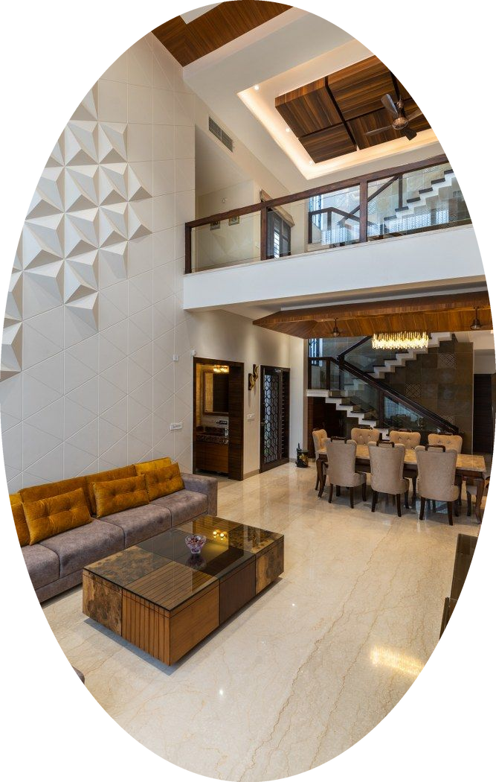






NEW
PROJECT
Q. Project Name
Residential
SPACE TO BE DESIGNED
11. Space to be designed
ROOM SIZE
Q. Area /m2
STYLE(S) SELECTED
Which style's do you like
LOCATION
Agra, India
WINNING PROJECT DESIGN FEES
<< Filled by Admin
WEBINAR BRIEF
<< Filled by Admin

Slide 2
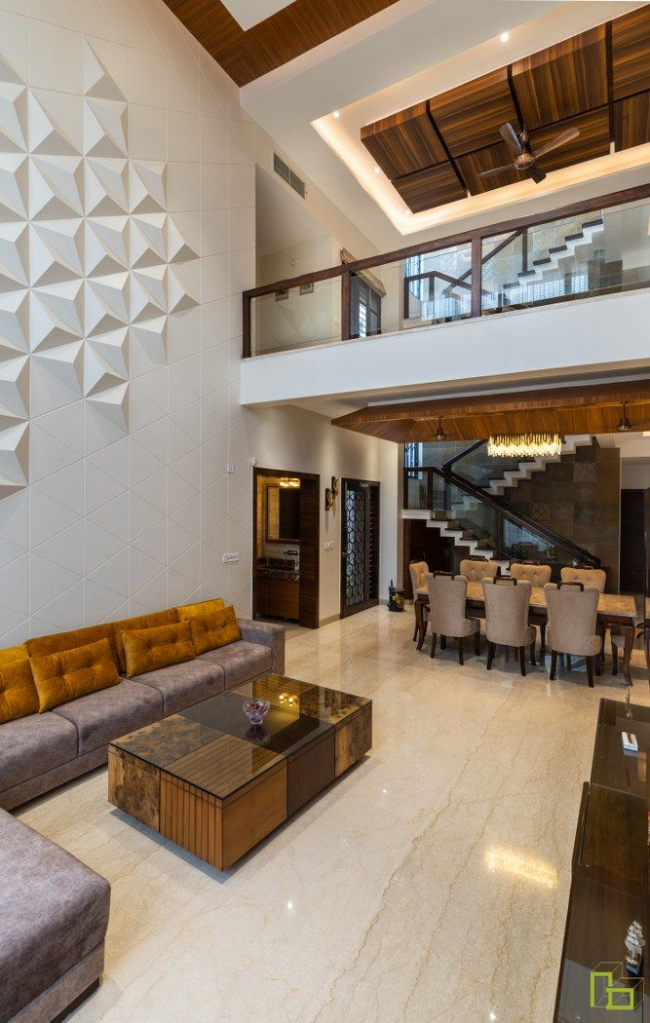


PROJECT TIMELINE
Thu | Fri | Sat | Sun | Mon | Tue | Wed
18-Sep | 19-Sep | 20-Sep | 21-Sep | 22-Sep | 23-Sep | 24-Sep
25-Sep | 26-Sep | 27-Sep | 28-Sep | 29-Sep | 30-Sep | 1-Oct
2-Oct | 3-Oct | 4-Oct | 5-Oct | 6-Oct | 7-Oct | 8-Oct
All Deliverables (highlighted in yellow) must be submitted via Monday.com at 23:59 your local time.
You’ll receive a booking link a few days before to schedule your optional Feedback Call. Make sure to submit your Version 1.1 before your call.
Client review timing may vary. Please review the timeline before signing up to ensure you can manage your time well alongside school, work, or other commitments.

Slide 3
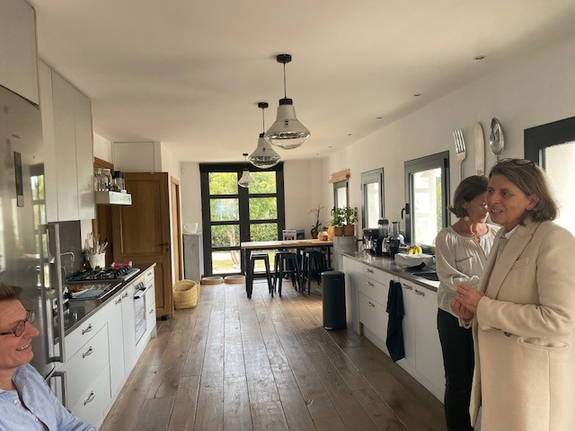

LAYOUT PLAN

Slide 6
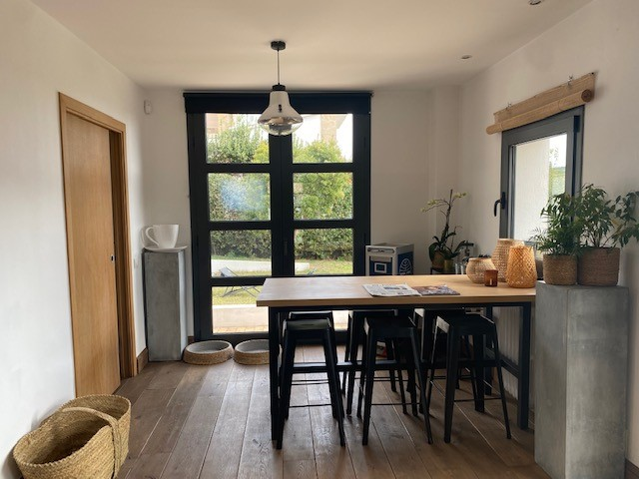
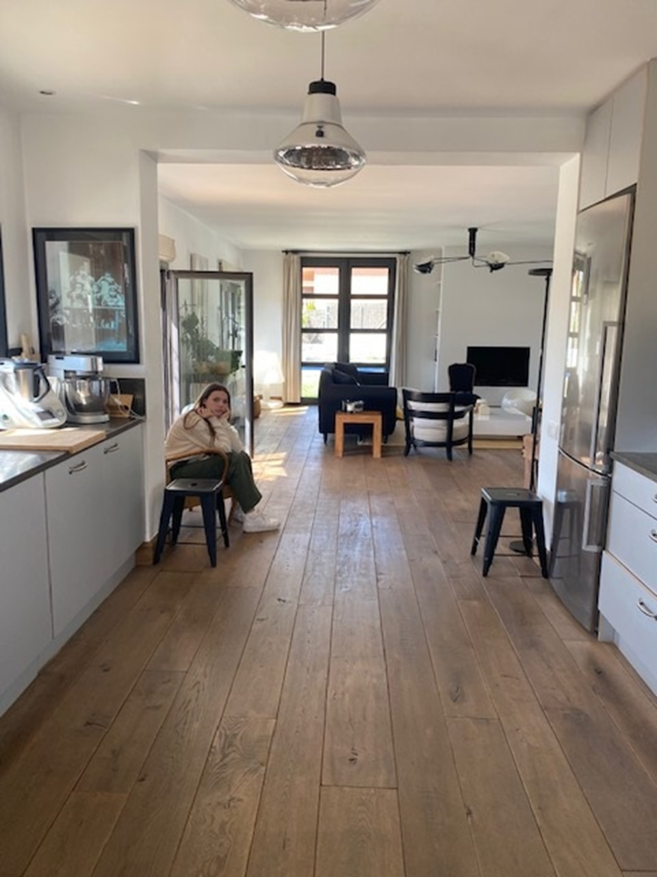

Slide 9
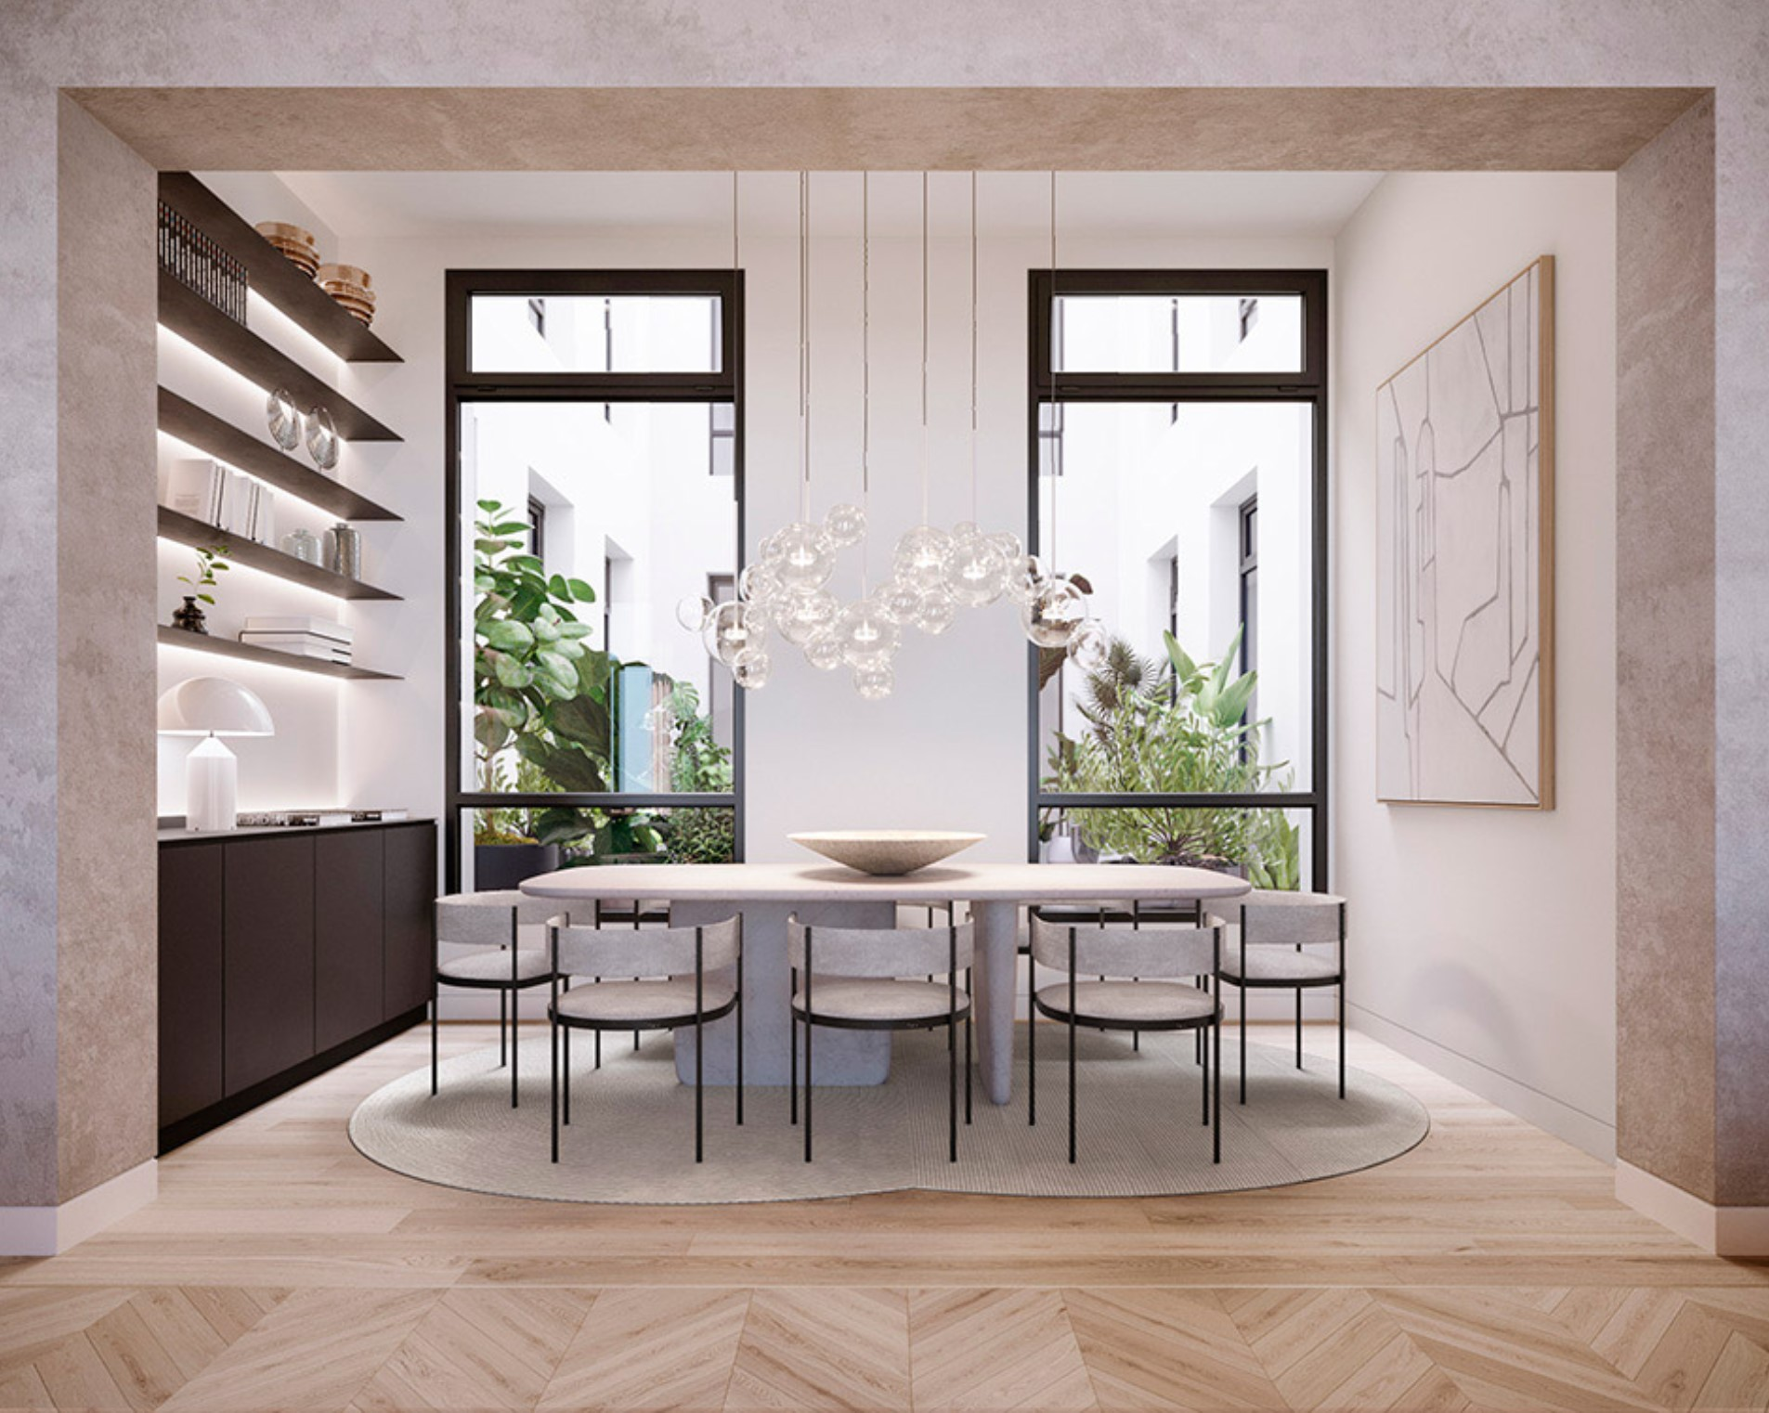


Slide 11


