Slide 1

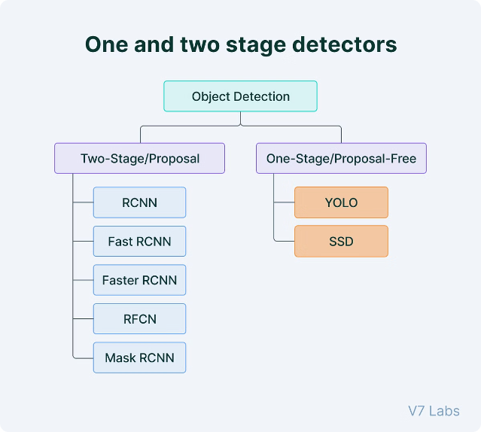

Introduction to YOLO Algorithm
YOLO (You Only Look Once) is a real-time object detection system that processes images in a single pass, making it highly efficient and accurate for a variety of applications.
by Priya Srivastava

Slide 2
AGENDA:
What is Object Detection
YOLO?
YOLO Architecture
How YOLO Works?
Real-Scenario with YOLO
Demo Code

Slide 3

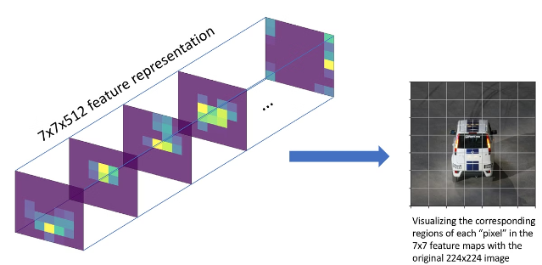
What is Object Detection?
1
Definition
Identifying and locating objects within an image or video.
2
Example
Detecting cars, pedestrians, and traffic signs in an image.
Object detection is a crucial task in computer vision, with applications in areas like autonomous driving, security, and medical imaging & much more.

Slide 4
Overview of YOLO Algorithm
What is YOLO?
Key Features
YOLO stands for "You Only Look Once." It is a real-time object detection system developed by Joseph Redmon et al.
YOLO processes images in a single pass, making it highly efficient and accurate compared to traditional object detection methods.
It is so fast and accurate

Slide 5

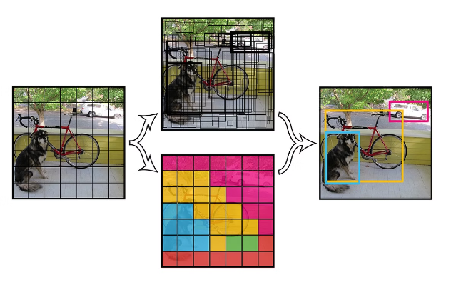
YOLO Architecture
1
Grid Division
The input image is divided into an S×S grid.
2
Bounding Box Prediction
Each grid cell predicts B bounding boxes and confidence scores.
3
Object Classification
Class probabilities are predicted for each grid cell.

Slide 6





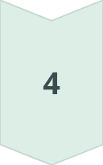
How YOLO Works
Step 1
Divide the input image into an S×S grid.
Step 2
Predict B bounding boxes and confidence scores for each grid cell.
Step 3
Classify the object within each bounding box.
Step 4
Apply Non-Max Suppression to remove duplicate detections.

Slide 7
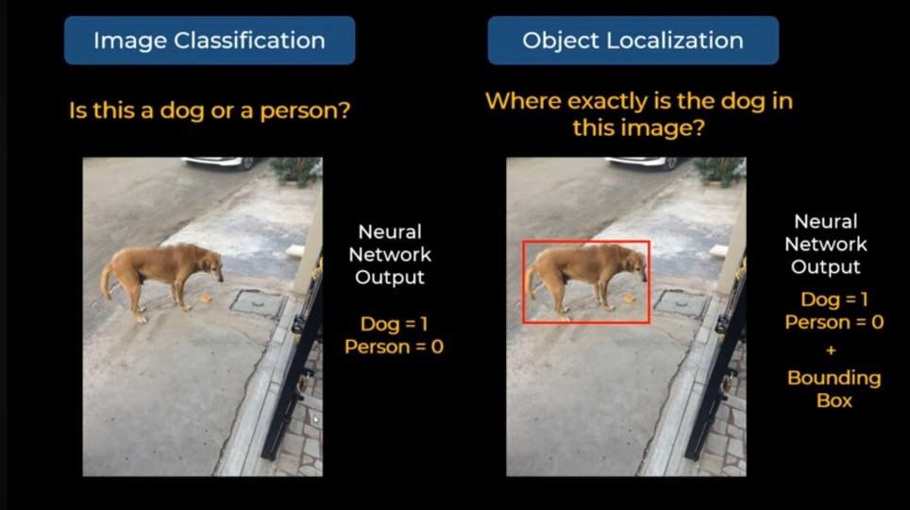

Slide 8
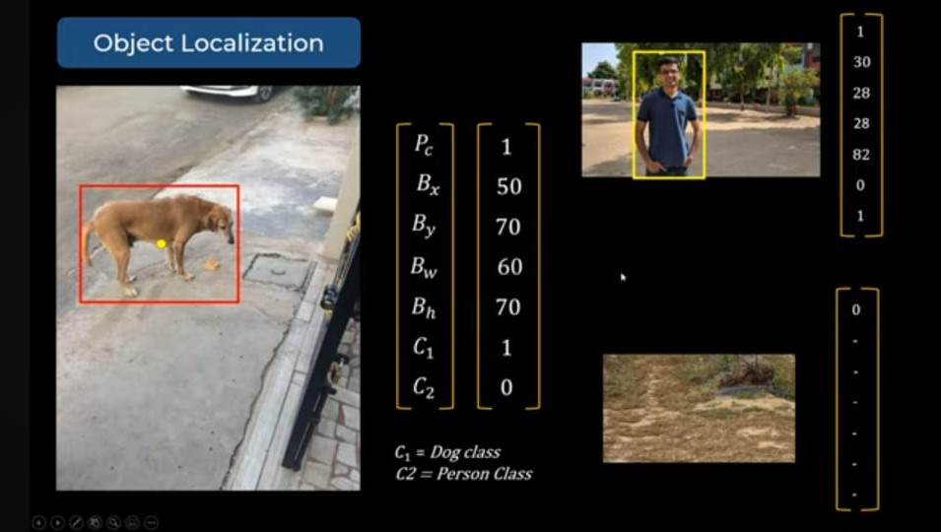

Slide 9
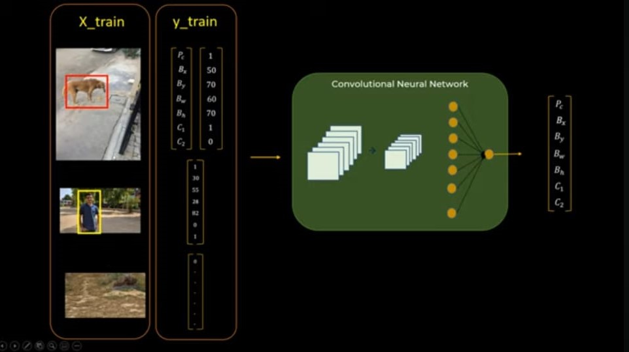

Slide 10
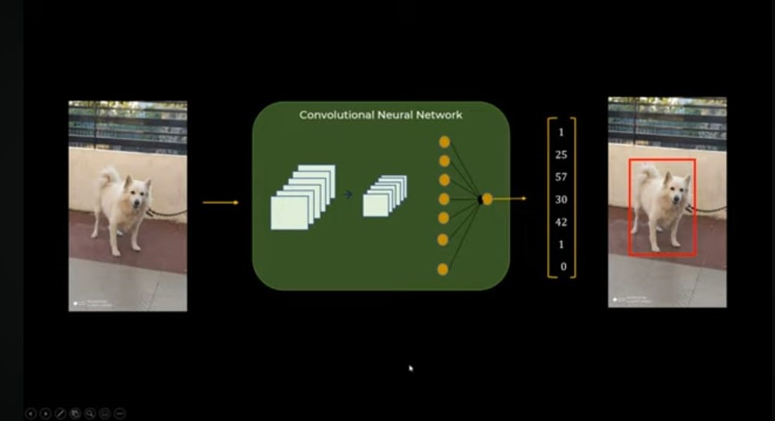

Slide 11
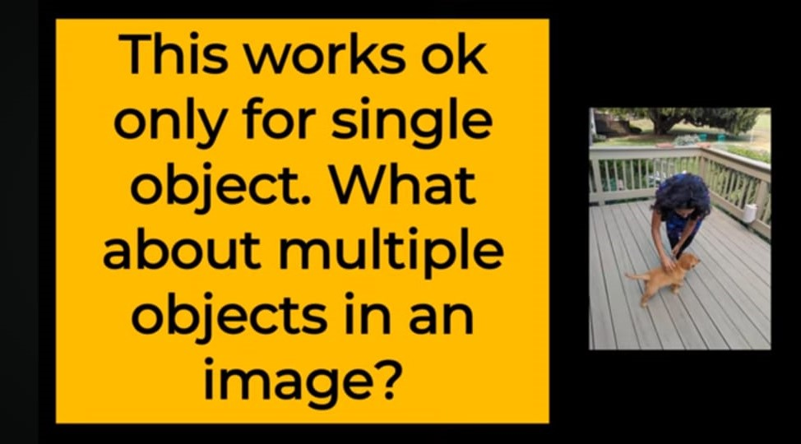

Slide 12
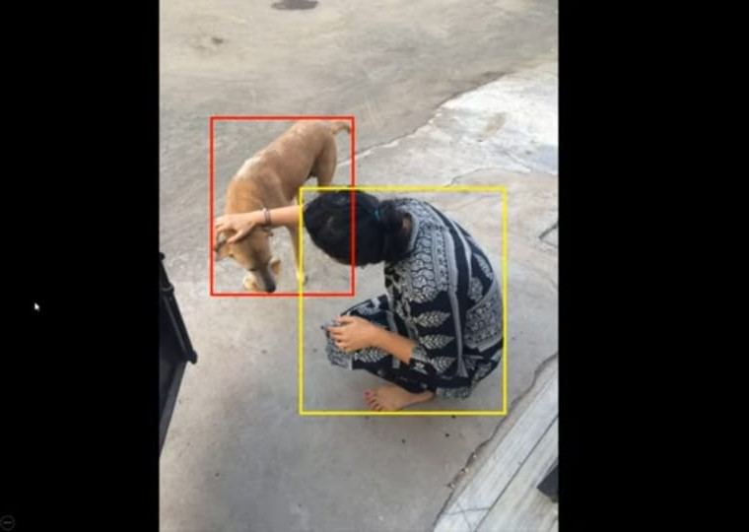
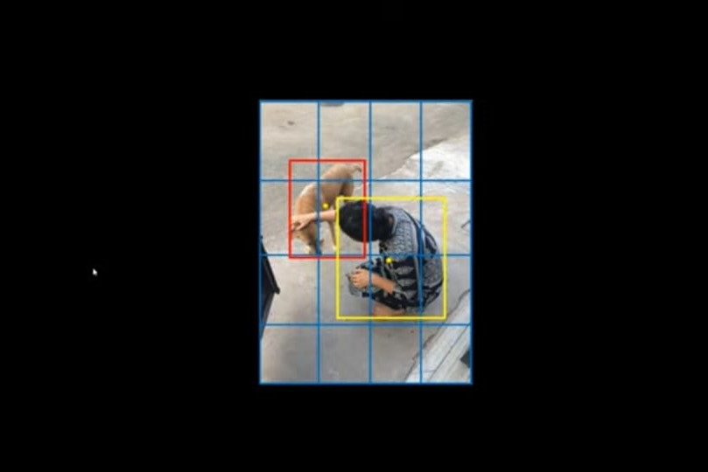

Slide 13
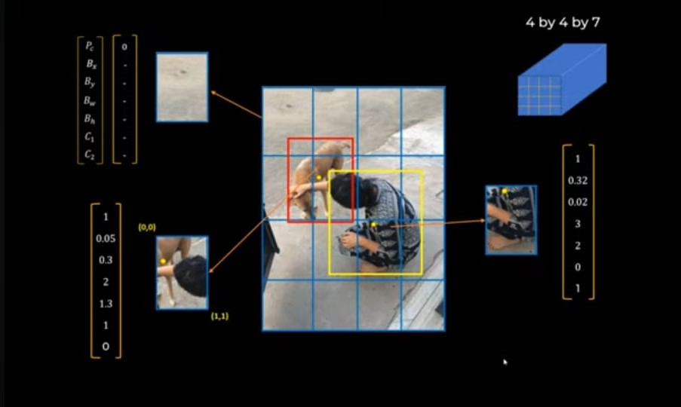

Slide 14
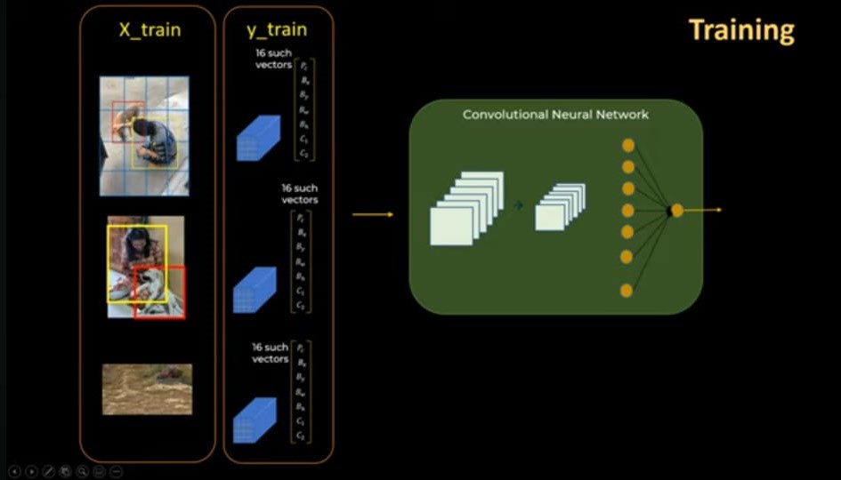

Slide 15
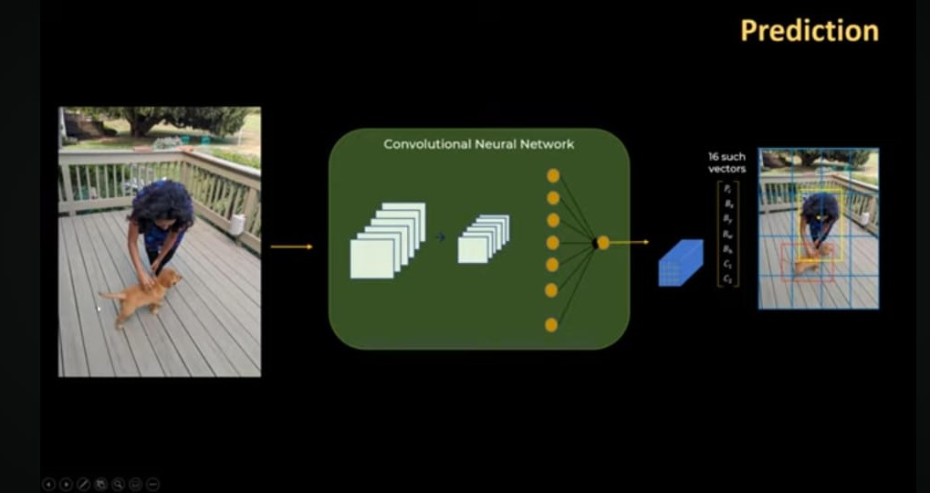

Slide 16
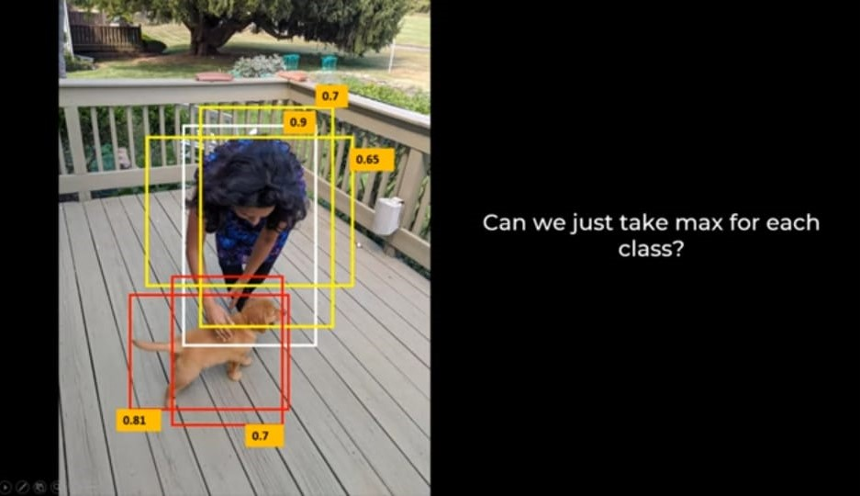

Slide 17
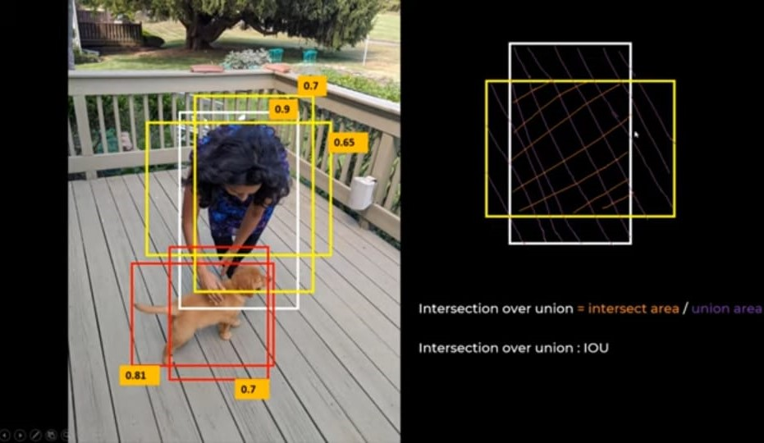

Slide 18
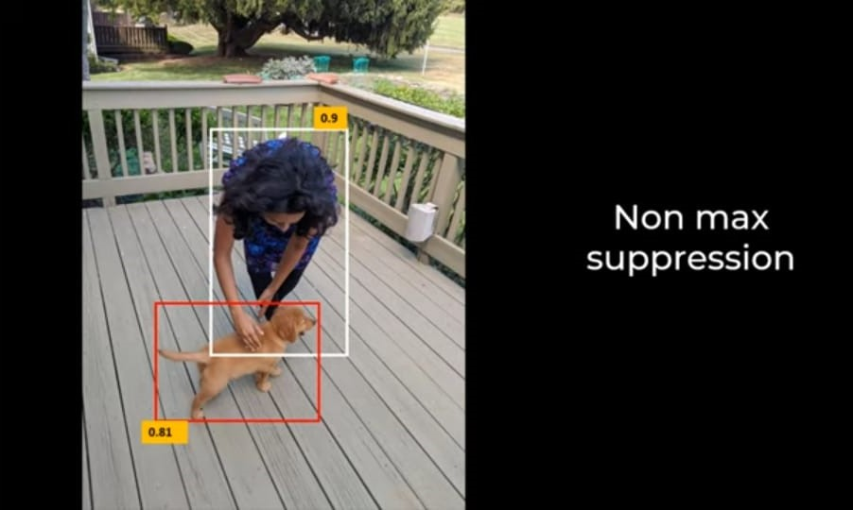

Slide 19
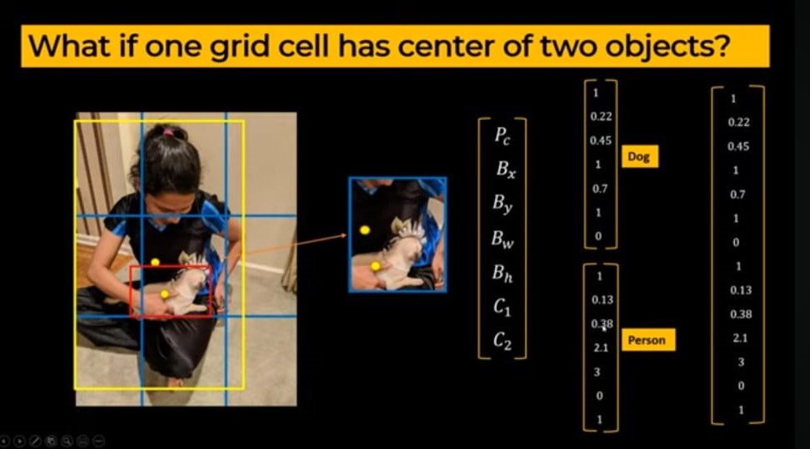

Slide 20
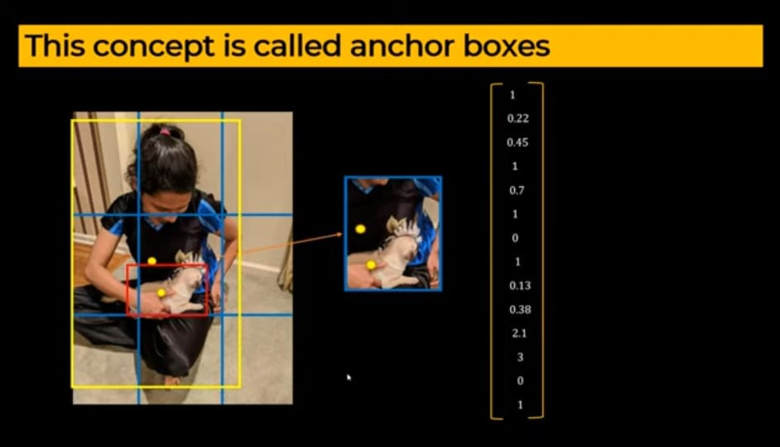

Slide 21
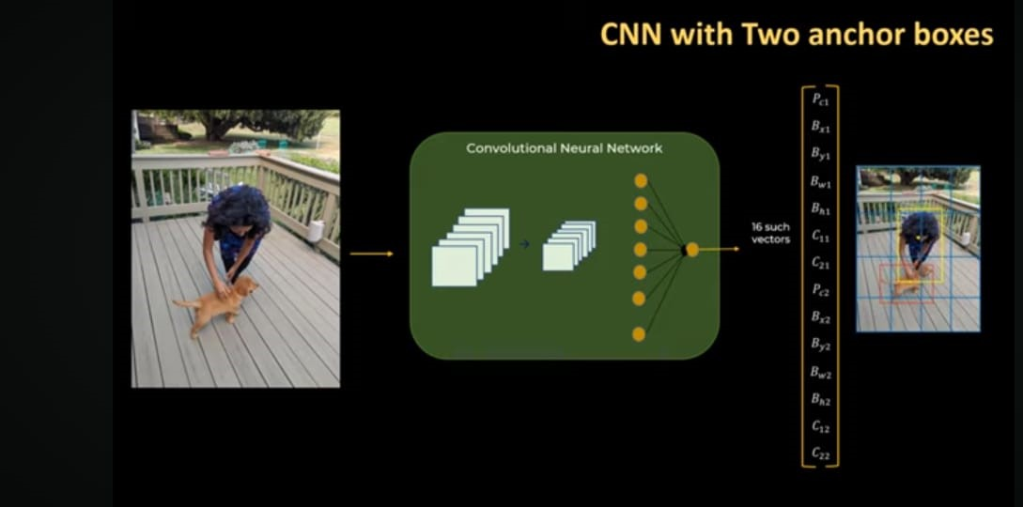

Slide 22
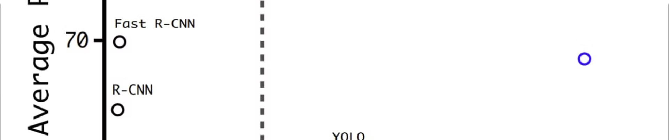
Advantages of YOLO
Speed
Accuracy
Unified Model
YOLO processes images in real-time, making it highly efficient.
YOLO achieves high accuracy with fewer background errors.
YOLO uses a single neural network to predict bounding boxes and class probabilities directly.

Slide 23
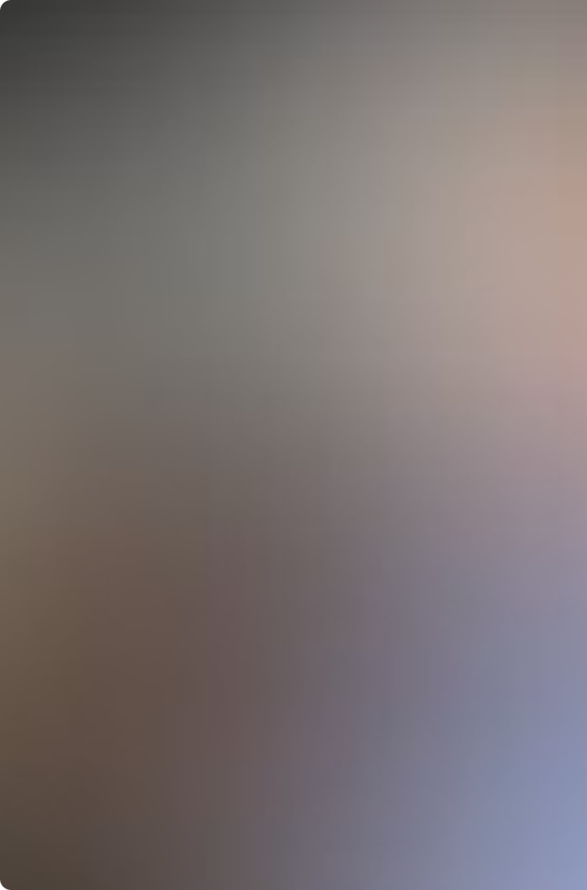





Real-World Applications of YOLO
Autonomous Driving
Vehicle and pedestrian detection
Security and Surveillance
Identifying suspicious activities
Medical Imaging
Detecting anomalies in scans
Robotics and Drones
Obstacle detection and avoidance

Slide 24

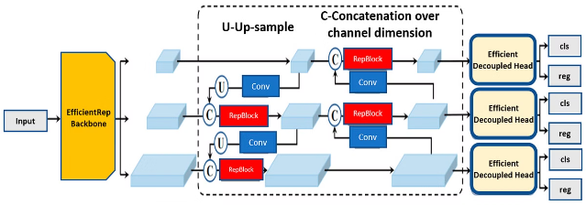
YOLO Demo and Scratch Code
1
Demo Introduction
Hands-on demonstration of the YOLO algorithm in action.
2
Required Tools
Python, OpenCV, YOLO weights and configuration files.

Slide 25

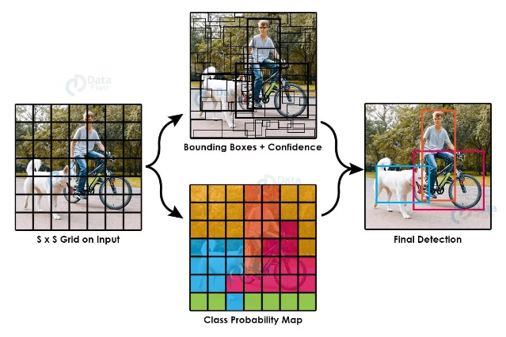
Setting Up the Environment
Install Libraries
pip install opencv-python numpy
Download YOLO Files
yolov3.weights, yolov3.cfg
Load the Model
net = cv2.dnn.readNet("yolov3.weights", "yolov3.cfg")

Slide 26

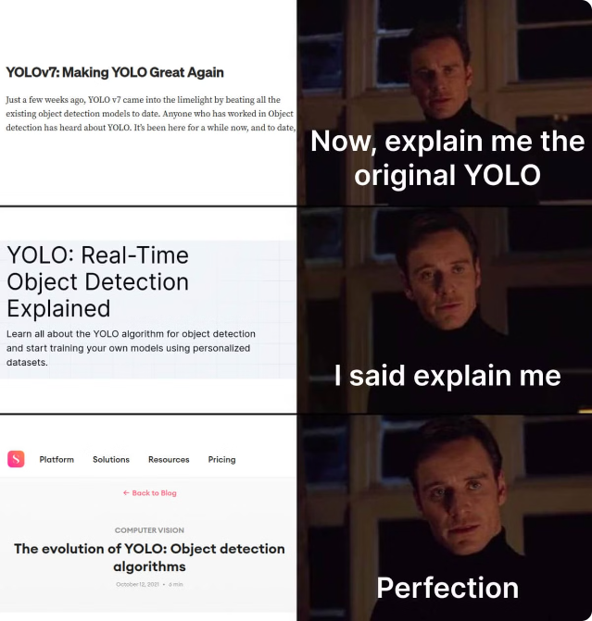
Conclusion and Q&A
1
Summary
YOLO is a powerful real-time object detection system with high speed and accuracy.
2
Next Steps
Exploring the code further and experiment with YOLO for the projects.

