Slide 1

SRINIVAS INSTITUTE OF TECHNOLOGY
AFFILIATED TO VTU, BELGAVI AND RECOGNIZED BY THE AICTE, NEW DELHI)
2023-2024
Department of Computer Science and Engineering
Data Base Management System
21CS053
Online Shopping Management System
Presented By:
1. Priya.M- 4SN21CS075
2. Sharadhi S Shetty -4SN21CS089
Guide name : Sandeep Bhat Designation : Assistant Professor
Department name : ComputerScience

Slide 2
Contents
Abstract
Front end tool
Back end tool
ER diagram
Schema diagram
Screenshots of all modules in our project
Conclusion

Slide 3
1.Abstract
Online shopping management system project aims at create an online shopping system which can be used to buy articles.
Traditional commerce is carried out physically with effort of a person to go and get products, ecommerce has made it easier for human to reduce physical work and save time.
The administrator will setup the categories of the items. A category is a logical subdivision of category of similar products such as watches, t-shirts, shoes.
The users of the system can cart the product they want and then chose the items they need and can buy it. If they don’t need any item or article which is in cart, they can delete that product and can buy the rest articles/items.

Slide 4
HTML
2.Front end Tools
HTML is a frontend language. The frontend is the part of a website that users can see and interact with. The backend is the part of a website that users can’t see and interact with.
The frontend uses HTML, CSS, JavaScript, and frontend frameworks. The backend uses programming languages like Java, Python, Ruby, APIs, and database management systems.

Slide 5
CSS
CSS is a front-end language. The front end is what users see and interact with on a website. It includes visual elements like buttons, graphics, and text messages.
Javascript
JavaScript (JS) is a text-based programming language used both on the client-side and server-side that allows you to make web pages interactive. It is one of the three core technologies of World Wide Web content production (along with HTML and CSS).

Slide 6
PHP
3.Backend Tools
PHP is one of the back-end languages which is known as the scripting language. When a PHP page is requested, the server parses the PHP code, which in most cases results in dynamically created HTML.
SQL
SQL is the most common backend language. It is used to interact with databases and to create and maintain relational database. It's a standard 4th generation language that’s supported by almost all database tools.

Slide 7
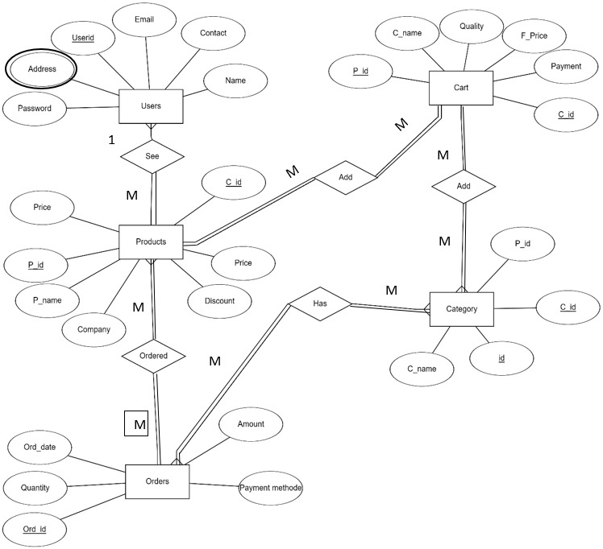
1
1
Fig: ER Diagram of Online management System

Slide 8
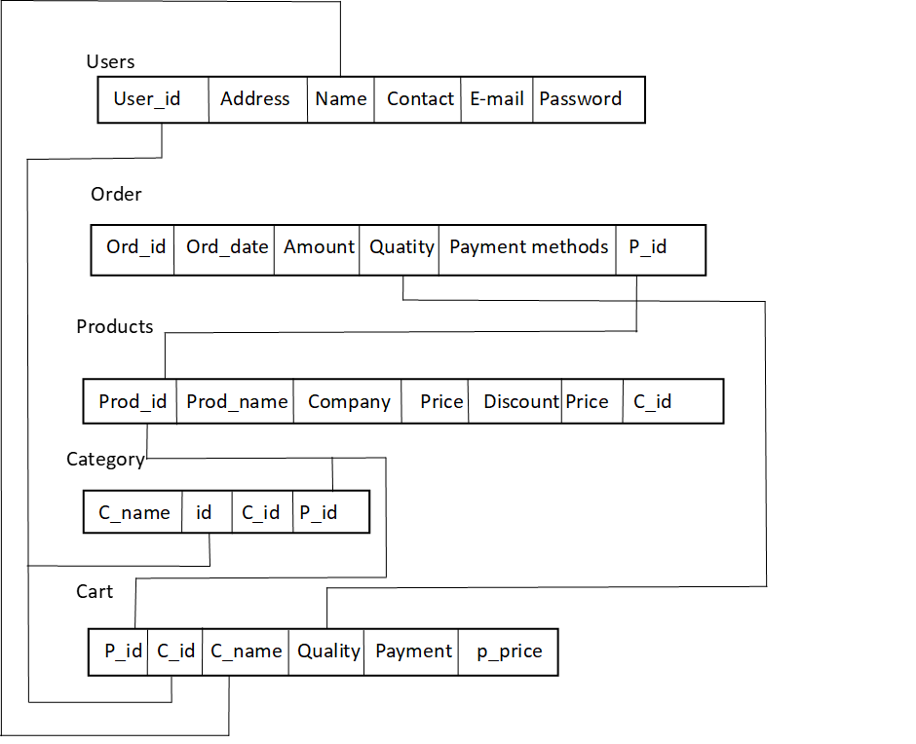
Fig: Schema Diagram of Online management System

Slide 9
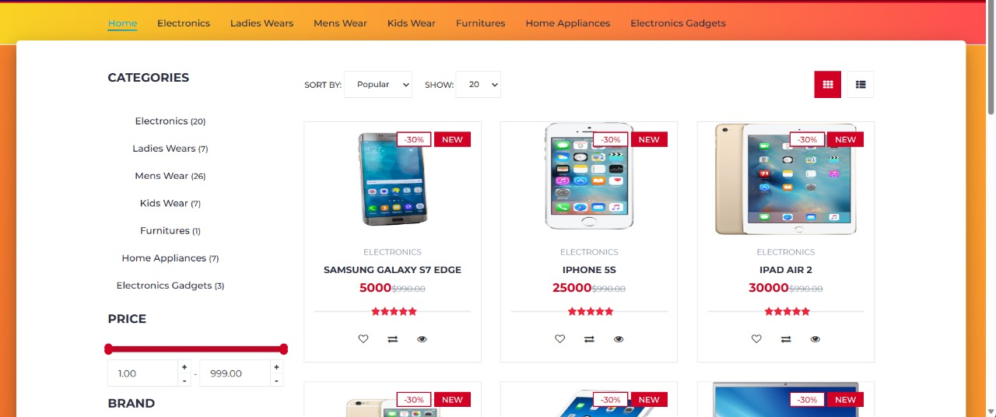
6.Screenshots

Slide 10
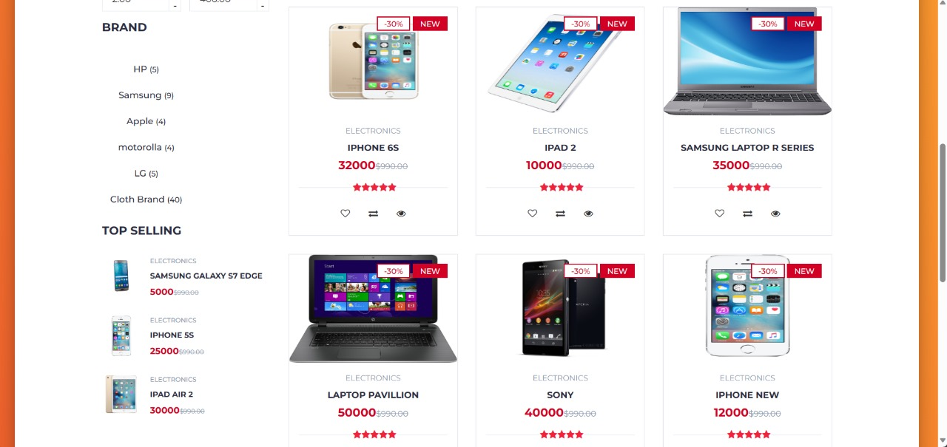

Slide 11
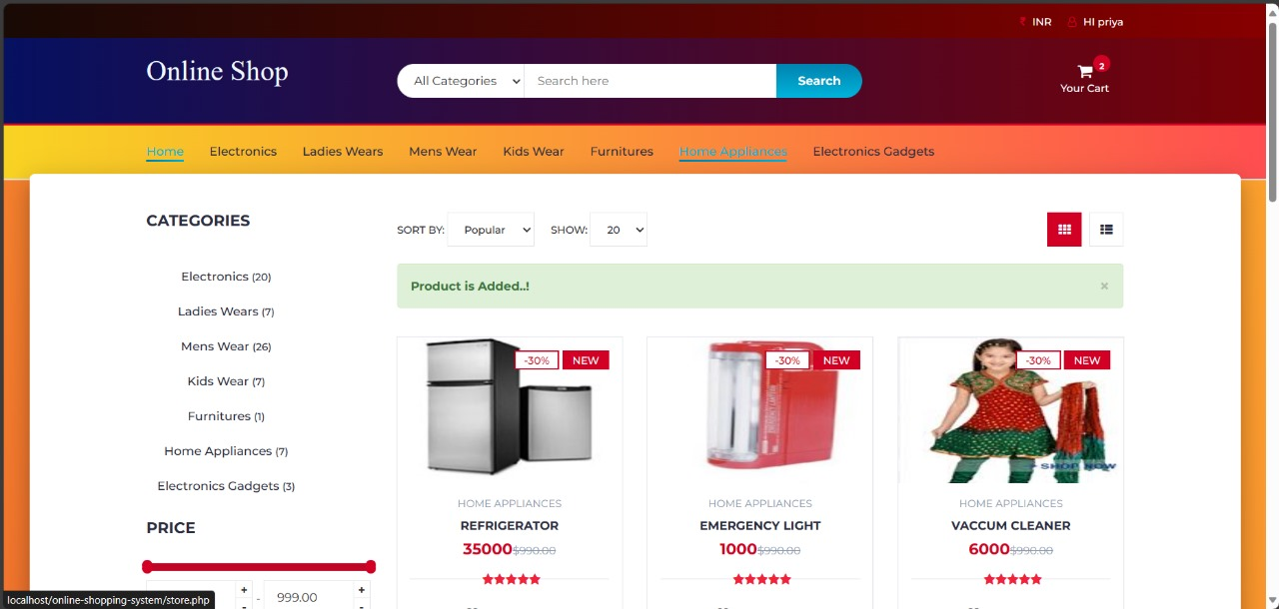

Slide 12
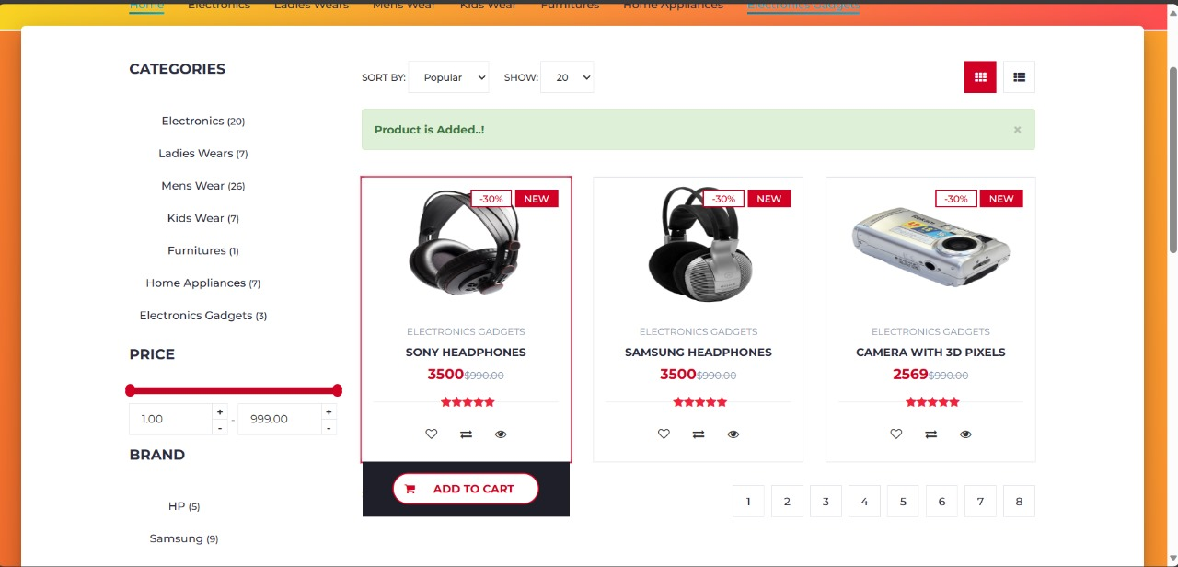

Slide 13
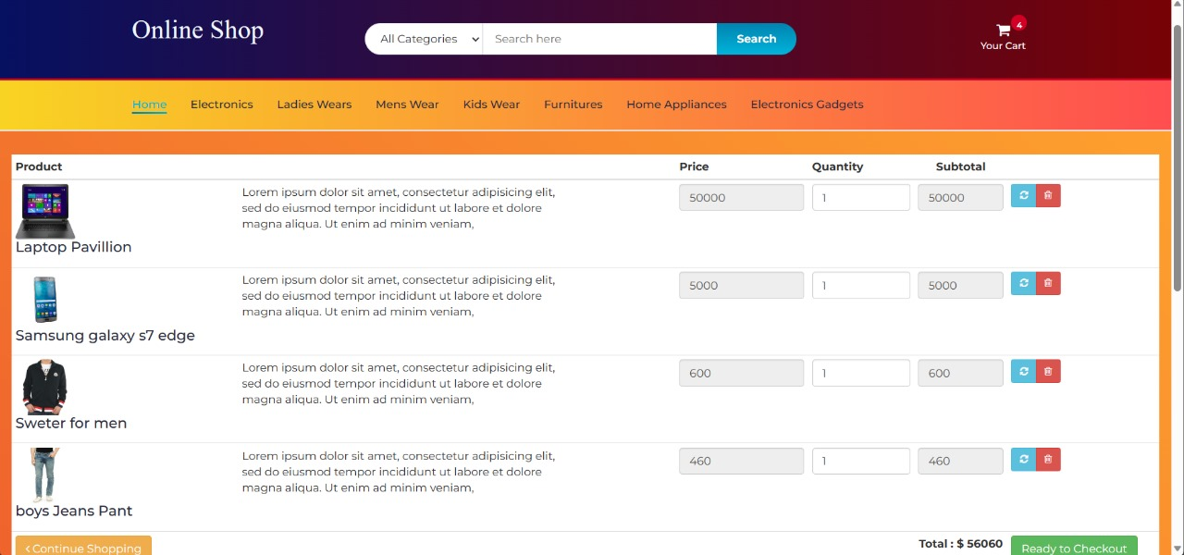

Slide 14
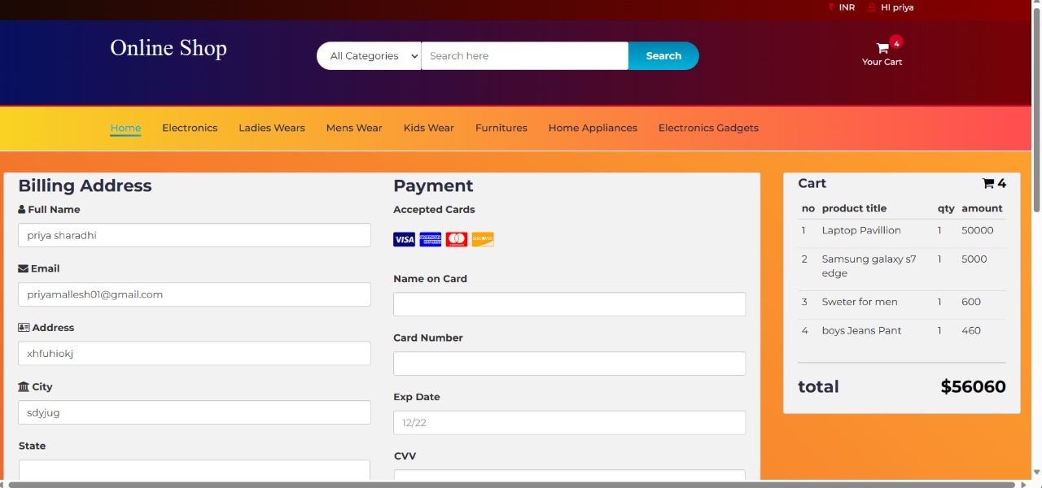

Slide 15
7.Conclusion
In conclusion, online shopping has revolutionized the way we shop, offering unparalleled convenience, a vast selection of products, competitive prices, and doorstep delivery.
It has empowered consumers with information, simplified the shopping process, and provided access to a global marketplace.
Embracing online shopping allows us to save time, make informed choices, and enjoy the convenience of shopping from anywhere, at any time.

Slide 16


