Slide 1

Project Report
INTRODUCTION
1.1 Overview
Here is the android tracking app named as “Sleep tracking", It has individual user to track the sleeping hours
1.2 Purpose
A sleep tracker application enables the user to start the timer when they are in bed and about to fall asleep . The timer will keep running in the background until it stopped , whenever the user wakes up . Based on the sleeping experience , that user can rate your sleep . Finally the result will display, that the user had at the previous night.

Slide 2
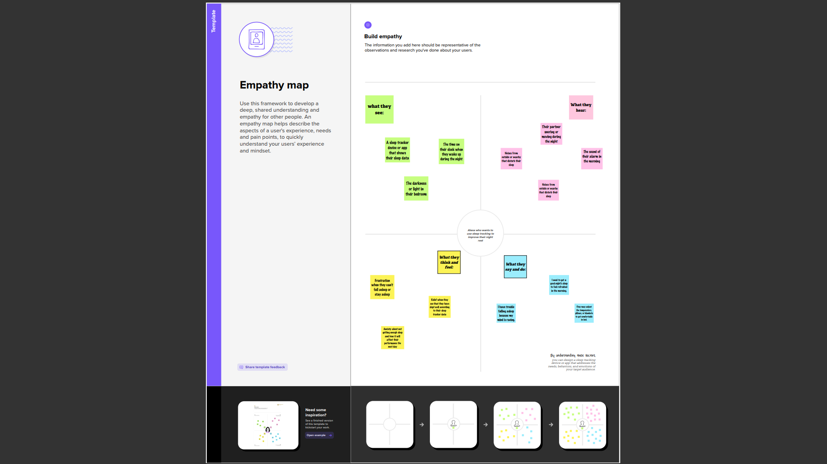
Problem Definition & Design Thinking
2.1 Empathy Map

Slide 3
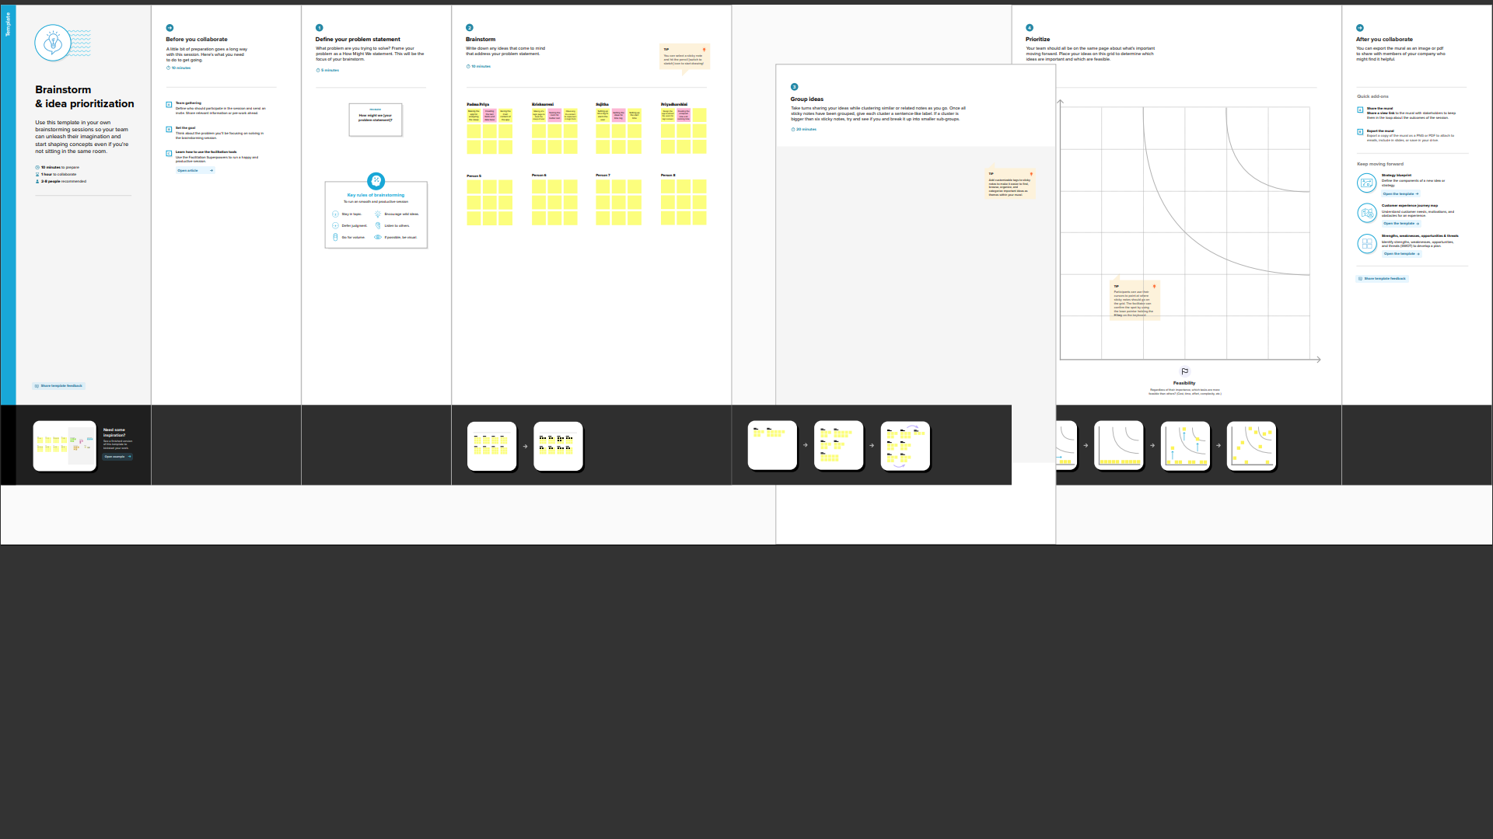
2.2 Ideation & Brainstorming Map

Slide 4
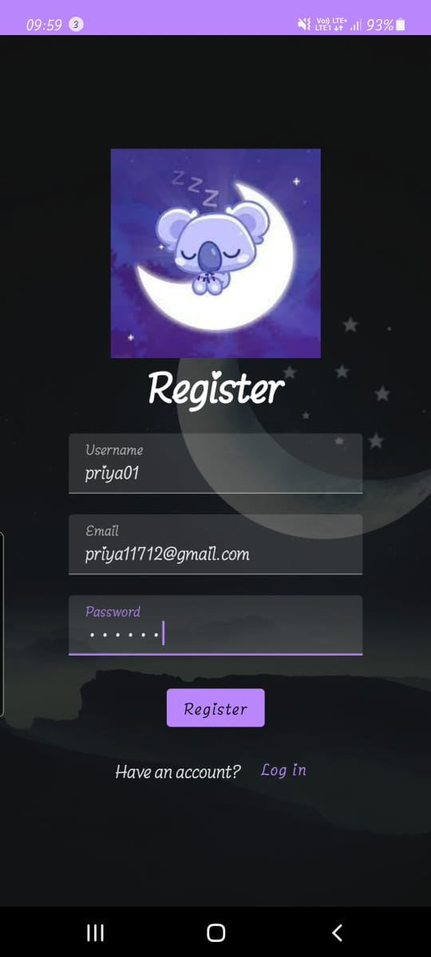
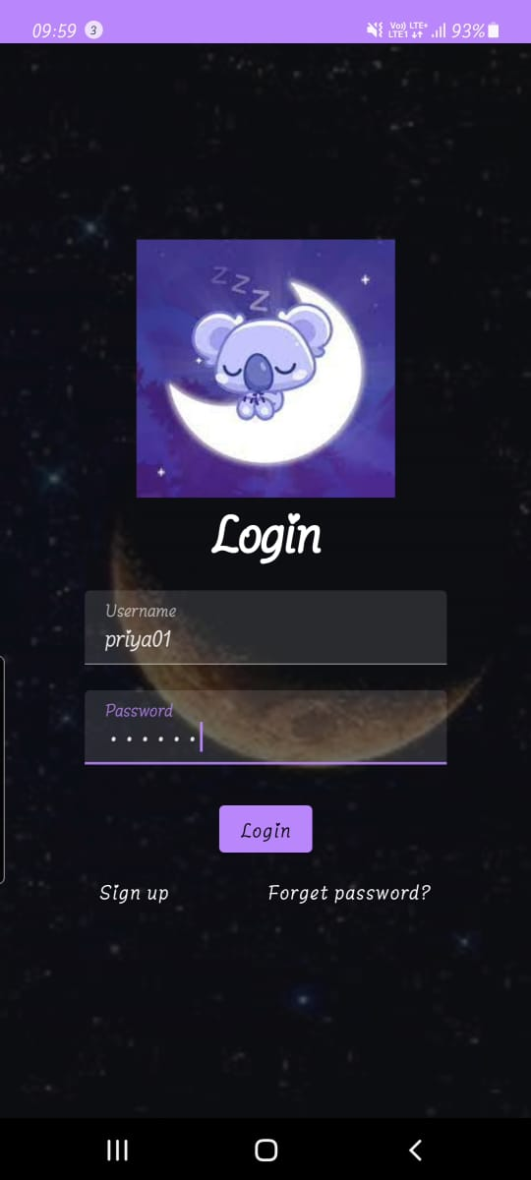
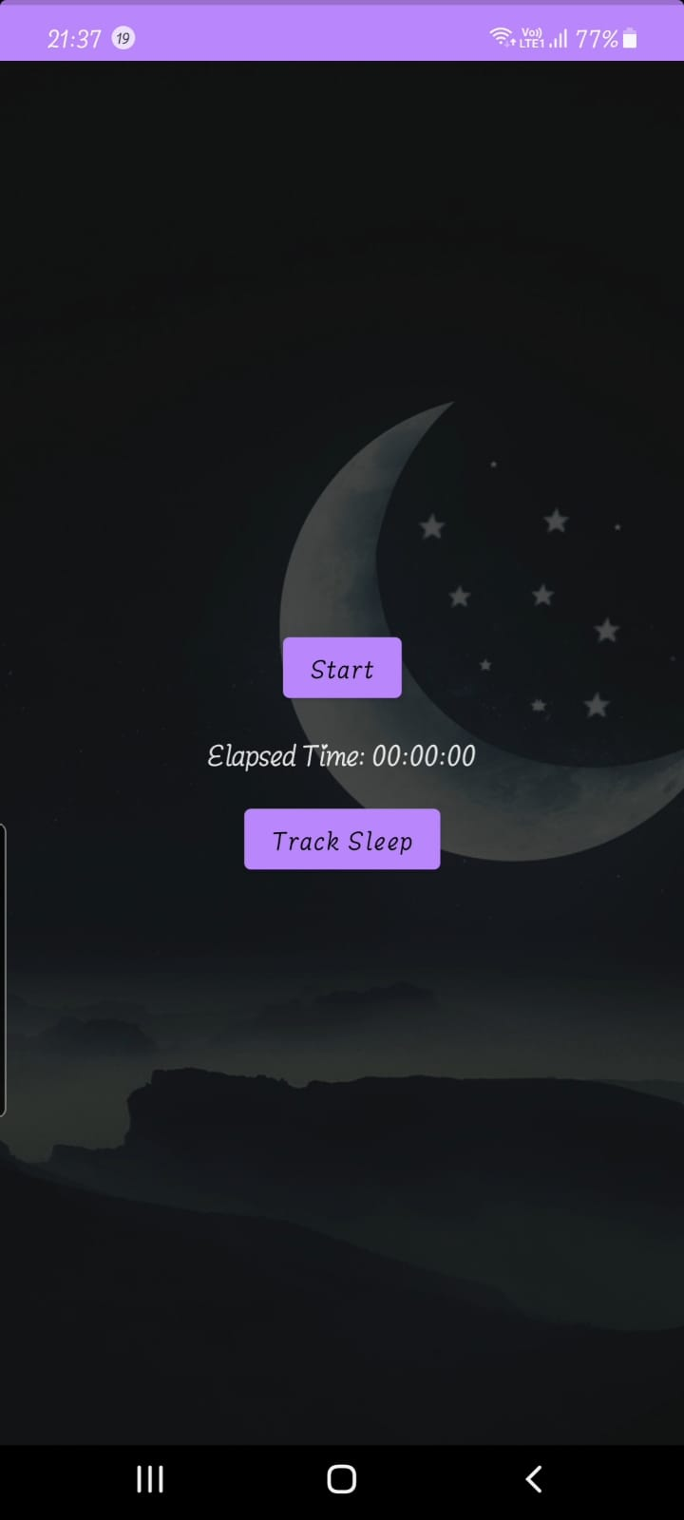
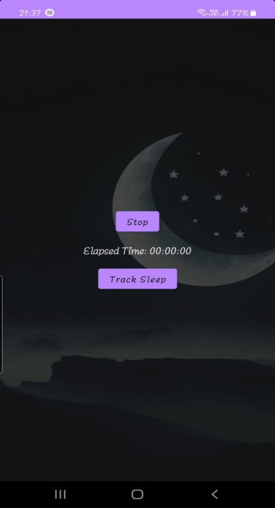

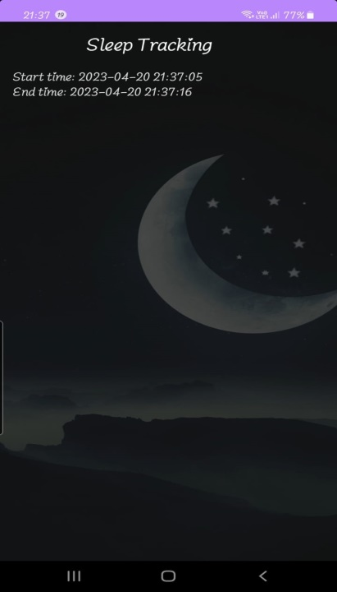
3 RESULT Output

Slide 5
4 ADVANTAGES & DISADVANTAGES
Advantages
Sleep tracking apps can increase awareness of sleep patterns and behaviors.
Some sleep tracking apps can customize recommendations based on data collected from the user.
Sleep tracking apps can be accessed easily and conveniently from a smartphone or wearable device.
Seeing progress and improvement in sleep patterns can motivate individuals to make necessary changes to improve their sleep health.
Disadvantages
Some sleep tracking apps require a subscription fee or additional in-app purchases, which can be costly
Sleep tracking apps collect personal data, such as location and sleep patterns.
Sleep tracking apps can create an obsession with achieving perfect sleep.

Slide 6
5 APPLICATIONS
Sleep tracking can help identify common sleep disorders
By tracking your sleep patterns, you can identify what factors affect your sleep quality
It is used to measure the sleeping hours
By using this ,user can know their sleeping capacity
6 CONCLUSION
The sleep tracking app provides a better and more flexible tracking system
Developed with the latest technology in the way of providing a reliable system.
The main advantage of the system is to tracking the sleeping by user

Slide 7
7 FUTURE SCOPE
Sleeping is essential for human life
Sleep tracking apps have been popular for use in hotels and support engagement
sleep tracker is a valuable tool that could make it easier to effectively track and optimize your sleep patterns.
Sleep tracing apps are great at tracking the sleep of users
8 APPENDIX
Source Code
Visit: https://github.com/Priya-paul-01/A-Sleep-Tracking-App-for-a-Better-Night-s-Rest

