Slide 1

AcademiBalance: An AI‑Driven Faculty Workload Time Allocation Assistant Tools: Excel, Power BI, Microsoft Copilot
Dr. Priya . A - Brindavan College · AICW 2026

Slide 2
Motivation & Problem
Current practice: Focus on raw teaching hours.
Complexity of programmes and batch size often ignored.
Leads to hidden overload / under‑load across faculty.
Need: simple, visual, evidence‑based tool for HODs.

Slide 3
Data & Metrics
Data:
Real workload data for 30–40 faculty from my institution.
Additional simulated records to reach 70 faculty for richer patterns.
Key metrics:
Total Workload Hours (TWH).
Complexity‑Adjusted Hours (CAH).
Student‑Adjusted Load Index (SALI)

Slide 4
Methodology & Thresholds
Excel: data cleaning, TWH, CAH, SALI formulas.
Power BI: model, measures, SALI‑based status.
SALI thresholds:
> 900 – Overloaded
600–900 – Balanced
< 600 – Under‑loaded

Slide 5
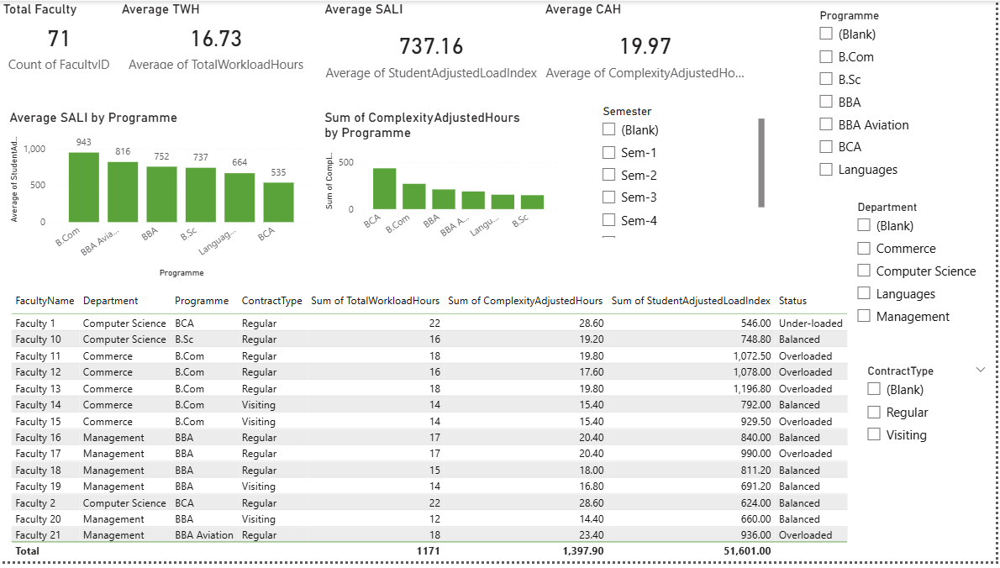
Dashboard Design
KPI cards: Avg TWH, Avg CAH, Avg SALI, Total Faculty.
Charts: SALI by programme; CAH by programme.
Table: faculty‑wise metrics + overload status.
Slicers: programme, semester, department, contract type

Slide 6
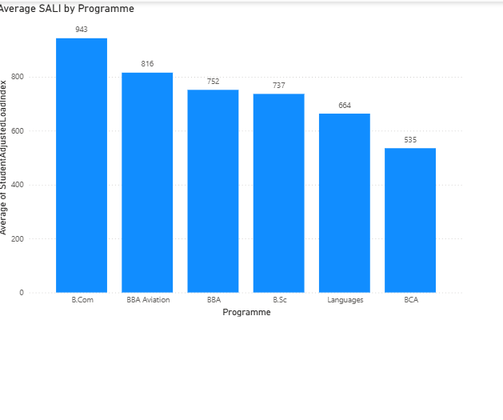
Key Patterns Observed
B.Com, BBA, BBA Aviation: higher average SALI than Languages/BCA.
Several regular B.Com and BBA/BBA Aviation faculty flagged as overloaded.
SALI‑based classification (subset n=37):
7 overloaded, 23 balanced, 7 under‑loaded

Slide 7
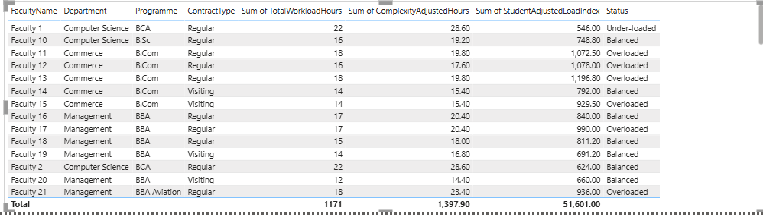
Faculty‑Level View & Use Cases
Faculty table highlights overloaded, balanced, under‑loaded cases.
HOD use:
Identify faculty needing relief.
Reassign courses from overloaded to balanced/under‑loaded.
Compare regular vs visiting patterns.

Slide 8
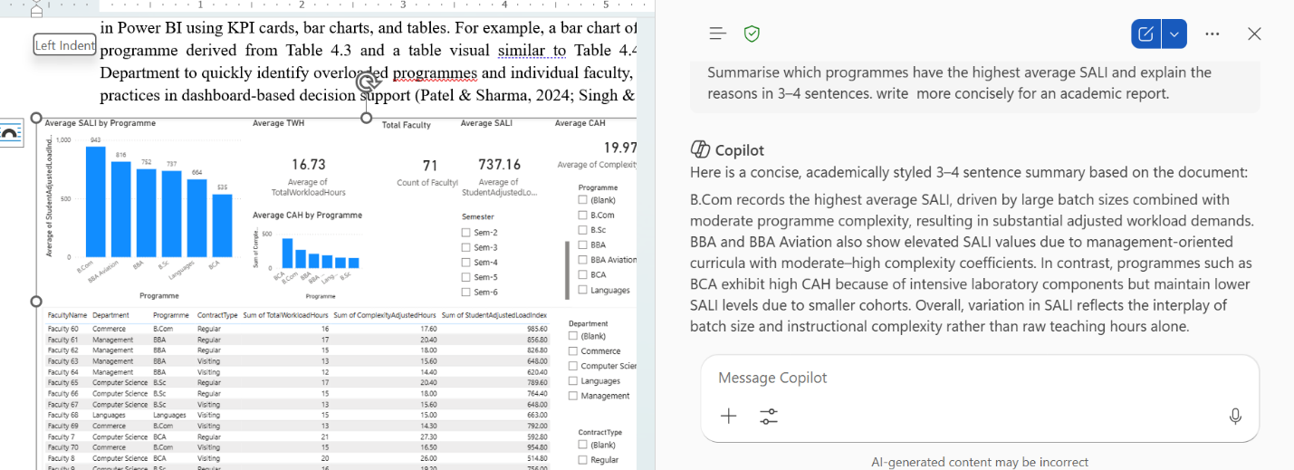
AI Narrative Integration
Copilot prompts over the same dataset.
Example:
“Summarise which programmes have highest average SALI and why.”
Output: short academic‑style narrative used in report and demo

Slide 9
Artefacts, Progress & Next Steps
GitHub repo with dataset + PBIX + documentation. https://github.com/Priya051188/AcademiBalance-Faculty-Workload
Shared Power BI dashboard link for evaluators.
Short demo video link
Next steps:
Refine what‑if planning scenarios.
Explore using more real data (policy‑permitting)

Slide 10
Thank YOU

