Slide 1
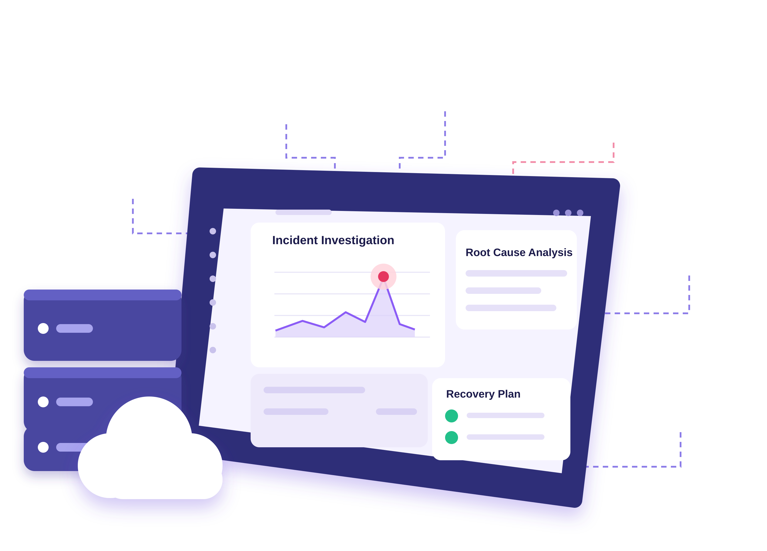















IncidentIQ AI
Metrics
Traces
Alerts
Investigate. Adapt. Recover. Verify.
Logs
An AI incident investigator that turns fragmented
production signals into evidence-backed diagnosis
and safer recovery decisions.
Deployments
Configurations
Cognify Crew
Priya R
Vaishnavi S
Revathi M
Harini R
Varshini S
Collect
Evidence
Build
Timeline
Form
Hypotheses
Investigate
with Tools
Identify
Root Cause
Propose
Recovery
Request
Approval
Verify
with Evidence

Slide 2

Problem & Solution
02
From fragmented signals and manual investigation to adaptive, evidence-backed recovery.
The Problem
Our Solution – IncidentIQ AI
Production incident response is difficult and time-consuming.
An AI-assisted incident investigator that turns fragmented signals
into evidence-backed diagnosis and safer recovery decisions.
01
Scattered signals
01
Correlate and analyze
Logs, metrics, traces and alerts are in
different tools.
Combine logs, metrics, traces and change history
into a clear incident timeline.
02
Manual investigation
02
Adaptive investigation
Engineers must correlate data under
time pressure.
Generate and compare hypothesss, and adapt when
new evidence contradicts the current hypothesis.
03
Uncertain and risky fixes
03
Safe recovery and verification
Initial explanations may be wrong and
fixes can introduce new issues.
Recommend recovery actions, get human approval for
critical changes, and verify with fresh evidence.
Fragmented Signals
Adaptive Investigation
Evidence-Backed Recovery
Multiple tools, no clear picture
Analyze, compare, and find the root cause
Recommend, approve, and verify

Slide 3
System Architecture
03
From multiple signals to verified recovery with adaptive investigation.
1. Signal Sources
2. Ingestion & Evidence
3. Investigation
Orchestrator
4. Recovery & Control
5. Verification & Reporting
Logs
Impact Analysis
Check Fresh Evidence
Connectors / Upload
Incident Timeline
Metrics
Traces
Normalize & Align
Hypothesis Manager
Recovery
Recommendation
Outcome Status
Alerts
Evidence Evaluation
Incident Summary
Evidence Store
Human Approval
Deployments / Config
Adaptive Planner
Service Dependencies
Anomaly Detection
Evidence Trail
Tool / API Execution
Controlled Execution
Incident History
New evidence (feedback)
Incident Occurs
Adaptive Investigation
Verified Recovery

Slide 4
Technical Stack & Implementation
04
A simple and modular stack to build and run IncidentIQ AI.
Frontend
(Web App)
Backend
(API)
Data &
Persistence
AI Reasoning
& Tool Use
Detection &
Analysis
Dependency &
Recovery Analysis
React + TypeScript
Python
SQLite
Gemini API
(Function Calling)
Isolation Forest
Service Dependency
Graph
SQLAlchemy
Vite + Tailwind CSS
FastAPI
Change-point
Detection
Impact Assessment
Pandas
Adaptive
Investigation
Orchestrator
Recharts + Lucide
Pydantic
Statistical Thresholds
Recovery Simulation
CSV / JSON
How it works together
User Interface
(React Web App)
Backend
Orchestration
(FastAPI)
Data &
Analysis
(SQLite, Pandas)
AI Reasoning
& Tool Calls
(Gemini API)
Approval &
Verification
(Human in the loop)
Incident Report
(Timeline & Findings)

Slide 5
Demo, Safety, Impact & Future
05
From incident to verified recovery.
Demo – Example Incident (Simulated)
Safety
01
Evidence-linked recommendations
Detect
Incident
Investigate
& Find Cause
Propose
Recovery
Verify
Outcome
02
Human approval for critical changes
Service errors
increase
Database
connection
exhaustion
Increase DB
connection pool
Errors return
to normal
03
Verify outcome with fresh evidence
Impact
Future Direction
Before (Simulated)
After (Simulated)
01
Faster and more
structured investigation
01
More observability
integrations
02
Reduced false assumptions
02
Richer dependency
context
High error rate
Errors back to normal
03
Safer recovery decisions
Controlled remediation
workflows
03
Cognify Crew
Investigate. Adapt. Recover. Verify.
Priya R • Vaishnavi S • Revathi M • Harini R • Varshini S

