Slide 1
PROJECT TITLE
CAPSTONE PROJECT
Presented By:
Student Name : Priya Kumari
College Name & Department : Panimalar Engineering College & IT(2nd year)

Slide 2
OUTLINE
Problem Statement
Technology used
Wow factor
End users
Result
Conclusion
Git-hub Link
Future scope

Slide 3
Problem Statement
Steganography is the technique of hiding secret information within an image so that its presence is not detectable. The goal is to modify the least significant bits (LSB) of image pixels without altering the image's visual appearance. The hidden message should remain intact even after image compression or minor alterations. This project focuses on embedding and extracting secret data in PNG image files for secure communication.

Slide 4
Technology used
Library Used: Pillow (PIL Fork)
Operating System: Windows, macOS, Linux
Python Version: Python 3.x
Hardware Requirements:
CPU: Any modern CPU (Intel/AMD)
RAM: 2 GB (8 GB recommended for large images)
Storage: Few MB to GB depending on image size
GPU: Not required
Image File Format: PNG

Slide 5
Wow factors
Unique Feature: The project uses Least Significant Bit (LSB) Steganography to hide a secret message within the pixel data of an image (specifically PNG), enabling secure communication by encoding text into the image's RGB channels without visibly altering the image. This method of embedding and extracting the message, combined with the use of a delimiter to mark the end, adds an extra layer of precision to the steganography technique.

Slide 6
End users
Privacy Advocates
Cybersecurity Professionals
Digital Artists
Researchers
Educators and Students
Developers

Slide 7
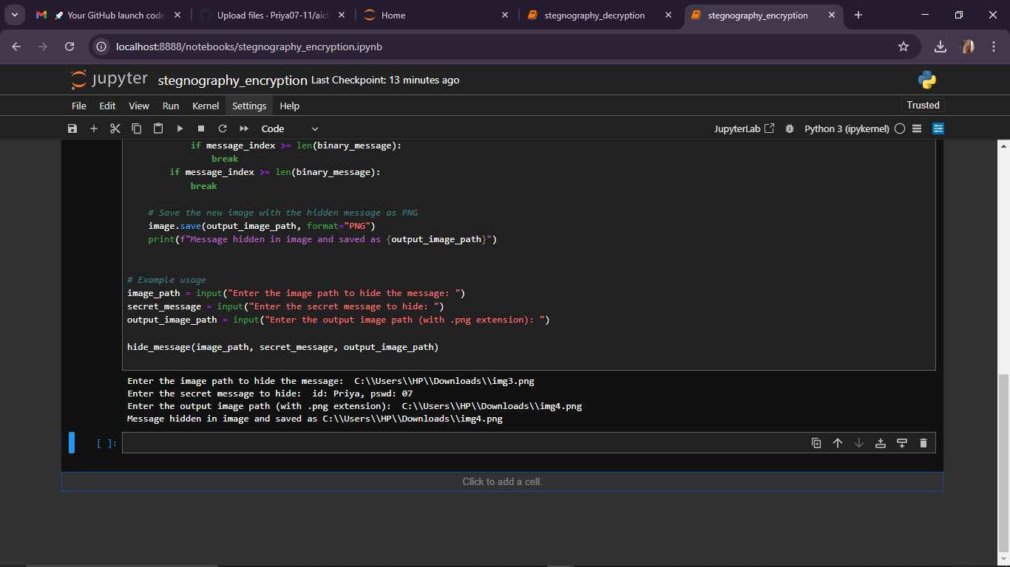
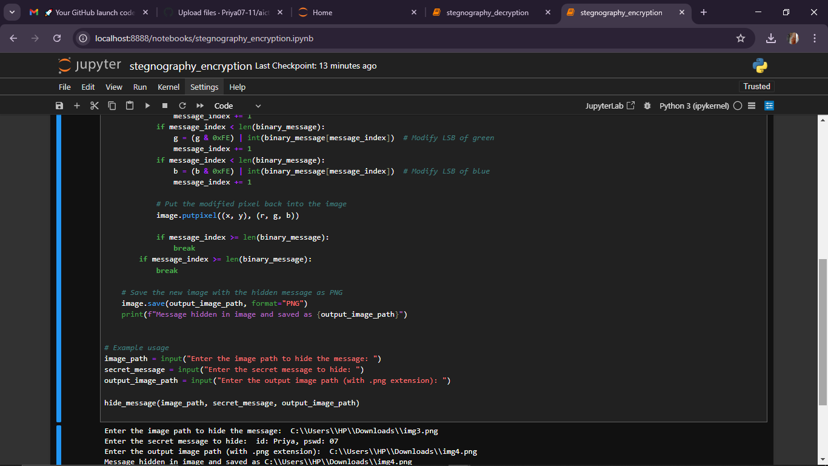
Results

Slide 8
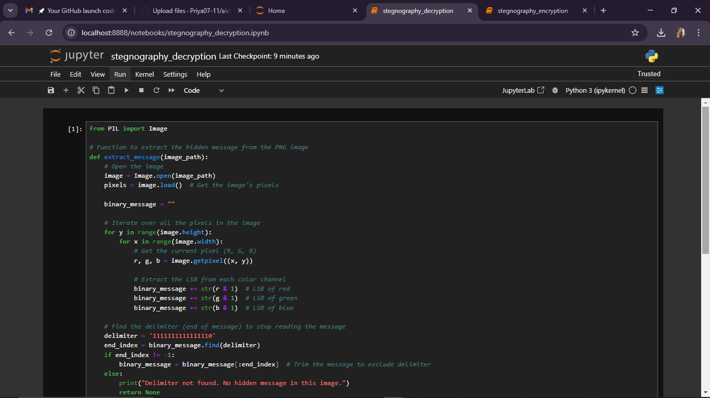
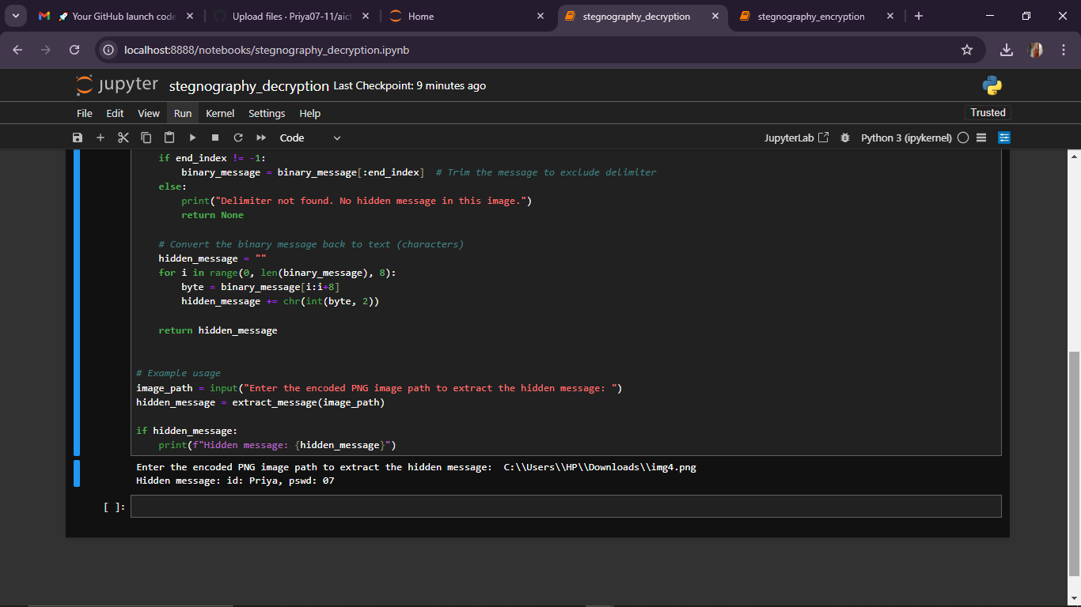
RESULTS

Slide 9
Conclusion
Steganography is a powerful technique for securely hiding information within digital media, ensuring privacy and confidentiality. It allows for covert communication by embedding data in ways that are not easily detectable. As digital security concerns grow, steganography continues to be an essential tool for safeguarding sensitive information in various fields.

Slide 10
GitHub Link
https://github.com/Priya07-11/aicte_stegnography.git

Slide 11
Future scope(optional)
Enhanced Security Algorithms
Dynamic Image Formats
AI Integration
Real-time Communication
Watermarking and Anti-Tamper

Slide 12
THANK YOU

