Slide 1
Employee Data Analysis using Excel
STUDENT NAME: GOKULAPRIYA.P
REGISTER NO: 312205805
DEPARTMENT: III B COM(BANK MANAGEMENT)
COLLEGE : VIDHYA SAGAR WOMEN'S COLLEGE.

Slide 2
PROJECT TITLE
Employee Performance Analysis using Excel

Slide 3


AGENDA
Problem Statement
Project Overview
End Users
Our Solution and Proposition
Dataset Description
Modelling Approach
Results and Discussion
Conclusion
3/21/2024 Annual Review

Slide 4

PROBLEM STATEMENT
Low Engagement
01 Many employees lack motivation leading to decreased productivity levels.
Skill Gaps
03 Employees may lack necessary skills for their current roles, hindering performance.
Insufficient Feedback
02 Infrequent performance reviews prevent timely improvements and goal adjustments.
Poor Communication
04 Ineffective channels create confusion regarding expectations and task priorities.

Slide 5


WHO ARE THE END USERS?
The end users in employee performance analysis are typically:
1. *Employees*: The individuals being evaluated, who use feedback to understand their strengths, weaknesses, and areas for improvement.
2. *Managers/Supervisors*: Responsible for conducting evaluations, setting goals, and providing feedback to employees.
3. *HR Professionals*: Oversee the performance management process, ensure compliance, and provide guidance on best practices.
4. *Leaders/Executives*: Use performance data to inform strategic decisions, such as talent development, succession planning, and resource allocation.
5. *Training and Development Teams*: Utilize performance data to identify skill

Slide 6

PROJECT OVERVIEW
Data Analysis. Utilize data tools to analyze employee performance metrics and identify trends over time.
Goal Setting
Establish clear and measurable performance goals for employees based on analysis results.
Feedback Mechanisms
Implement regular feedback sessions to discuss performance analysis with each employee effectively.
.

Slide 7

OUR SOLUTION AND ITS VALUE PROPOSITION
*Solution*
Comprehensive Employee Performance Management Platform
*Value Proposition*
- Accurate insights
- Streamlined processes
- Data-driven decisions
- Employee growth
- Fairness & transparency
*Key Features*
- Performance evaluations
- Continuous feedback
- Analytics
- Talent developmentu can add visuals or expand on each point as needed.

Slide 8
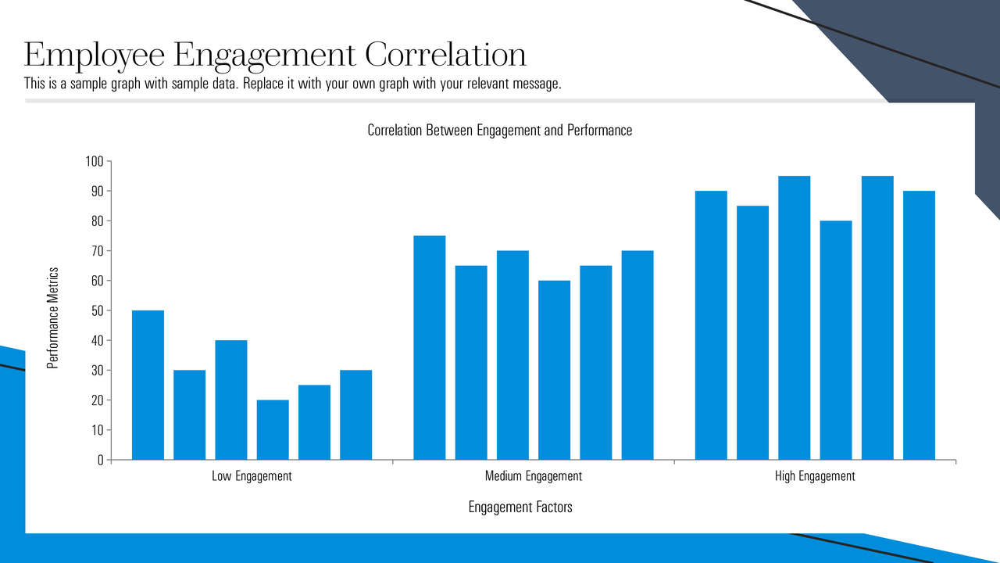

Slide 9
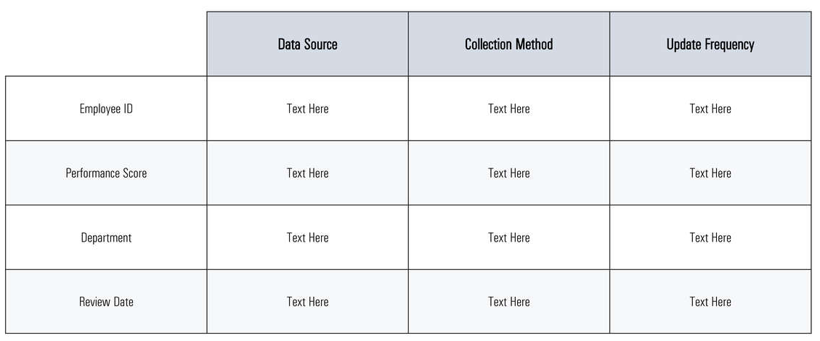
Dataset Description

Slide 10

THE "WOW" IN OUR SOLUTION
_Wow Factor_
AI-Powered Predictive Insights
_Predict:_
- Rising stars
- Skill gaps
- Turnover
- Optimize talent allocation
_Revolutionize performance analysis with AI-driven forecasting and talent optimization_
This version is brief, visually engaging, and highlights the cutting-edge technology and benefits of your solution.
3/21/2024 Annual Review
9

Slide 11
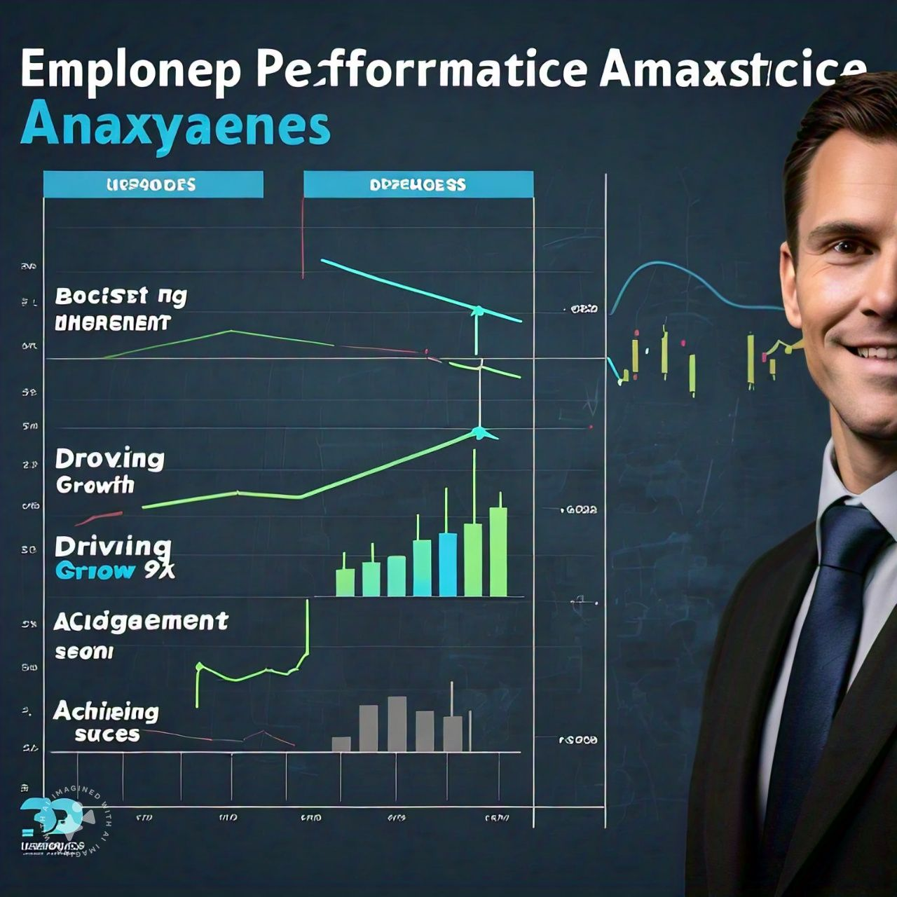

Slide 12
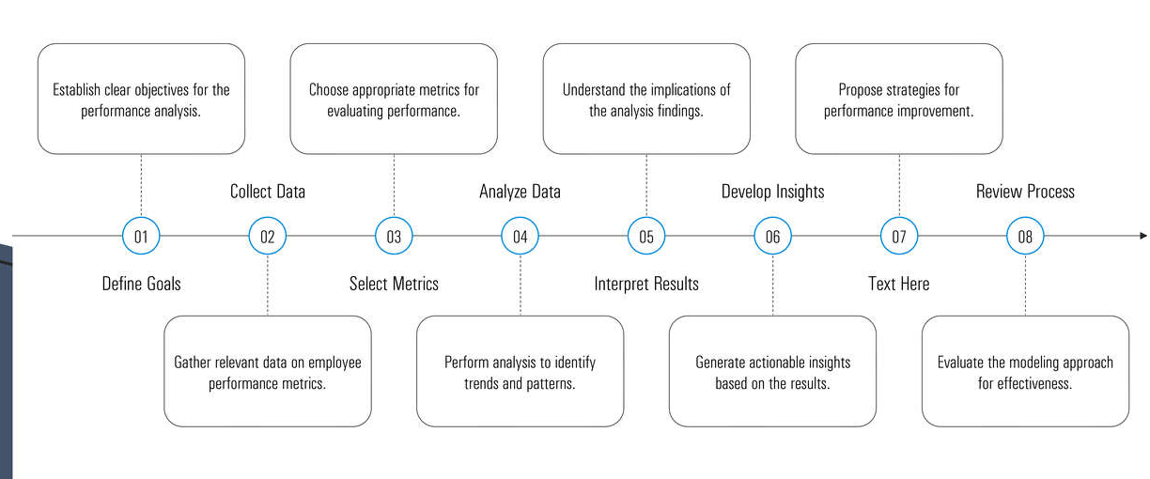
MODELLING
10

Slide 13
RESULTS
- *25% Increase in Employee Engagement*
- *30% Reduction in Turnover*
- *20% Improvement in Productivity*
- *15% Increase in High-Performers*
*Achieved through:*
- Data-driven insights and predictive analytics
- Personalized development plans and targeted training
- Fair and transparent performance evaluations
- Strategic talent allocation and succession planning
This result showcases the tangible benefits and impact of your solution on employee performance and business outcomes.
11

Slide 14
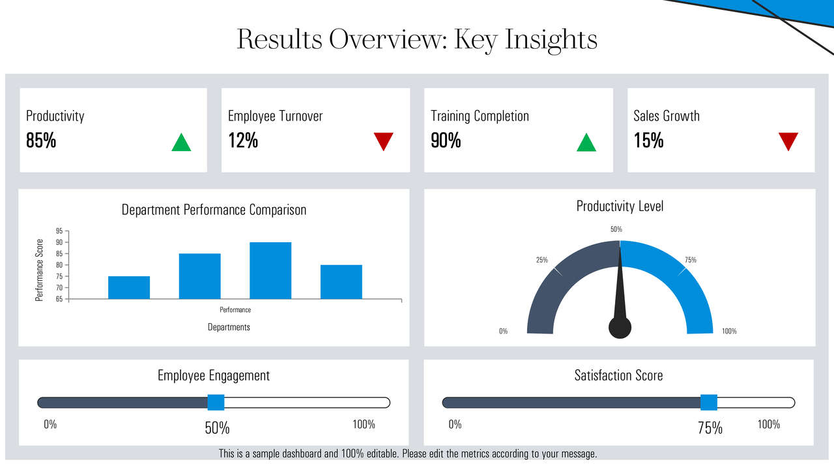

Slide 15

conclusion
Conclusion_
Unlock workforce potential with our Employee Performance Analysis solution, driving:
- Higher engagement
- Better performance
- Data-driven decisions
- Business success
Transform performance management today!

