Slide 1

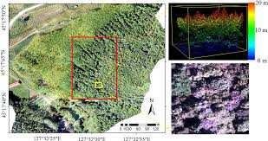
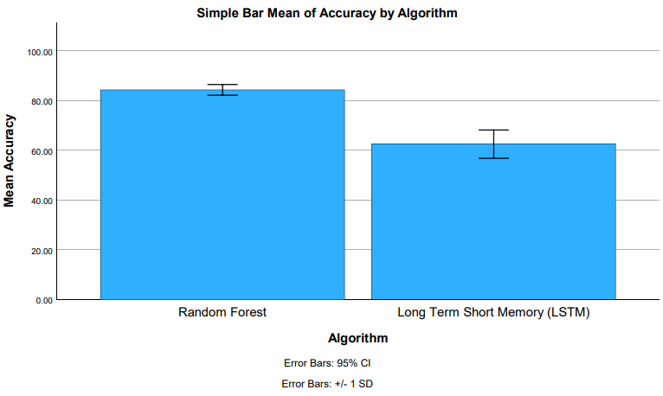
K Shanmukha Priya
Reg No:192011233
GUIDED BY : Dr. R.Dinesh kumar
Ms. Poorani.S
Guided by Dr. Mary Valantina. G
Improving Accuracy in Image Recognition for Unmanned Aerial Vehicles with Random Forest Algorithm Comparing with Long Short-Term Memory Algorithm
INTRODUCTION
This project aims to improve Unmanned Aerial Vehicles(UAV) picture identification accuracy through the implementation and optimisation of the Random Forest(RF) method, along with a performance comparison with the LSTM.
The goal of this research is to determine the best method for real-time picture analysis and UAV application decision-making.
The main source of data for the study was the Kaggle dataset.
In this investigation, two separate groups, Group I and Group 2, each with 20 samples, were used. Group 2 used the Long Short-Term Memory, and Group I used the Random Forest.
The deployment and operation of UAVs depends heavily on the accuracy of image recognition, which affects decision-making in real-time applications.
The goal of this project is to improve the accuracy of UAV photo recognition by optimising and implementing the Random Forest method and evaluating its performance against the Long Short-Term Memory approach.
MATERIALS AND METHODS
Random Forest
Kaggle Dataset
Feature Selection and data processing
Training and Testing
LSTM
UAV Detection Using Random Forest
Statistical Analysis of the Results Using SPSS Software
Model Evaluation
Unmanned Aerial Vehicles Detection using RF over LSTM
RESULTS
Group Statistics
Accuracy | Group | N | Mean | Std. Deviation | Std. Error Mean
 | RF | 10 | 84.2330 | 3.00324 | 0.94971
 | LSTM | 10 | 62.4220 | 7.95488 | 2.51555
In the present work, the Random Forest(RF) algorithm is compared with Long Short-Term Memory(LSTM) Algorithm and it indicates that the proposed algorithm gives more accuracy when compared with the other one.
RF VS LSTM
DISCUSSION AND CONCLUSION
Based on T-test Statistical analysis, the significance value of p=0.004 (independent sample T - test p<0.05) is obtained and shows that there is a statistical significant difference between the group 1 and group 2.
They look at the influence of various picture feature descriptors on place recognition algorithm performance.
All things considered, these research further the development of technology and image processing methods related to unmanned aerial vehicles.
Overall , the accuracy of the Random Forest algorithm is 84.23 % and it is better than the other algorithm.
Random Forest (RF) Algorithm - 84.23%
Long Short-Term Memory(LSTM) Algorithm - 62.42%
The analysis primarily focused on comparing the performance of the Random Forest and Algorithm using accuracy value as the key evaluation metric.
From the work, it is concluded that the Random Forest Algorithm gains the high accuracy when comparing with Long Short-Term Memory(LSTM) Algorithm in Image Recognition for Unmanned Aerial Vehicles.
This technique has the potential to significantly increase the accuracy and effectiveness of unmanned aerial drones in real-time picture identification and analysis.
BIBLIOGRAPHY
Al Said, Nidal, Yuri Gorbachev, and Aleksei Avdeenko. 2021. “Retracted: An Unmanned Aerial Vehicles Navigation System on the Basis of Pattern Recognition applications—Review of Implementation Options and Prospects for Development.” Software: Practice & Experience 51 (7): 1509–17.
Bayhan, Erdem, Zehra Ozkan, Mustafa Namdar, and Arif Basgumus. n.d. “Deep Learning Based Object Detection and Recognition of Unmanned Aerial Vehicles.” Accessed March 13, 2024.
Carrio, Adrian, Carlos Sampedro, Alejandro Rodriguez-Ramos, and Pascual Campoy. 2017. “A Review of Deep Learning Methods and Applications for Unmanned Aerial Vehicles.”
Gao, Pengbo, Yan Zhang, Linhuan Zhang, Ryozo Noguchi, and Tofael Ahamed. 2019. “Development of a Recognition System for Spraying Areas from Unmanned Aerial Vehicles Using a Machine Learning Approach.” Sensors 19 (2): 313.
R. Yang and X. Wang, "UAV Landmark Detection Based on Convolutional Neural Network," 2020 IEEE Eurasia Conference on IOT, Communication and Engineering (ECICE), Yunlin, Taiwan, 2020, pp. 5-8.

