Slide 1

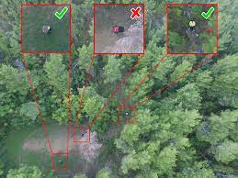
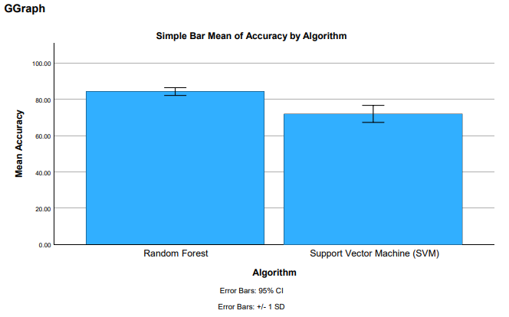
K Shanmukha Priya
Reg No:192011233
GUIDED BY : Dr. R.Dinesh kumar
Ms. Poorani.S
Guided by Dr. Mary Valantina. G
Improving real time accuracy in Image Recognition for Unmanned Aerial Vehicles with Random Forest algorithm compared with Support Vector Machine algorithm
INTRODUCTION
The primary objective of this work is to enhance the real-time performance of image recognition for Unmanned Aerial Vehicles (UAVs).
The main source of data for the study was the Kaggle dataset.
This study used two different groups, Group I and Group 2, each with 20 samples, Group 2 used the SVM, and Group I used the Random Forest.
The authors of the study paper "Research on Low Altitude Aerial Image Stitching," which uses Unmanned Aerial Vehicles (UAVs) to perform low altitude aerial picture stitching, describe this method.
They examine the difficulties and solutions involved in combining many UAV-captured photos to produce a sizable, continuous image of the studied region.
Primary goal is to increase accuracy through the use of Support Vector Machine(SVM) Algorithm and Random Forest(RF) Algorithm .
It can easily identify the object or picture.
MATERIALS AND METHODS
Random Forest
Training and Testing
Kaggle Dataset
Feature Selection and data processing
SVM
UAV Detection Using Random Forest
Statistical Analysis of the Results Using SPSS Software
Model Evaluation
Unmanned Aerial Vehicles Detection using RF over SVM
RESULTS
Group Statistics
Accuracy | Group | N | Mean | Std. Deviation | Std. Error Mean
 | RF | 10 | 84.233 | 3.00324 | 0.94971
 | SVM | 10 | 72.874 | 6.56549 | 2.07619
In the present work, the Random Forest(RF) algorithm is compared with Support Vector Machine (SVM) Algorithm and it indicates that the proposed algorithm gives more accuracy when compared with the other one.
RF VS SVM
DISCUSSION AND CONCLUSION
Based on T-test Statistical analysis, the significance value of p=0.022 (independent sample T - test p<0.05) is obtained and shows that there is a statistical significant difference between the group 1 and group 2.
The benefits of employing unmanned aerial vehicles (UAVs) for this real-time image recognition capability for UAVs are discussed, along with the usage of UAVs in monitoring the effects of techno-ecological phenomena.
Overall , the accuracy of the Random Forest algorithm is 84.23 % and it is better than the other algorithm.
Random Forest (RF) Algorithm - 84.23%
Support Vector Machine (SVM) Algorithm - 72.87%
The analysis primarily focused on comparing the performance of the Random Forest and Algorithm using accuracy value as the key evaluation metric.
From the work, it is concluded that the Random Forest Algorithm gains the high accuracy when comparing with Support Vector Machine (SVM) Algorithm in Image Recognition for Unmanned Aerial Vehicles.
The capabilities of airborne drones might be improved by this technology, allowing for more accurate and efficient operations.
Bayhan, Erdem, Zehra Ozkan, Mustafa Namdar, and Arif Basgumus. n.d. “Deep Learning Based Object Detection and Recognition of Unmanned Aerial Vehicles.” Accessed March 13, 2024.
Al Said, Nidal, Yuri Gorbachev, and Aleksei Avdeenko. 2021. “Retracted: An Unmanned Aerial Vehicles Navigation System on the Basis of Pattern Recognition applications—Review of Implementation Options and Prospects for Development.” Software: Practice & Experience 51 (7): 1509–17.
Balint, Krisztian. 2018. “UAVs with Biometric Facial Recognition Capabilities in the Combat against Terrorism.” In 2018 IEEE 16th International Symposium on Intelligent Systems and Informatics (SISY).
R. Yang and X. Wang, "UAV Landmark Detection Based on Convolutional Neural Network," 2020 IEEE Eurasia Conference on IOT, Communication and Engineering (ECICE), Yunlin, Taiwan, 2020, pp. 5-8.
Gao, Pengbo, Yan Zhang, Linhuan Zhang, Ryozo Noguchi, and Tofael Ahamed. 2019. “Development of a Recognition System for Spraying Areas from Unmanned Aerial Vehicles Using a Machine Learning Approach.” Sensors 19 (2): 313.
BIBLIOGRAPHY

