Slide 1

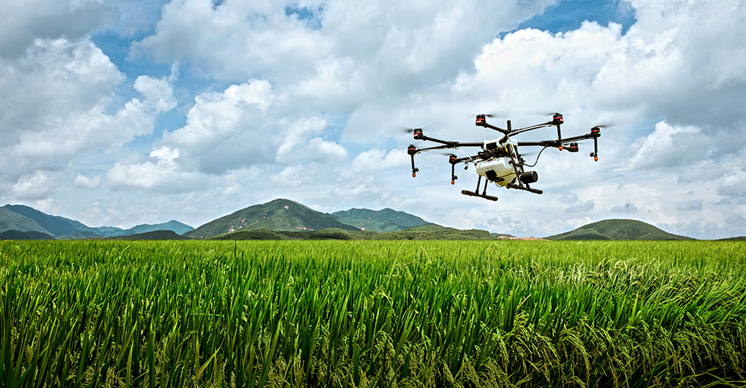
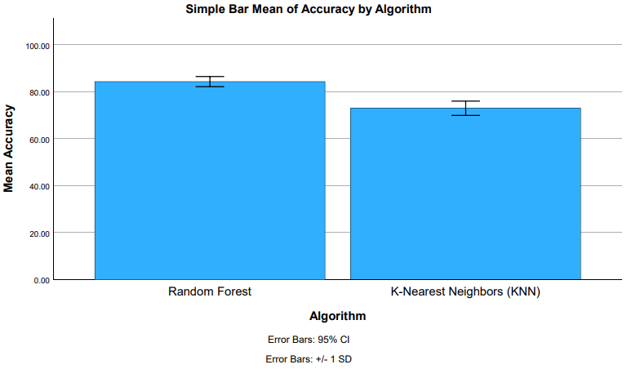
K Shanmukha Priya
Reg No:192011233
GUIDED BY : Dr. R.Dinesh kumar
Ms. Poorani.S
Guided by Dr. Mary Valantina. G
Improving Real Time Performance of Image Recognition for Unmanned Aerial Vehicles with Random Forest Algorithm Comparing with K-Nearest Neighbor Algorithm
INTRODUCTION
The objective of this project is to optimize the efficiency and accuracy of UAVs in dynamic environments by enhancing their real-time image recognition capabilities through the implementation of the Random Forest algorithm and comparing its performance with the K-Nearest Neighbour (KNN) algorithm.
The main source of data for the study was the Kaggle dataset.
This study used two different groups, Group I and Group 2, each with 20 samples, Group 2 used the K-Nearest Neighbor , and Group I used the Random Forest.
Unmanned aerial vehicles, or UAVs, are becoming essential in a variety of domains, from environmental monitoring to surveillance and reconnaissance. Strong real-time picture recognition skills are one of their main requirements for effectiveness in dynamic contexts
This project implements the Random Forest method and compares its performance with the K-Nearest Neighbour (KNN) algorithm in order to answer the urgent need to optimise the efficiency and accuracy of UAVs.
This paper proposes an image-sequence compressing algorithm for unmanned aerial vehicles, based on homography transformation
MATERIALS AND METHODS
Random Forest
Kaggle Dataset
Feature Selection and data processing
Training and Testing
KNN
UAV Detection Using Random Forest
Statistical Analysis of the Results Using SPSS Software
Model Evaluation
Unmanned Aerial Vehicles Detection using RF over KNN
RESULTS
Group Statistics
Accuracy | Group | N | Mean | Std. Deviation | Std. Error Mean
 | RF | 10 | 84.2330 | 3.00324 | 0.94971
 | KNN | 10 | 72.8740 | 4.24769 | 1.34324
In the present work, the Random Forest(RF) algorithm is compared with K-Nearest Neighbor(KNN) Algorithm and it indicates that the proposed algorithm gives more accuracy when compared with the other one.
RF VS KNN
DISCUSSION AND CONCLUSION
Based on T-test Statistical analysis, the significance value of p=0.001 (independent sample T - test p<0.05) is obtained and shows that there is a statistical significant difference between the group 1 and group 2.
Overall , the accuracy of the Random Forest algorithm is 84.23 % and it is better than the other algorithm.
Random Forest (RF) Algorithm - 84.23%
K-Nearest Neighbor(KNN) Algorithm - 72.87%
The analysis primarily focused on comparing the performance of the Random Forest Algorithm and K-Nearest Neighbor(KNN) Algorithm using accuracy value as the key evaluation metric.
From the work, it is concluded that the Random Forest Algorithm gains the high accuracy when comparing with Support Vector Machine (SVM) Algorithm in Image Recognition for Unmanned Aerial Vehicles.
The Random Forest technique provides more accurate and efficient item recognition in aerial photos taken by UAVs than the K-Nearest Neighbour approach.
Drones are now able to navigate and react to their environment quickly and technology advancements, which makes them indispensable tools for a variety of sectors including agriculture monitoring, search and rescue.
BIBLIOGRAPHY
Bayhan, Erdem, Zehra Ozkan, Mustafa Namdar, and Arif Basgumus. n.d. “Deep Learning Based Object Detection and Recognition of Unmanned Aerial Vehicles.” Accessed March 13, 2024.
Carrio, Adrian, Carlos Sampedro, Alejandro Rodriguez-Ramos, and Pascual Campoy. 2017. “A Review of Deep Learning Methods and Applications for Unmanned Aerial Vehicles.” Journal of Sensors 2017 (August).
Gao, Pengbo, Yan Zhang, Linhuan Zhang, Ryozo Noguchi, and Tofael Ahamed. 2019. “Development of a Recognition System for Spraying Areas from Unmanned Aerial Vehicles Using a Machine Learning Approach.” Sensors 19 (2): 313
Hong, Zhonghua, Fan Yang, Haiyan Pan, Ruyan Zhou, Yun Zhang, Yanling Han, Jing Wang, et al. n.d. “Highway Crack Segmentation From Unmanned Aerial Vehicle Images Using Deep Learning.” Accessed March 13, 2024.
Balint, Krisztian. 2018. “UAVs with Biometric Facial Recognition Capabilities in the Combat against Terrorism.” In 2018 IEEE 16th International Symposium on Intelligent Systems and Informatics (SISY).
Zhang, Chen, Kai Xia, Hailin Feng, Yinhui Yang, and Xiaochen Du. 2020. “Tree Species Classification Using Deep Learning and RGB Optical Images Obtained by an Unmanned Aerial Vehicle.” Research Journal of Forestry 32 (5): 1879–88.

