Slide 1

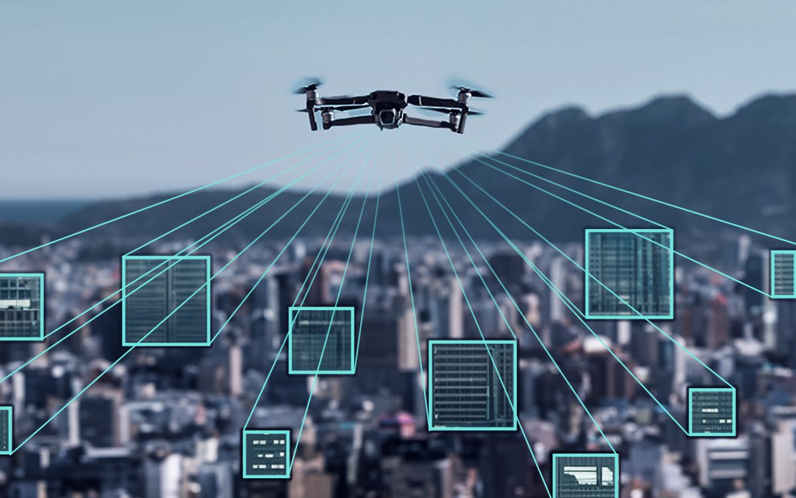
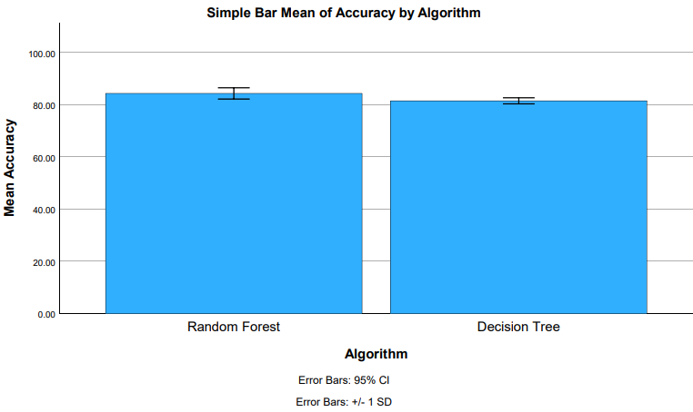
K Shanmukha Priya
Reg No:192011233
GUIDED BY : Dr. R.Dinesh kumar
Ms. Poorani.S
Guided by Dr. Mary Valantina. G
Improving Performance in Image Recognition for Unmanned Aerial Vehicles (UAVs) with Random Forest Algorithm Compared with Decision Tree Algorithm
INTRODUCTION
The purpose of this research is to apply the Random Forest (RF) algorithm and compares its effectiveness with the Decision Tree (DT) Algorithm in order to improve the picture recognition performance for Unmanned Aerial Vehicles(UAVs).
The main source of data for the study was the Kaggle dataset.
This study used two different groups, Group I and Group 2, each with 20 samples. Group 2 used the Decision Tree, and Group I used the Random Forest.
The main goal is to increase accuracy and efficiency while also making a significant contribution to the current discussion on algorithmic decisions made by UAV-based image recognition systems.
The main motive of this study is the improve the accuracy by implementing Random Forest and Decision Tree Algorithm.
The goal is to improve the accuracy of UAV photo recognition by optimising and implementing the Random Forest Algorithm and evaluating its performance against the Decision Tree Algorithm.
MATERIALS AND METHODS
Random Forest
Training and Testing
Kaggle Dataset
Feature Selection and data processing
DT
UAV Detection Using Random Forest
Statistical Analysis of the Results Using SPSS Software
Model Evaluation
Unmanned Aerial Vehicles Detection using RF over DT
RESULTS
Group Statistics
Accuracy | Group | N | Mean | Std. Deviation | Std. Error Mean
 | RF | 10 | 84.2330 | 3.00324 | 0.94971
 | DT | 10 | 81.3930 | 1.61415 | 0.51044
RF VS DT
In the present work, the Random Forest(RF) algorithm is compared with Decision Tree(DT) Algorithm and it indicates that the proposed algorithm gives more accuracy when compared with the other one.
DISCUSSION AND CONCLUSION
Based on T-test Statistical analysis, the significance value of p=0.014 (independent sample T - test p<0.05) is obtained and shows that there is a statistical significant difference between the group 1 and group 2.
The authors' work focuses on UAV aerial image enhancement monitoring technique for burning straw. The purpose of this project is to increase the visibility and quality of UAV aerial photos so that straw burning may be more effectively monitored and prevented.
Overall , the accuracy of the Random Forest algorithm is 84.23 % and it is better than the other algorithm.
Random Forest (RF) Algorithm - 84.23%
Decision Tree(DT) Algorithm - 81.39%
The analysis primarily focused on comparing the performance of the Random Forest Algorithm and Decision Tree (DT) Algorithm using accuracy value as the key evaluation metric.
From the work, it is concluded that the Random Forest Algorithm gains the high accuracy when comparing with Decision Tree(DT) Algorithm in Image Recognition for Unmanned Aerial Vehicles.
This development has improved aerial picture analysis performance and accuracy, which raises the overall efficacy and efficiency of UAVs.
BIBLIOGRAPHY
Al Said, Nidal, Yuri Gorbachev, and Aleksei Avdeenko. 2021. “Retracted: An Unmanned Aerial Vehicles Navigation System on the Basis of Pattern Recognition applications—Review of Implementation Options and Prospects for Development.” Software: Practice & Experience 51 (7): 1509–17.
Bayhan, Erdem, Zehra Ozkan, Mustafa Namdar, and Arif Basgumus. n.d. “Deep Learning Based Object Detection and Recognition of Unmanned Aerial Vehicles.” Accessed March 13, 2024.
Carrio, Adrian, Carlos Sampedro, Alejandro Rodriguez-Ramos, and Pascual Campoy. 2017. “A Review of Deep Learning Methods and Applications for Unmanned Aerial Vehicles.” Journal of Sensors 2017 (August).
Gao, Pengbo, Yan Zhang, Linhuan Zhang, Ryozo Noguchi, and Tofael Ahamed. 2019. “Development of a Recognition System for Spraying Areas from Unmanned Aerial Vehicles Using a Machine Learning Approach.” Sensors 19 (2): 313.
Liu, William J., Peter Sun, and Qihui Wang. 2023. Crystal Clear: Visualizing the Immune Recognition for the Mechanism and Intervention. Frontiers Media SA.
Moranduzzo, Thomas, and Farid Melgani. n.d. “Automatic Car Counting Method for Unmanned Aerial Vehicle Images.” Accessed March 13, 2024.

