Slide 1
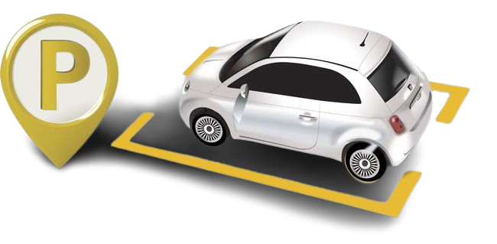
Easy Park
k.shanmukha priya
192011233

Slide 2
Description
In India, vehicle numbers are rising rapidly, but parking space hasn't kept place, leading to traffic congestion, on-street parking, and illegal parking. To address this, parking solutions software can provide real-time parking availability and optimize pricing, balancing revenue with environmental impact.
Purpose
The goal is to develop an app that helps city administrators manage parking efficiently and allows citizens to reserve spots and pay, reducing congestion, saving time, and generating sustainable revenue for the city.

Slide 3
Usages
Real-time Parking Info: Find and reserve parking spots instantly.
Dynamic Pricing: Adjust prices based on demand for optimal usage.
Easy Payments: Quick, cashless transactions via the app.
Data-Driven Management: City admins monitor and manage parking effectively.
Advantages
Less Traffic: Reduced congestion from quicker parking searches.
Environmental Impact: Lower emissions and noise pollution.
Revenue Boost: Optimized pricing for better revenue.
Convenience: Simplified parking experience for users.
Better Planning: Data aids in improving urban infrastructure.
Sustainable Growth: Supports organized and efficient city development.

Slide 4
1
Typs of Login
Admin
Admin can see no.of users, no.of parking owners and no.of pending request in Home Page.
Admin can view building name, no.of floors, cost for parking which has sent by the partner. Admin will accept or reject the request sent by the partner.
If Admin rejects the request he need to give the reason.
The approved and rejected request will
shown in the history page.

Slide 5
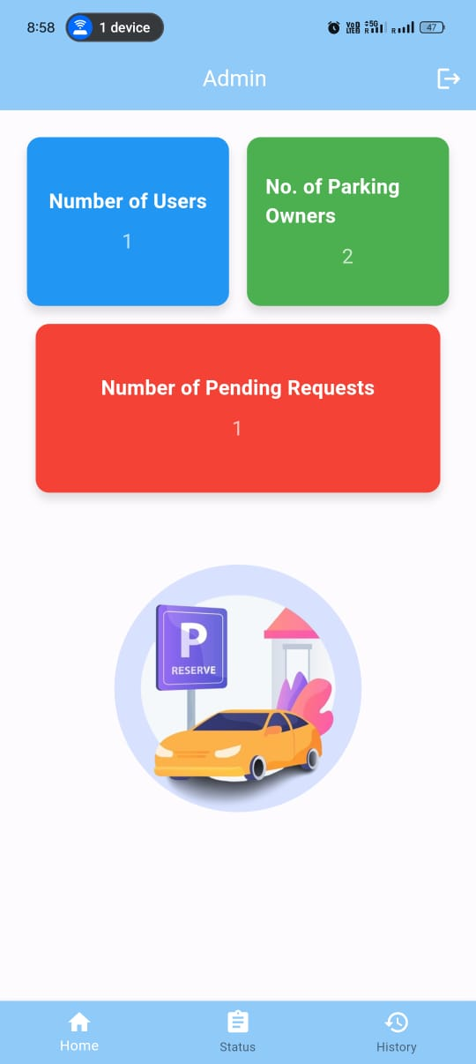
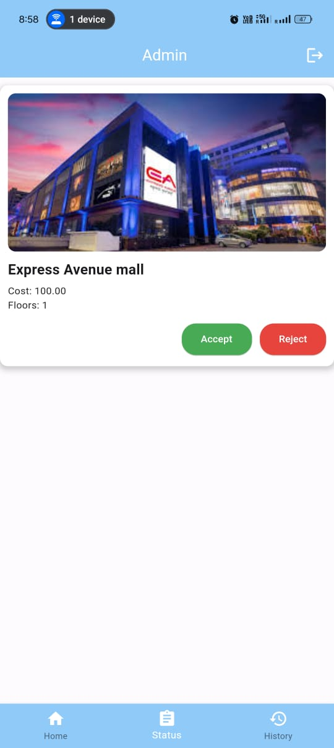
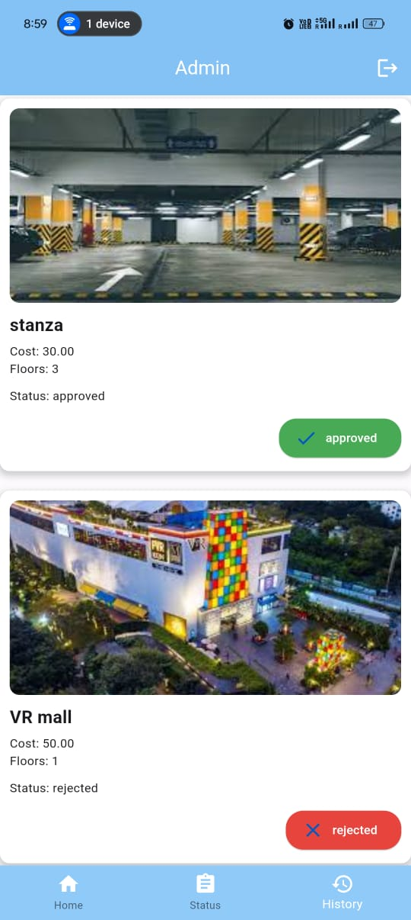

Slide 6
2
Partner
Partner should register the parking and the partner should
give the area name, no.of floors, cost per hour, plot number.
In home page it shows the building name, cost, no.of floors.
which is accepted by the Admin.
In status page, pending status it shows the request sent by the user.
And the Partner has to accept or reject the request which is sent by the user.
In status page it also shows the accepted and
rejected request sent by the user.

Slide 7
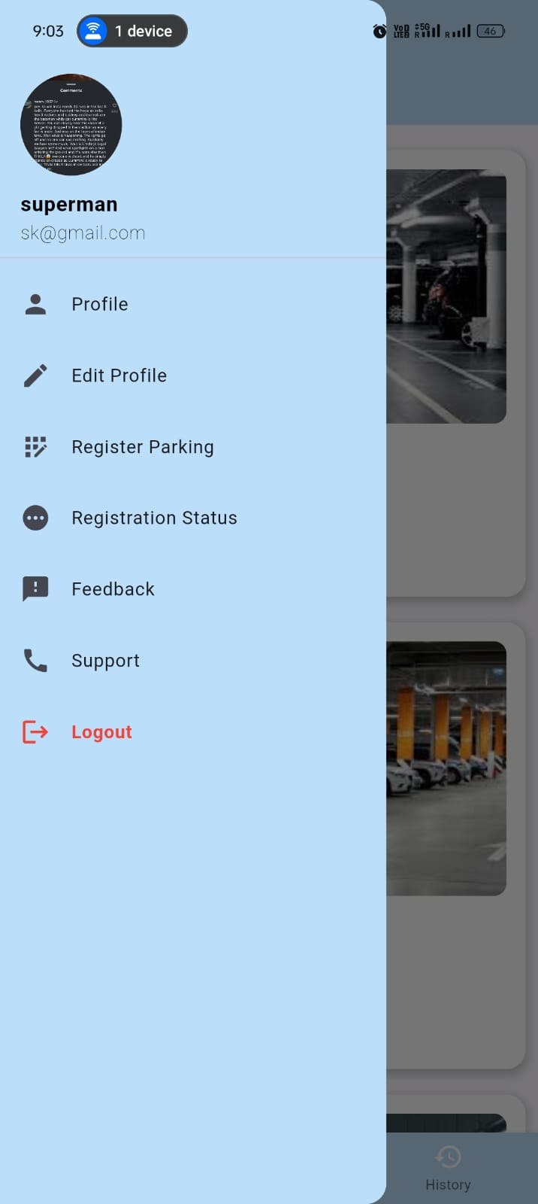
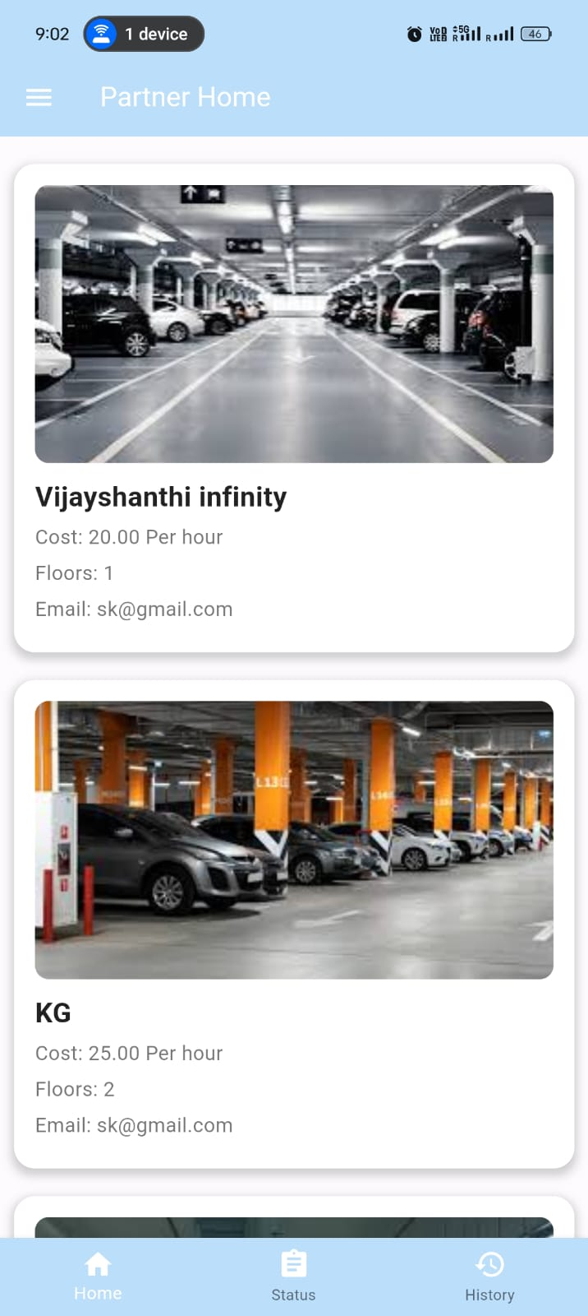
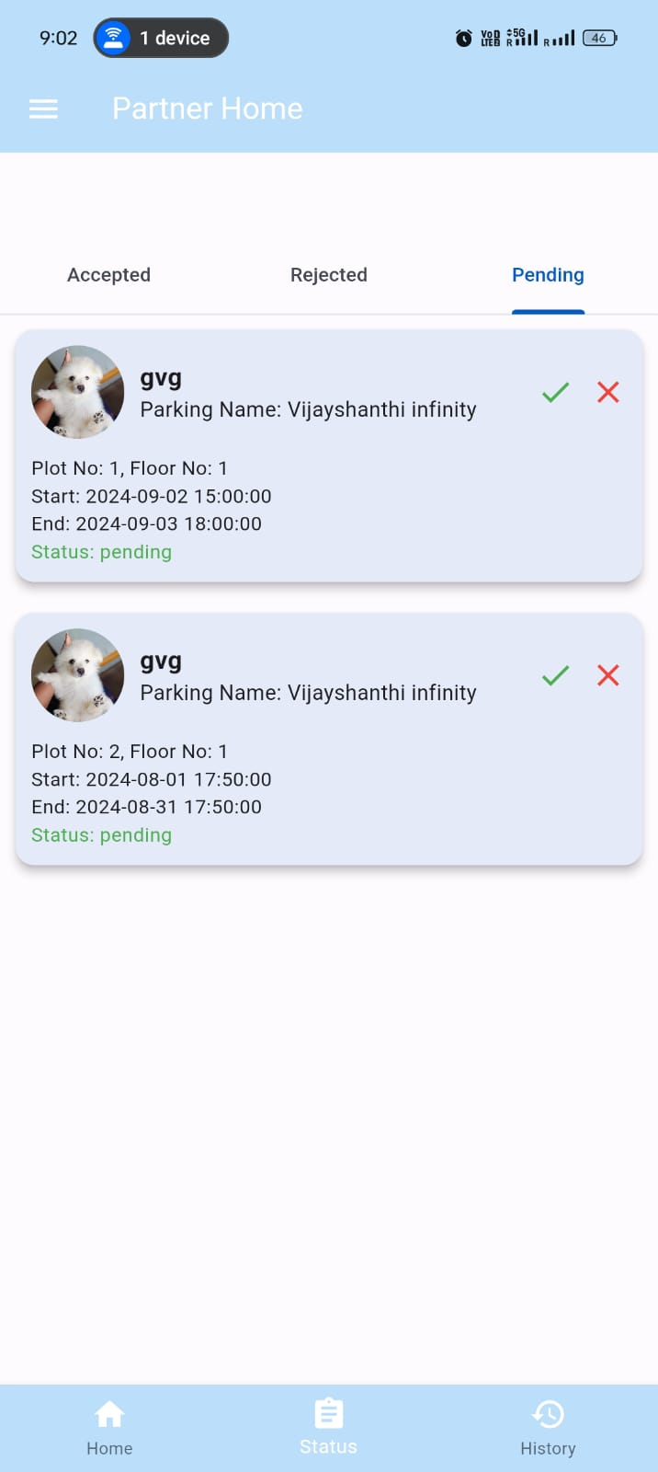
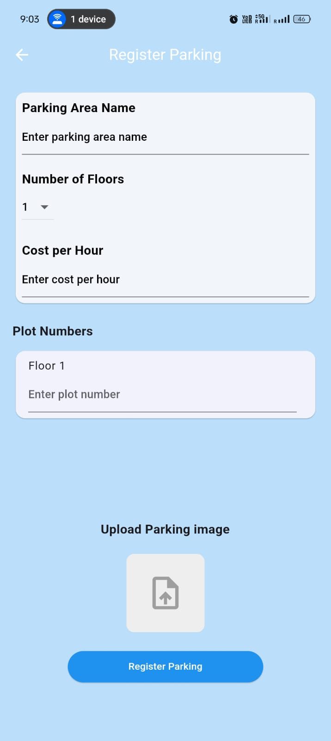

Slide 8
3
User
User can able select the plot number and set date and time(Start - End).
Automatically it generates cost for parking based on the duration.
Then the user can give request for parking and the partner will accept or reject the request.
The user can see status of the request in status page.
The user can select the payment methods which way
he/she wants to pay.
The payments history and booking history will be
shown also they can edit the profile page and they can
share opinion about parking space and rate the app.

Slide 9
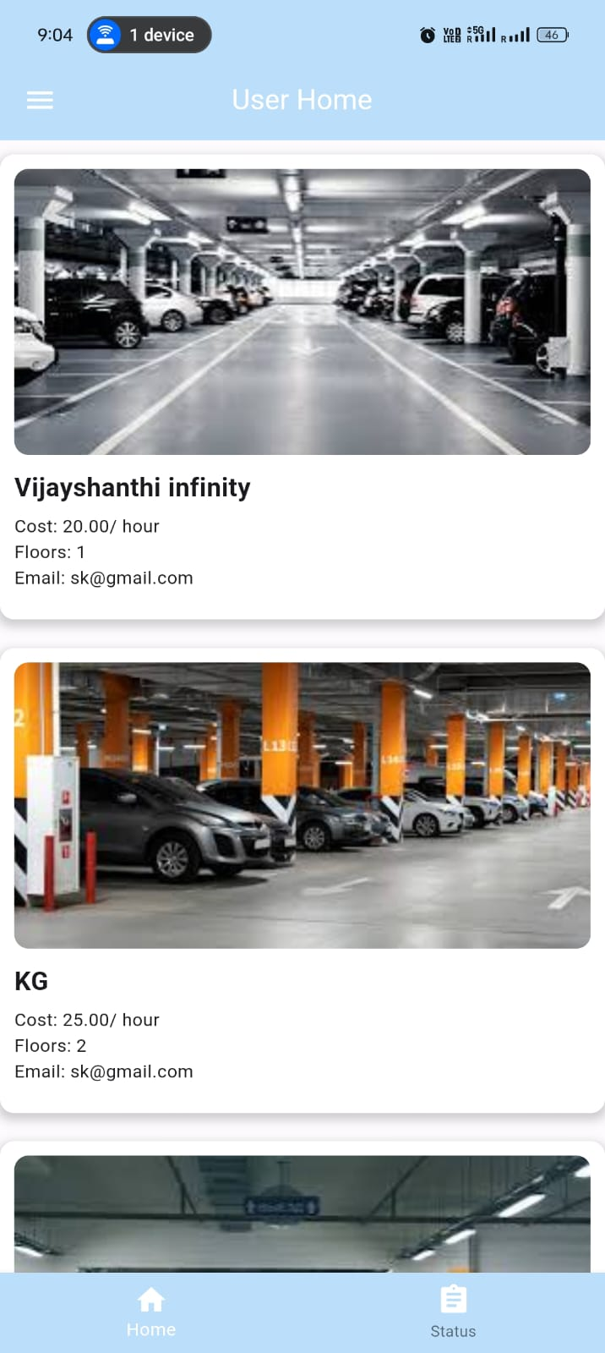
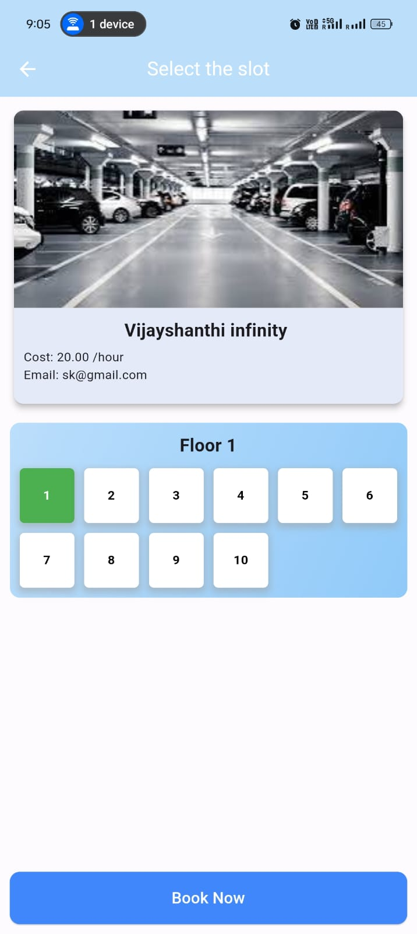
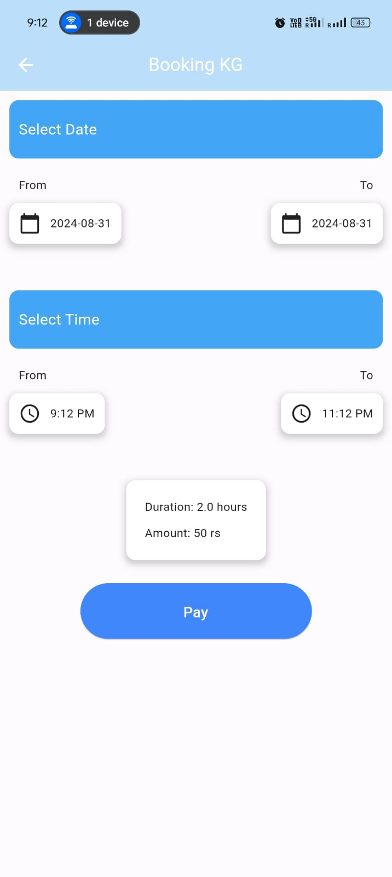
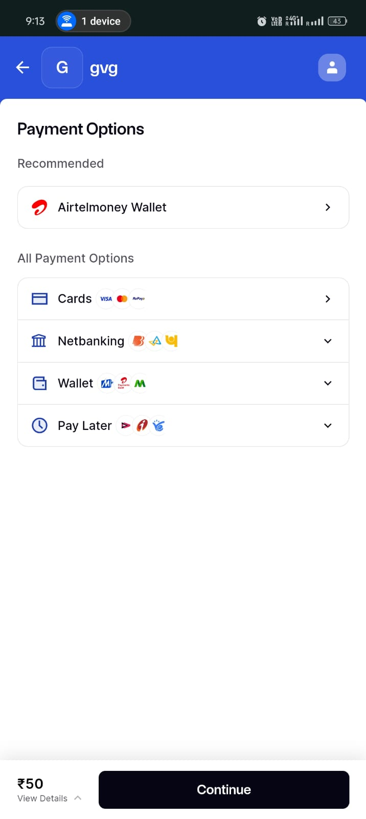

Slide 10
Languages and platforms
Front end dart (Flutter)
Backend (php)
Database (MySQL)
Server (Xampp)

Slide 11
Thank You

