Slide 1
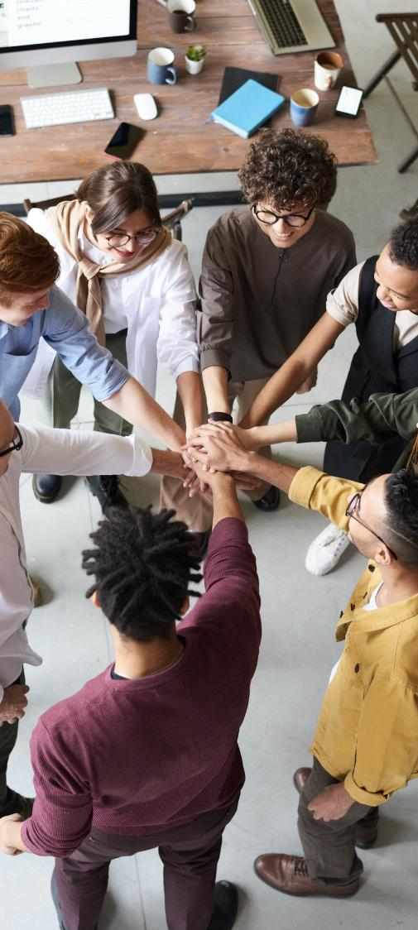
AI-Powered Hiring App
BUSINESS
PROPOSAL
Notes:
Links:
https://www.pexels.com/photo/photo-of-people-holding-each-other-s-hands-3184423/

Slide 2
Project Name : AI-Powered Hiring App
Present By : Priya Wanjari (BA in XYZ)
Project Sponsor : Mr. Shrikant (CEO of ABC)
Client : Webmobi 360
Notes:
Links:
https://www.pexels.com/photo/photo-of-people-holding-each-other-s-hands-3184423/

Slide 3

INTRODUCTION
Our AI-Powered Hiring App is a groundbreaking solution designed to revolutionize the recruitment process for organizations of all sizes. By harnessing the capabilities of artificial intelligence, our app streamlines hiring, minimizes biases, and delivers unparalleled value to both employers and job seekers.
Notes:
Links:
https://www.pexels.com/photo/top-view-of-people-at-the-meeting-3184287/

Slide 4
The Problem:
Traditional hiring processes are time-consuming, costly, and often prone to human bias. Inefficient candidate screening and selection result in missed opportunities and suboptimal hires. Our app addresses these challenges head-on.

Slide 5
Our Solution:
Our AI-Powered Hiring App leverages cutting-edge machine learning algorithms to automate candidate sourcing, screening, and assessment. It analyzes resumes, evaluates skills, and predicts candidate suitability with unparalleled accuracy, saving organizations time and resources.

Slide 6
Key Features:
Resume Parsing: Our app extracts relevant information from resumes, minimizing manual data entry.
Skill Assessment: AI-driven skill matching ensures candidates possess the required qualifications.
Bias Reduction: By focusing on skills and qualifications, our app reduces unconscious biases in hiring decisions.
Automated Interviews: Schedule and conduct automated video interviews to gauge candidate suitability.

Slide 7
Benefits
Faster Hiring: Reduce time-to-hire by up to 50%, ensuring top talent doesn't slip away.
Improved Quality: Make more accurate hires, increased productivity and reduced turnover.
Diversity and Inclusion: Promote diversity by minimizing unconscious biases in the selection process.

Slide 8
Team
Our team comprises AI and machine learning experts, HR professionals, and experienced software developers. Collectively, we bring a wealth of knowledge and experience to this project.

Slide 9

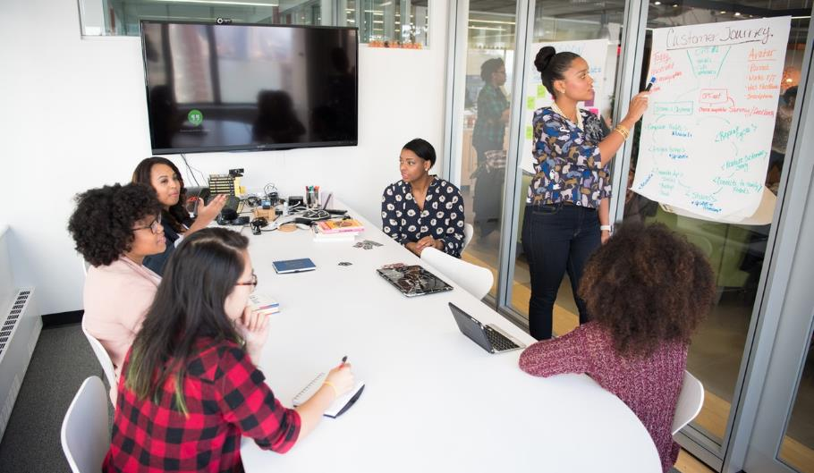
Conclusion
Our AI-Powered Hiring App is poised to transform the way organizations hire talent.
By providing a faster, fairer, and more efficient hiring process.
Notes:
Links:
https://www.pexels.com/photo/six-woman-standing-and-siting-inside-the-room-1181622/

Slide 10
THANK
YOU!

