Slide 1
WinCC-OA Log Analysis SCADA Application Service - Reporting
James Hamilton

Slide 2
WinCC-OA Log Analysis
Aim:
Collect, parse, analyse WinCC-OA Logs
Provide centralised access and search abilities
Related use case: value change and alarm statistics from Oracle RDB

Slide 3

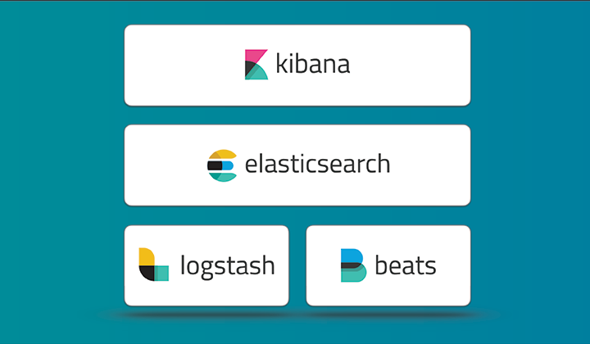
The Elastic Stack

Slide 4

Elasticsearch
“Elasticsearch is a distributed, open source search and analytics engine, designed for horizontal scalability, reliability, and easy management. It combines the speed of search with the power of analytics via a sophisticated, developer-friendly query language covering structured, unstructured, and time-series data.”
https://www.elastic.co/products
CERN IT provide Elasticsearch and Kibana as a service
For our use cases IT has provided us we a cluster on the TN
REST API
Password protected
HTTPS

Slide 5


Logstash / Filebeat
“Logstash is a flexible, open source data collection, enrichment, and transportation pipeline. With connectors to common infrastructure for easy integration, Logstash is designed to efficiently process a growing list of log, event, and unstructured data sources for distribution into a variety of outputs, including Elasticsearch.”
https://www.elastic.co/products
Filebeat is a lightweight application for reading log files and forwarding to Logstash (or directly to Elasticsearch).

Slide 6

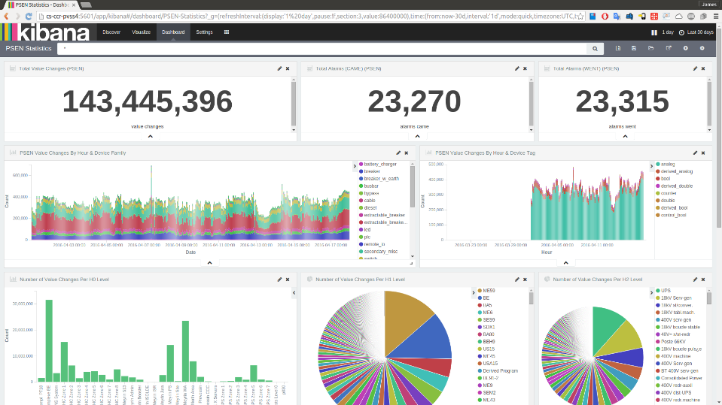
Kibana
Current Time Period
Filter Bar

Slide 7
Our Installation
Single Machine
IT Service

Slide 8
Our Installation - Filebeat
Installed on each server
Updates are sent to the Logstash Shipper
Filebeat waits for acknowledgements from the Logstash Shipper

Slide 9
Our Installation - Logstash Shipper
Concatenates multi-line messages
Outputs concatenated messages and statistics to the queue

Slide 10
Our Installation - Logstash Indexer
Reads messages from the queue
Parses the WinCC-OA logs with regexes
Outputs parsed message to Elasticsearch and statistics to the queue

Slide 11
Our Installation - Logstash Monitor
Reads statistics messages from the queue
Reads log files from Logstash
Outputs statistics messages to Elasticsearch

Slide 12
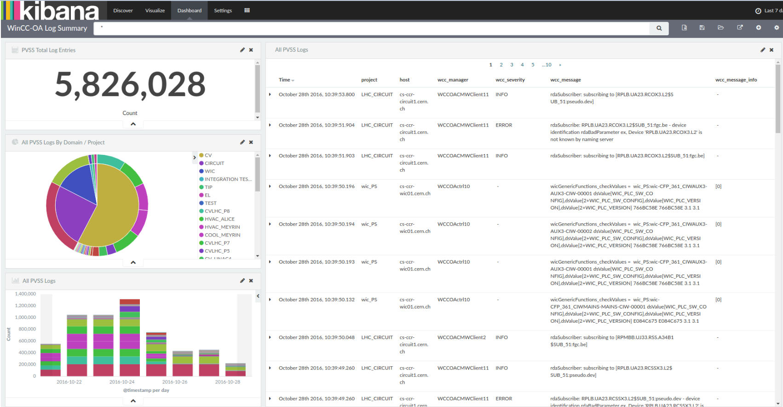
WinCC-OA Log Dashboard

Slide 13
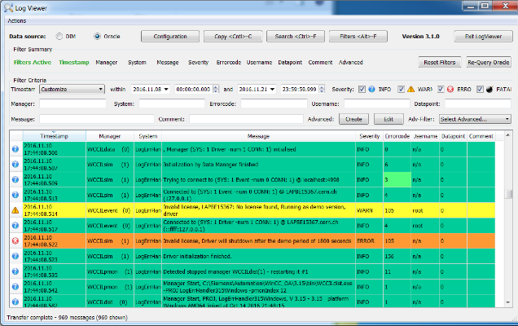
Existing Log Viewer
Standalone application with Oracle & DIM interfaces

Slide 14
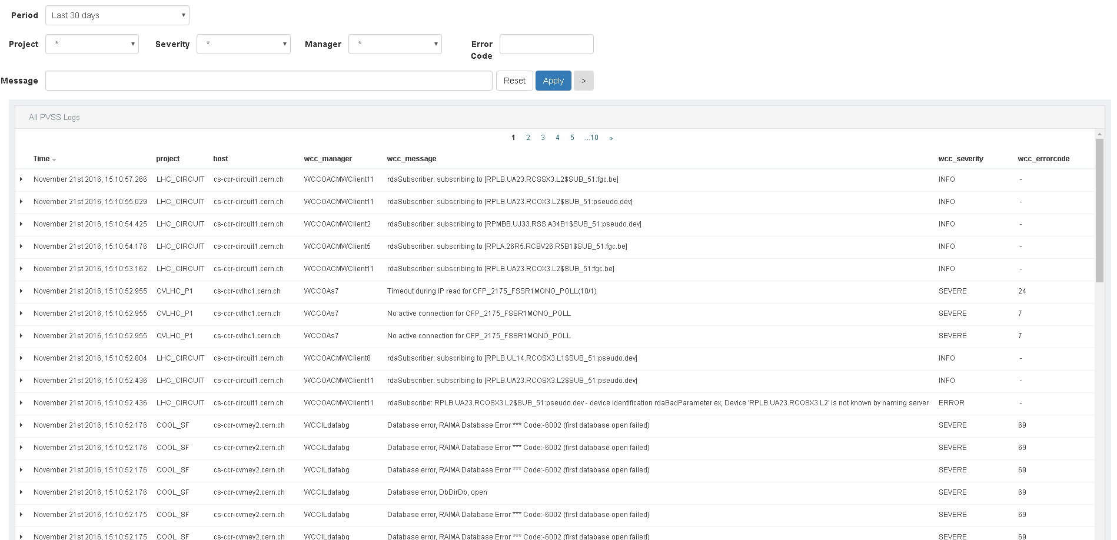
ELK Log Viewer

Slide 15
Log Viewer comparison
Feature | ELK Logviewer | Old Logviewer
Database | Elasticsearch | Oracle
Project modification required? | No | Yes (log handler dll)
Type | Web application | Standalone application
Save filters | Feasible to implement | Yes
Severity colour coding | Feasible to implement | Yes

Slide 16
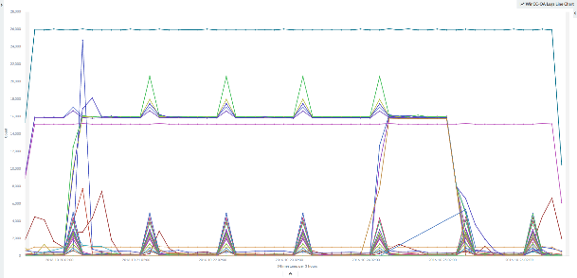
Statistics
30 projects (on-going adoption)
~41 million WinCC-OA log entries in total, ~12GB total*
~600,000 log entries per day, ~500MB per day
* includes 2 replicas

Slide 17
RDB Statistics

Slide 18
Our Installation
Aim: to get high-level statistics from the SCADA Application Service archive

Slide 19
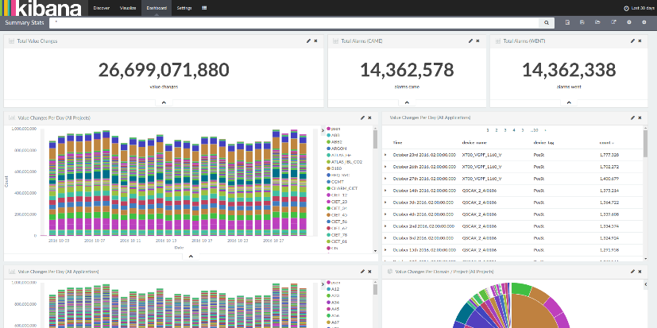
RDB Statistics Dashboards
Summary Statistics
PSEN
CIET Early Warning System
MOON statistics

Slide 20
Demo
WinCC-OA Log Dashboard
ELK Log Viewer

Slide 21
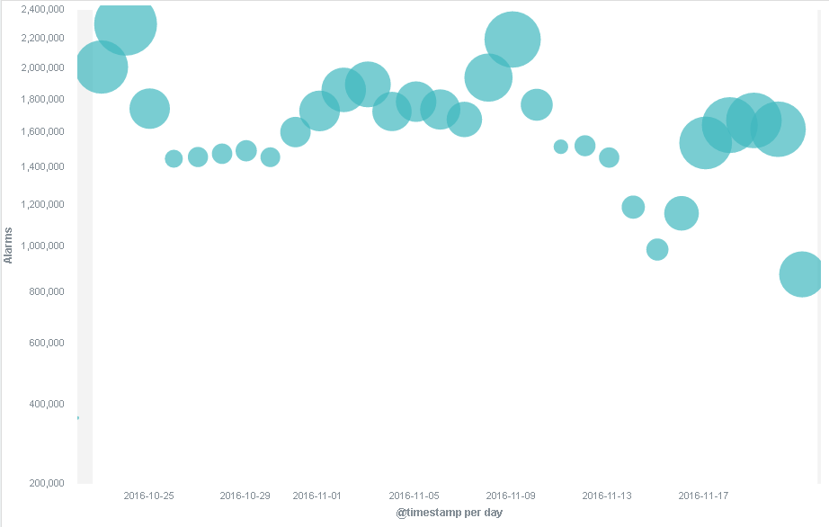
Correlations?

