Slide 1
Visualizing employee attendance trends with excel chartsis using Excel
STUDENT NAME: Priya.K
REGISTER NO: 312217031(341AC2B7530BBE49B374E2ABE)
DEPARTMENT: B.Com(General)
COLLEGE: Shir Krishnaswamy College For Women.

Slide 2
PROJECT TITLE
Visualizing employee attendance trends with excel charts

Slide 3


AGENDA
Problem Statement
Project Overview
End Users
Our Solution and Proposition
Dataset Description
Modelling Approach
Results and Discussion
Conclusion
3/21/2024 Annual Review

Slide 4

PROBLEM STATEMENT
Our organization struggles to effectively track and analyze employee attendance patterns, leading to:-
🎯 Inefficient management of absenteeism and tardiness.
🎯 Lack of insight into attendance trends and potential underlying causes.
🎯 Inability to identify employees who may need support or intervention.
🎯 Difficulty in making data-driven decisions to improve attendance and overall workforce productivity.

Slide 5

PROJECT OVERVIEW
Design and develop an interactive visualization tool to track and analyze employee attendance patterns, providing insights to improve attendance management, employee engagement, and overall workforce productivity.
💫 Collect and integrate attendance data from existing HR systems.
💫 Design and develop a user-friendly visualization dashboard.
💫 Implement interactive features for exploring attendance trends. Conduct analysis to identify patterns, anomalies, and correlations.
💫 Develop recommendations for improving attendance and productivity.

Slide 6

WHO ARE THE END USERS?
The end users of the Visualizing Employee Attendance Trends project are likely to be:
1. HR Managers: To identify attendance patterns, manage absenteeism, and develop strategies to improve employee engagement.
2. Team Managers: To monitor team attendance, identify trends, and address potential issues affecting team productivity.
3. Department Heads: To oversee attendance trends across departments, make informed decisions, and optimize workforce planning.
4. Business Analysts: To analyze attendance data, identify correlations, and provide insights for business improvement.
5. Employees: To view their own attendance records, understand company policies, and manage their own attendance.

Slide 7

OUR SOLUTION AND ITS VALUE PROPOSITION
Our solution provides an interactive and intuitive visualization tool that helps organizations:
1. Gain insights: Identify attendance patterns, trends, and anomalies to inform data-driven decisions.
2. Improve attendance management: Reduce absenteeism, tardiness, and turnover by addressing underlying causes.
3. Enhance employee engagement: Foster a positive work environment by recognizing and supporting employees with attendance challenges.
4. Boost productivity: Optimize workforce planning, reduce costs, and increase overall business performance.
5. Simplify attendance tracking: Integrate with existing HR systems for effortless data management.

Slide 8
Dataset Description
Here is a simplified version of the datasets descriptionDatasets:
1. Employee Attendance: Daily attendance records (Employee ID, Date, Attendance Status)
2. Employee Info: Basic employee information (Employee ID, Name, Job Title, Department)
3. Attendance Trends: Aggregated attendance data (Date, Total Present, Total Absent, etc.)
4. Absence Reasons: Reasons for absences (Reason, Frequency, Percentage)
5. Employee Performance: Performance ratings (Employee ID, Performance Rating, Review Date)

Slide 9

THE "WOW" IN OUR SOLUTION
Here's a simplified version of the "WOW" factor:-
✨ Interactive Heatmap: Visualize attendance patterns.
✨ AI-powered Insights: Predictive analytics for attendance.
✨ Real-time Alerts: Swift response to attendance issues.
✨ Employee Engagement Portal: Easy access to attendance records.
✨ Data-Driven Storytelling: Turn data into actionable stories.
3/21/2024 Annual Review
9

Slide 10
MODELLING
Here's a simplified version of the modeling approach:
Modeling Approach:
1. Collect attendance data.
2. Clean and prepare data.
3. Extract relevant features.
4. Group employees with similar attendance patterns.
5. Predict future attendance trends.
6. Identify unusual attendance patterns.
7. Visualize attendance trends and insights.
Modeling Techniques:
~ Regression.
~ Decision trees.
~ Clustering.
~ Anomaly detection.
Modeling Tools:
• Python libraries (Pandas, Scikit-learn, Matplotlib).
• Data visualization tools (Tableau, Power BI).
10

Slide 11
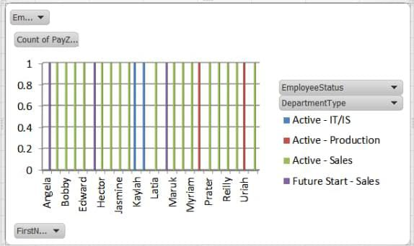
RESULTS
Here's a simplified version of the results:
Results:
1. Better attendance insights.
2. Increased employee engagement.
3. Data-driven decision making.
4. Improved productivity.
5. Enhanced work-life balance.
11

Slide 12
conclusion
Visualizing employee attendance trends helps organizations improve attendance, engagement, and productivity by identifying patterns, addressing underlying causes, and making data-driven decisions.

