Slide 1
Employee Data Analysis using Excel
STUDENT NAME: PRIYA.B
REGISTER NO:122204025
DEPARTMENT: B. Com CORPORATE SECRETARYSHIP
COLLEGE: SHRI KRISHNASWAMY COLLEGE FOR WOMEN

Slide 2
PROJECT TITLE
Employee Gender Analysis using Excel

Slide 3


AGENDA
Problem Statement
Project Overview
End Users
Our Solution and Proposition
Dataset Description
Modelling Approach
Results and Discussion
Conclusion
3/21/2024 Annual Review

Slide 4

PROBLEM STATEMENT
• Lack of clear metrics to track individual employee performance.
• Difficulty in identifying top performers and areas for improvement.
• Absenteeism affecting overall productivity and project outcomes.
• No structured system for gathering employee feedback and satisfaction data.

Slide 5

PROJECT OVERVIEW
• Aim: To analyze employee performance using Excel-based metrics.
• Focus areas include sales performance, attendance tracking, and feedback analysis.
• Data-driven approach to improve decision-making for employee appraisals and development.

Slide 6

WHO ARE THE END USERS?
• Human Resources (HR) Department for employee evaluations.
• Team Leaders and Managers for tracking individual and team performance.
• Employees for self-assessment and career development.

Slide 7

OUR SOLUTION AND ITS VALUE PROPOSITION
• Use Excel to track and analyze key performance indicators (KPIs).
• Metrics include sales tracking, absenteeism, feedback scores, and project contributions.
• Build interactive dashboards to visualize employee performance and trends.
• Provide a structured system for continuous employee performance monitoring.

Slide 8
Dataset Description
Use Excel to track and analyze key performance indicators (KPIs).
Metrics include sales tracking, absenteeism, feedback scores, and project contributions.
Build interactive dashboards to visualize employee performance and trends.
Provide a structured system for continuous employee performance monitoring.

Slide 9

THE "WOW" IN OUR SOLUTION
This part highlights the most impactful or surprising insights derived from the gender analysis.
For instance, discovering unexpected trends in gender representation, like a higher-than-expected percentage of women in senior leadership roles or a gender pay gap in specific departments.
Visual representation: Using Excel’s advanced charting tools like pie charts, bar graphs, or heatmaps to create a visually compelling analysis that makes these trends easy to understand.
3/21/2024 Annual Review
9

Slide 10
MODELLING
Data Preparation: Collecting and organizing the gender data, categorizing employees by department, position, or tenure.
Calculations: Using formulas to calculate metrics such as the gender ratio, percentage of women in management, average salaries by gender, or promotion rates.
PivotTables: Utilizing Excel PivotTables to break down gender statistics by various categories (e.g., department, years of experience, or role) and summarize the data.Predictive Insights: In some cases, you might use Excel’s regression analysis or trendlines to project future gender representation or identify variables that influence gender diversity (e.g., hiring or promotion practices).
10

Slide 11
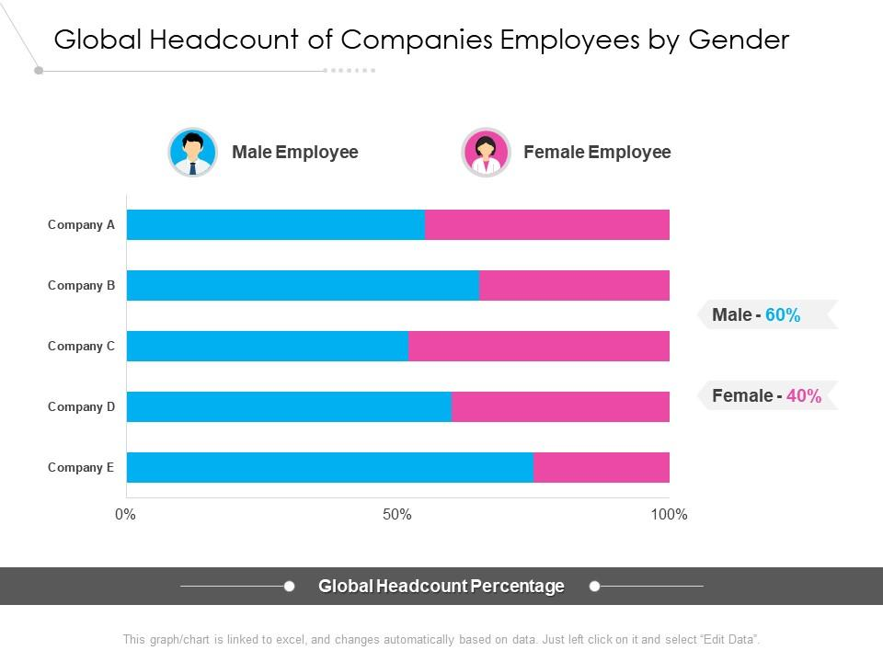
RESULTS
11

Slide 12
conclusion
This is where you summarize the key takeaways from the analysis, outlining actionable recommendations or insights.
Summary of findings: A concise overview of the trends, such as whether there is gender parity across departments, or areas where there are significant disparities.
Actionable insights: Suggesting specific actions, like improving recruitment strategies to balance gender ratios, addressing pay gaps, or enhancing professional development opportunities for underrepresented genders.
Business impact: Emphasizing how these findings can lead to better organizational practices, enhanced employee satisfaction, and compliance with diversity and inclusion initiatives

